Slide 1
Installation of Anacoda

Slide 2
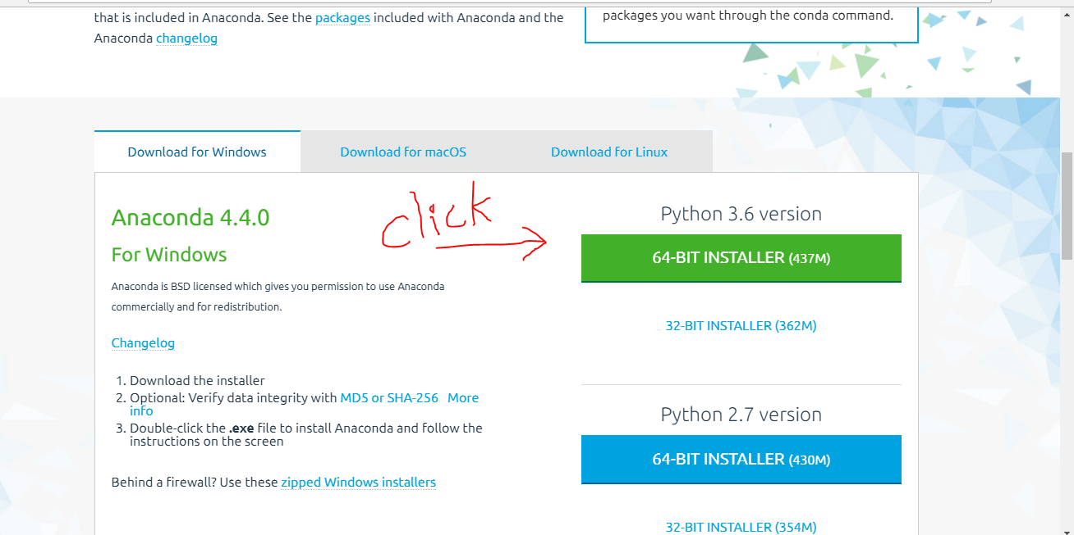
Download Anaconda From the below URL:
URL: https://www.continuum.io/downloads
Download the latest version => Click 32-BIT or 64-BIT depending on OS (32 or 64 bit) available
In your system

Slide 3
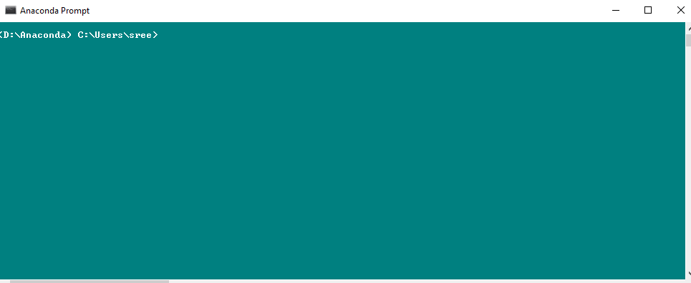
Installing .exe file and Checking any updates
Click on Anaconda3-4.3.1-Windows-x86_64.exe and Run as Administrator
Click next. Once installed, open anaconda prompt and type
conda update --all and Check if everything is updated or not.
And type conda update anaconda and check if the anaconda is updated or not.
To install any library, open command prompt and type => conda install <library name>

Slide 4
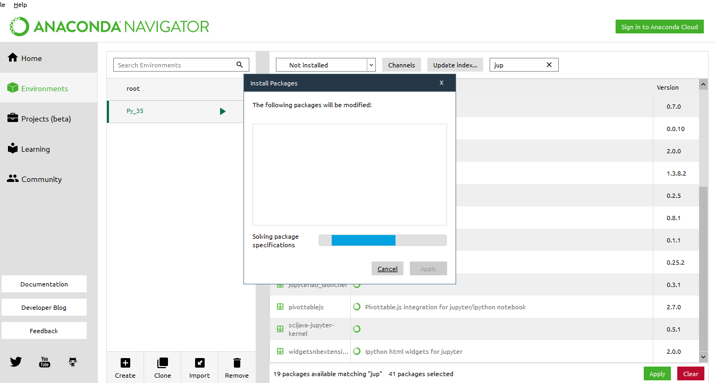
Install Packages from Anaconda Navigator
To install any package
Open Anaconda Navigator and Click Environments
On right side, change the option installed to not installed.
We will be getting list of packages and search for the you want to install in search bar and check the box for that package and click apply.

Slide 5
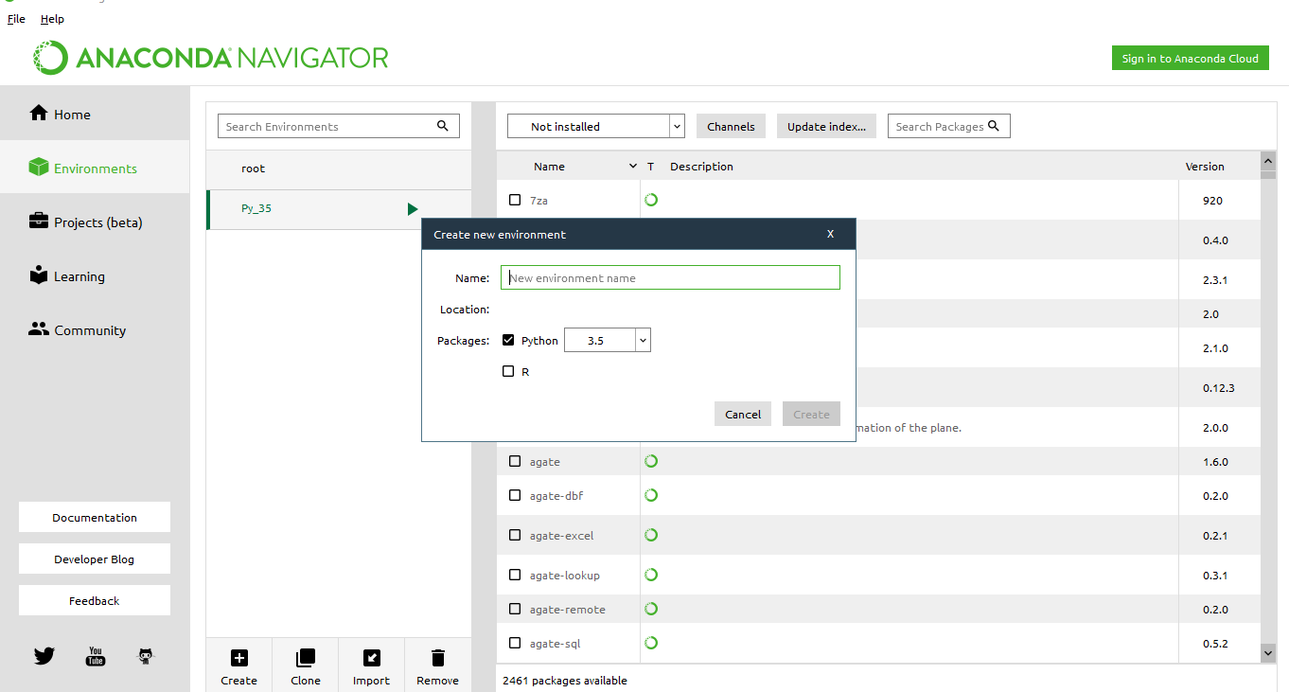
Creating New Environment
Some packages will work only on specific python version.
Ex: word cloud package was created under python 3.5.
To work with those packages we need to create new environment
To create new environment apart from the root environment i.e. python 3.6, Open Anaconda Navigator and go to Environments
Click create and type appropriate name for the new environment so that it will reflect python version and choose the python version and click ok.

Slide 6
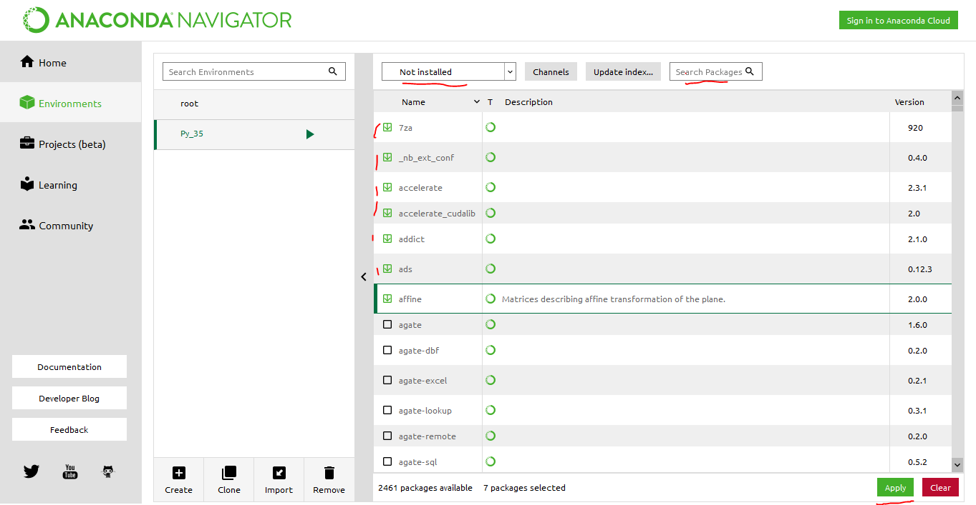
Installing Packages in New Environment
Open Anaconda Navigator and click environments
And Click the environment, for which you need to install packages into that environment.
Change the option on right side to installed to see which packages are installed in that environments.
Change that option to not installed to install any new package which is necessary. And check the box beside the package and click Apply.
Those packages will be installed. Make sure you were installing the environment which you are going to work.

Slide 7
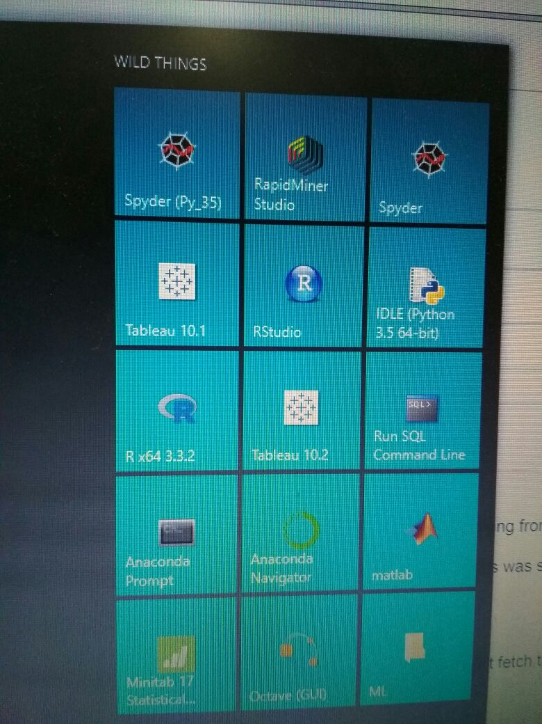
For Creating new programs (Python Script -spyder)
Open windows and type spyder ( or spyder 3.5), You will see 2 different spyder versions.
Click any one of the spyder and you can start working on it.
To use word cloud package use spyder 3.5 version instead of deafault spyder and make sure you install the wordcloud package in the new environment.

Slide 8
Word cloud Package Installation For Text Mining
Once new environment is created i.e. which use python 3.5 version
Open anaconda navigator and go to environments tab and choose the newley created environment which uses python 3.5 version
Then click on the “play” button which we see beside the created environment name. It will show few options then choose open terminal.
It will now open anaconda terminal which is related to newley created environment which is uses python 3.5 version
Now copy the below syntax and paste, press enter. It will install the word cloud package for that specific environment.
Syntax : conda install -c conda-forge wordcloud
If we want to implement text mining code then we need to choose the spyder application from the environment where we have installed our word cloud package i.e. environment which works on python 3.5 version
To do that, open Anaconda Navigator, go to home button and We can see Applications on Tab. In that choose the environment where we newley created. Once it is chosen then launch spyder application and Now we can start executing the Text Mining Code.

Slide 9
Error After Installing Anaconda( Resolution)
Once the Anaconda installation is done. And when we try to launch anaconda navigator, If it is throwing any error or unable to launch then we need to reset the anaconda navigator
For this open the anaconda prompt by simply typing “anaconda prompt”.
It will be looking like our cmd terminal. Once it is opened, past the below line and press enter. It will reset the Anaconda Navigator.
Now we can using the spyder, Anaconda Navigator and other applications with out any kind of interruptions. Below are the lines to reset specific applications.
# Below lines should be done in Anaconda prompt
Anaconda navigator : anaconda-navigator --reset
Spyder : spyder --reset

Slide 10
https://www.anaconda.com/distribution/

