Slide 1

PlugIn
// Andrew
ENTER

Slide 2



What is it?
01
02
03
// PlugIn is a light-weight and interactive selling service This project prioritizes privacy.
04

Slide 3
TABLE OF CONTENTS
Code & DB
DESIGNS
01
Looking at the specifics
How was PlugIn drafted?
02
03
04
OBSTACLES
SUMMARY
What did I overcome?
Technical design

Slide 4
01.
Code & DB
01
02
03
04
Let's take a look

Slide 5
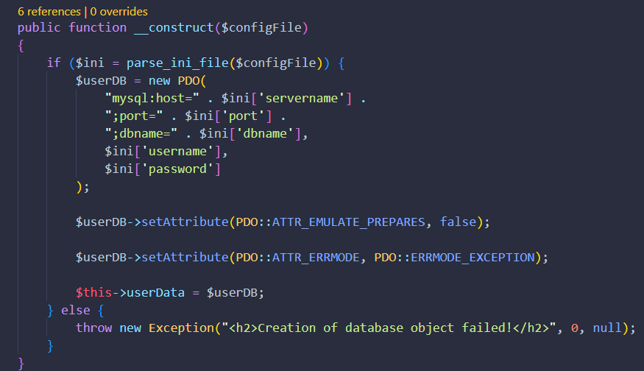
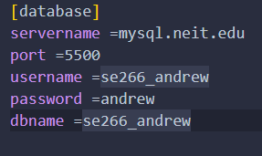
SCHEDULE
01
02
03
04

Slide 6
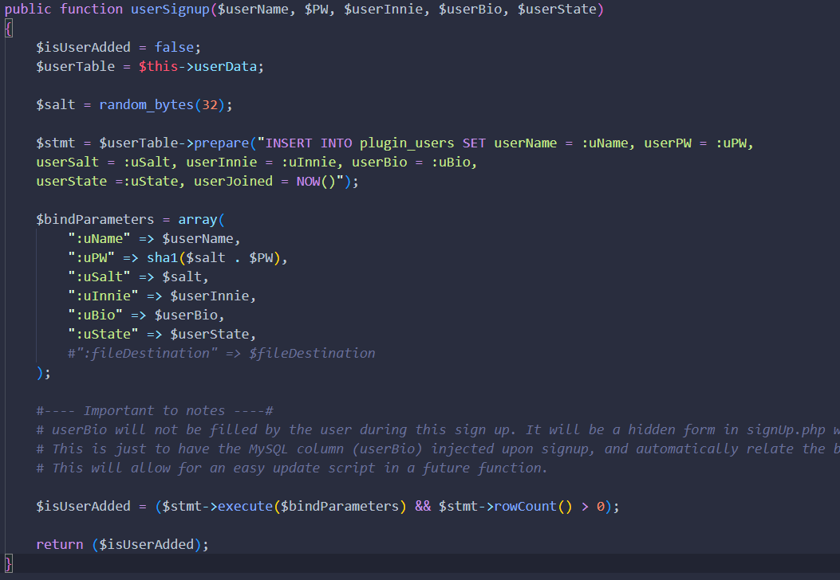
SCHEDULE
01
02
03

Slide 7
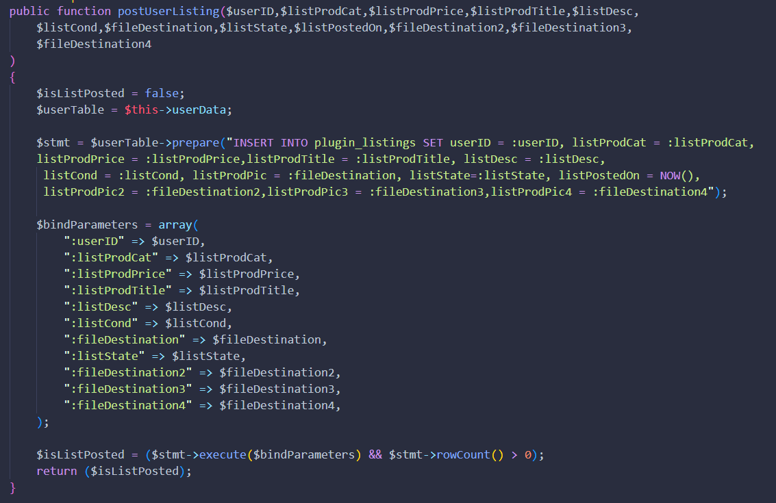
SCHEDULE
01
02
03
INSIDE USERS CLASS

Slide 8
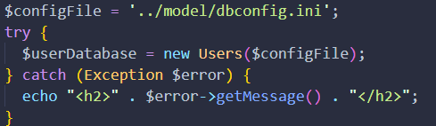
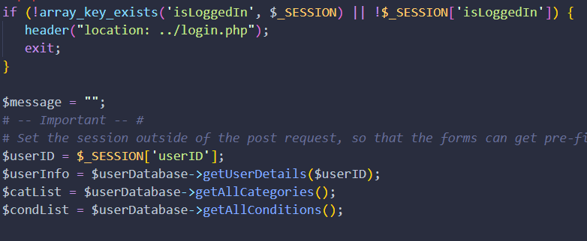
SCHEDULE
<- Inside header.php, which is referenced in ALL pages. It creates a new instance of the users class, and assigns it to $userDatabase.
01
02
03
04

Slide 9
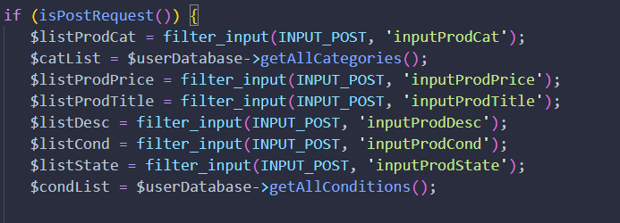
SCHEDULE
01
02
03

Slide 10
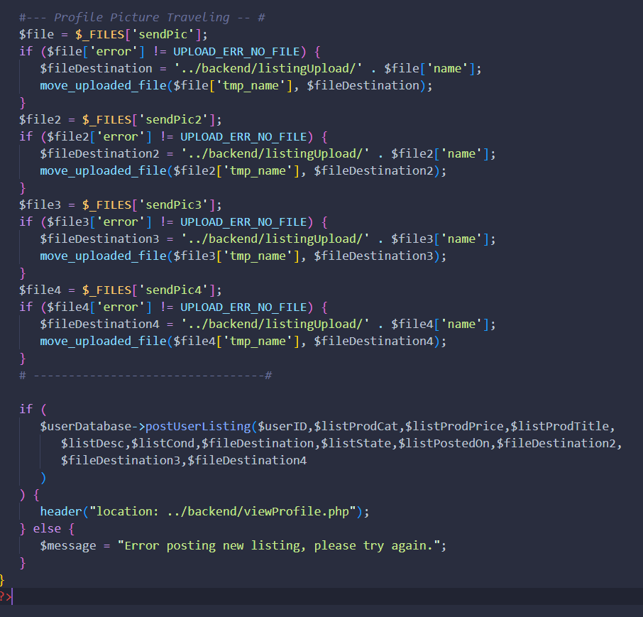
SCHEDULE
01
02
03

Slide 11
02.
DESIGNS
01
02
03
04
THE DATABASE

Slide 12
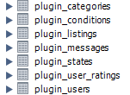
2.1 TABLE NAMES & USES
01
Plugin_users
Plugin_user_ratings
Plugin_states
Plugin_listings
Plugin_categories
plugin_conditions
Plugin_messages
-> Store user’s login info.
-> Store all ratings given to user.
-> Allow user to choose state
-> Store all posted listings.
-> Allow user to choose list category
-> Allow user to choose condition
-> Store all user messages.
02
03
04

Slide 13
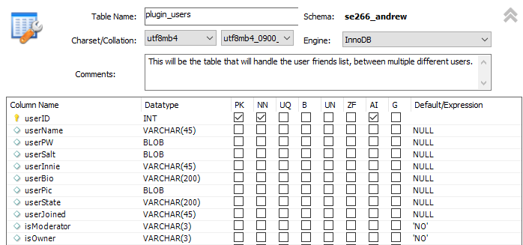
PLUGIN_USERS
01
02
03
04

Slide 14


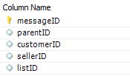

RELATIONSHIPS
plugin_users
Plugin_listings
01
02
03
plugin_messages
plugin_user_ratings
04

Slide 15
03.
OBSTACLES
01
02
03
04
WHAT OBSTACLES DID I ENCOUNTER?

Slide 16
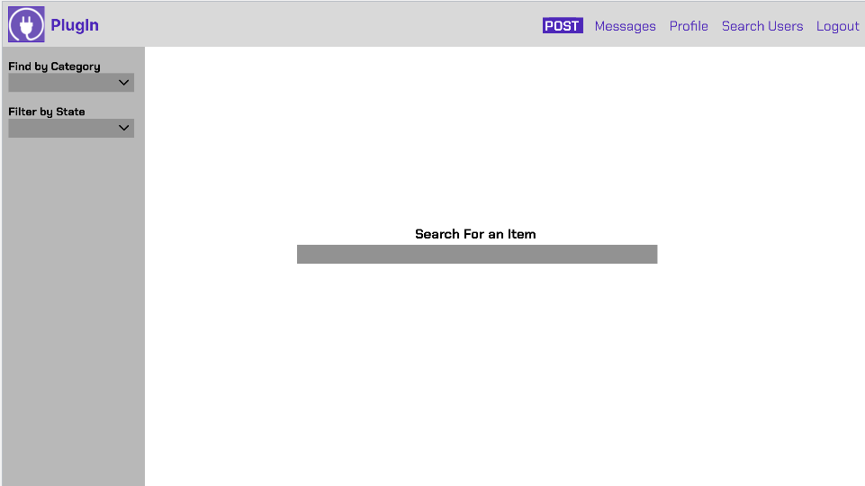
ORIGINAL DESIGN
OUTDATED
TABLES
01
The original design was very outdated.
Too many tables were used to display the results.
02
03
04
SEARCHING
INCONSISTENT
Inconsistent themes and layout of buttons.
Search Bar and filtering should have been in the header, and all results displayed on one page.

Slide 17
3.5
Future Changes
01
02
03
04
What I would do differently

Slide 18
RE-DIRECTING
01
02
03
04
Spend more time planning where each button and page will redirect to which page. For ex. After a msg, where should it go?

Slide 19
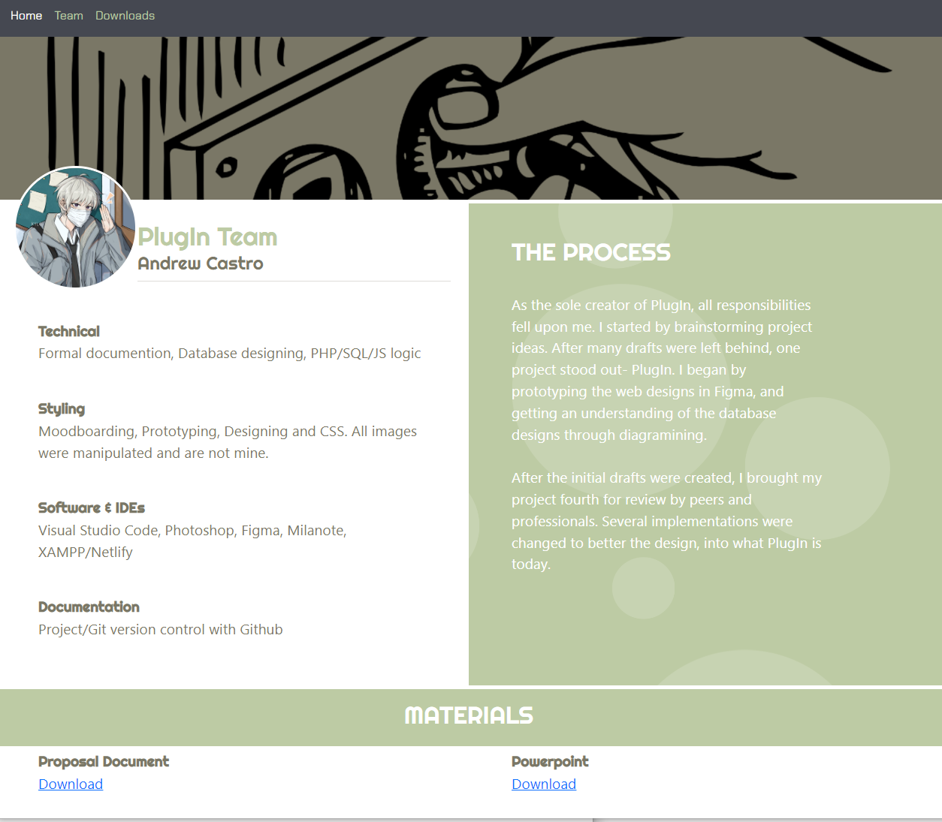
PROFILES
01
02
03
04
I would change how profiles are utilized, and the layout they have. For example, similar to my document website’s layout.

Slide 20
05.
SUMMARY
01
02
03
04
Let's summarize it al

Slide 21
SUMMARY
01
02
Users create accounts.
Users can customize their profiles.
Users can create listings to sell products.
Users can request products.
A user can negotiate or discuss the product.
Users can see their purchases and sales.
03
04

Slide 22
THANKS!
01
02
03
Questions before going live?
04
Please keep this slide for attribution

