Slide 1


Slide 2


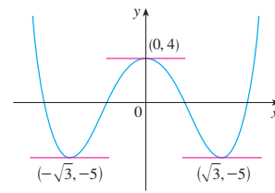

Slide 3



Slide 4

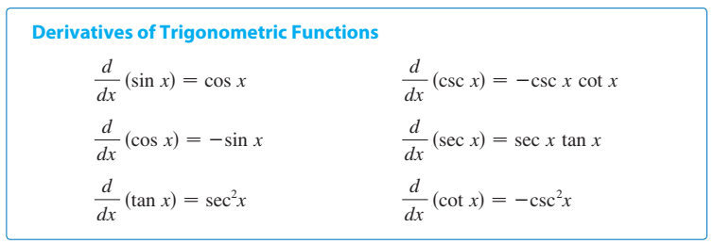

Slide 6
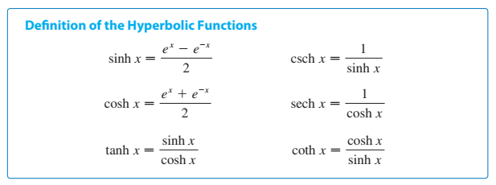
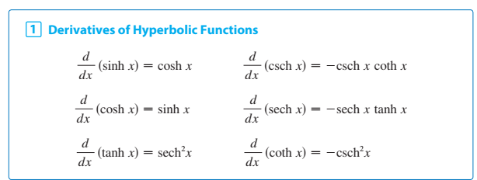

Slide 7
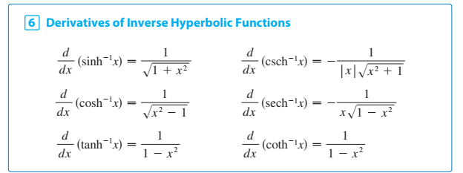

Slide 8


Slide 9
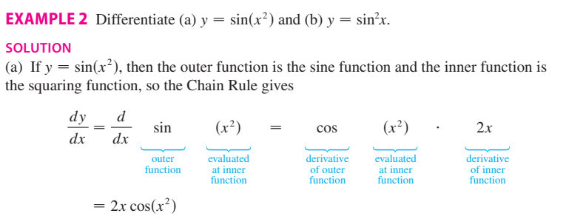


Slide 10
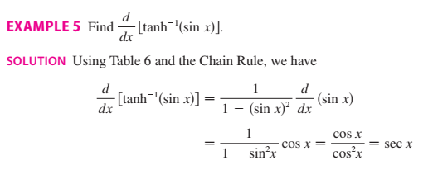

Slide 11

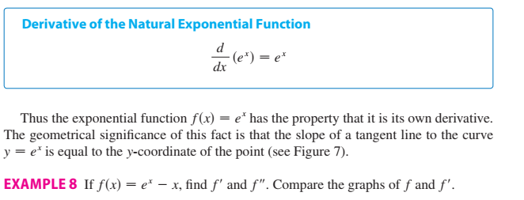
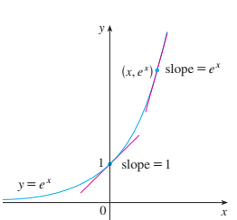
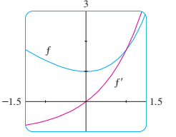


Slide 12





Explicit and implicit functions
The function is an explicit function if we can expressed one variable explicitly in term of another variable,
If not then the function is known as an implicit function for examples
$$y=xsinx$$
$$y=\sqrt{x^{2}+1}$$
Explicit functions
Implicit functions
$$x^{3}+y^{3}=6xy$$

Slide 13





Slide 14



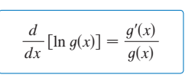



Slide 15




Slide 16






Slide 17

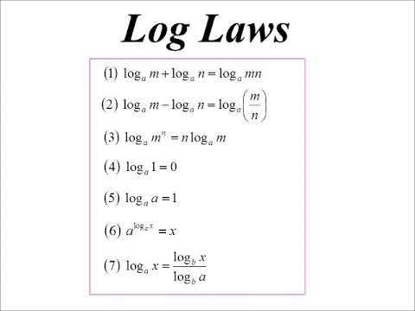

Slide 18




Slide 19







Slide 20


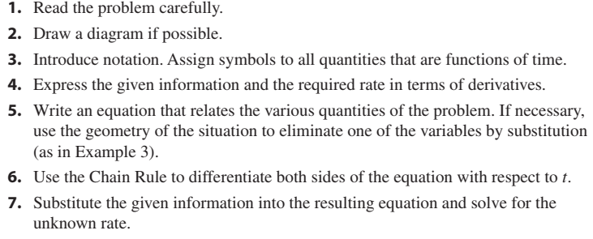

Slide 21




Slide 22






$$⟹$$

Slide 23


Slide 24

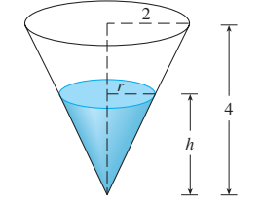




Slide 25



Practice Examples: 2, 4, 5 (see on page 246)

Slide 26

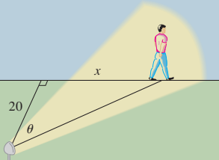




Slide 27
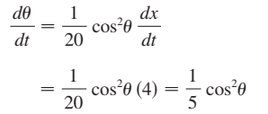
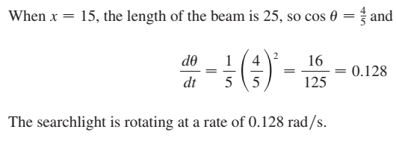

Slide 28


Slide 29


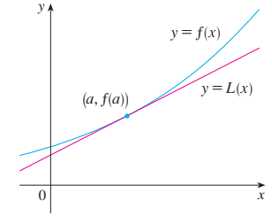

Slide 30







Slide 31

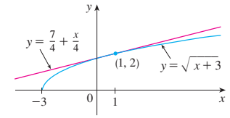


Slide 32



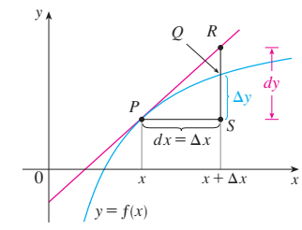


Slide 33







Slide 34





Slide 35






Slide 36
The End

