Slide 1
LOCO Anomaly Inspector
An interactive, reproducible system for logical & structural anomaly detection
on the MVTec LOCO AD industrial benchmark

Slide 2
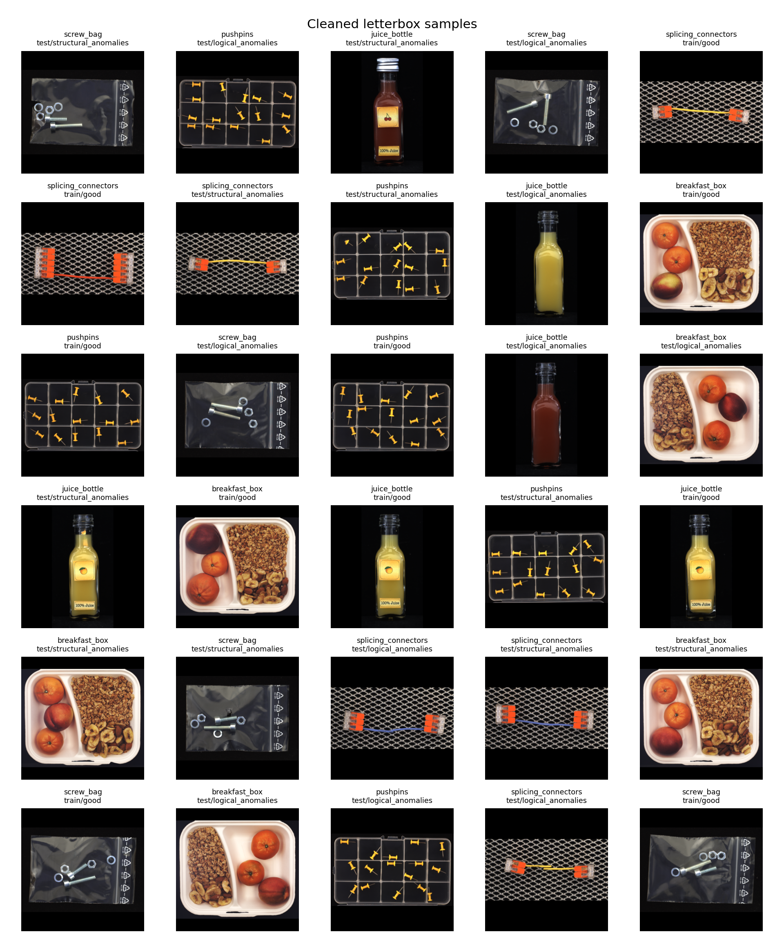
Two kinds of defect
Structural anomalies
Local appearance defects — scratches, dents, cracks. Visible in a small region.
Logical anomalies
Global rule violations — a missing fruit, an extra pushpin, a swapped part. Every region looks normal; only the overall composition is wrong.
Trained only on defect-free images — no labelled defects.

Slide 3
What we built — and why
A self-contained dashboard + reproducible ML pipeline that detects and explains anomalies in industrial product images.
Detect both types
Flag logical and structural defects from good images only.
Explain every decision
Show the anomaly score, the threshold, and where the defect is.
Relevant analysis only
Surface the EDA that informs the model — not decorative charts.
Fully reproducible
Fixed seeds, leakage-checked data, saved configs — every result is auditable.

Slide 4
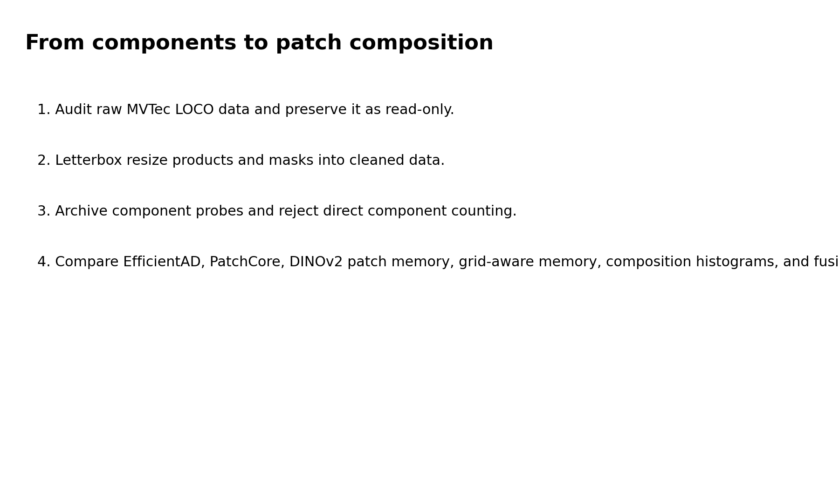
How it works — end to end
Data audit & letterbox preprocessing → EDA → four detectors → validation-only fusion → evaluation → dashboard & report. All logic in one shared module.

Slide 5
Data & preprocessing rigor
3,651
product images
5
categories
0
cross-split leaks
384²
letterbox resize
Raw dataset treated as read-only.
Aspect-preserving letterbox to 384×384 (bilinear images, nearest-neighbour masks).
MD5 + perceptual hashing across splits to detect duplicate leakage — none found.
Fit on Train(good); threshold on Validation(good); Test held out. No test labels in tuning.

Slide 6
Four DINOv2 detectors + fusion
DINOv2 Patch Memory
Memory bank of normal DINOv2 patch tokens; cosine nearest-neighbour distance. Catches structural defects.
DINOv2 Region-Aware Memory
Memory conditioned on image region — adds positional awareness. Strongest single detector.
DINOv2 Composition Histogram
DINOv2 visual-word histogram scored by Mahalanobis distance. Targets logical anomalies.
Global Image-Stat (proxy)
Single global descriptor vs. the normal mean. Fast image-level baseline (non-DINOv2).
Fusion
Each detector is z-normalised on Validation(good) only, then combined (mean / max / rank-average). Complementary detectors fused beat any single one.

Slide 7
Results — fusion wins
Method | Logical | Structural | Overall
Fusion (mean) | 0.731 | 0.804 | 0.761
DINOv2 Region-Aware | 0.730 | 0.784 | 0.750
DINOv2 Patch Memory | 0.697 | 0.765 | 0.724
Composition Histogram | 0.644 | 0.498 | 0.576
Global Image-Stat (proxy) | 0.634 | 0.683 | 0.655
Image-level AUROC, averaged over 5 categories.
Fusing a local detector with a global one beats either alone.
Region-aware memory is the strongest single detector and leads on structural.
Real frozen DINOv2-small features — verified end-to-end and fully reproducible.

Slide 8
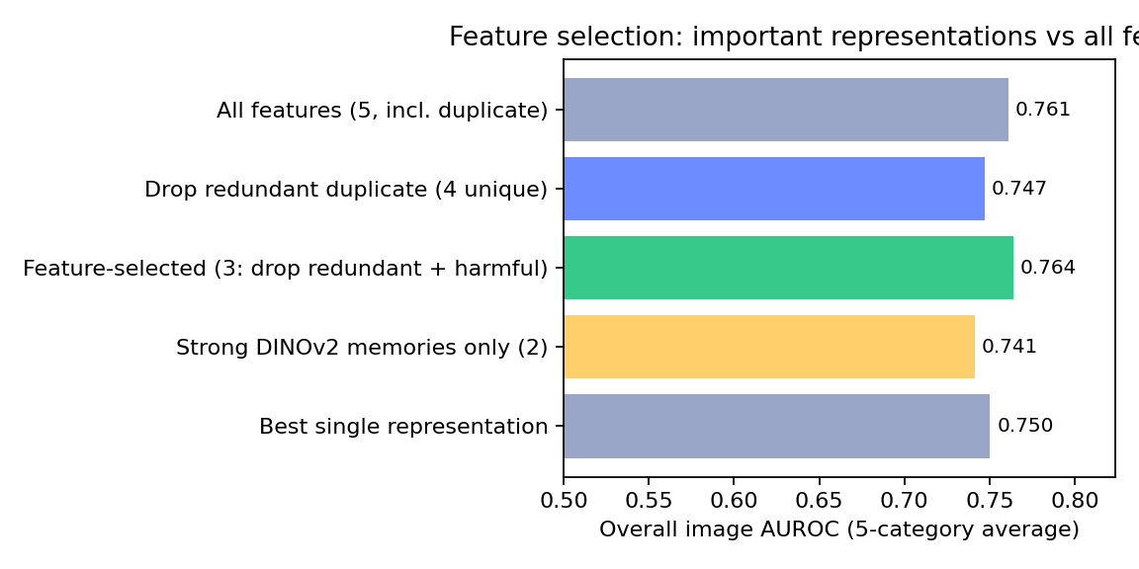
Feature selection — fewer, better representations
Each detector is a feature representation of the image. We rank them by single-branch AUROC and by leave-one-out contribution to the fusion.
PatchCore is byte-identical to DINOv2 PatchMemory — a redundant duplicate.
The Composition-Histogram branch is the only one that hurts the fusion (Δ < 0).
Dropping both → a leaner 3-representation model: 0.764 overall, 0.826 structural — edging the full fusion with fewer features.
No anomalous validation images exist, so importance is test-assessed and reported as analysis; the headline 0.76 fusion stays pre-specified and untuned.

Slide 9
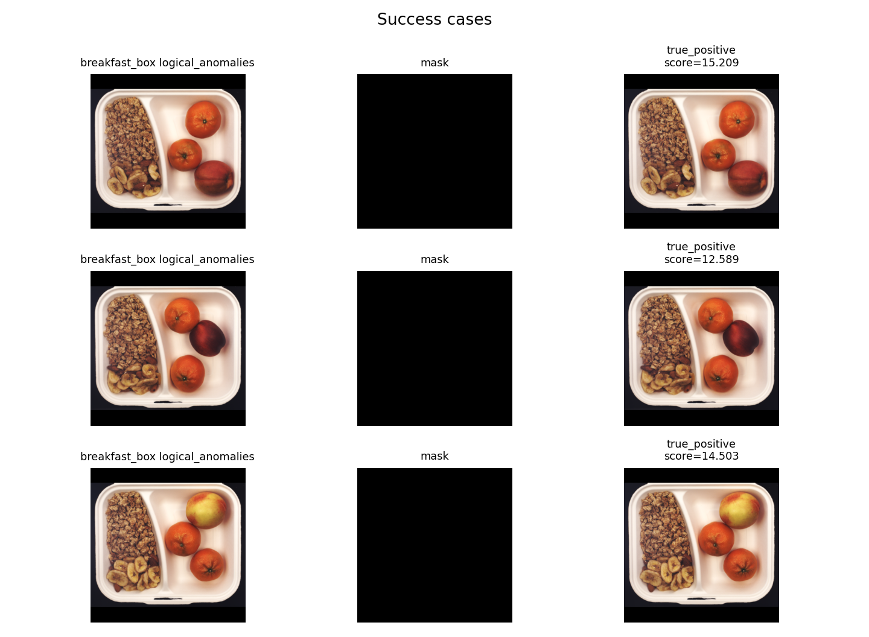
An explainable, offline dashboard
Overview
EDA (relevant only)
Leaderboard
Explainability
Per-category drill-down
One self-contained HTML file. Opens in any browser, fully offline — no install, no server, no internet. Every decision shows image, ground-truth, score vs. threshold, ✓/✗.

Slide 10
Honest about where we stand
Ours — DINOv2 (now)
Ours + padding/base
SOTA (CSAD/SALAD)
0.76
frozen DINOv2-small,
fully reproducible
~0.83–0.90
mask padding, DINOv2-base,
multi-seed
0.95–0.96
component segmentation,
heavy training
Our contribution is rigor, reproducibility, and explainability — not chasing a leaderboard number.
We name each method for what it actually computes, keep evaluation leakage-free, and audit the data end to end. Features are verified as real DINOv2; the remaining gap is padding-masking, a larger backbone, and multi-seed — not a redesign.

Slide 11
Summary & next steps
A complete, working product: reproducible pipeline, four detectors + fusion, and an offline explainable dashboard.
Best fusion: 0.76 overall AUROC (0.73 logical / 0.80 structural) on real DINOv2 features — a transparent, defensible result.
Feature selection (drop redundant + harmful branches) gives a leaner, better model (0.764).
Next: mask letterbox padding, move to DINOv2-base, add the official sPRO metric, and report multi-seed confidence intervals.
Thank you — live demo: open dashboard.html

