Slide 1
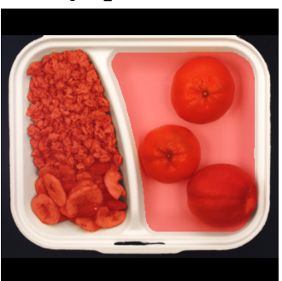
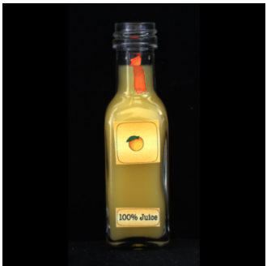
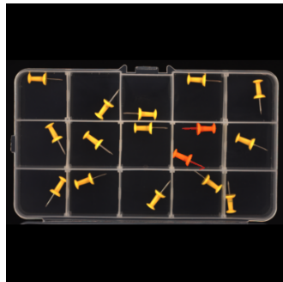
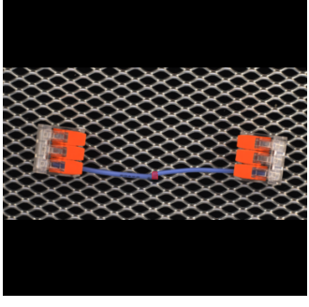
DATA ANALYTICS LAB · 8TH TRIMESTER · PROJECT A
LOCO Anomaly Inspector
Logical & structural anomaly detection on the MVTec LOCO AD industrial benchmark — a leakage-free DINOv2 pipeline with validated fusion and an explainable, fully offline dashboard.
Azmain Islam · ID 0152330058
Shamanta Rahman Roza · ID 0152330045
Data Analytics Lab · June 2026
3,651
0.761
100%
images · 5 categories
fused image AUROC
offline, reproducible
MVTec LOCO AD test samples — ground-truth defect regions in red
Notes:
Frame the project in one sentence: an end-to-end, auditable anomaly-detection system for the MVTec LOCO benchmark. Mention the three headline numbers and that everything shown is reproducible from the repo. 30–40 seconds, then move on.

Slide 2
AGENDA
What this talk covers
01
02
03
Problem & benchmark
Data audit & EDA
Methods
Why logical anomalies break classic AD; the MVTec LOCO dataset.
Leakage checks, letterbox preprocessing, and the EDA that shaped the model.
Four frozen-DINOv2 detectors and a validation-only fusion.
04
05
06
Results & ablations
Explainability & dashboard
Limits & roadmap
Main table, per-category analysis, feature selection, efficiency.
Every decision inspectable in a self-contained offline dashboard.
Honest positioning vs SOTA and what comes next.
02
Notes:
One breath per box. Signal that results AND their honest limits both get airtime — that is the story of the project: rigor over leaderboard-chasing.

Slide 3
MOTIVATION
Why industrial anomaly detection is hard
1
No labels for what can go wrong
Production lines collect thousands of good images but few, unpredictable defects. Models must train on normal data only — unsupervised anomaly detection.
2
Two very different failure modes
Local damage (a scratch, a contamination) and global rule violations (missing, extra or misplaced parts) leave completely different statistical footprints.
3
Decisions must be explainable
A bare score convinces nobody on a factory floor. Operators need the score, the threshold it is compared against, and the evidence — for every single image.
Nothing here is damaged. The compartment contents violate the product's composition rules — a logical anomaly (ground-truth region in red).
03
Notes:
Sell the problem before the solution. Emphasise point 2: it predicts the whole method design — we will need local AND global detectors. Point at the breakfast box: every patch is normal, the composition is not.

Slide 4
PROBLEM DEFINITION
Two kinds of anomaly, one detector budget
STRUCTURAL — appearance breaks
LOGICAL — rules break
Local defects: scratches, dents, contaminations.
Evidence is confined to a small region — comparing patches against normal appearance finds it.
Wrong count, position or combination of otherwise-normal parts.
Every patch looks perfectly normal in isolation; only the global composition is wrong.
juice_bottle — a local defect near the bottle neck (red overlay). A patch-level nearest-neighbour search nails this.
pushpins — extra / misplaced pins highlighted in red. No patch is locally abnormal.
Why LOCO exists: patch-based detectors (PatchCore-style) excel at structural defects but are nearly blind to logical ones (Bergmann et al., IJCV 2022). Closing that gap drives every design choice that follows.
04
Notes:
The core conceptual slide. Make the audience predict the method: local memory for structural, something global for logical. If they get this, the rest of the talk is easy.

Slide 5
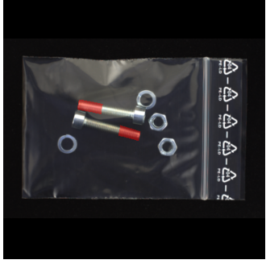
BENCHMARK
MVTec LOCO AD — five products, three splits
3,651
1,778
305
1,568
images total
train — good only
validation — good only
held-out test
screw_bag — wrong part set (red)
Category | Train | Val | Test | Test composition
breakfast_box | 351 | 62 | 275 | 102 good · 83 logical · 90 structural
juice_bottle | 335 | 54 | 330 | 94 good · 142 logical · 94 structural
pushpins | 372 | 69 | 310 | 138 good · 91 logical · 81 structural
screw_bag | 360 | 60 | 341 | 122 good · 137 logical · 82 structural
splicing_connectors | 360 | 60 | 312 | 119 good · 108 logical · 85 structural
splicing_connectors — wiring rule violation (red)
Validation contains only good images — anomaly types are unknown until test time, by design.
05
Notes:
Key protocol point: the validation split has NO anomalies. Every threshold and every fusion weight must therefore come from good images only — this constraint shapes the whole calibration story.

Slide 6
RIGOR FIRST
Data audit & preprocessing — before any modeling
01
Raw data is read-only
02
Aspect-preserving letterbox to 384×384
Full inventory of 3,651 product images + 1,246 defect masks; per-file MD5 manifest stored as CSV. The raw tree is never modified.
Bilinear for images, nearest-neighbour for masks (labels must stay binary). Scale and padding offsets logged per image — every pixel is traceable back.
03
Cross-split leakage check
04
Split discipline, enforced
MD5 + perceptual hashing compared across train / validation / test. Result: zero duplicate leaks. The headline numbers cannot be inflated by memorised images.
Fit on Train(good). Calibrate on Validation(good). Test stays untouched until the final, single evaluation pass. No test labels in any tuning loop.
Every step emits CSV artifacts (hashes, counts, resize metadata) — the audit is reproducible, not anecdotal.
06
Notes:
This is the slide reviewers tend to reward: most course projects skip the audit. Stress the zero-leakage finding and that masks use nearest-neighbour interpolation — a classic silent bug elsewhere.

Slide 7
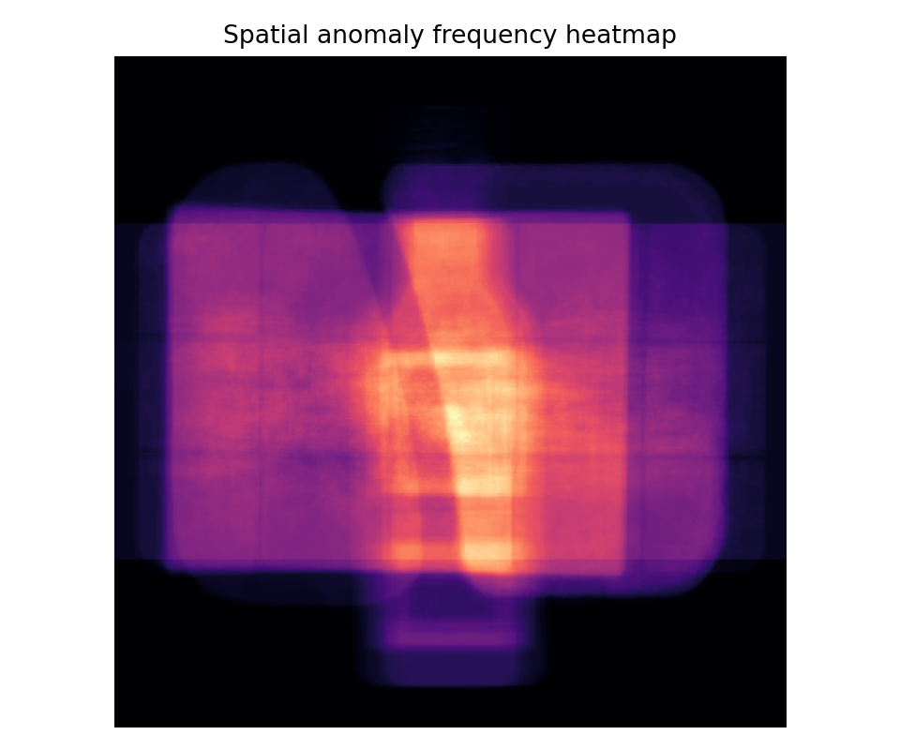
EXPLORATORY ANALYSIS
EDA that informed the model — not decoration
Defect footprint separates the two types
Structural masks are small and local (median ≈ 1–2% of the image). Logical masks can cover over 30% (screw_bag). One detector cannot serve both — we need local and global branches.
Anomalies live on the product, not the padding
Defect-frequency heatmaps concentrate on the object region. Letterbox borders carry no defect signal — yet still feed the feature extractor. We track this as a known caveat.
Five very different layouts
Fixed grid (pushpins) vs free-form tray (breakfast_box): no single spatial prior fits all. Position must be modeled explicitly — this motivates the region-aware memory.
Where defects occur (all categories pooled): frequency mass sits on the product region; padding stays dark.
Test anomalies are used for descriptive EDA only — never for model tuning.
07
Notes:
Each finding maps 1:1 to a design decision — say that mapping out loud. Finding 1 → two branch families; finding 2 → padding caveat (returns on the limitations slide); finding 3 → region-aware memory.

Slide 8
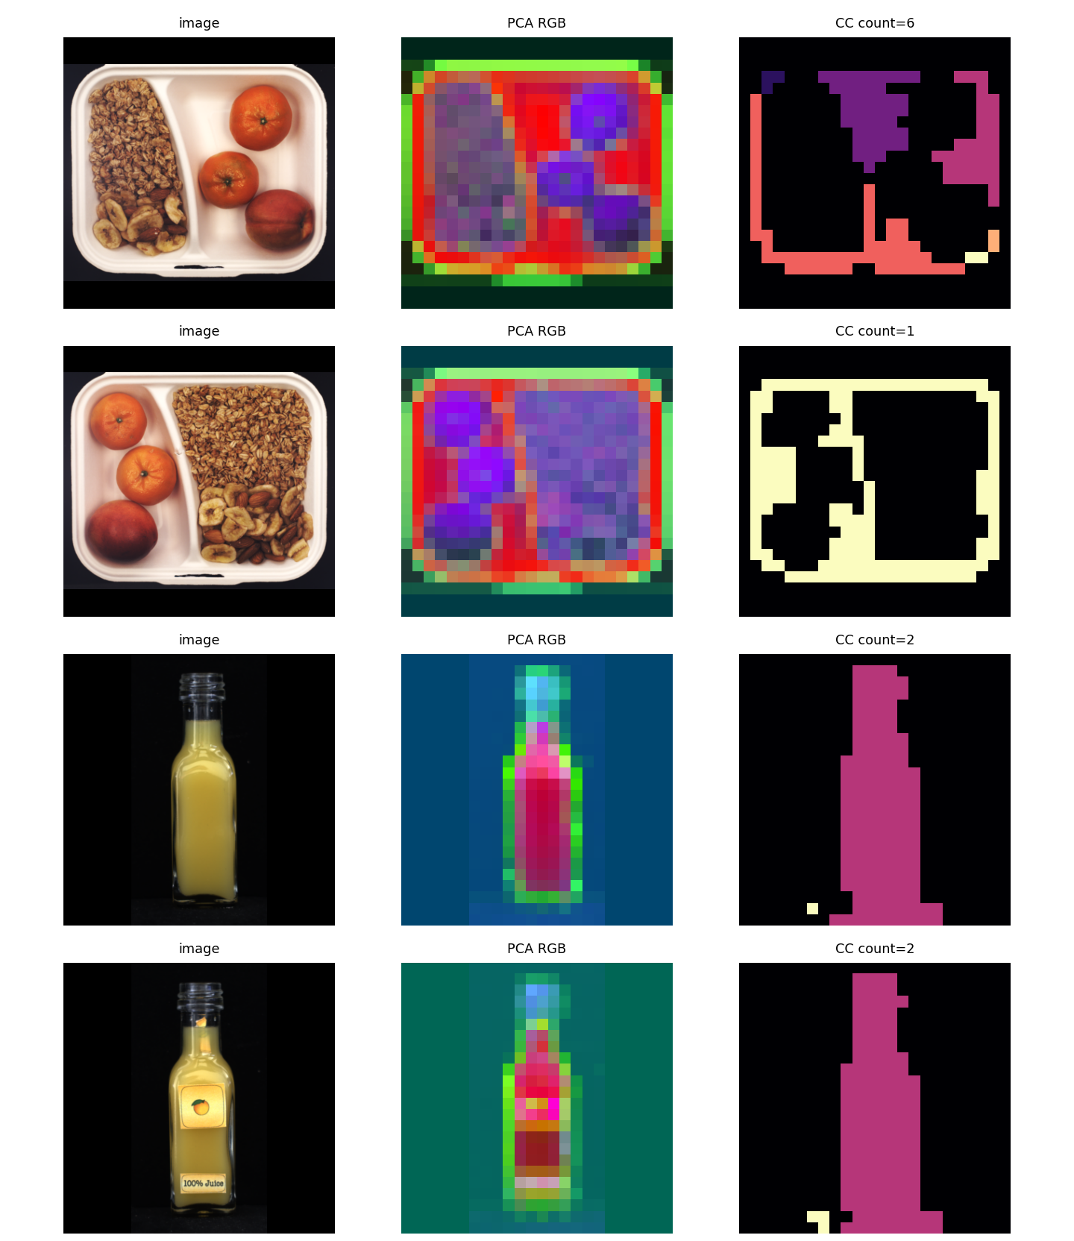
A NEGATIVE RESULT WE KEPT
Probe: can we just segment & count components? No.
Hypothesis: if components could be segmented and counted reliably, logical anomalies would reduce to comparing counts.
METHOD
PCA-RGB projection + K-means clustering on frozen DINOv2 patch features; connected components treated as candidate 'parts'.
RESULT
Counts are unstable even between two normal images of the same product — 6 vs 1 components on near-identical breakfast trays. Clusters track texture, not objects.
DECISION
Reject explicit component counting as the main method. Encode composition statistically instead: visual-word histograms + region-aware memories.
Why show a failure? Cheap probes killed a dead-end before it became the project. Negative results steer design.
image · PCA-RGB · components — two normal trays yield counts 6 vs 1
08
Notes:
This slide demonstrates scientific process. One sentence of humility ('our first idea failed') buys a lot of credibility for the numbers that follow.

Slide 9
METHOD OVERVIEW
One pipeline, end to end — every stage auditable
Audit + letterbox
Frozen DINOv2-small
Four anomaly scorers
Calibrate & fuse
Evaluate & explain
read-only raw, MD5 manifest, 384×384 letterbox
patch tokens, d = 384 — zero training
2 local memories, 2 global descriptors
z-norm + mean rule, Validation(good) only
held-out test, AUROC / F1 → dashboard
THE FOUR SCORERS
Patch Memory
Region-Aware Memory
Composition Histogram
Image-Stat (proxy)
local appearance
local + position
global counts
global baseline
Three rules everywhere: backbone stays frozen (zero training) · test data never enters fitting or tuning · every stage writes CSV artifacts that the report and dashboard are rebuilt from.
09
Notes:
Walk left to right in ~45 seconds. The two highlighted boxes are where this project differs from a baseline run: frozen-feature scorers and validation-only calibration.

Slide 10
METHODS · LOCAL BRANCHES
Detectors 1–2: nearest-neighbour patch memories
D1 · DINOv2 Patch Memory (PatchCore-style)
D2 · Region-Aware Memory (strongest single)
Build: memory bank M of normal patch tokens (coreset, 50,000 entries, d = 384).
Score: each test patch → cosine distance to its nearest normal patch; the image score is the worst patch.
Catches structural: a damaged patch has no close normal neighbour.
Build: partition the token grid into 6×6 spatial regions; one memory per region (36 per category, 455k entries total).
Score: a patch is compared only to normal patches from the same region — appearance and position must both match; mean of top-5 neighbour distances.
Catches: “right part, wrong place” — the positional half of logical anomalies.
s(x) = max_{p} min_{m∈M} [ 1 − cos(f_{p}, m) ]
AUROC 0.724
367 ms / image
AUROC 0.750
154 ms / image
All hyperparameters (region size 6, top-5) selected on validation-good stability — details on the ablation slide.
10
Notes:
D1 is the literature workhorse — give it 30 seconds. Spend the time on D2: same memory idea, but conditioned on position, which is exactly what misplaced-part anomalies need. It is also 2.4x faster because each query searches a 36x smaller memory.

Slide 11
METHODS · GLOBAL BRANCHES
Detectors 3–4: composition without segmentation
D3 · Composition Histogram
D4 · Global Image-Stat (honestly-named proxy)
Vocabulary: k-means over normal patch tokens → 32 visual words.
Represent: each image → normalised word histogram h(x): what is present, in what proportion.
Score: Mahalanobis distance to the normal histogram distribution — counting without segmenting.
One global descriptor per image, scored against the normal mean — an EfficientAD-style stand-in, deliberately labeled a proxy rather than passed off as the real network.
The only non-DINOv2 branch, and the fastest.
Weak alone — but the most complementary branch in fusion: removing it costs −0.043 AUROC (leave-one-out).
s(x) = √( (h−μ)^{T} Σ⁻¹ (h−μ) )
AUROC 0.576 alone
28 ms / image
AUROC 0.655
21 ms / image
Design logic: two local + two global branches that fail differently. Fusion exploits their disagreement — single-branch weakness is not a verdict.
11
Notes:
Two honesty beats live here: D4 is explicitly a proxy (named as such everywhere), and D3's weak standalone number is shown in red — it sets up the feature-selection slide where it turns out to actively hurt the fusion.

Slide 12
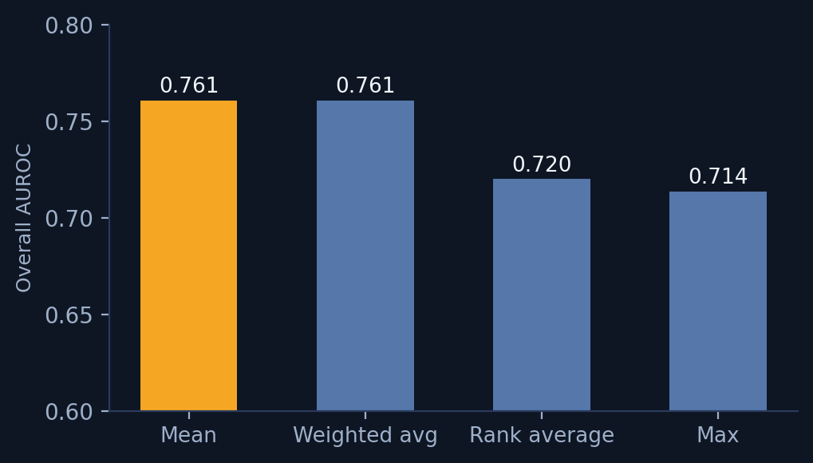
METHODS · CALIBRATION
Leakage-free fusion: calibrated on good images only
1
z-normalise each branch on Validation(good)
Branch scores live on different scales; statistics (μ, σ) come from good validation images only.
2
Combine with the pre-specified mean rule
The mean rule was fixed before test evaluation. Max, rank-average and weighted variants are reported as ablations — weighted ties mean at 0.761.
3
Threshold at the 90th percentile of fused val-good scores
Fusion-rule ablation. Mean (pre-specified) and validation-weighted average tie at 0.761; max and rank-average trail. No rule was picked using test labels.
This single operating point drives every ✓/✗ verdict in the dashboard and the F1 numbers.
z_{k}(x) = ( s_{k}(x) − μ_{k} ) / σ_{k} s_{fused}(x) = mean_{k} z_{k}(x)
FIT — Train(good)
CALIBRATE — Val(good)
REPORT — Test, untouched
12
Notes:
If the audience remembers one methods detail, make it this: nothing downstream of the train/val split ever sees a test label. The fusion rule itself was committed to in advance — the ablation exists for completeness, not cherry-picking.

Slide 13
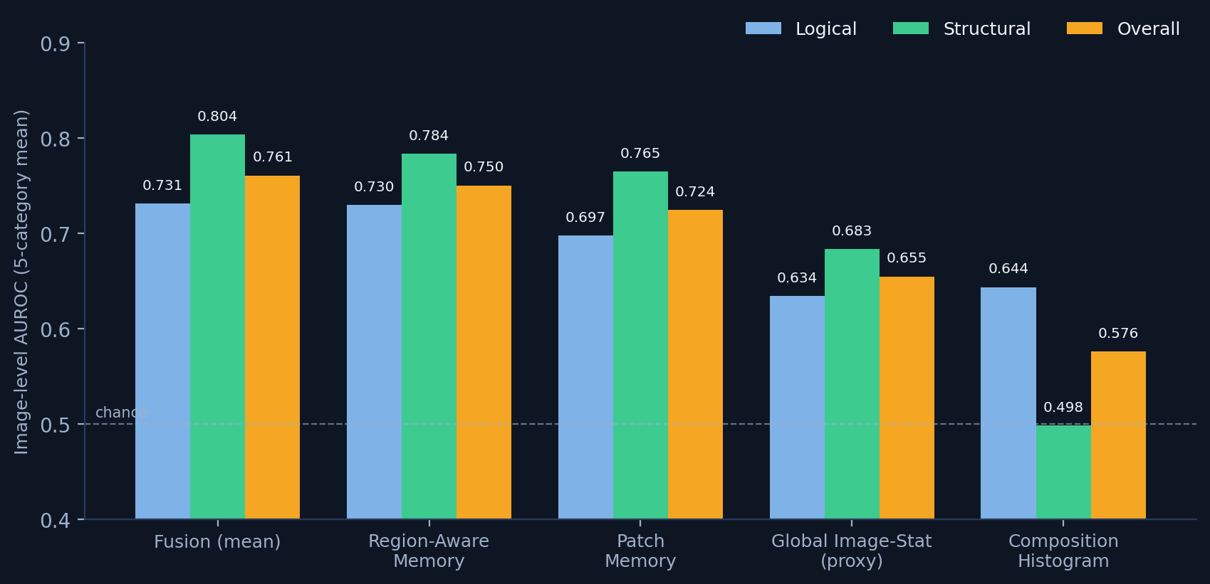
RESULTS
Main results — fusion beats every single branch
0.761 — fusion wins
vs 0.750 for the best single branch. Complementary local + global signals, fused with validation-only statistics.
Structural 0.804 / logical 0.731
The logical side remains harder — exactly the gap the LOCO benchmark was built to expose.
Real, verified features
Image-level AUROC, mean over 5 categories. PatchCore omitted: byte-identical to Patch Memory in this setup.
Runtime logs record feature_backend = dinov2-small for every branch; deterministic config, fixed seeds.
Every number regenerates from 06_method_results/Final_Evaluation/*.csv — the deck, report and dashboard all read the same tables.
13
Notes:
Pause on this slide. Read the fusion bar triplet once, then the two takeaways on the right. Anticipate the question 'why is 0.76 good?' — answer comes two slides later in the SOTA positioning slide.

Slide 14
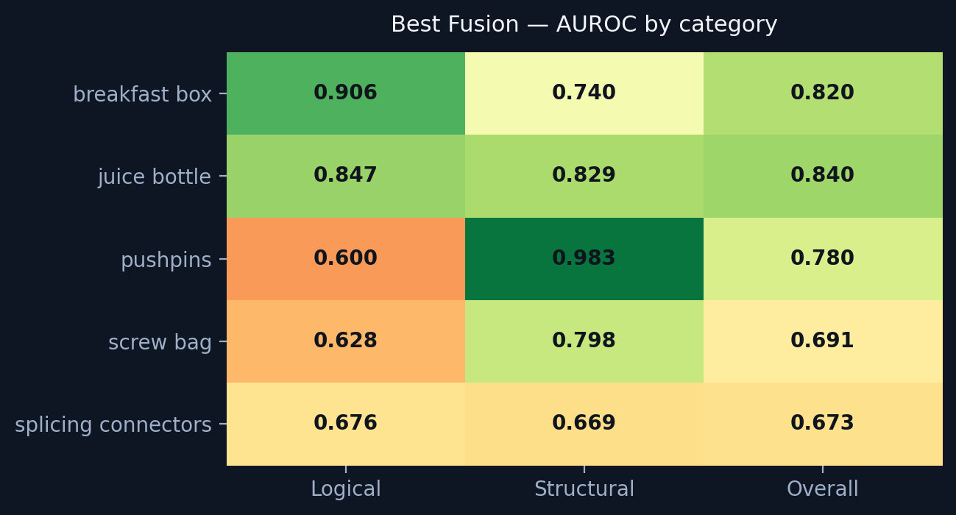
RESULTS · PER CATEGORY
Where it works, where it struggles — and why
juice_bottle & breakfast_box: strong
0.840 / 0.820 overall — rich appearance cues suit patch memories; fill levels and fruit composition give global signal.
pushpins: a split personality
Structural 0.983 (near-perfect) vs logical 0.600. Detecting a damaged pin ≠ noticing one pin too many — exact counting is still out of reach.
screw_bag & splicing: the open problem
Best Fusion, image-level AUROC on the held-out test split.
Logical 0.628 / 0.676. Small interchangeable parts in variable layouts need component-aware reasoning — our roadmap's P2.
Consistent with the literature: across published methods, logical anomalies in counting-heavy categories remain the hardest cell of this benchmark.
14
Notes:
The pushpins row is the most quotable: 0.983 vs 0.600 in one category is the cleanest possible demonstration that structural and logical anomalies are different problems.

Slide 15
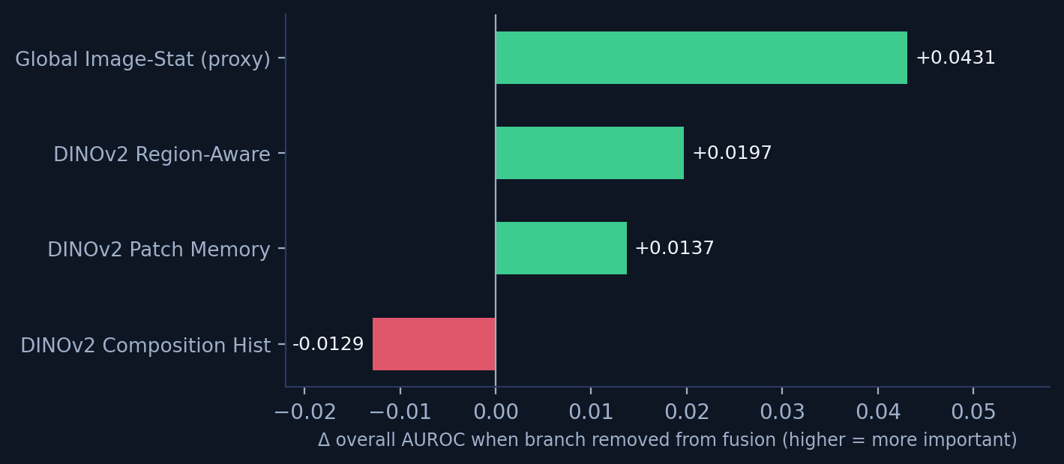
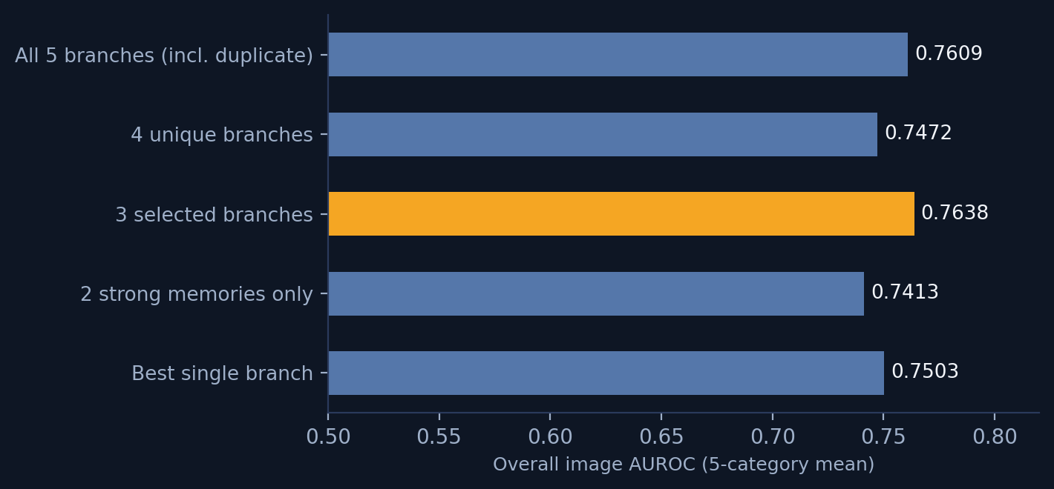
RESULTS · ABLATIONS
Feature selection: fewer branches, better model
Leave-one-out: what each branch adds
Branch subsets: overall AUROC
Drop the redundant duplicate + the harmful branch → 3-branch model: 0.764 overall, 0.826 structural — better than all five.
Composition Histogram hurts the fusion (−0.013) despite decent logical-only skill; the Global proxy is weak alone (0.655) yet most complementary (+0.043). Lesson: single-branch strength ≠ fusion value.
15
Notes:
This is the analytical heart of the deck — feature selection done on representations, evaluated leakage-free. The counter-intuitive pair (weak-but-complementary vs decent-but-harmful) usually gets the best questions.

Slide 16
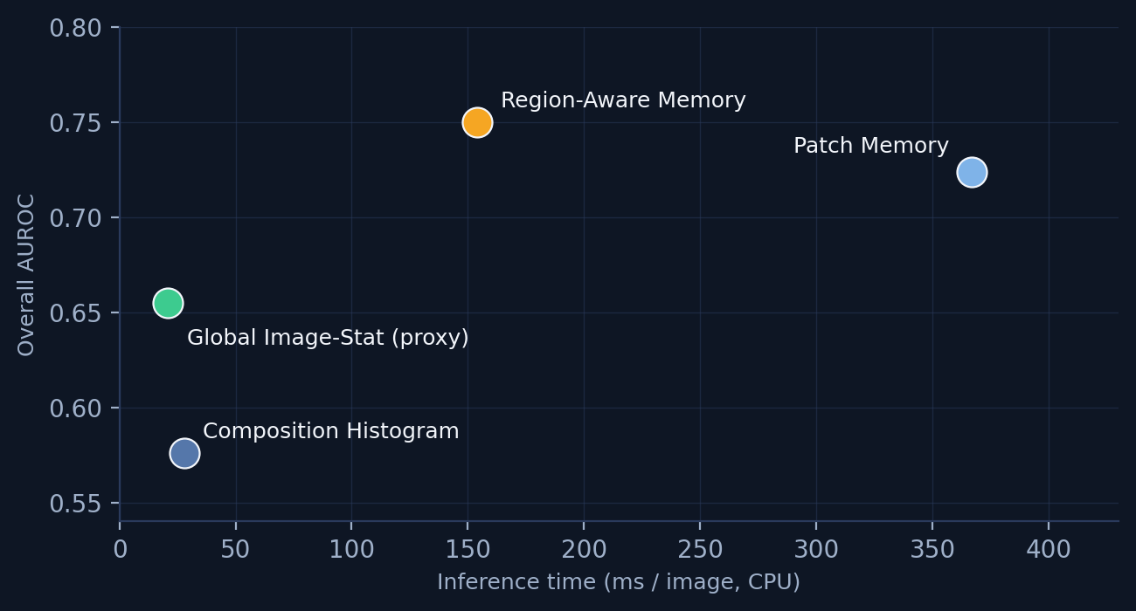
RESULTS · ABLATIONS & COST
Hyperparameters picked blind; cost measured
Selected on validation-good stability — never on test
Accuracy vs inference cost (CPU)
Region grid
4 · 6 · 8
Neighbours top-k
1 · 5 · 10 · mean · max
Visual words k
16 · 32 · 64 · 128
Fusion rule
mean — pre-specified, no search
Region-Aware sits on the sweet spot: best single AUROC at 2.4× less cost than Patch Memory (each query searches one region's memory, not all of it).
Chosen values highlighted; full grids in the ablation CSVs.
No GPU training anywhere: frozen features + classical statistics. Full fusion ≈ 0.57 s per image on CPU.
16
Notes:
Two messages: (1) hyperparameter selection cannot have leaked test signal — grids were judged on validation-good stability; (2) the system is deployable on CPU, which matters for factory edge hardware.

Slide 17
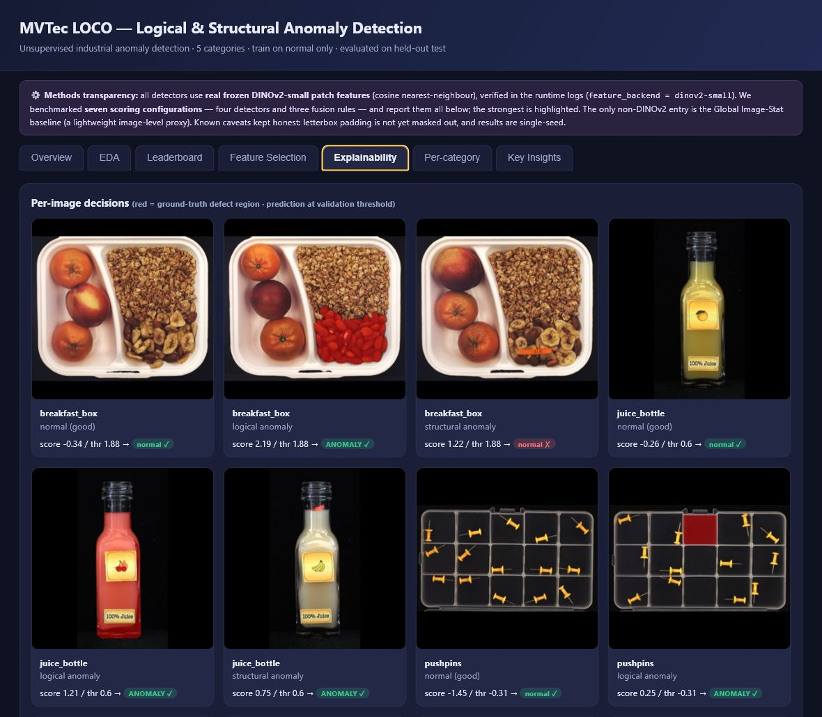
EXPLAINABILITY
Every decision is inspectable — successes and failures
What each card shows
Input image · ground-truth defect overlay (red) · fused score vs the validation threshold · verdict checked against the true label (✓/✗).
Failures are first-class citizens
Example in row 1: score 1.22 vs threshold 1.88 → a missed structural defect, shown in red — visible, not hidden in an appendix.
Why it matters
Operators can audit any flag in seconds; we used the same view for error analysis (near-threshold breakfast_box false positives).
Per-image decisions, Explainability tab of the dashboard.
17
Notes:
Point physically at one card and read it: image, truth, score vs threshold, verdict. Showing a miss on your own slide is the credibility move of the talk.

Slide 18
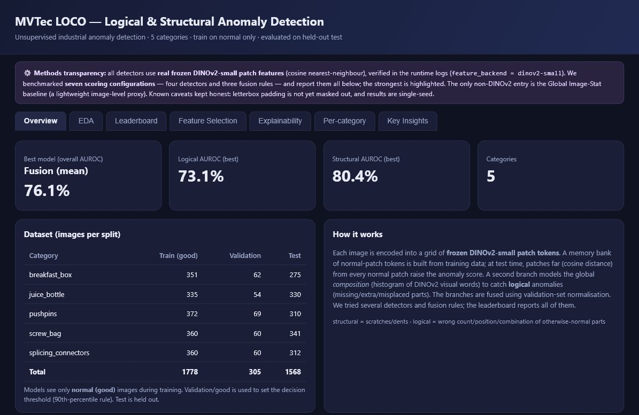
DELIVERABLE
A self-contained, offline analytics dashboard
One HTML file
No install, no server, no internet. Opens in any browser — submission-proof.
Seven tabs
Overview · EDA · Leaderboard · Feature Selection · Explainability · Per-category · Key Insights.
Transparency banner
States up front: real frozen DINOv2-small features, single seed, padding caveat. Honesty is part of the UI.
Always in sync
Rebuilt directly from the result CSVs by script — the dashboard cannot drift from the numbers.
Live demo: 09_dashboard/dashboard.html
18
Notes:
If a live demo is allowed, switch to the real dashboard here (it opens offline). Otherwise walk the screenshot: stat cards, dataset table, methods text — all generated from the same CSVs as this deck.

Slide 19
HONEST POSITIONING
Where 0.761 sits — and what the gap is made of
OURS — TODAY
OURS — NEAR-TERM HEADROOM
PUBLISHED SOTA
0.761
~0.83–0.90
0.95–0.96
Frozen DINOv2-small · single seed · zero training · fully audited and reproducible from raw data to dashboard.
Mask the letterbox padding, upgrade to DINOv2-base, run multi-seed. Engineering steps — not a redesign.
CSAD / SALAD: component segmentation, heavy training pipelines, far higher complexity budgets.
We compete on rigor per unit of compute.
Each method is named for what it actually computes, evaluation is leakage-free, and the data is audited end to end. The remaining gap is understood and itemised — not mysterious.
19
Notes:
Pre-empt the obvious challenge ('SOTA is 0.95, you have 0.76'). The three-card framing converts it: we know exactly which engineering steps buy the next ~0.1, and we did not spend our budget on training — we spent it on auditability.

Slide 20
LIMITATIONS & ROADMAP
What we don't claim — and what comes next
Known limitations
Prioritised roadmap
— Image-level metrics only — sPRO / pixel-level localization not yet reported.
— Letterbox padding still feeds the feature extractor (small, tracked bias).
— Single-seed results — no variance estimates yet.
— Global Image-Stat is a proxy, not the full EfficientAD it stands in for.
— Logical anomalies that require exact counting stay hard (pushpins logical 0.600).
P0
Mask letterbox padding in feature space; re-run the full benchmark.
P0
Backbone upgrade DINOv2-small → base (expected ≈ +0.05–0.08).
P1
Multi-seed runs; report mean ± std for every headline number.
P1
Add sPRO and pixel-level localization to evaluation + dashboard.
P2
Component-aware logical branch (CSAD-style) for the counting categories.
20
Notes:
Symmetry sells it: every limitation on the left has a numbered fix on the right. P0 items are in-progress engineering, not aspirations.

Slide 21
CONCLUSIONS
Four things to take away
1
A leakage-free pipeline, end to end
2
Fusion of complementary detectors works
Read-only raw data, hashed splits with zero duplicates, validation-only calibration, held-out test. Every artifact is a CSV you can re-run.
Four frozen-DINOv2 branches → 0.761 overall AUROC (0.731 logical / 0.804 structural), beating every single branch without training anything.
3
Feature selection beats feature accumulation
4
Explainability is a deliverable, not a slide
Leave-one-out analysis drops a duplicate and a harmful branch: the leaner 3-branch model reaches 0.764 overall and 0.826 structural.
A self-contained offline dashboard shows score, threshold and evidence for every test decision — failures included.
Rigor, reproducibility and explainability — that is the contribution. The leaderboard number is the start, not the point.
21
Notes:
Close with the four numbered cards in order — they recapitulate the agenda. End on the amber line; it is the thesis sentence of the whole project.

Slide 22
THANK YOU
Questions welcome.
Everything in this talk regenerates from the repository — data audit → EDA → methods → results → dashboard → these slides.
Live demo: 09_dashboard/dashboard.html — fully offline
22
Notes:
Offer the live dashboard for the Q&A screen. Likely questions: why not train the backbone (answer: reproducibility budget + frozen features already close most of the gap), and how the 0.83–0.90 headroom estimate was derived (padding/backbone/multi-seed itemisation on slide 19).

