Slide 1
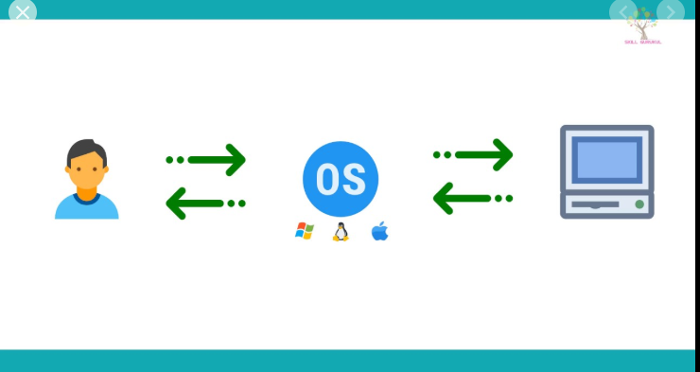
CONTIGUOUS MEMORY ALLOCATION
T VISHWAAK CHANDRAN 18154
YASWANT R 18162
KV SAI SAMPATH 18124

Slide 2
WHAT IS CONTIGUOUS MEMORY ALLOCATION?
* The main memory has to allocate both the operating system and the user space from secondary memory
* Contiguous memory allocation is a memory allocation method that allocates a single contiguous section (to keep in sequence) of memory to a process or a file
* In Contiguous memory allocation, when the process arrives from the ready queue to the main memory for execution, the contiguous memory blocks are allocated to the process according to its requirement.

Slide 3
ADVANTAGES AND DISADVANTAGES OF CONTIGUOUS MEMORY ALLOCATION
Advantages:-
* Address translation
* Increases the processing speed
* Access is easy
Disadvantages:-
* It always suffer from external fragmentation
* Inflexibility
External fragmentation:- The total space which is required is available but not in contiguous fashion, so it suffers from external fragmentation.

Slide 4
TYPES OF CONTIGUOUS MEMORY ALLOCATION
There are two types of contiguous memory allocation-
* Fixed size partitioning (or) Static partitioning
* Variable size partitioning (or) Dynamic partitioning
Fixed size partitioning (or) Static partitioning:-
* In which the memory is divided into certain partitions and the size of each partitions will be fixed and cannot be changed. Administrator decides the size of the partitions.
Advantages:-
* Easy to implement
* Little OS overhead

Slide 5
TYPES OF CONTIGUOUS MEMORY ALLOCATION(CONTD…)
Disadvantages:-
* Internal fragmentation- Main memory use is inefficient. Any program, no matter how small, occupies an entire partition. This can cause internal fragmentation.
* External fragmentation
* Limit process size
* Limitation on Degree of Multiprogramming
Variable size partitioning (or) Dynamic partitioning:-
* It doesn’t have partitions. The partitions is made after allocating the process.
Advantages:-
* No internal fragmentation

Slide 6
TYPES OF CONTIGUOUS MEMORY ALLOCATION(CONTD…)
* No restriction on Degree of Multiprogramming
* No Limitation on the size of the process
Disadvantages:-
* Difficult implementation.
* External fragmentation.

Slide 7
ALGORITHMS FOR PARTITION ALLOCATION
There are three types of algorithms:-
* First fit algorithm
* Best fit algorithm
* Worst fit algorithm
First fit algorithm:-
* This algorithm starts scanning the partitions serially from the starting.
* When an empty partition that is big enough to store the process is found, it is allocated to the process.
* Obviously, the partition size has to be greater than or at least equal to the process size.

Slide 8
ALGORITHMS FOR PARTITION ALLOCATION(CONTD…)
Best fit algorithm:-
* This algorithm first scans all the empty partitions.
* It then allocates the smallest size partition to the process.
Worst fit algorithm:-
* This algorithm first scans all the empty partitions.
* It then allocates the largest size partition to the process.

Slide 9
FIXED SIZE PARTITIONING (OR) STATIC PARTITIONING IMPLEMENTATION

Slide 10
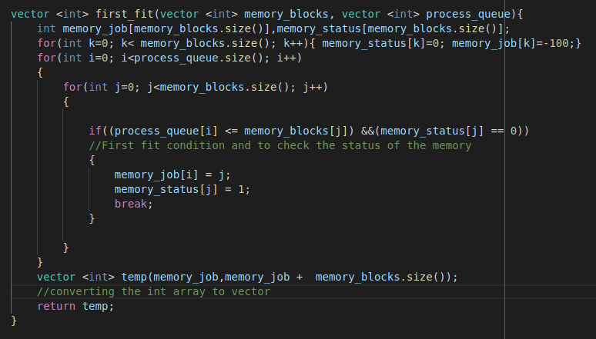
FIRST-FIT

Slide 11
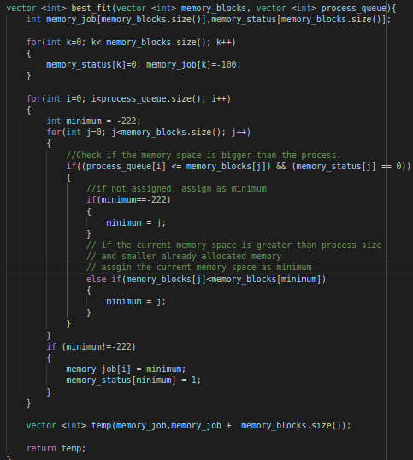
BEST FIT

Slide 12
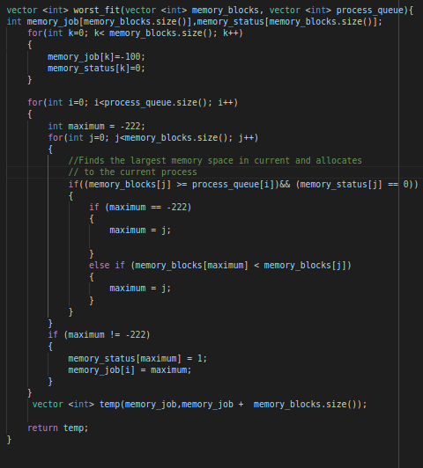
WORST FIT

Slide 13
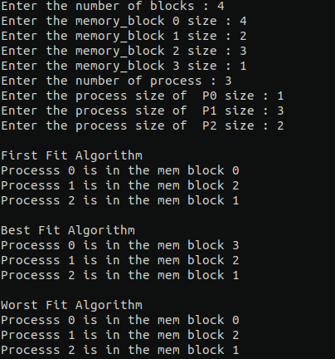
OUTPUT:-

Slide 14
VARIABLE SIZE PARTITIONING (OR) DYNAMIC PARTITIONING IMPLEMENTATION

Slide 15
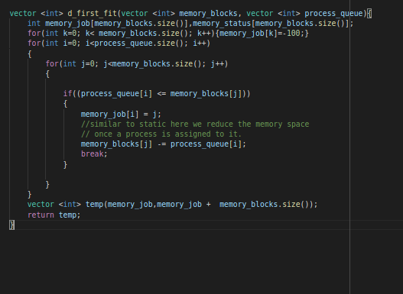
FIRST FIT

Slide 16
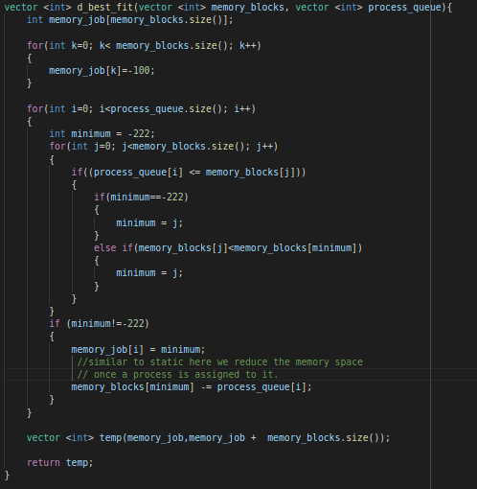
BEST FIT

Slide 17
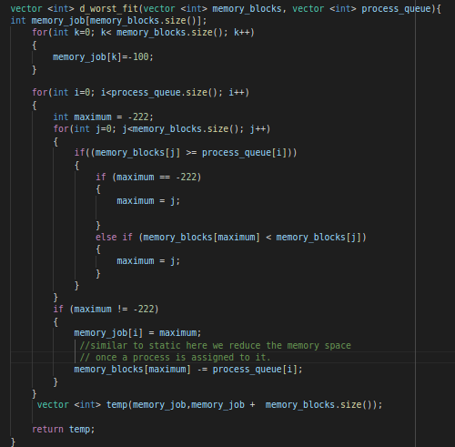
WORST FIT

Slide 18
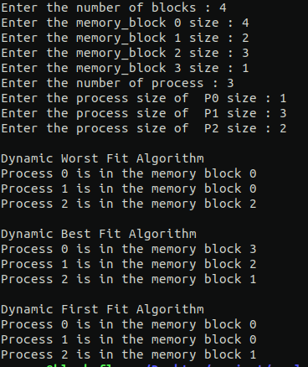
OUTPUT:-

Slide 19
Source Code
https://github.com/Vishwaak/curly-memory-guide

