Slide 1
CSL6010-Cybersecurity Major Project:
Eyes on Your Typing & CASOM Defense
Analysis of SNOOPFINGER Attack and Proposed Middleware
By: Group of 7 Members
Repository: https://github.com/AzDevops143/CSIEEE

Slide 2
Introduction: SNOOPFINGER Attack
What is SNOOPFINGER?
A novel cross-modality side-channel attack in AR/VR systems.
Exploits head movement data (which requires zero permissions) to infer hand-based typing on virtual keyboards.
Adversaries can deduce typed words by translating 3D head orientation into 2D gaze points.

Slide 3
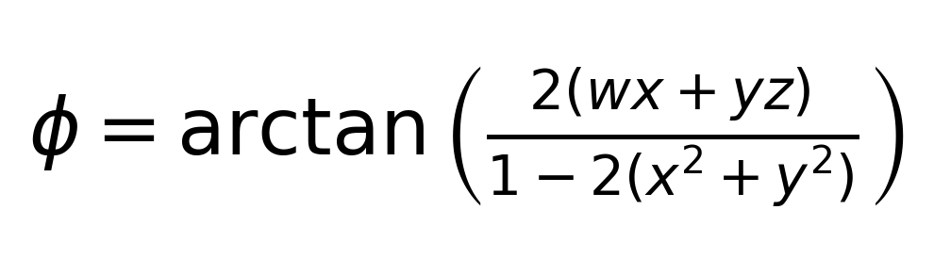
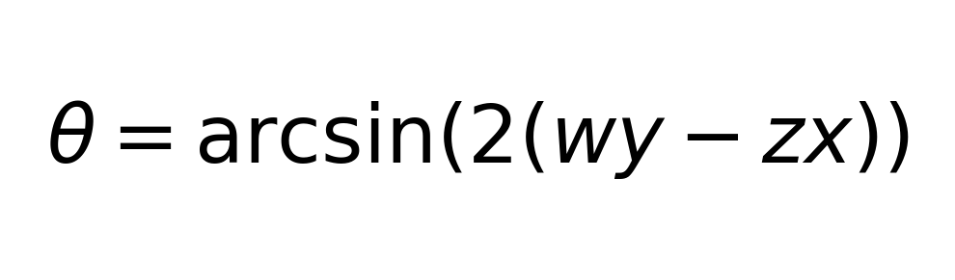
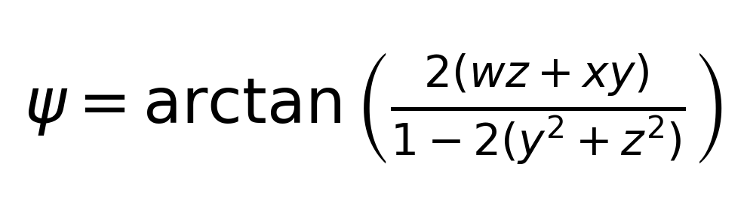
Understanding the Attack: Mathematical Background
Conversion from Quaternions to Euler Angles
The attack relies on converting the headset's quaternion orientation (w, x, y, z) into Euler angles (Roll, Pitch, Yaw) to estimate gaze direction.

Slide 4
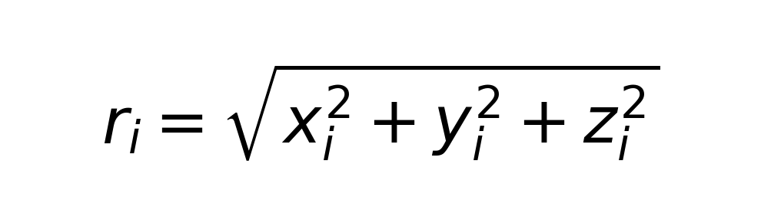
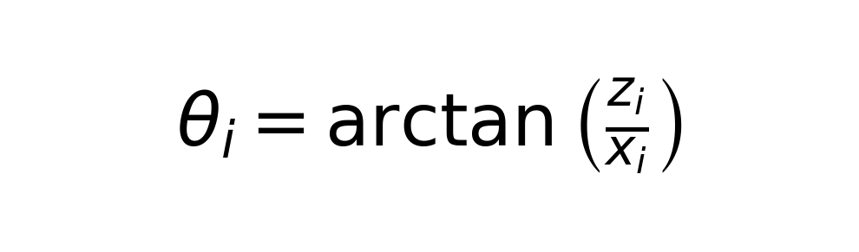
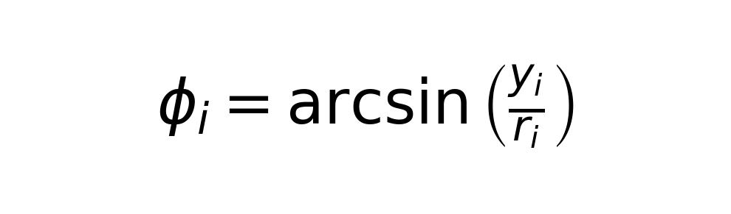
3D Gaze Direction to 2D Points
Equirectangular Projection
3D gaze directions are mapped onto a 2D plane (the virtual keyboard) to estimate which keys the user is looking at while typing.

Slide 5
Identified Gaps & Limitations
Limitations of SNOOPFINGER Attack Model:
User Deviation Gestures (Gap 1): Extraneous head movements (nods, shakes, circles) cannot be detected by the attacker and serve as an effective bypass.
External Sensor Tampering (Gap 2): Physical travel vibrations (walking, moving vehicle) or hardware tampering inject noise that cannot be separated from typing.
Gaps in Mitigation:
The paper proposes theoretical countermeasures (e.g., Adaptive Sensor Data Obfuscation) but provides no practical implementation or architectural blueprint.

Slide 6
Our Solution: CASOM Middleware
Context-Aware Sensor Obfuscation Middleware (CASOM)
Architecture:
Sits between the AR/VR OS Sensor Manager and Background Apps.
Monitors sensor data to detect when a user is typing (using movement thresholding).
Operation:
If typing is NOT detected, passes raw data.
If typing IS detected, injects Laplacian Noise into the data sent to background applications.

Slide 7
Implementation details
We built a complete Python Simulation:
generator.py: Simulates human gaze points targeting specific keys with natural micro-variances.
attacker.py: Simulates SNOOPFINGER by clustering temporal gaze points to infer the typed word.
defender.py: The CASOM Middleware that intercepts data and applies dynamic Laplacian noise (scale = 1.5).
main.py: Orchestrates the attack both WITH and WITHOUT the defense, providing visualizations.

Slide 8
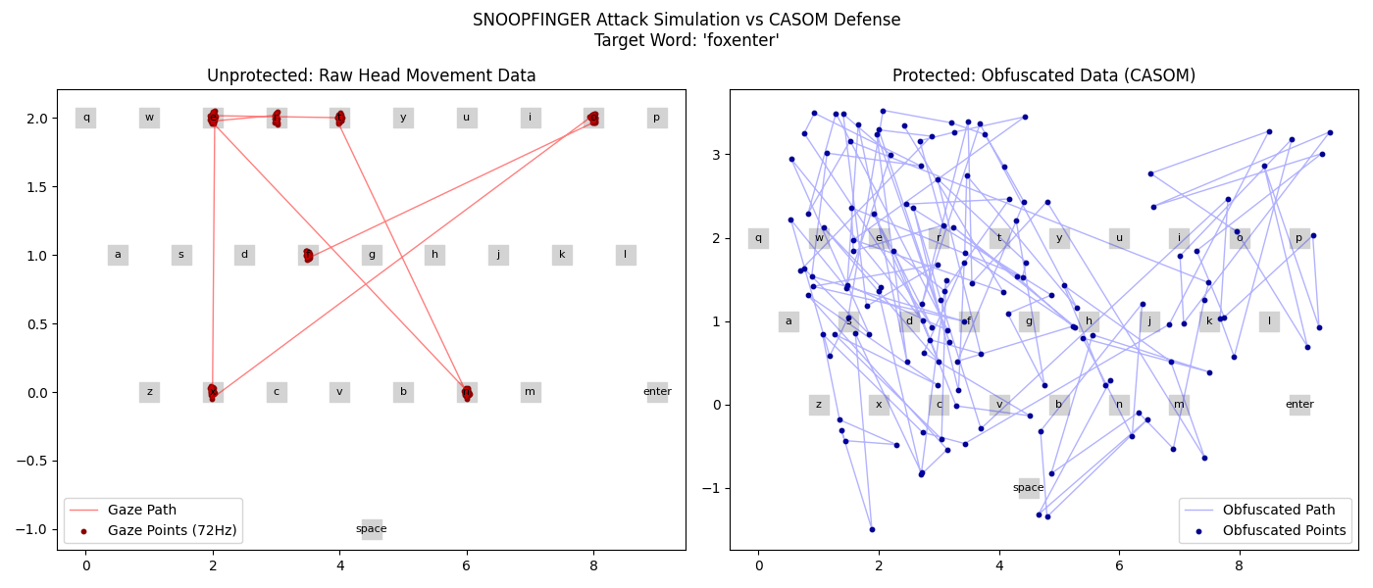
Results & Validation

Slide 9
Conclusion
Summary
SNOOPFINGER exploits zero-permission sensors, posing a major risk.
Our CASOM implementation successfully defends against the attack by dynamically degrading data utility for background apps.
As proven in our simulation, the attacker infers the exact word when unprotected, but infers useless gibberish when CASOM is active.
Project Repository: https://github.com/AzDevops143/CSIEEE

