Slide 1

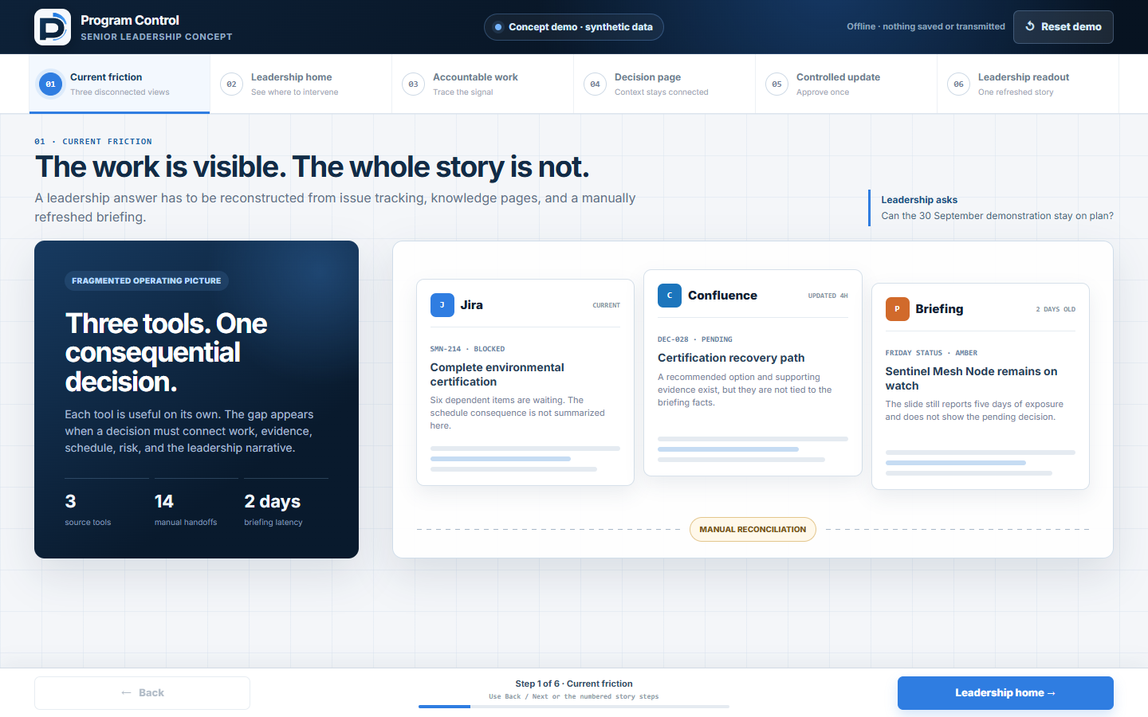
PROGRAM CONTROL · LEADERSHIP CONCEPT
01
Three systems create
one leadership blind spot.
Every leadership readout starts with manual reconciliation.
Jira
· work
Confluence
· context
Slides & spreadsheets
· status
FIVE-MINUTE CLICKABLE PROTOTYPE
CONCEPT DEMO — SYNTHETIC DATA
Notes:
Today, execution, context, and leadership reporting are managed as separate artifacts. The cost is not only the number of tools; it is the handoff—people reconcile definitions, status, and evidence before every readout. This concept asks whether Program Control can make that chain one governed workflow.
[Sources]
- Internal: Senior Leadership Concept Demo brief, 2026-08-24.
- Internal: Program Control leadership concept prototype; all displayed data is synthetic.
- The fragmentation statement is a problem hypothesis to validate with leadership, not a measured enterprise finding.

Slide 2
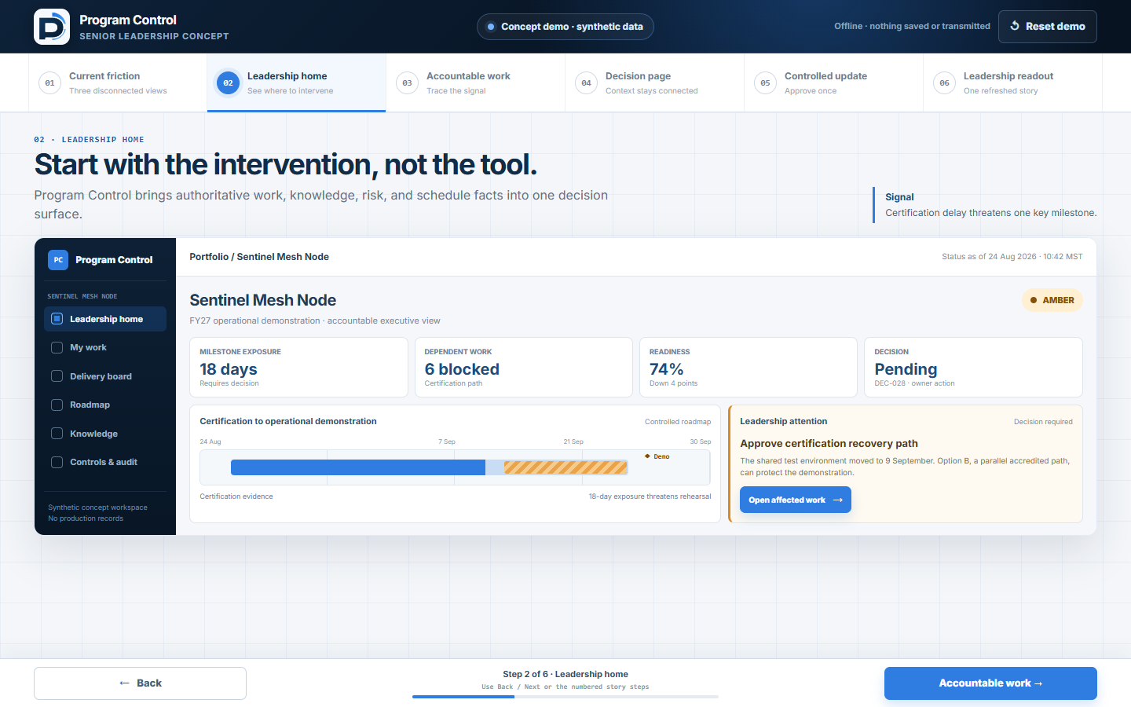
PROGRAM CONTROL · LEADERSHIP CONCEPT
02
One governed record replaces the handoffs.
WORK
KNOWLEDGE
DECISION
READOUT
One update.
One history.
One operating picture.
CONCEPT DEMO — SYNTHETIC DATA
Notes:
The proposed operating model is one source record with linked views, not one giant screen. Delivery teams maintain the work, the decision page retains the reasoning, and leadership receives an outcome-level view. The same update carries its identity and history into each view.
[Sources]
- Internal: Program Control leadership concept prototype; synthetic Sentinel Mesh Node scenario.

Slide 3
PROGRAM CONTROL · LEADERSHIP CONCEPT
03
Leadership sees the intervention—not another dashboard.
PROJECT SIGNAL
SENTINEL MESH NODE
AMBER
MILESTONE EXPOSURE
18 DAYS
DECISION NEEDED
Approve a recovery path
Certification delay threatens the demonstration milestone.
CONCEPT DEMO — SYNTHETIC DATA
Notes:
In this synthetic scenario, leadership does not begin with a project plan or a wall of metrics. It begins with a specific intervention: certification is threatening the demonstration milestone, and a recovery choice is needed. The amber signal is the doorway into the evidence, not the conclusion.
[Sources]
- Internal: Program Control leadership concept prototype; all project names, dates, values, and outcomes are synthetic.

Slide 4
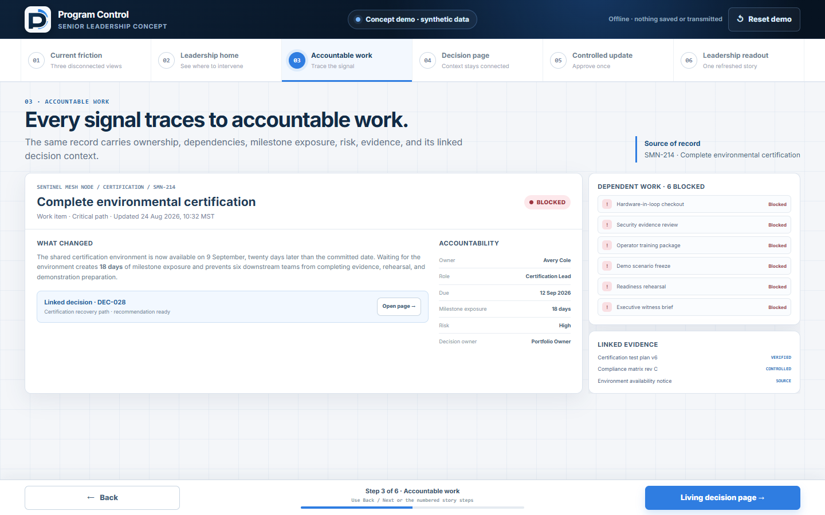
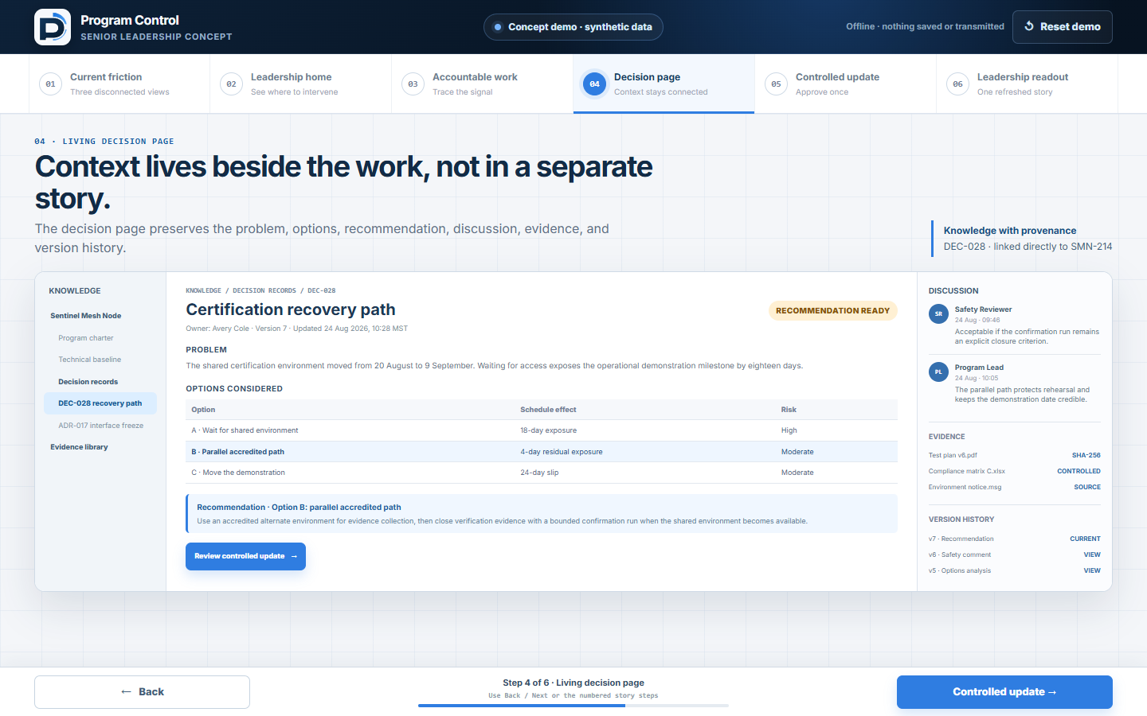
PROGRAM CONTROL · LEADERSHIP CONCEPT
04
Every signal opens to accountable work and evidence.
DEC-028 · LINKED
SMN-214 · Environmental certification
DEC-028 · Options · recommendation · comments · version history
Owner · dependencies · schedule exposure · linked evidence
No re-keying between the signal, work item, and decision page.
CONCEPT DEMO — SYNTHETIC DATA
Notes:
Opening the alert reveals SMN-214, its accountable owner, six dependent items, and eighteen days of schedule exposure. The linked decision page retains the options, recommendation, supporting evidence, discussion, and version history. Leadership can follow the signal to its source without asking someone to reconstruct the story in another briefing.
[Sources]
- Internal: Program Control leadership concept prototype; synthetic work item SMN-214 and decision DEC-028.

Slide 5
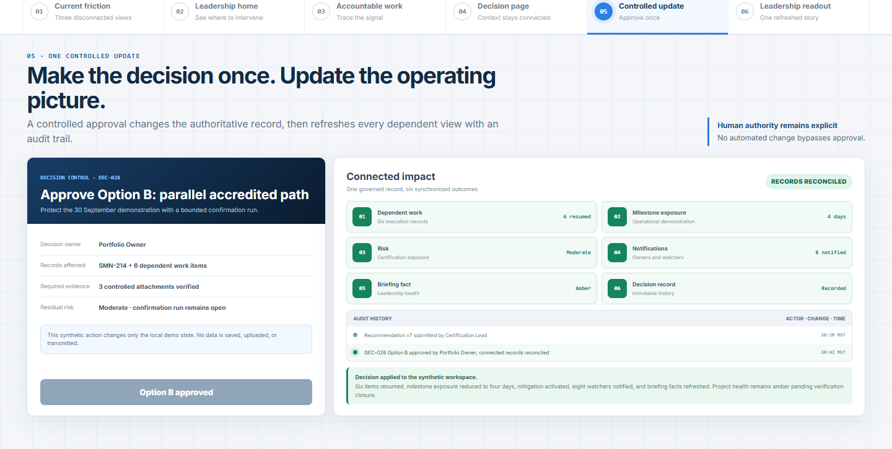
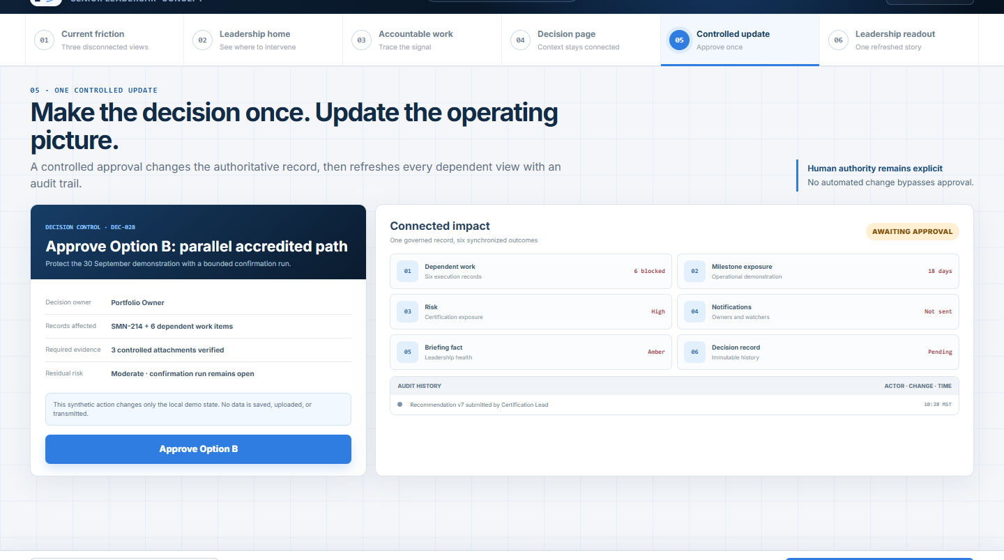
PROGRAM CONTROL · LEADERSHIP CONCEPT
05
One approval updates the operating picture.
BEFORE
18 days exposed
6 blocked
Decision pending
AFTER
4 days exposed
6 resumed
Mitigation active
Project remains AMBER until verification evidence closes.
SCHEDULE · RISK · AUDIT · NOTIFICATIONS · BRIEFING
CONCEPT DEMO — SYNTHETIC DATA
Notes:
We approve Option B in the concept. The decision changes from pending to approved; six dependent items resume; milestone exposure falls from eighteen to four days; and the risk treatment, audit trail, notification, and briefing facts refresh. The project remains amber until verification evidence closes—the system records mitigation, not false certainty.
[Sources]
- Internal: Program Control leadership concept prototype.
- All before-and-after values are synthetic scenario behavior, not measured operational results.

Slide 6
PROGRAM CONTROL · LEADERSHIP CONCEPT
06
This is a workflow concept—not a production claim.
DEMONSTRATED TODAY
Connected path from signal to evidence
Controlled decision and traceable update
Leadership readout from the same synthetic record
CONCEPT DEMO
SYNTHETIC DATA
Standalone HTML
No APIs · no persistence
No authenticated data
MUST BE PROVEN BEFORE A PILOT
Workflow fit and migration fidelity
Security, scale, integrations, and operations
CONCEPT DEMO — SYNTHETIC DATA
Notes:
Everything shown is a front-end concept with synthetic data. It demonstrates the intended workflow and leadership experience; it does not claim completed migration, enterprise scale, or production readiness. Those are the questions a pilot would have to prove.
[Sources]
- Internal: Senior Leadership Concept Demo brief, 2026-08-24.

Slide 7
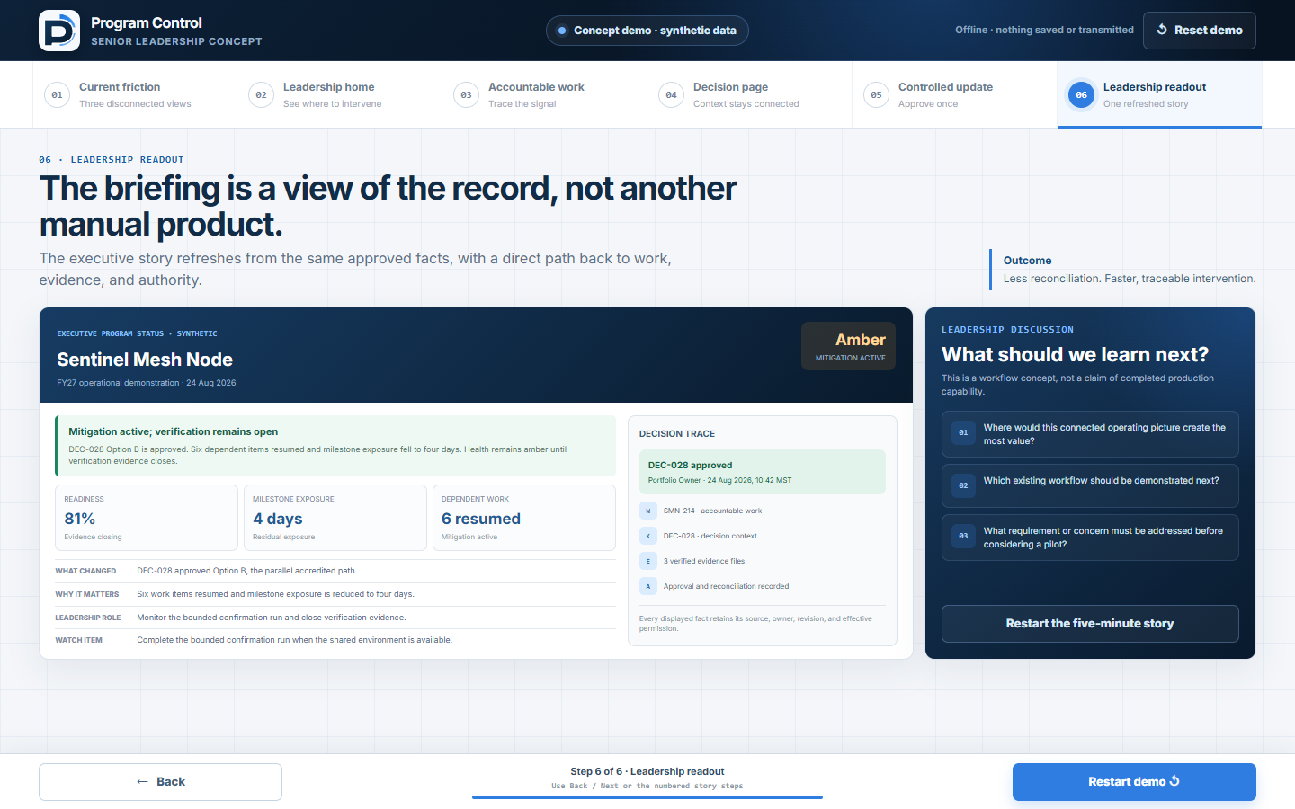
PROGRAM CONTROL · LEADERSHIP CONCEPT
07
What should we test next?
1
Where would this create the most value?
2
Which existing workflow should be demonstrated next?
3
What requirement or concern must be addressed before considering a pilot?
Feedback and requirement discovery — not approval or funding.
CONCEPT DEMO — SYNTHETIC DATA
Notes:
The purpose today is not approval to buy or deploy. We want to identify the highest-value workflow, the next scenario worth making real, and the requirement that could stop a pilot. Capture the answers directly and use them to define the next prototype and evaluation criteria.
[Sources]
- Internal: Program Control leadership concept prototype; synthetic leadership readout.

Slide 8
PROGRAM CONTROL · APPENDIX
08
The production path extends Program Control’s control boundary.
EXPERIENCE
EXISTING
PROPOSED
Dashboard · roadmap · search · briefing
Work and knowledge views
GOVERNANCE
EXISTING
PROPOSED
Identity · role scope · revisions · audit
Page permissions · comments · approvals
RECORD CORE
EXISTING
PROPOSED
Projects · risks · files · projections
Normalized work · pages · migration ledger
PLATFORM
EXISTING
PROPOSED
Worker · D1 · R2
Queues · notifications · webhooks
Concept demo · standalone HTML · no APIs or persistence
CONCEPT DEMO — SYNTHETIC DATA
Notes:
Program Control already documents an authenticated workspace boundary, scoped roles, D1/R2 storage, revisions, audit, and connected projections. The replacement path would extend that foundation with normalized work and page records, richer knowledge versioning, permission-aware search, and asynchronous event handling. The concept demo itself uses none of these services.
[Sources]
- Internal: Program Control README.md, Connected Records, multi-tenant workspace, authentication, roadmap, and Knowledge Hub sections.
- Internal: Program Control ENTERPRISE-READINESS.md, Decision and Priority 1 sections.

Slide 9
PROGRAM CONTROL · APPENDIX
09
Migration should be staged, verified, and reversible.
Inventory
Map
Rehearse
Freeze + delta
Verify
Read-only window
VERIFICATION GATE
Counts and references reconcile
Permissions are preserved
Attachment checksums pass
User acceptance is complete
Atlassian remains authoritative until each team’s cutover.
No bidirectional synchronization.
CONCEPT DEMO — SYNTHETIC DATA
Notes:
Migrate one team at a time. Inventory workflows and customizations, trial the mapping, rehearse the import, freeze the source, apply the final delta, and verify objects, permissions, references, and attachments. Preserve each migrated Atlassian area as read-only for thirty days rather than creating a fragile bidirectional sync.
[Sources]
- Internal: Approved Jira and Confluence replacement implementation plan, 2026-08-22.

