Slide 1
U
SENIOR LEADERSHIP CONCEPT
ONE GOVERNED RECORD
Unified Project
Management Suite
WORK
KNOWLEDGE
A credible path to replace fragmented Jira, Confluence, and manual reporting with one governed operating record.
LEADERSHIP
Execution and context stay connected from task to decision to briefing.
Five-minute product walkthrough - feedback and requirement discovery
Concept prototype - 24 August 2026
Notes:
This is a product concept for a Unified Project Management Suite: one place for delivery work, governed knowledge, decisions, risks, evidence, and leadership status. The purpose today is to test workflow value and requirements - not to represent completed production capability.
[Sources]
- Internal: Unified Project Management Suite interactive prototype; all displayed people, projects, dates, metrics, and outcomes are synthetic.

Slide 2
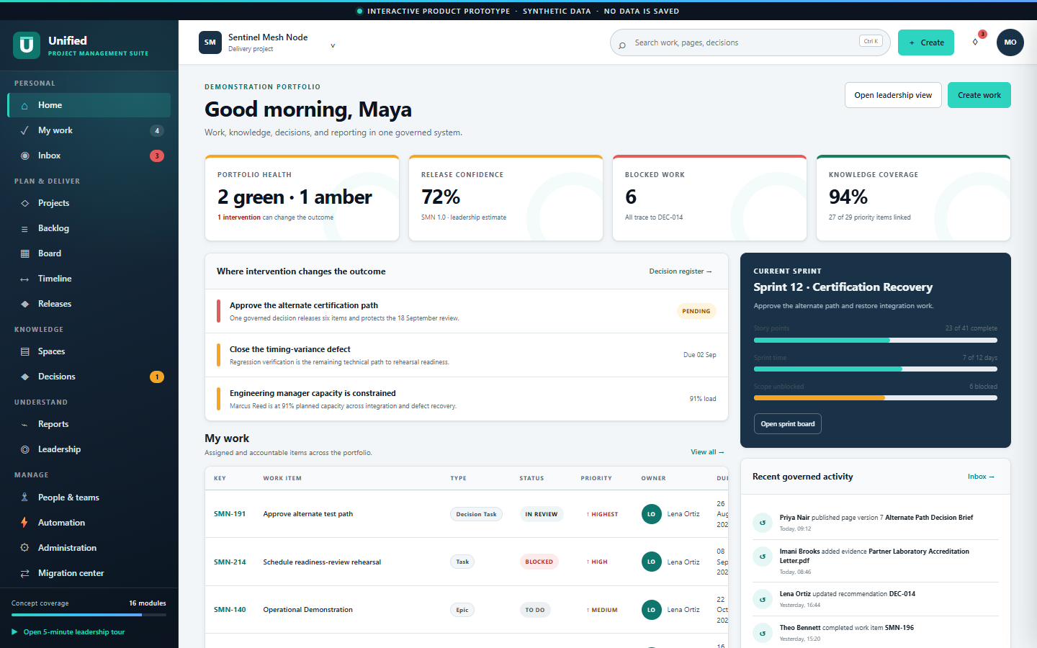
U
UNIFIED PROJECT MANAGEMENT SUITE · LEADERSHIP CONCEPT
02
One operating record removes the handoffs.
The home view combines the questions that are split across Jira, Confluence, spreadsheets, and briefing slides today.
WORK
Accountable scope, owner, status, dependencies, and dates
KNOWLEDGE
Living context, evidence, comments, and version history
LEADERSHIP
Current intervention, risk, forecast, and briefing facts
INTERACTIVE PRODUCT PROTOTYPE - SYNTHETIC DATA - NOT PRODUCTION CAPABILITY
Notes:
The replacement argument is not simply fewer licenses. It is the removal of reconciliation. This home view connects portfolio health, current intervention, accountable work, the sprint, recent governed activity, and leadership facts. Every signal can be opened and traced.
[Sources]
- Internal: Unified Project Management Suite interactive prototype; all displayed people, projects, dates, metrics, and outcomes are synthetic.

Slide 3
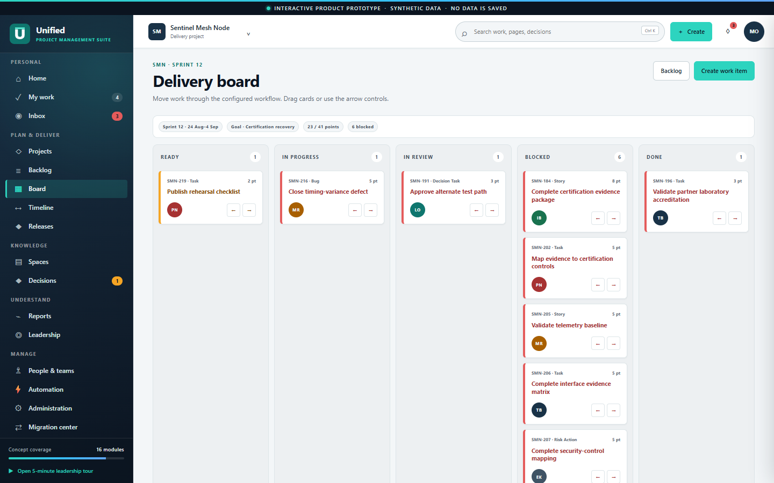
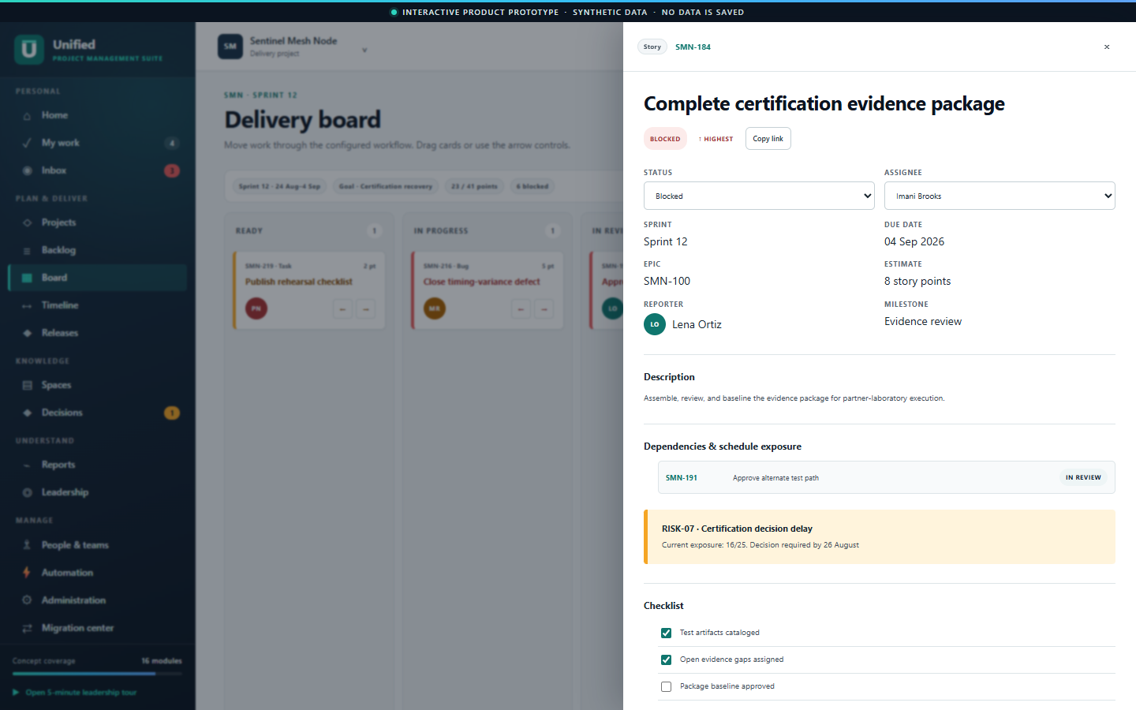
U
UNIFIED PROJECT MANAGEMENT SUITE · LEADERSHIP CONCEPT
03
Delivery stays accountable without losing context.
Board, backlog, workflow, issue detail, dependencies, risk, evidence, comments, and activity operate as one work record.
SPRINT FLOW
ACCOUNTABLE DETAIL
Move work with drag, controls, or editable status.
Follow a blocker directly to its decision and evidence.
INTERACTIVE PRODUCT PROTOTYPE - SYNTHETIC DATA - NOT PRODUCTION CAPABILITY
Notes:
This is the Jira-replacement surface. Teams can plan the sprint, move cards, edit status and ownership, add comments, complete checklists, and inspect a full activity trail. The important difference is that dependencies, linked risk, knowledge pages, and evidence are not separate references that must be reconciled later.
[Sources]
- Internal: Unified Project Management Suite interactive prototype; all displayed people, projects, dates, metrics, and outcomes are synthetic.

Slide 4
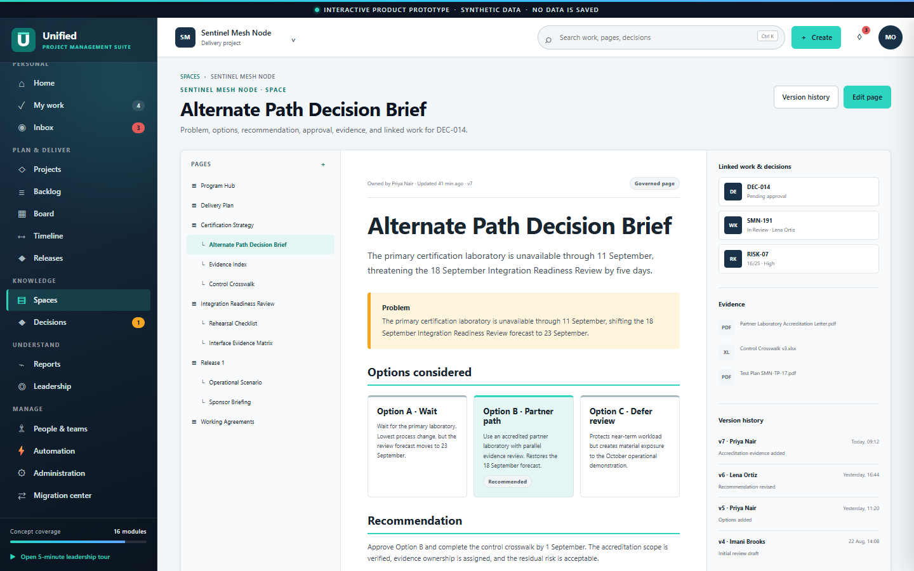
U
UNIFIED PROJECT MANAGEMENT SUITE · LEADERSHIP CONCEPT
04
Knowledge remains a living part of delivery.
The Confluence-style page is governed, versioned, searchable, and directly linked to decisions, work, risk, comments, and evidence.
INTERACTIVE PRODUCT PROTOTYPE - SYNTHETIC DATA - NOT PRODUCTION CAPABILITY
Notes:
This is the Confluence-replacement surface. The page tree supports structured spaces, the page contains the actual problem, options, and recommendation, and the right side shows connected work, decision, risk, evidence, and version history. Edits publish a new in-memory version and enter the same audit record.
[Sources]
- Internal: Unified Project Management Suite interactive prototype; all displayed people, projects, dates, metrics, and outcomes are synthetic.

Slide 5
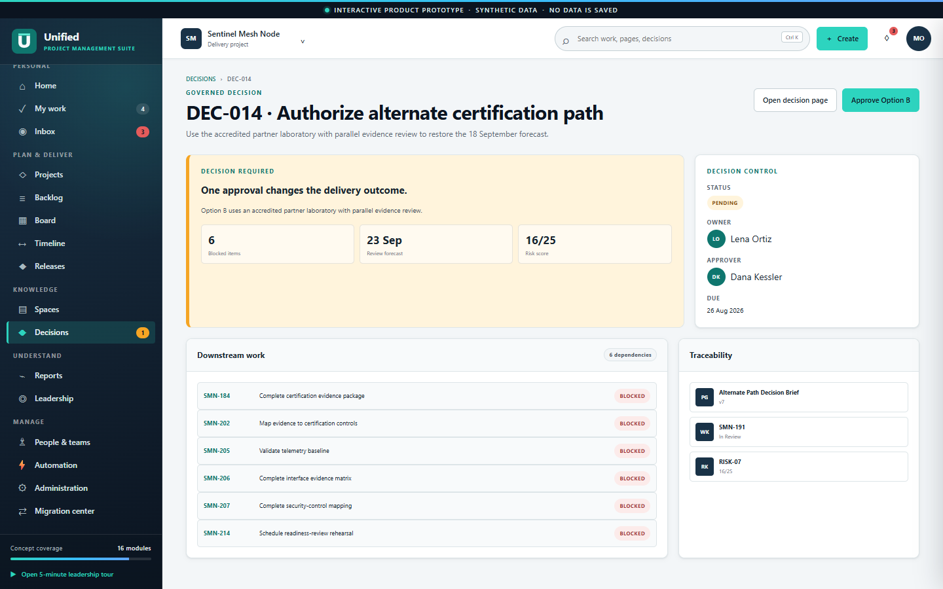
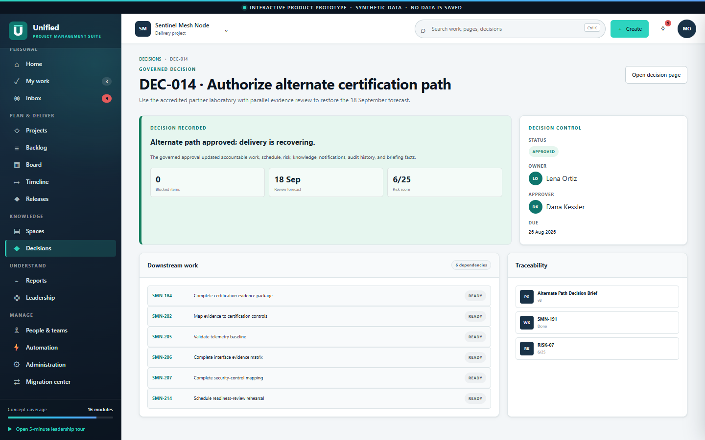
U
UNIFIED PROJECT MANAGEMENT SUITE · LEADERSHIP CONCEPT
05
One decision updates the operating picture.
Approval is not a note. It changes execution, schedule, risk, history, knowledge, notifications, and briefing facts together.
BEFORE
AFTER
→
6 blocked · 23 Sep · 16/25
0 blocked · 18 Sep · 6/25
INTERACTIVE PRODUCT PROTOTYPE - SYNTHETIC DATA - NOT PRODUCTION CAPABILITY
Notes:
This is the central demonstration. Before approval, six items are blocked, the review forecast is 23 September, and the risk score is 16 out of 25. Approving Option B completes the decision task, moves six dependencies to Ready, restores 18 September, reduces risk to 6, publishes the decision page version, notifies owners, records audit events, and refreshes leadership status.
[Sources]
- Internal: Unified Project Management Suite interactive prototype; all displayed people, projects, dates, metrics, and outcomes are synthetic.

Slide 6
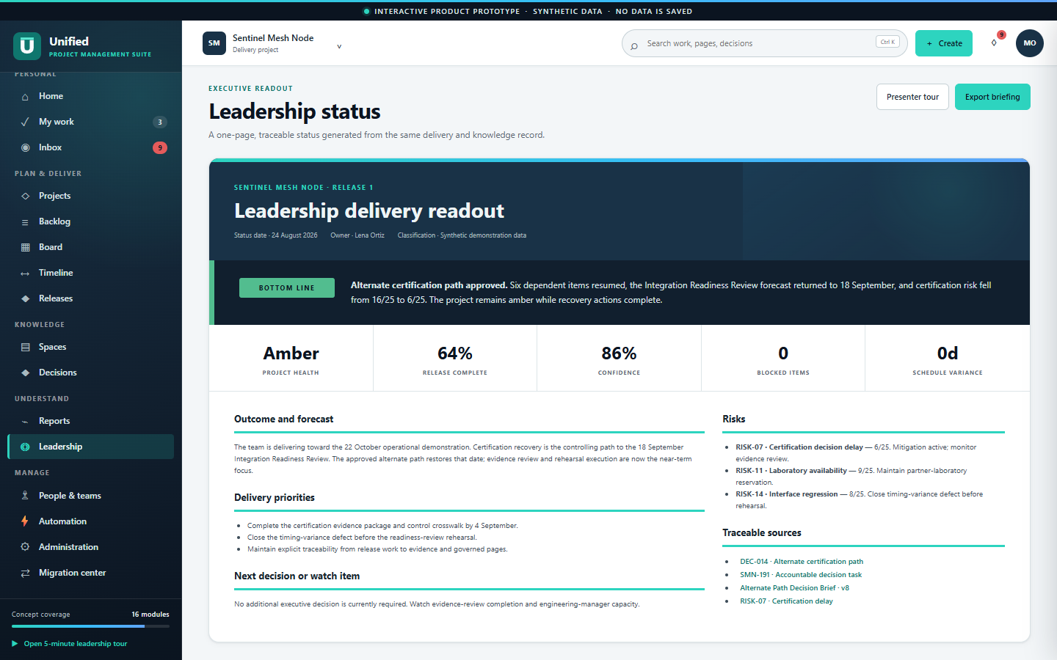
U
UNIFIED PROJECT MANAGEMENT SUITE · LEADERSHIP CONCEPT
06
Leadership sees traceable status, not a reconstructed slide.
The one-page readout refreshes from the same governed facts and links back to the decision, work, page, and risk.
DEMONSTRATED NOW
Connected workflow value
Session-only interactions
Synthetic traceability
Offline leadership tour
PRODUCTION MUST PROVE
Identity and permissions
Scale, security, integrations
Migration fidelity and support
INTERACTIVE PRODUCT PROTOTYPE - SYNTHETIC DATA - NOT PRODUCTION CAPABILITY
Notes:
Leadership no longer depends on a manually assembled slide. The same source record produces the briefing and keeps every claim traceable. This prototype demonstrates workflow value and product breadth. It does not yet demonstrate production identity, permissions, data durability, scale, integration, security, or migration fidelity.
[Sources]
- Internal: Unified Project Management Suite interactive prototype; all displayed people, projects, dates, metrics, and outcomes are synthetic.

Slide 7
U
UNIFIED PROJECT MANAGEMENT SUITE · LEADERSHIP CONCEPT
07
Which workflow should we prove next?
The next step is requirement discovery - not approval or funding.
01
Where would a connected work-and-knowledge record create the most value?
02
Which existing Jira or Confluence workflow should be demonstrated next?
03
What requirement or concern must be addressed before considering a pilot?
Live prototype: azjester.github.io/J-C_Replace/
INTERACTIVE PRODUCT PROTOTYPE - SYNTHETIC DATA - NOT PRODUCTION CAPABILITY
Notes:
I would close by asking these three questions and recording the answers as requirements. We need to learn where the workflow has the highest value, which current workflow would make the strongest next demonstration, and what concern must be resolved before a pilot is even considered.
[Sources]
- Internal: Unified Project Management Suite interactive prototype; all displayed people, projects, dates, metrics, and outcomes are synthetic.

Slide 8
U
UNIFIED PROJECT MANAGEMENT SUITE · APPENDIX
08
Production requires a governed enterprise architecture.
Illustrative target architecture for Q&A - the current concept is only the presentation layer and in-memory state.
EXPERIENCE
Web application · mobile-responsive views · accessible workflows
CONTROL
SSO · role and attribute permissions · policy enforcement · approvals
DOMAIN
Work · knowledge · decisions · risks · search · reports · automation
DATA
Relational records · object storage · immutable audit · indexing · backup
INTEGRATION
GitHub · Microsoft Teams · BI · email · migration connectors · APIs
INTERACTIVE PRODUCT PROTOTYPE - SYNTHETIC DATA - NOT PRODUCTION CAPABILITY
Notes:
For Q&A: a production suite needs more than the visible workflows. It needs an accessible web experience, enterprise identity and authorization, explicit domain services, durable data and audit storage, search and asynchronous automation, and supported integrations. The concept implements none of those production services.
[Sources]
- Internal: Unified Project Management Suite interactive prototype; all displayed people, projects, dates, metrics, and outcomes are synthetic.
- Architecture is illustrative and intentionally technology-agnostic; it is not an approved target-state design.

Slide 9
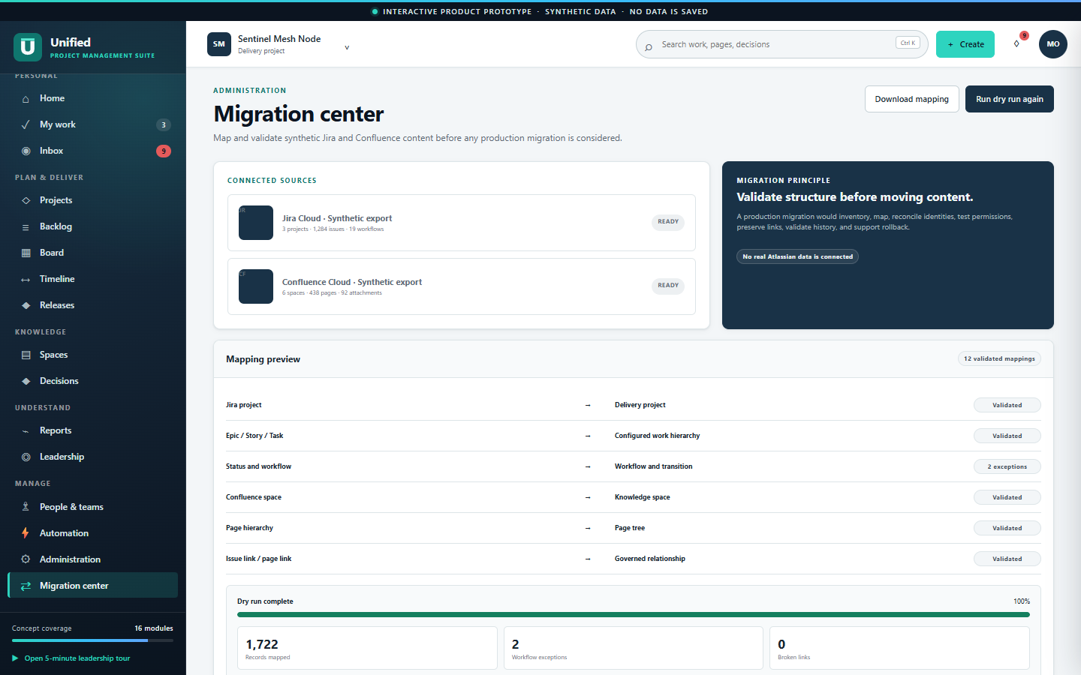
U
UNIFIED PROJECT MANAGEMENT SUITE · APPENDIX
09
Migration should prove fidelity before cutover.
Atlassian remains authoritative until records, permissions, history, attachments, and links pass agreed validation gates.
Inventory
→
Map
→
Dry run
→
Reconcile
→
Pilot
→
Cut over
VALIDATION GATES
Identity and permissions
Workflow and field mappings
Page hierarchy and version history
Attachments and cross-links
Counts, exceptions, and rollback
INTERACTIVE PRODUCT PROTOTYPE - SYNTHETIC DATA - NOT PRODUCTION CAPABILITY
Notes:
For Q&A: migration should be staged and reversible. Inventory the source estate, define mappings, run synthetic and representative dry runs, reconcile every exception, pilot with a bounded team, and cut over only after validation gates pass. Avoid bidirectional synchronization; keep Atlassian authoritative until each team's approved cutover.
[Sources]
- Internal: Unified Project Management Suite interactive prototype; all displayed people, projects, dates, metrics, and outcomes are synthetic.

