Slide 1
Hotel booking analaysis
CAPSTONE PROJECT
Presented By:
Azaaudeen A
Akshaya college of engineering and technology
B.E.Computer science engineering

Slide 2
OUTLINE
Problem Statement
Proposed System/Solution
System Development Approach
Algorithm & Deployment
Result
Conclusion
Future Scope
References

Slide 3
Problem Statement
Have you ever wondered when the best time of year to book a hotel room is? or the optimal length of stay in order to get the best daily rate? What if you wanted to predict whether or not a hotel was likely to receive a disproportionately high number of special requests?
This hotel booking dataset can help you explore those questions! This data set contains booking information for a city hotel and a resort hotel, and includes information such as when the booking was made, length of stay, the number of adults, children, and/or babies, and the number of available parking spaces, among other things. All personally identifying information has been removed from the data. Explore and analyse the data to discover important factors that govern the bookings.

Slide 4
Proposed Solution
Explore The Dataset
After loading the dataset, we explored the data and divided the project into three different categories as – 1. Hotel wise, 2. Booking wise, and remaining part 3. Type of rooms, meal, customer, market segment, countries etc.
Null values Treatment
Our dataset contains a large number of null values which might tend to disturb our operations hence we replaced them at the beginning of our project in order to get a better result.
Exploratory Data Analysis
In this section, we tried to make some insights, finding out reasons for variation of bookings across different years with types of hotels, different countries and so on.

Slide 5
System Approach
Libraries used to build the model
We have used Python version 3 to its following packages:
Pandas
Matplotlib
Seaborn
Sklearn

Slide 6
System Approach
System requirements:
Operating system: windows
Programming language: Python
Data visualization tools: Matplotlib, Seaborn
Hardware: Server with sufficient CPU, memory and storage for handling large datasets.

Slide 7
Algorithm & Deployment
In this,we describe the machine learning algorithm chosen for the hotel booking analysis. The algorithm structure as follows:-
Exploratory Data Analysis: Descriptive Statistics: Use pandas to calculate mean, median, mode, standard deviation, and other summary statistics. Correlation Analysis: Use seaborn or pandas to generate a correlation matrix to identify relationships between variables.
Predictive Modeling: Linear Regression: For predicting continuous variables like the number of bookings. Decision Trees and Random Forests: For both regression and classification tasks. Support Vector Machines (SVM): For classification tasks. . Time Series Analysis: If the data includes time components, use ARIMA, Prophet, or LSTM for forecasting future bookings. Clustering: K-Means Clustering: To segment customers or bookings into different clusters. Visualization Techniques (Matplotlib and Seaborn): . Bar Charts: For categorical data visualization (e.g., number of bookings per hotel). . Histograms: For distribution of numerical variables (e.g., distribution of booking lead times). . Box Plots: To show the spread and outliers in the data.

Slide 8
Result
We learned that
Almost 38% of bookings were canceled.
More than 64% of the population booked the City hotel.
More than double bookings were made in 2016, compared to the previous year. But the bookings decreased by almost 12% next year.
Most bookings were made from July to August. And the least bookings were made at the start and end of the year.
Portugal, the UK, and France, Spain and Germany are the top countries from most guests come, more than 84% come from these 5 countries.
Most people stay for one, two, or three. -> For Resort hotel, the most popular stay duration is three, two, one, and four days respectively. -> For City hotel, most popular stay duration is one, two, seven(week), and three respectively
Couple (or 2 adults) is the most popular accommodation type. So hotels can make arrangement plans accordingly

Slide 9
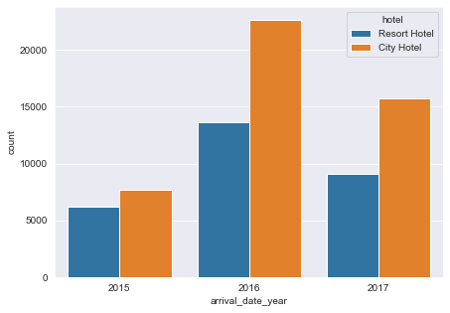
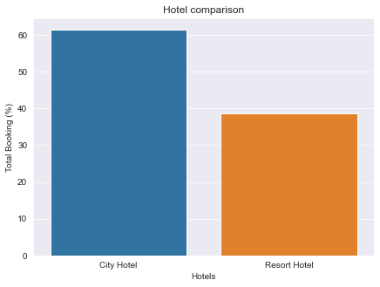
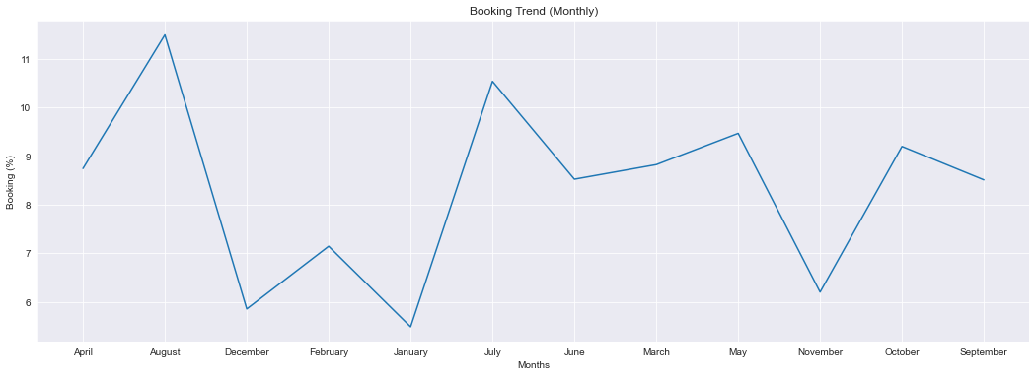
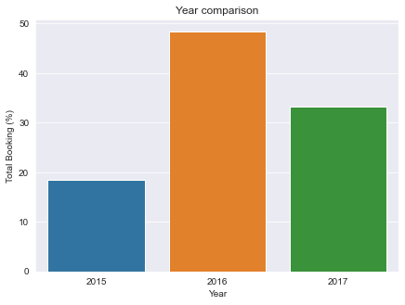

Slide 10
Conclusion
At last but not the least we reached the end of our exercise. Starting with loading the data so far, we have done EDA, null values treatment, data cleaning, processing and finally with analysis we found some insights such as reason for booking cancellation, Peak season, Types of hotels customer preferred, the time to get best rate of booking on daily rate basis etc.

Slide 11
Future scope
The hotel booking analysis project has a wide range of future scopes, including:
Real-time Analytics: Develop a real-time analytics system to track bookings, cancellations, and customer behavior, allowing hotels to respond promptly to changing demand and optimize their operations.
Customer Segmentation: Enhance customer segmentation analysis to identify high-value customer groups, preferences, and behavior patterns, enabling hotels to create targeted marketing campaigns and personalized services.
Mobile App Development: Create a mobile app for customers to book and manage their stays, providing a seamless user experience and enhancing customer engagement.
Big Data Analytics: Leverage big data analytics to process large datasets, including social media, customer reviews, and market trends, to gain deeper insights and improve hotel operations.
Cloud Deployment: Migrate the project to the cloud to ensure scalability, flexibility, and cost-effectiveness, and to enable hotels to access the analytics platform from anywhere.
By exploring these future scopes, the hotel booking analysis project can continue to evolve and provide valuable insights, enabling hotels to stay competitive and improve their overall performance.

Slide 12
References
Analytics Vidhya
Matplotlib doc.
Pandas Doc.
Stack overflow.
Kaggle.
Geeks for geeks
Target point

Slide 13
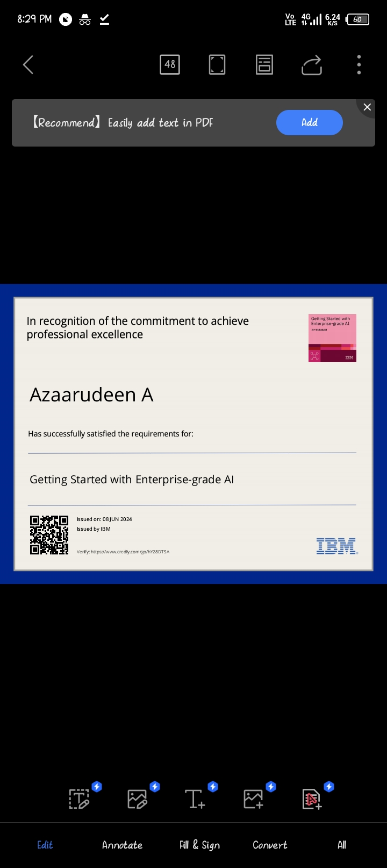
course certificate 1

Slide 14
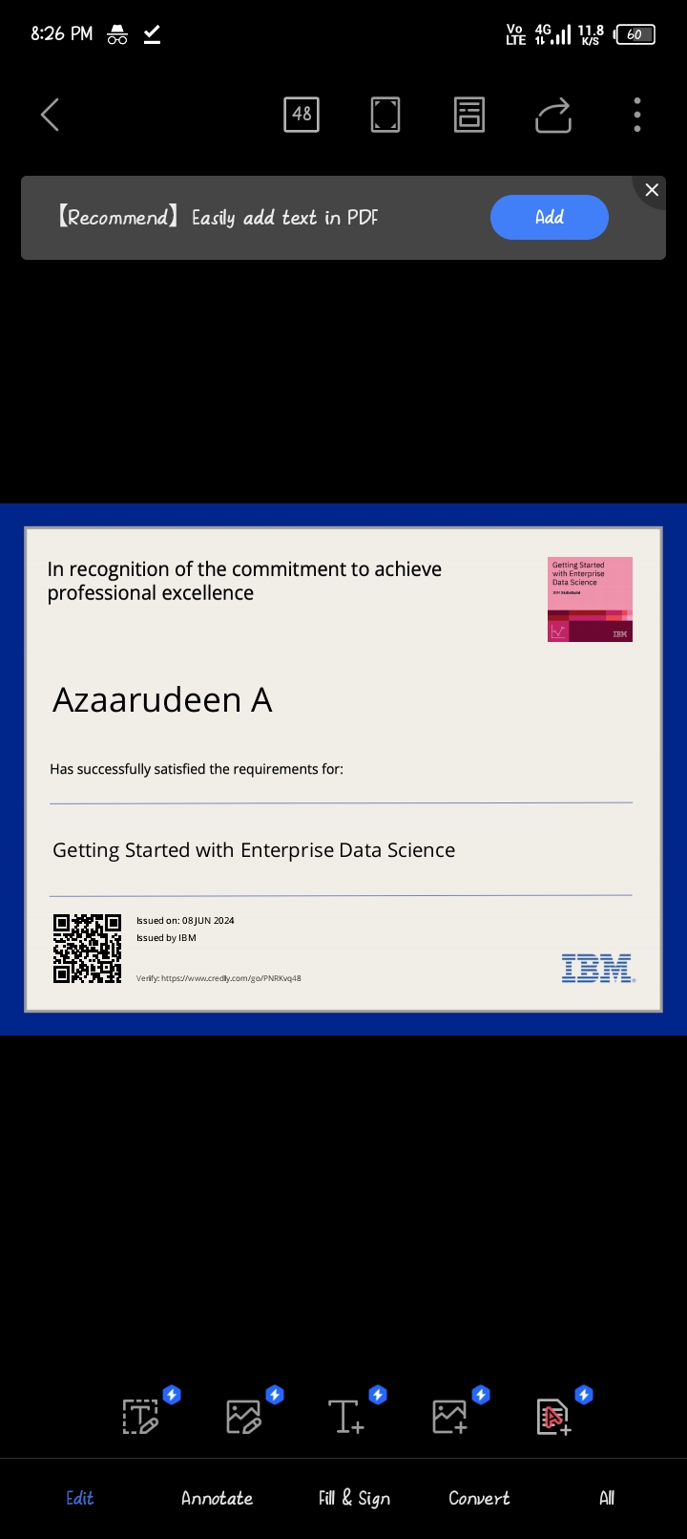
course certificate 2

Slide 15
THANK YOU

