Slide 1
WEB APPLICATION
CRAWLER

Slide 2
TABLE OF CONTENTS
01
03
About the Project
Sneak Peek
Project Goals
02
04
Our team
What is this project about ?
more details about the project
What we can achieve by this project?

Slide 3

ABOUT THE PROJECT
A Web crawler is an internet bot that browses WWW (World Wide Web). It is sometimes called as spider bot or spider. The main purpose of it is to index web pages by brute forcing the directories of the web page and save it for latter use.

Slide 4
—Patrick Engebretson
“If I had 6 h to chop down a tree, I’d spend the first four of them sharpening my axe.”

Slide 5


OUR GOALS
Get insight
Hidden files/dirs
Knowing most of the web application directores can be very helpful to search for vulnerabilities in it
Looking for hidden directories can be useful to find sensitive information about the web application

Slide 6
SNEAK PEEK
The project consist of two main components
- The main source code that crawl the web application which is dir_Crawler.py
- The wordlist that we will use to brute force directories.
Let’s inspect the source code ….

Slide 7
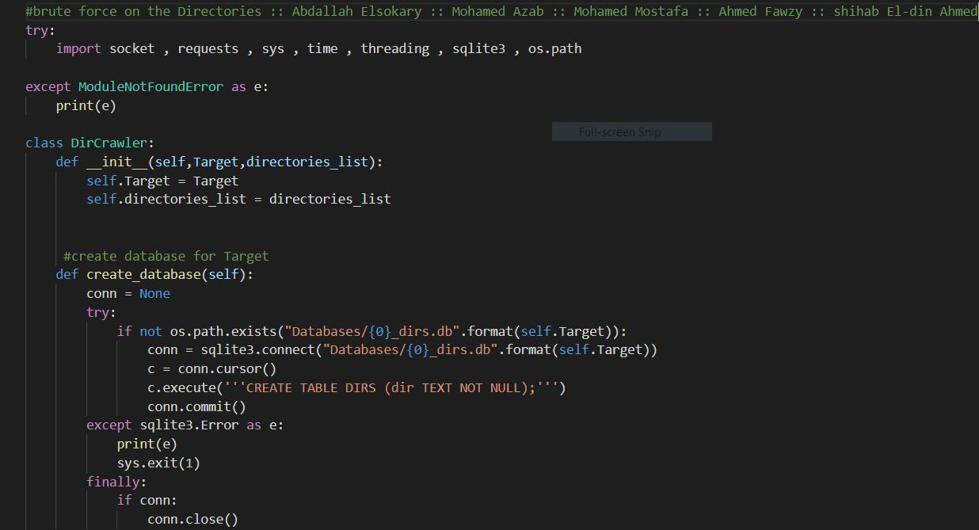

Slide 8
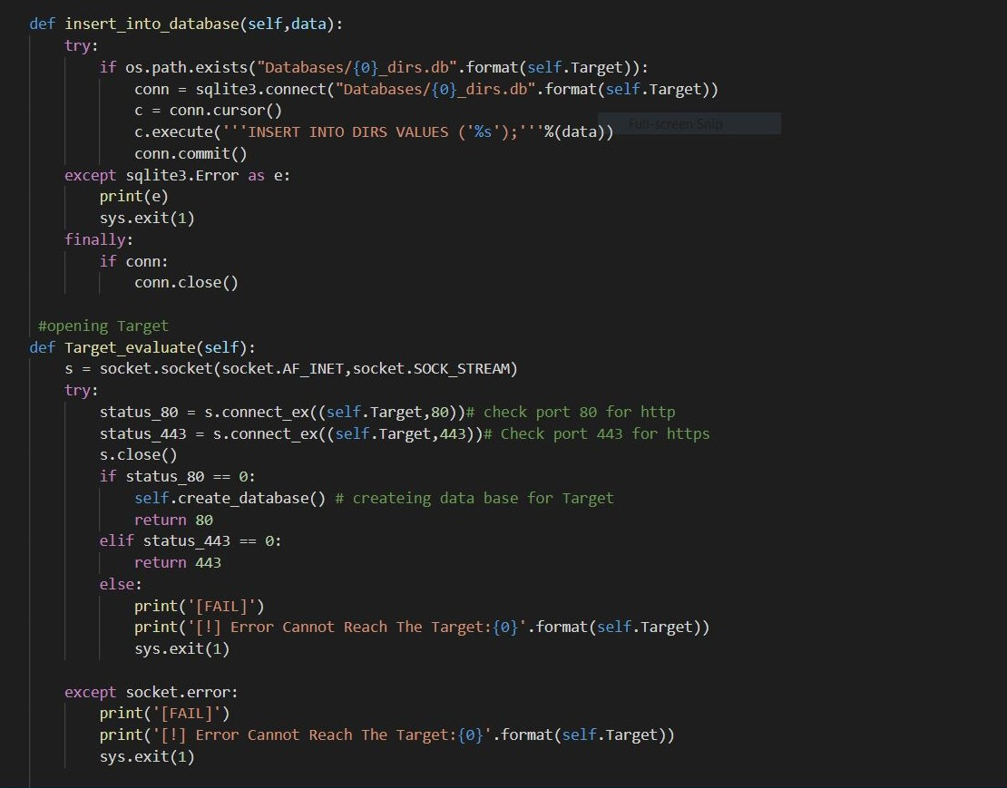

Slide 9
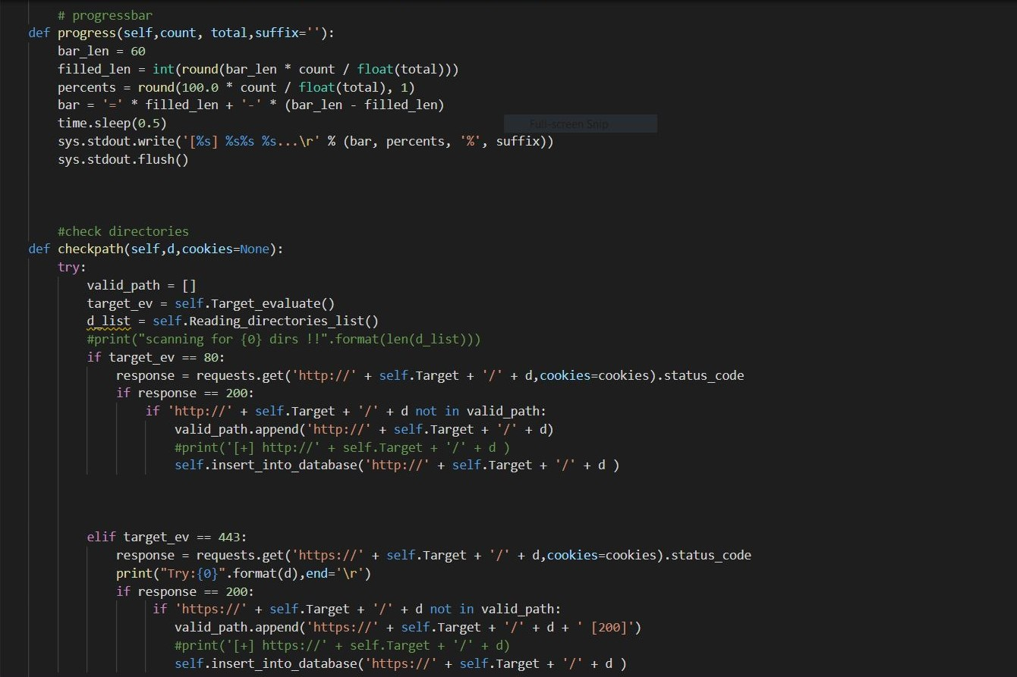

Slide 10
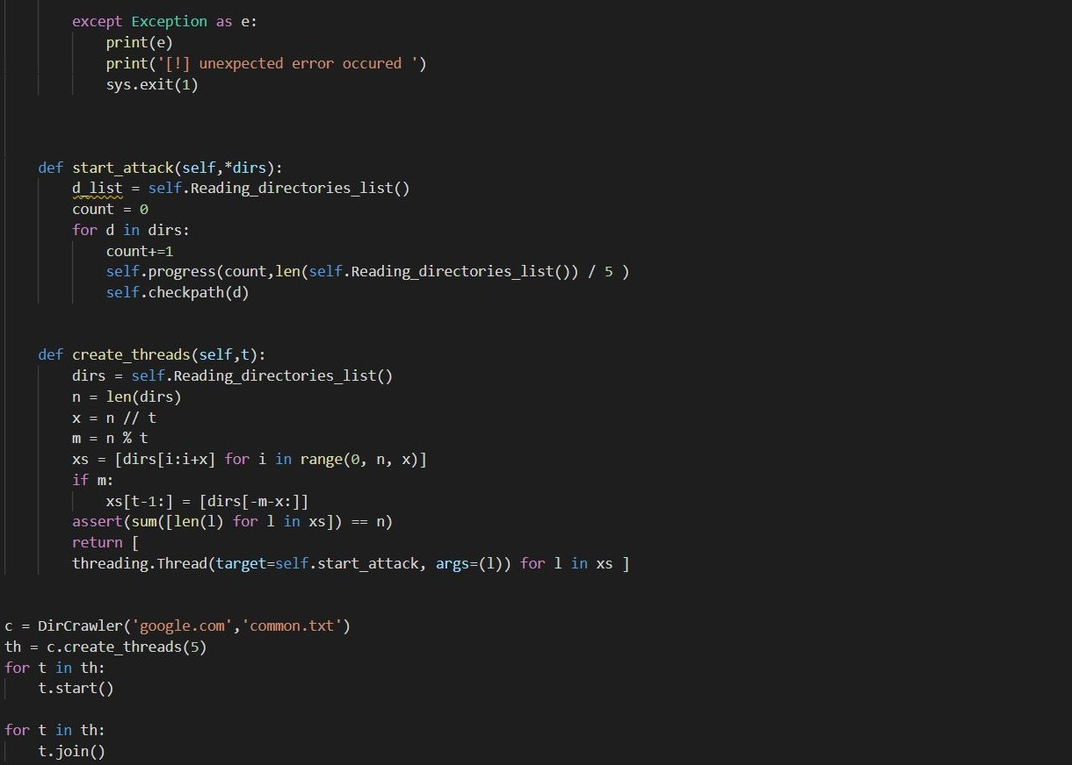

Slide 11
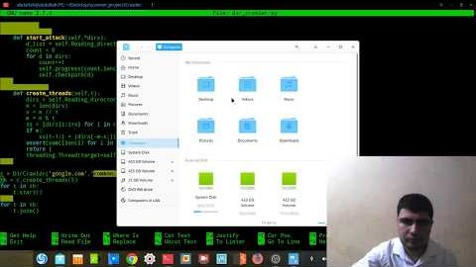
A VIDEO IS A GOOD IDEA
Insert your multimedia content here

Slide 12
THE DARK ARMY
TEAM MEMBERS: Mohamed Azab Mohamed Mostafa Ahmed Fawzy Shihab el-din Ahmed
Coordinator Abdallah Elsokary
Follow-up
Nada Elsayed

Slide 13
THANKS!
Does anyone have any question?

