Slide 1
Direct Infix Evaluator

Slide 2
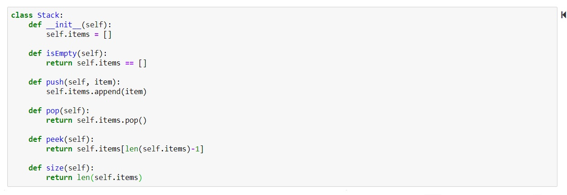
Stack Implementation

Slide 3
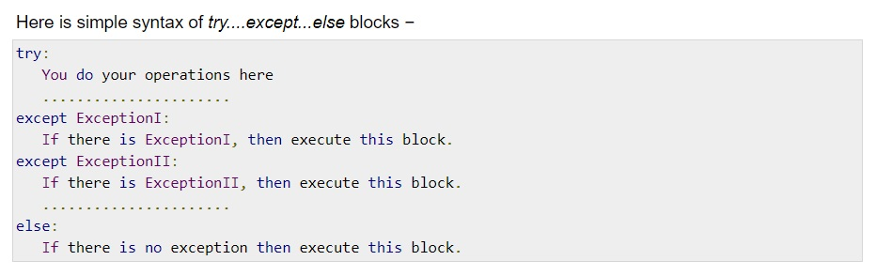
Avoiding Expected Errors

Slide 4
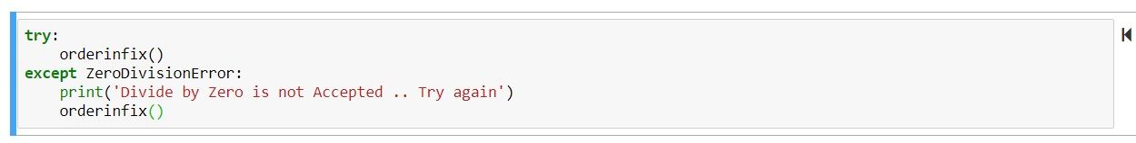
Our Exception

Slide 5
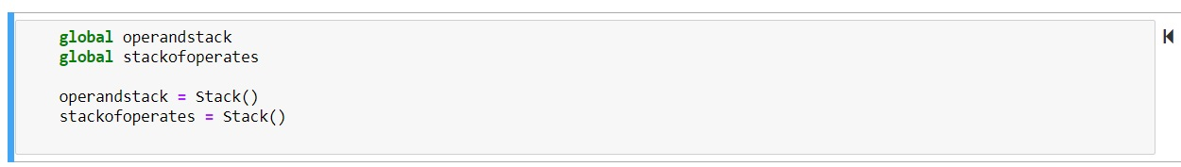
Using global

Slide 6
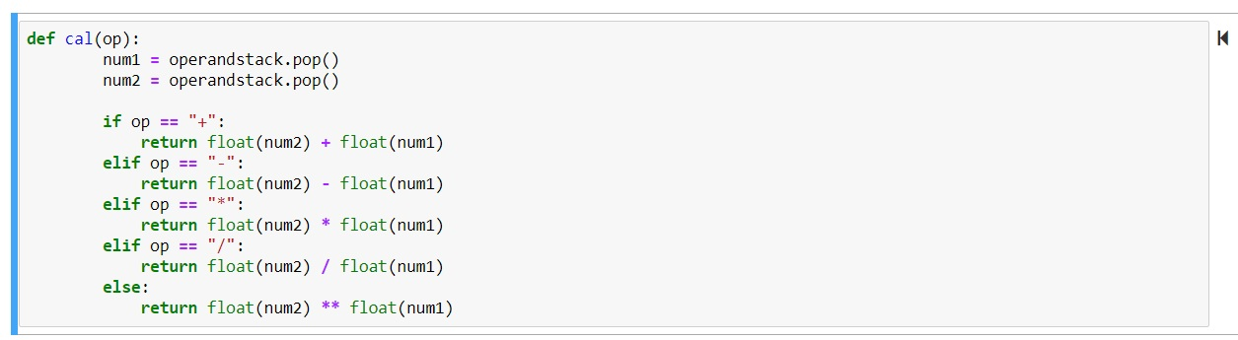
Mathematical Calculation Function

Slide 7
Idea of the code
We should use two stacks. one for the operands and one for the operators.
We used the global so we can use them inside the functions.

Slide 8
How it works?
Scan the token list from left to right.
If the token is digit, push to operandstack.
If the token is “(“, push to stackofoperates.
If the token is “)“, pop from stackofoperates then:
If the popped isn’t “(“, make a calculation then push it to operandstack and pop from stackofoperates again.
If the popped is “(“, do nothing.
If the token is an operator, and while stackofoperates isn’t empty:
If priority of the token <= priority of the peek, pop from stackofoperates, make a calculation then push it to operandstack.
If priority of the token > priority of the peek, push it to stackofoperates.

Slide 9
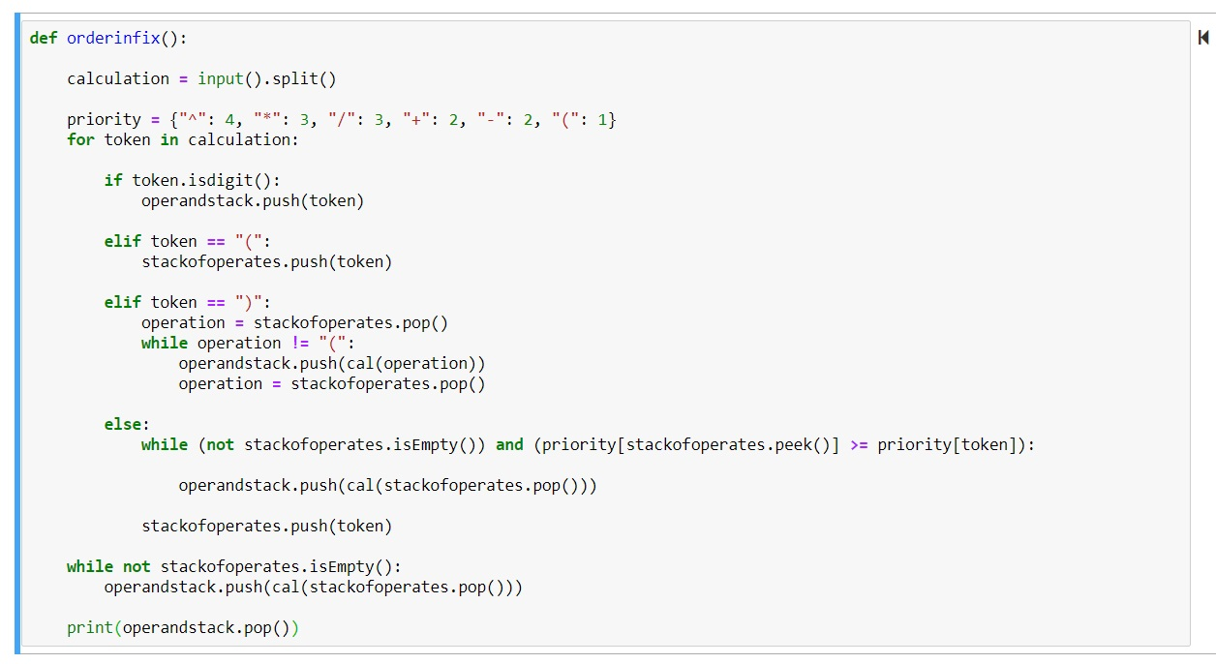
Order Infix Function

Slide 10
Test Case ( A + B * Z ^ 2 ) * C ^ D / E - F
Ps. | operandstack | stackofoperates
 |  | (
 | A | (
 | A | (+
 | AB | (+
 | AB | (+*
 | ABZ | (+*
 | ABZ | (+*^
 | ABZ2 | (+*^
Y=Z^2 | ABY | (+*
T=B*Y | AT | (+
R=A+T | R | (

Slide 11
Test Case ( A + B * Z ^ 2 ) * C ^ D / E - F
Ps. | operandstack | stackofoperates
 | R
 | R | *
 | RC | *
 | RC | *^
 | RCD | *^
H=C^D | RH | *
V=R*H | V | /
 | VE | /
X=V/E | X | -
 | XF | -
 | FINAL RESULT

Slide 12
Test Case ( 12 + 3 * 4 ^ 2 ) * 2 ^ 4 / 5 - 9
Ps. | operandstack | stackofoperates
 |  | (
 | 12 | (
 | 12 | (+
 | 12 3 | (+
 | 12 3 | (+*
 | 12 3 4 | (+*
 | 12 3 4 | (+*^
 | 12 3 4 2 | (+*^
Y=Z^2 | 12 3 16 | (+*
T=B*Y | 12 48 | (+
R=A+T | 60 | (

Slide 13
Test Case ( 12 + 3 * 4 ^ 2 ) * 2 ^ 4 / 5 - 9
Ps. | operandstack | stackofoperates
 | 60
 | 60 | *
 | 60 2 | *
 | 60 2 | *^
 | 60 2 4 | *^
H=C^D | 60 16 | *
V=R*H | 960 | /
 | 960 5 | /
X=V/E | 192 | -
 | 192 9 | -
 | 183

Slide 14
أحمد خالد عبد الحميد
عبد الله وليد عبد الله الشناوي
علي حسن علي
كريم أحمد السيد عبد الله
محمد سعيد أحمد
محمد عز الدين عبد القادر
محمد عزب محمد
محمد ياسر صقر
مصطفى الصياد عيسى
وادي أسامة العزب

Slide 15
Thank you for your listening.

