Slide 1

An Automated Mosaicer
Team 3

Slide 2
Overview
Automated tool to restore torn documents
Simple and intuitive User Interface
Provides fast and accurate results for multiple images

Slide 3
Motivation
Saves labor
Much faster than manual alternative
On-screen visual verification
Applications in archiving and forensics

Slide 4
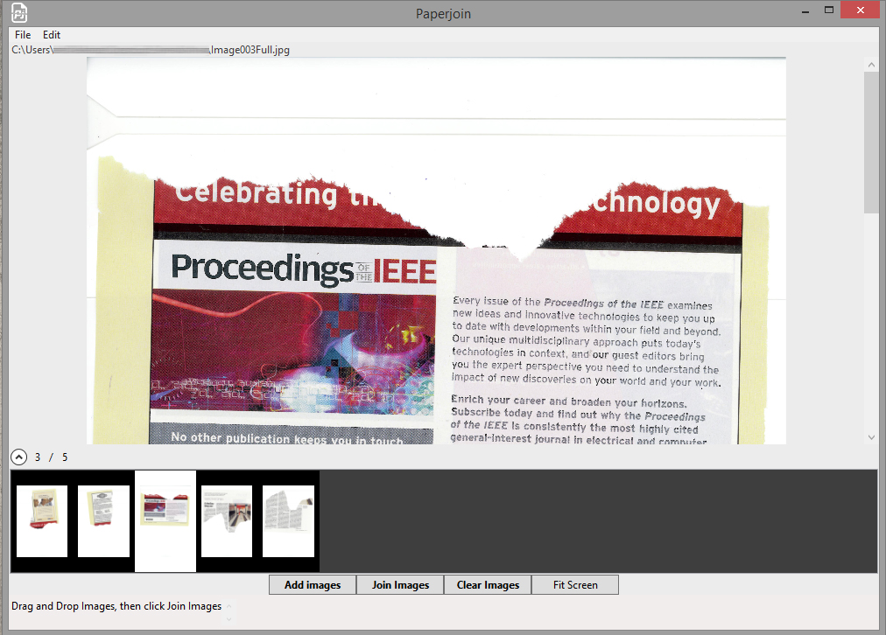
Application Interface

Slide 5
Modular Workflow
User Interface
Image Processing
Image Matching
Image Merging

Slide 6
Image Processing
Foreground Extraction
Calculate Image Entropy (Shannon’s Formula)
Threshold Optimally (Otsu’s method)
Apply Distance Transform
Remove noise morphologically
Extract connected components
Approximate Polygons from image piece boundaries (Ramer-Douglas-Pecker algorithm)
Extract features based on geometry and content

Slide 7
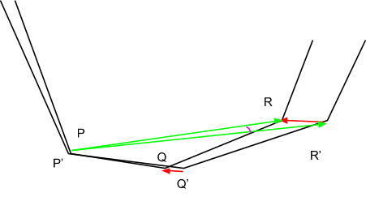
Image Matching
Content-agnostic geometric matching
Compute cumulative angular sum
Match polygons
Content-aware feature matching
Maximize cross-correlation between edges

Slide 8

Image Merging
Employ incremental growth
$mergePoly \left(P\right)$ {
$$S≔ ∪P_{i} , where P_{i} is the i^{th} polygon, i≥2$$
$$R≔ P_{1}$$
$$while \left|S\right|>0 \{$$
$$Select Q such that Q∈S and Q=Best Match with R$$
$$R=R ∪Q$$
$$S=\frac{S}{Q}$$
$$\}$$
$$return R$$
$$\}$$

Slide 9

Optimizations
Fast, custom implementation of image processing functions (OpenCV only used for reading/writing images)
Lowered complexity of image entropy calculation ($O\left(n^{4}\right)$ to $O\left(n^{3}\right)$) and of distance transform ($O\left(n^{4}\right)$ to $O\left(n^{2}\right)$)
Iterative error reduction is much more elegant than commonly-used corner matching

Slide 10
Technical Specifications
Programming Language – C++
Libraries Used – OpenCV
User Interface – Windows Presentation Framework

Slide 11
Future Directions
Region classification – Identify regions of text or image, enhancing context-aware matching
Mutual information – Refine the matching along edges.

