Slide 1

"Analyzing Global Mortality Trends (1970-2010)"
Presenter: Azadeh Asgari
Mentor: Prof. Aritri Debnath

Slide 2
Contents
1. Introduction & Problem Statement
2. Dataset Description
3. Data Preprocessing
4. Exploratory Data Analysis
5. Charts & Findings
6. Conclusion
7. Presenter Profile

Slide 3
Understanding global mortality patterns is essential for identifying public health challenges, allocating resources, and shaping global health policies. This project explores trends over 40 years, focusing on variations by country, age, and sex.
This project analyzes global mortality data from the GBD 2010 study.
Objective: Identify trends and patterns in death rates over time by country, age, and sex.
Notes:
The dataset is from the Institute for Health Metrics and Evaluation. It covers 58,905 records with fields like country, year, age group, sex, and death statistics.

Slide 4
Source: IHME - GBD 2010 Mortality Results (1970–2010)
Rows: 58,905 | Columns: 7
Includes: Country, Year, Age Group, Sex, Number of Deaths, Death Rate per 100,000
Notes:
We cleaned the data by removing commas, converting fields to numeric types, and verifying there were no missing or duplicate values.

Slide 5
- Removed commas from numeric fields
- Converted columns to float
- Checked for missing values and duplicates
- Result: Clean dataset ready for analysis
Notes:
This chart shows a steady increase in global deaths over time, which may reflect both population growth and improved data reporting.

Slide 6

Exploratory analysis shows a consistent increase in total deaths over time, likely due to population growth and improved death reporting mechanisms. This trend prompts further exploration of age, sex, and country-level patterns.

Slide 7
Exploratory Data Analysis
Line chart of total deaths from 1970 to 2010.
Trend shows rising mortality, likely due to population growth or data improvements.
Notes:
The global death count increased steadily from 1970 to 2010. This reflects both population growth and better reporting practices over time.

Slide 8
Charts & Findings
- Total Deaths Trend: Increasing over decades
- Country-wise Analysis: To be expanded
- Age & Sex Impact: Analysis planned
Notes:
This breakdown shows how mortality varies significantly by age and sex. Notably, early childhood and elderly groups tend to have higher death rates.

Slide 9
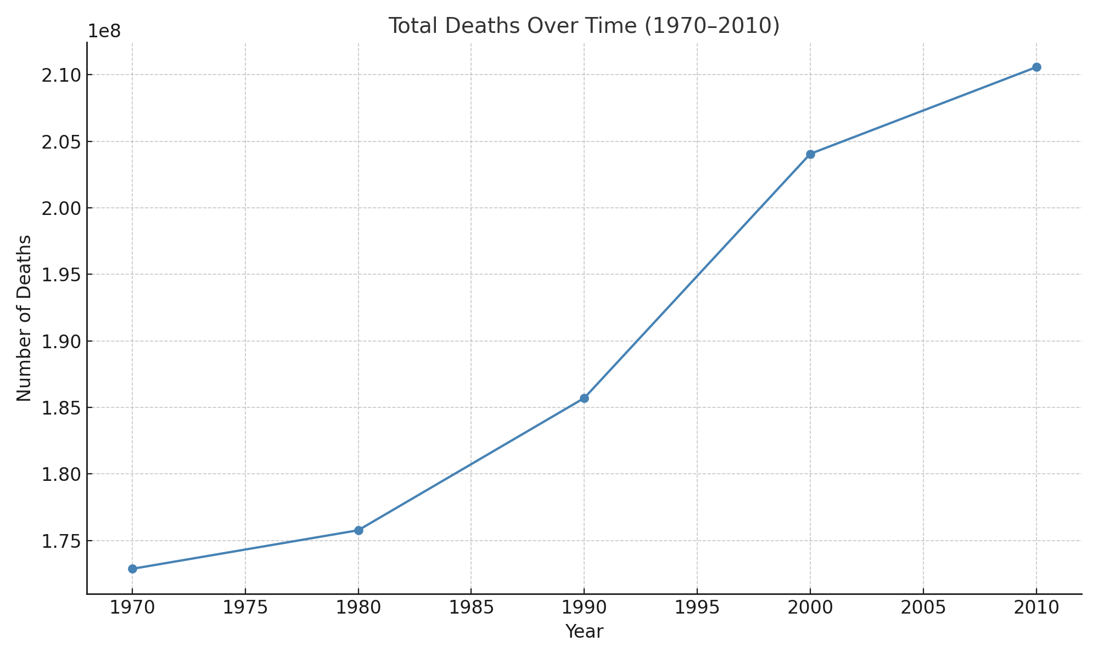
Chart: Total Deaths Over Time
This line chart shows a steady increase in global deaths from 1970 to 2010, likely due to population growth and improved data recording.

Slide 10
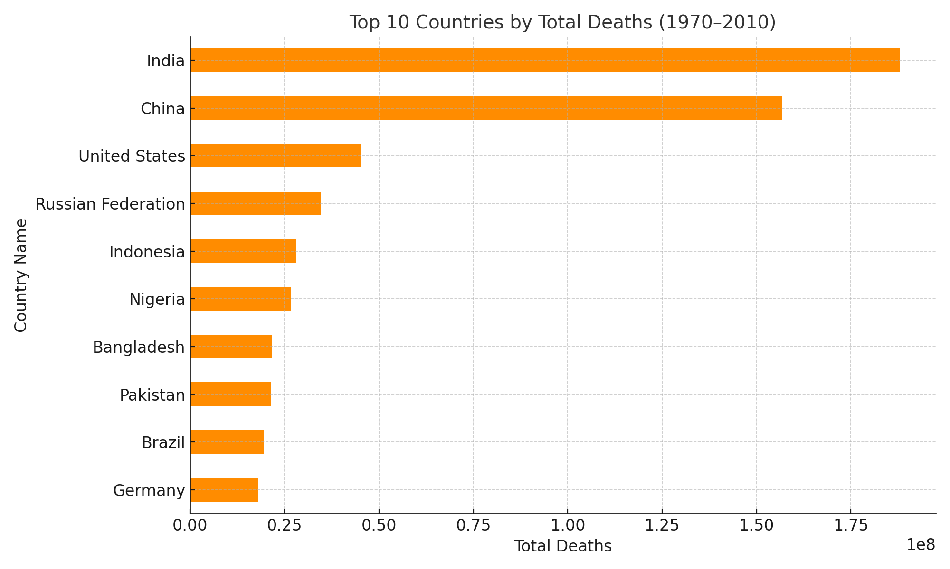
This bar chart shows countries with the highest total deaths Here we see the top 10 countries by cumulative deaths over the period. These are generally the most populous countries or those affected by significant health burdens. over the period — often large populations or regions with conflicts or poor health systems.

Slide 11
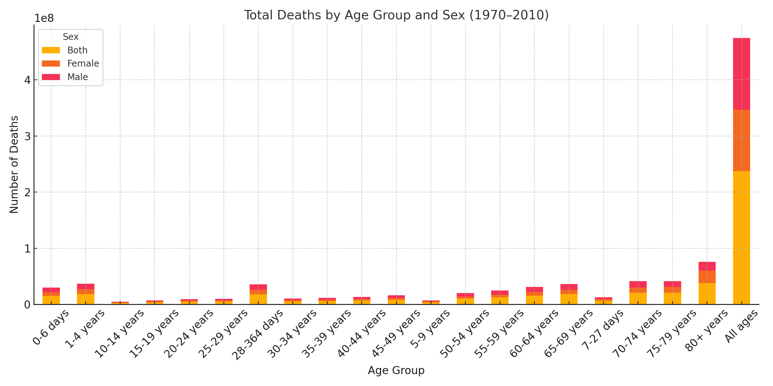
- Global deaths increased steadily from 1970 to 2010, likely influenced by population growth and better data. - Countries with high total deaths are often the most populous; those with high death rates may face greater health challenges. - Infant and elderly groups remain the most vulnerable. - Future research should explore regional health investments, causes of death, and prevention opportunities.

Slide 12
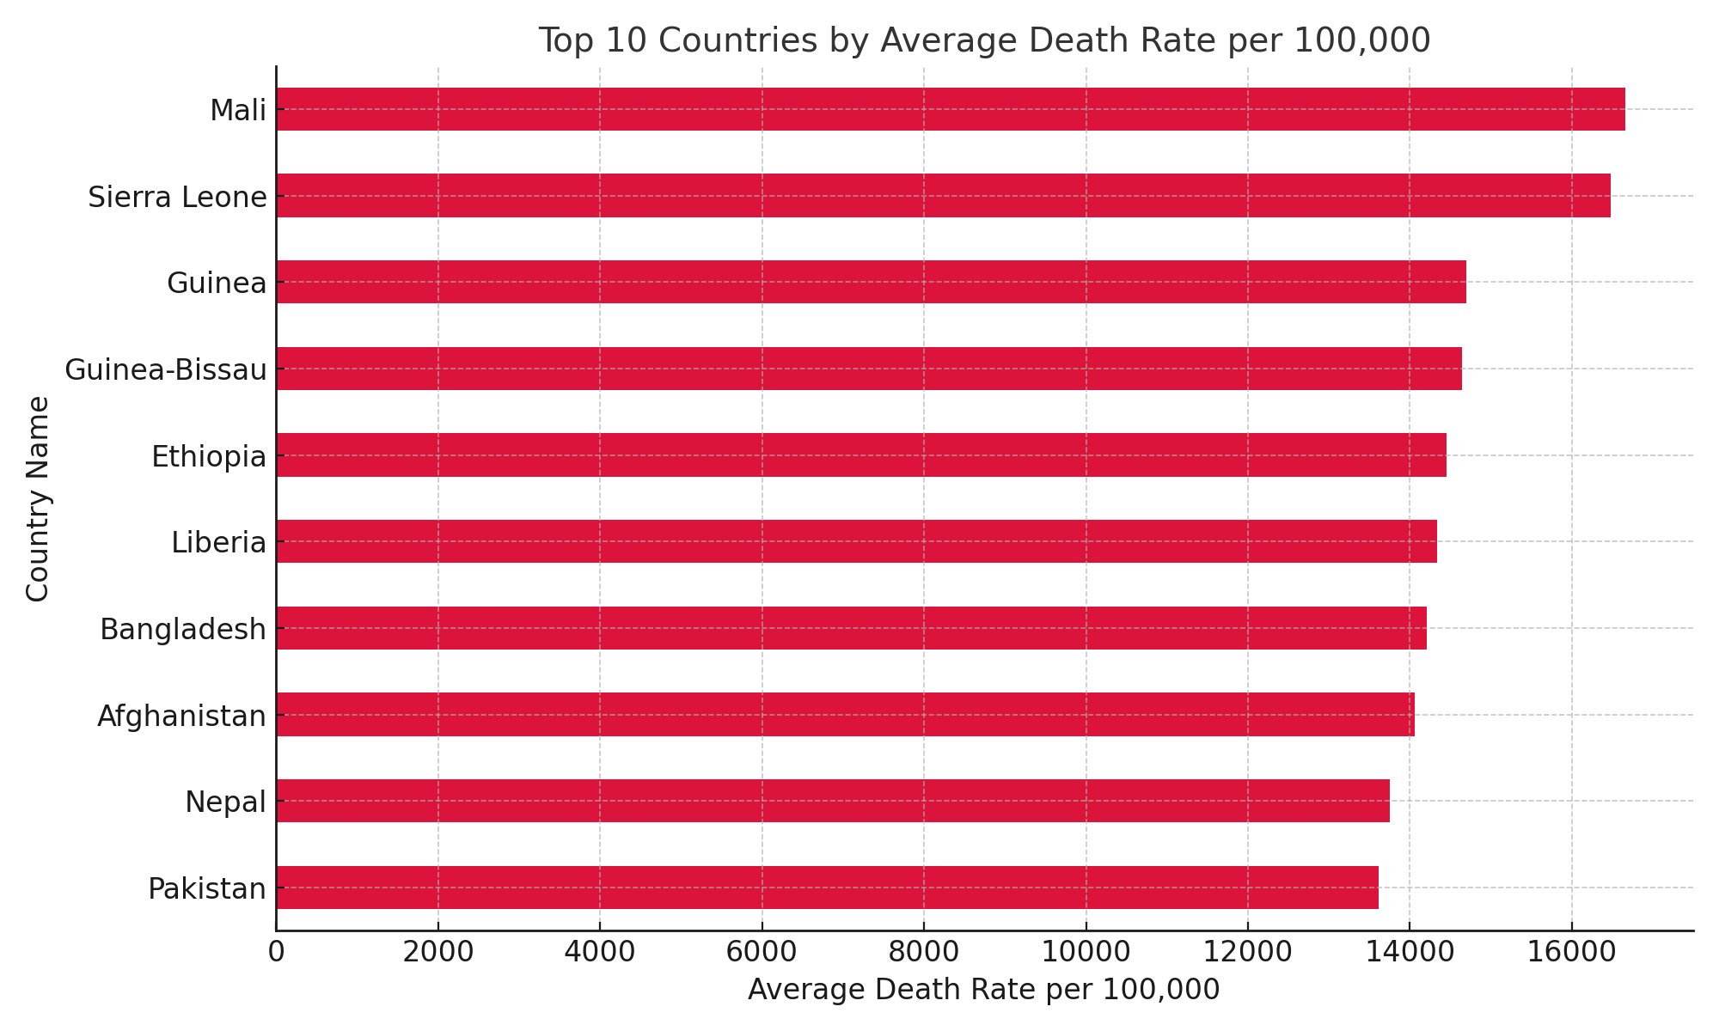
Average death rate per 100,000 gives a fairer comparison across populations. High rates suggest deeper public health issues or demographic effects. Unlike total deaths, this chart adjusts for population size. These countries have the highest death rates per 100,000, revealing deeper health system issues.
Notes:
This chart ranks countries by their average death rate over the 40-year period. It adjusts for population, offering a more accurate view of health outcomes. These countries may face specific public health challenges or historical events influencing mortality.

Slide 13
Conclusion
Initial analysis shows upward trend in global deaths.
Further analysis can explore regional, age, and sex-specific trends.
Supports public health planning and prioritization.
Notes:
In conclusion, the GBD 2010 data reveals consistent global mortality trends and highlights areas for deeper demographic and regional analysis.

Slide 14

Presenter Profile
Name: Azadeh Asgari
Role: Data Analyst / Student
Skills: Python, Data Visualization, Public Health Analytics

