Slide 1
Enterprise Programmering 1 Lesson 01: Introduction
Dr. Andrea Arcuri

Slide 2

Course Info
12 lessons, once a week
Check TimeEdit for possible changes of time and rooms
4-hour lectures
Between 2 and 4 hours of teaching
Remaining time is for exercises and questions
Focus on coding and exercises
Enterprise systems

Slide 3
Course Material
Git repository: https://github.com/arcuri82/testing_security_development_enterprise_systems
Module “intro”
Note: pull often, as material can get updated throughout the course

Slide 4
Necessary Tools
JDK 8
not any other version, but exactly 8
Git
Maven
An IDE (I strongly recommend IntelliJ IDEA)
Docker
A Bash command-line terminal
Mac/Linux: use the built-in one
Windows: I recommend GitBash

Slide 5
Goals
Learn about developing enterprise applications, with a focus on how to test and secure them
Access to databases
Business logic with enhanced beans
Server-side rendering with HTML templates
Not only studying theory, but being able to build and deploy a full application

Slide 6
Enterprise Applications
Large business applications
Tens/hundreds of people (developers/managers/etc) involved
Many (different) processes running on many servers
Think about Google, Amazon, Facebook, Netflix, etc.
A web application is usually just the “front-end”, or a not so large application
Backend: databases, (hundreds of) web services, load balancers, gateways, etc.

Slide 7
Enterprise 1 vs Enterprise 2
In this E1 course, we start from building a web application that can use a SQL database
In E2 next semester, we will look more into the backend, with RESTful APIs and microservices
We focus more on backend than frontend, but still we will build full-stack applications

Slide 8
Enterprise 1 vs Web Development
In “Web Development and API Design” (WDAD) we focus on modern frontend with client-side rendering using Single-Page-Applications (SPA), written in JavaScript
plus intro to REST and GraphQL
E1 looks at the more historical perspective of server-side rendering with no JS (just HTML/CSS)
WDAD can be seen as a course between E1 and E2
although most you are taking it in parallel with E1

Slide 9
Technologies
Java Enterprise Edition (JEE)
Data layer (JPA/JTA)
Business logic layer (EJB)
Front-end layer (JSF)
SpringBoot Framework
Testing: Selenium
Deployment: Docker

Slide 10
Spring vs JEE
JEE was the “official” framework for building Java enterprise applications, but not anymore (since 2017)
now it is just a framework like any other
Spring is a different framework made by Pivotal that builds on top the foundations of JEE
As of now, Spring is more widely used, and also a much more pleasant framework to work with
But you cannot really appreciate SpringBoot until you have gone through the blood, sweat and tears of debugging an EJB test using Arquillian to deploy to a WildFly container…

Slide 11
If You Skip Class…
Usually acceptable that a student skips 1-2 classes
You are supposed to attend, although no strict checks
If you skip too many classes, it is YOUR responsibility to catch up and find out what done in class

Slide 12
Java Enterprise Edition (JEE)

Slide 13
What is JEE?
It is a set of specifications of libraries for developing enterprise applications
Think about it as a set of “interfaces”, with different possible implementations
Eg, Hibernate and EclipseLink are two different implementations for the JPA specs

Slide 14
History
1998: JPE (Java Platform for the Enterprise)
At Sun Microsystems, developer of Java
2009: Oracle buys Sun
2013: Java EE 7
2017: Java EE 8
2017: Oracle gives EE to the Eclipse Foundation
now it is called “Jakarta EE”

Slide 15
Java EE Specs in This Course
JPA: Java Persistence API
For database accesses
Bean Validation
For handling constraints on data
EJB: Enterprise Java Beans
For business logic
Servlet
To handle HTTP request
JSF: JavaServer Faces
For building web GUIs
But there is more…

Slide 16
JEE Vendors
You build Java EE applications against its interfaces, but then you need to choose a container to run them
Different vendors and implementations:
RedHat: JBoss and Wildfly
Oracle: GlassFish and WebLogic
IBM: WebSphere
Note that in 2018 IBM did buy RedHat…
Payara Services: Payara
Etc.

Slide 17
Why Containers???
In an ideal world…
JAR/WAR files are smaller, as no need to package all the library implementations
Can run different EE applications on same container
Can deploy on different containers, and not get stuck with a single implementation
In the real world…
Lot, lot of overhead in handling/configuring containers
Much worse testing: less automation, and mismatch between development and production environments
Changing container is far from simple…

Slide 18
“Partial” Containers: Web Servers
Not supporting full JEE specifications
Mainly supporting Servlet and web assets
Tomcat and Jetty are most famous/used ones
Can add needed EE as libraries (eg, Hibernate for JPA)
Can be embedded with the application
Ie self-executable JAR files
Approach used by SpringBoot Framework

Slide 19
Maven

Slide 20
Course Repository
The Git course repository uses Maven: https://github.com/arcuri82/testing_security_development_enterprise_systems
More than 150 Maven submodules, with several layers of nesting
Not uncommon to see something like that in large enterprise systems
Need to understand how Maven works

Slide 21
Build Tools
Maven
Most popular, XML based, my build tool of choice
Verbose, but not a big problem with autocomplete in IntelliJ
Gradle
Popular in Android, script based
Being scripts is its best and worst feature
Good: highly flexible
Bad: harder to maintain and use for new developers in a project
Note: still handling Maven dependency libraries
Ant
Old, not so much in use any more

Slide 22
Role of A Build Tool
Compile your code
Handle complex modularization
Automatically download all needed third-party libraries
Apply custom pre/post processing
Run test cases
Eg, Continuous Integration, fail whole build if any test is failing
Easy to checkout and automatically build your project on a new machine

Slide 23
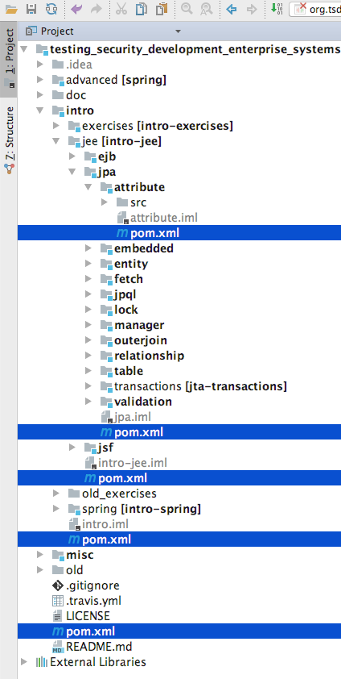
Maven “pom.xml” files
POM: Project Object Model
XML file describing how to build a module
Project can be composed of several modules, with each module having its own pom.xml file
Hierarchy of modules and submodules

Slide 24
<project xmlns="http://maven.apache.org/POM/4.0.0" xmlns:xsi="http://www.w3.org/2001/XMLSchema-instance" xsi:schemaLocation="http://maven.apache.org/POM/4.0.0 http://maven.apache.org/xsd/maven-4.0.0.xsd"> <modelVersion>4.0.0</modelVersion> <groupId>org.tsdes</groupId> <artifactId>tsdes</artifactId> <version>0.0.1-SNAPSHOT</version> <packaging>pom</packaging> <name>Root of TSDES</name> <modules> <module>misc</module> <module>intro</module> <module>advanced</module> </modules>
…
<project> defines a series of namespaces and XSD (XML Schema Definition)
A pom.xml does not contain all kinds of XML tags, but only the ones defined in the XSD schema
When the Maven command runs, it parses the content of the pom.xml file in current directory

Slide 25
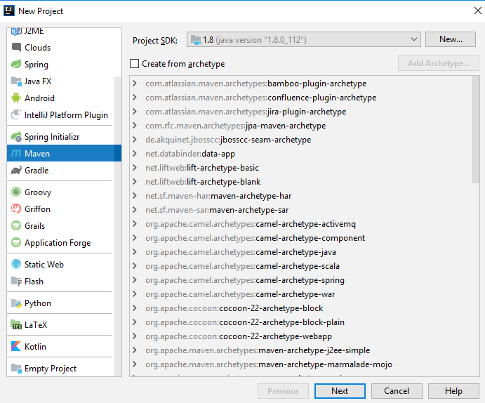
New Projects
Can ask your IDE to create a pom.xml for you…
… or can just copy&paste&adapt an existing one

Slide 26
Module/Artifact Coordinates
Each module/artifact is uniquely identified by 3 tags
<groupId>: a string id identifying a group of related artifacts
<artifactId>: an id that is unique within a group
<version>: the version of the module/artifact, usually in the M.m.p numeric format, ie, Major-Minor-Patch version
Usually ending with SNAPSHOT if under development, and not published
<groupId>org.tsdes</groupId> <artifactId>tsdes</artifactId> <version>0.0.1-SNAPSHOT</version>

Slide 27
Type of Packaging
<packaging>: having value either pom, war or jar
pom: this module is responsible to build other modules, specified in <modules> tag
Useful to share settings that are common among different sub-modules
war: module creates a WAR (Web application ARchive) file
These are the files deployed on EE containers like Wildfly
jar: module creates a JAR (Java ARchive) file
A single file containing your compiled code
Technically, it is a zipped file, so can use “unzip” to open it

Slide 28
Using Maven
You can run Maven from an IDE, but BEST to learn to use it from command line
Need to download recent version
As developers, there are many tasks that are simplified on the command line, or tools with no GUI
We will go back on this point when dealing for example with self-executable jar files and Docker

Slide 29
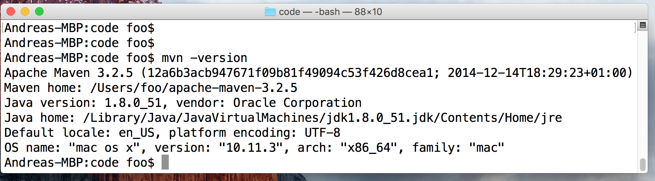
Make sure you can run Maven from a terminal / console / command line
On Windows, you might want to try out GitBash
You need to configure the PATH environment variable to be able to use Maven from command line
If everything is configured, run “mvn -version”

Slide 30
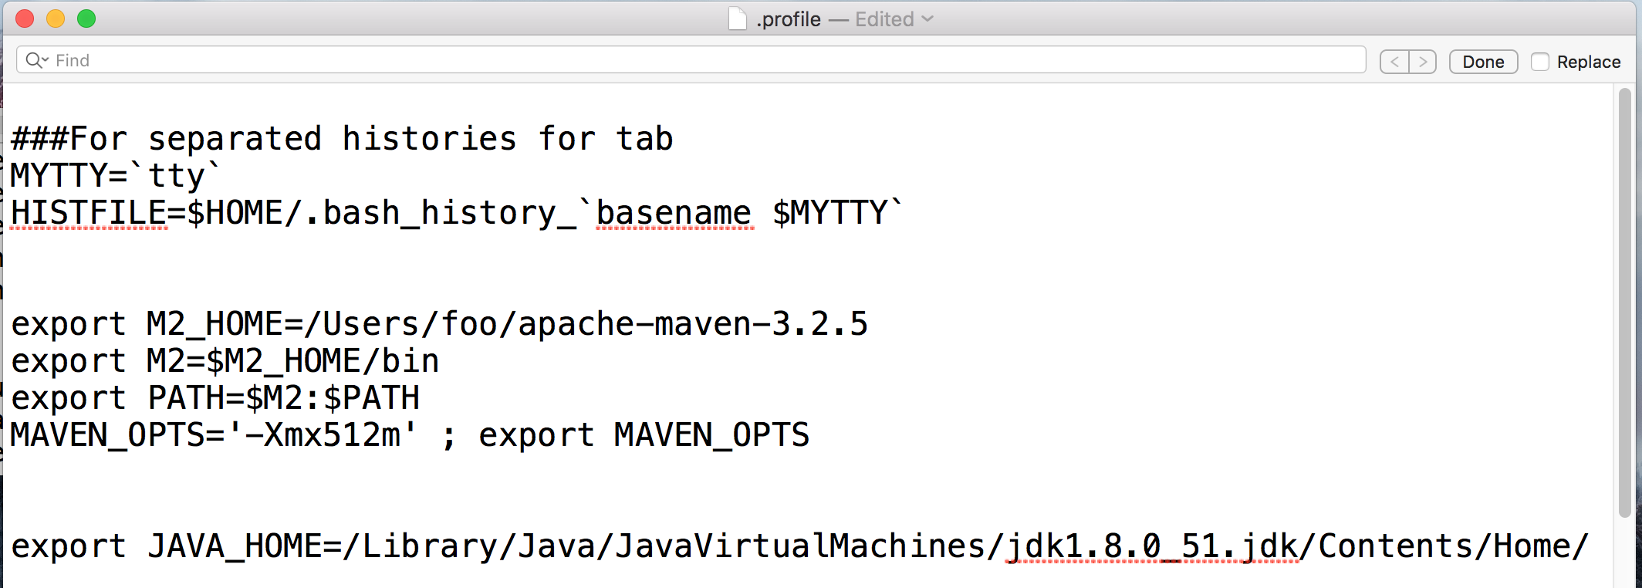
On Mac, need to edit the “.profile” file under your home directory
Of course, actual paths depend on where you install the JDK and Maven…

Slide 31
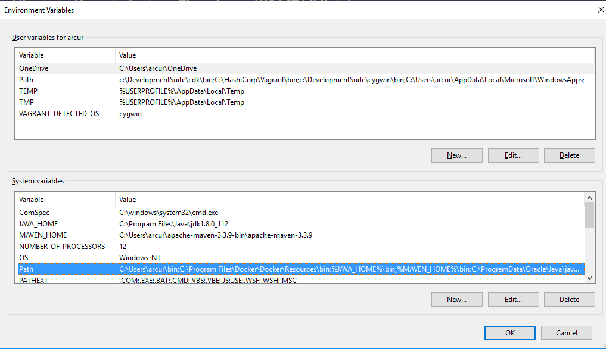
In Windows, setup environment variables for MAVEN_HOME and JAVA_HOME, and then update PATH

Slide 32
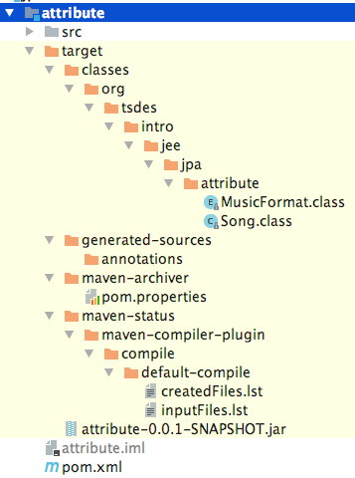
Mvn Clean
“mvn clean”
Used to “clean” your project, ie delete all generated files
When you build a project, a “target” folder is created, where all compiled files (.class files) and other built artifacts (eg, JAR and WAR files) are stored

Slide 33
Maven Main Phases
compile
compile all your .java files into .class
test
run all the unit tests
package
create a WAR/JAR file
verify
run all the integration tests
install
copy the packaged WAR/JAR into your local Maven repository
When you run a phase like “mvn package”, all the previous phases are executed as well
Note: there are more phases, but these here are the most important ones

Slide 34
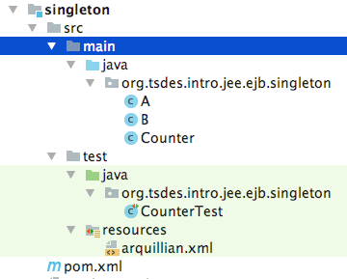
Convention Over Configuration
Maven expect a clear structure of where to put your files
src/main/java: your Java source files
src/main/resources: files that will be added into the JAR/WAR file
src/test/java: sources of test classes
src/test/resources: resources for tests
You can change these defaults, but not recommended

Slide 35
Third-Party Libraries
One of the main benefits of Maven is to automatically download dependencies
Added on pom.xml files
Maven will check if such dependency jar is in your “~/.m2” folder
“~” is home folder of your user account
If not, it will be downloaded
<dependency> <groupId>junit</groupId> <artifactId>junit</artifactId> <version>4.12</version> <scope>test</scope> </dependency>

Slide 36
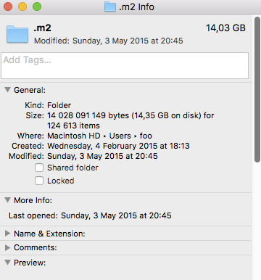
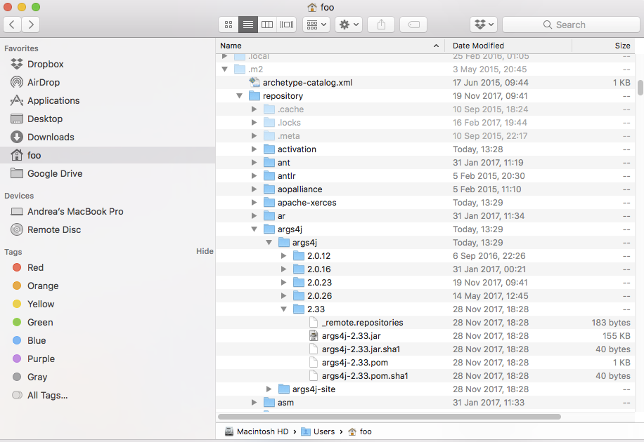
With passing of years, it can grow large (eg 14 GB in my case)
“.” in front of a folder/file makes it “hidden” in Mac/Linux
The “2” just refers to old Maven 2.x version (3.x is backward compatible, but 1.x was not)

Slide 37
Main Dependency Scopes <scope>
compile: default one
provided: needed at compilation, but will not be included in generated JAR/WAR files. Expected to be provided by the runtime (eg, a JEE container)
test: needed only for testing, not in the generated JAR/WAR files
eg, JUnit library to run test cases
import: used for POM dependencies, imported and embedded from the pom.xml of the dependency
Used by libraries with many related dependencies, so you do not need to add each single of them manually

Slide 38
Bill of Materials (BOM)
Example of Spring
Many dependencies, want to keep them in version sync
ie, if 100 related dependencies, with same version number, then want to update version only in 1 place to get all those related dependencies updated and in sync
<dependency> <groupId>org.springframework.boot</groupId> <artifactId>spring-boot-starter-parent</artifactId> <version>${version.springboot}</version> <scope>import</scope> <type>pom</type> </dependency>

Slide 39
// in intermediate pom.xml
<dependencyManagement> <dependencies>
<dependency> <groupId>junit</groupId> <artifactId>junit</artifactId> <version>4.12</version> <scope>test</scope> </dependency>
//in modules building JAR/WAR
<dependencies>
<dependency> <groupId>junit</groupId> <artifactId>junit</artifactId> </dependency>
You might use a library in many, many modules
To avoid copy&paste and maintain <version>/<scope> everywhere, use <dependencyManagement> in a shared ancestor pom.xml, eg the root one
All submodules will inherit the <version>/<scope> values

Slide 40
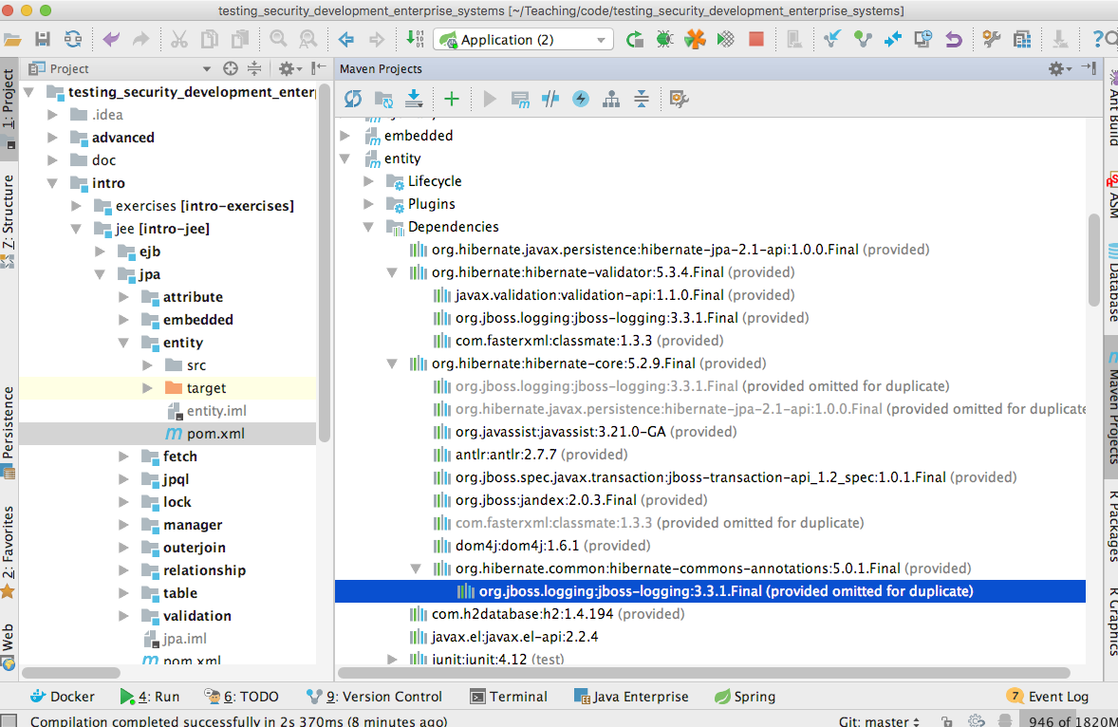
Transitive Dependencies
A dependency JAR can have its own dependencies.
And these transitive dependencies can have their own dependencies, and so on…
Can use IntelliJ “Maven Projects” view to see exactly what is used in a module
For example: hibernate-core pulls in hibernate-commons-annotations, which pulls in jboss-logging

Slide 41
Properties ${}
<properties> <project.build.sourceEncoding>UTF-8</project.build.sourceEncoding> <project.build.sourceEncoding>UTF-8</project.build.sourceEncoding> <project.reporting.outputEncoding>UTF-8</project.reporting.outputEncoding> <fs>${file.separator}</fs> <version.java>1.8</version.java> <version.jacoco>0.7.9</version.jacoco> <version.javax.el>2.2.4</version.javax.el> <version.hibernate.jpa>1.0.0.Final</version.hibernate.jpa> <version.hibernate.core>5.2.9.Final</version.hibernate.core> <version.hibernate.validator>5.3.4.Final</version.hibernate.validator> <version.h2>1.4.194</version.h2> <version.postgres>42.1.4</version.postgres> <version.resteasy>3.1.3.Final</version.resteasy> <version.testcontainers>1.4.3</version.testcontainers> </properties>
<dependency> <groupId>javax.el</groupId> <artifactId>javax.el-api</artifactId> <version>${version.javax.el}</version> </dependency> <dependency> <groupId>org.glassfish.web</groupId> <artifactId>javax.el</artifactId> <version>${version.javax.el}</version> </dependency>

Slide 42
Plugins
Used to extend the functionalities of Maven
Plugins are downloaded and configured like any third-party library
Many of the base functionalities of Maven are themselves represented as plugins
Eg, compile Java code
<pluginManagement> <plugins> <plugin> <groupId>org.apache.maven.plugins</groupId> <artifactId>maven-compiler-plugin</artifactId> <version>3.1</version> <inherited>true</inherited> <configuration> <source> ${version.java} </source> <target> ${version.java} </target> </configuration> </plugin>

Slide 43
Surefire and Failsafe
Surefire: plugin to run unit tests
By default, all files in src/main/test with name pattern *Test.java
Unit tests are run before the package phase
Failsafe: plugin to run integration tests
By default, all files in src/main/test with name pattern *IT.java
Integration tests are run after the package phase, so can use the packaged JAR/WAR files
Note: in both cases, still writing them with JUnit
WARNING: If you misspell *Test.java/*IT.java, tests will not run from Maven

Slide 44
Build Course Git for First Time
From root folder: “mvn clean install -DskipTests”
It will recursively build all the modules
clean: just make sure you start from a clean state
install: it executes all previous phases, including compile and package
-DskipTests: avoid running tests
WARNING: first time, it will take a long while, as many libraries will need to be downloaded

Slide 45
JPA: Java Persistence API

Slide 46
Object-Relational Mapping (ORM)
Mapping data from SQL Databases (DB)
In your programs, using Java classes to represent data from DB
Idea of JPA: define @Entity classes for each table in the DB, and let the JPA framework do all the work to read/write to/from DB when modify the @Entity classes
In theory, no need of SQL. But still might want to use in some cases (eg, for complex queries), or when the JPA implementation gives weird results…

Slide 47
Hibernate
A JPA implementation
Most popular in Java
Default in JEE containers like WildFly
Default in SpringBoot
As a library, can be used in any Java program
ie, not necessarily in EE or Spring
src/main/resources/META-INF/persistence.xml
Configuration file for JPA

Slide 48
Database Schema
Given an existing DB, need to write @Entity classes for each table
Other option: write the @Entity classes first, and generate the schemas automatically afterwards
Easier when you are more familiar with Java than SQL
Good for prototyping

Slide 49
Git Repository Modules
NOTE: most of the explanations will be directly in the code as comments, and not here in the slides
intro/jee-provided-dependencies
intro/jee/jpa/entity
intro/jee/jpa/table
intro/jee/jpa/embedded
intro/jee/jpa/attribute
Exercises for Lesson 01 (see documentation)

