Slide 1
Terrestrial Ecosystem Models

Slide 2
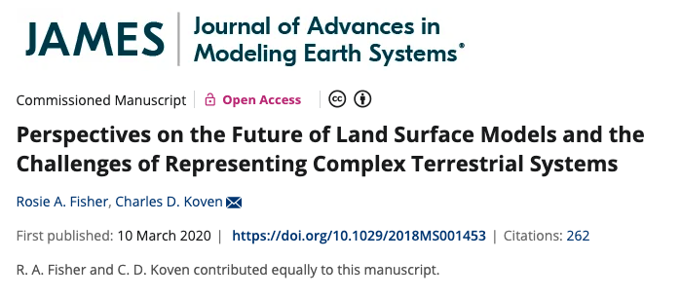

Slide 3
Different types of models
Land surface models
Terrestrial biosphere models
Terrestrial ecosystem models
Dynamic vegetation models
Earth system models

Slide 4
Different types of models
Land surface models
Terrestrial biosphere models
Terrestrial ecosystem models
Dynamic vegetation models
Earth system models
Generally thought of to be the same thing:
“numerical models that solve the coupled fluxes of water, energy, and carbon between the land surface and atmosphere, within a context of direct and indirect human forcings and ecological dynamics” (Fisher and Koven, 2020)

Slide 5
Different types of models
Land surface models
Terrestrial biosphere models
Terrestrial ecosystem models
Dynamic vegetation models
Earth system models
A type of land surface model where the type of vegetation in a given location can change

Slide 6
Different types of models
Land surface models
Terrestrial biosphere models
Terrestrial ecosystem models
Dynamic vegetation models
Earth system models
A model that couples together models of different components of the Earth system (e.g., land, ocean, atmosphere, sea ice, etc.)

Slide 7
This class will focus on land surface/terrestrial biosphere/terrestrial ecosystem models
Land surface models
Terrestrial biosphere models
Terrestrial ecosystem models
Dynamic vegetation models
Earth system models
“numerical models that solve the coupled fluxes of water, energy, and carbon between the land surface and atmosphere, within a context of direct and indirect human forcings and ecological dynamics” (Fisher and Koven, 2020)

Slide 8
Why were these models originally developed?
Plant biophysical responses have an appreciable effect on climate
Terrestrial biogeochemical responses have an appreciable effect on climate through their impact on the carbon cycle

Slide 9
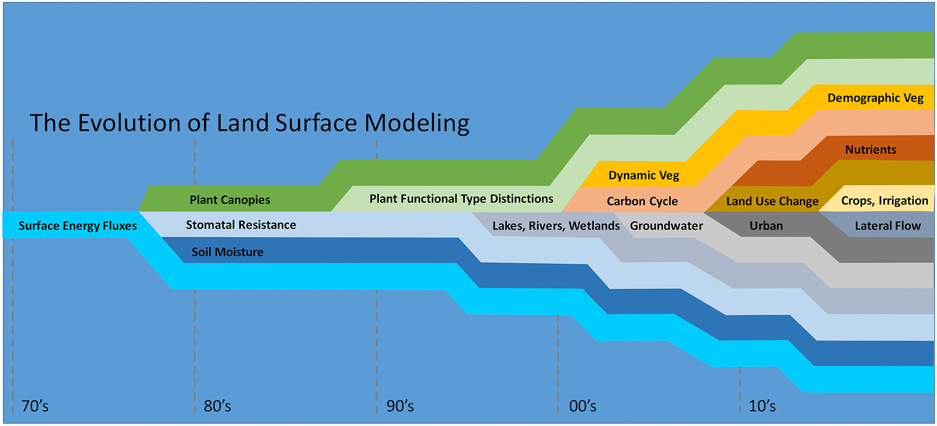

Slide 10
How do these influence biophysical and biogeochemical processes?

Slide 11
Fisher and Koven’s 3 grand challenges
Managing and understanding process complexity
Heterogeneity and the dimensionality of the land surface
Projecting the temporal and spatial dynamics of model parameters

Slide 12
Fisher and Koven’s 3 grand challenges
Managing and understanding process complexity
Heterogeneity and the dimensionality of the land surface
Projecting the temporal and spatial dynamics of model parameters

Slide 13
Fisher and Koven’s 3 grand challenges
Managing and understanding process complexity
Heterogeneity and the dimensionality of the land surface
Projecting the temporal and spatial dynamics of model parameters

Slide 14
Fisher and Koven’s 3 grand challenges
Managing and understanding process complexity
Heterogeneity and the dimensionality of the land surface
Projecting the temporal and spatial dynamics of model parameters

