Slide 1
3 R’s of Terrestrial Ecosystem Modeling

Slide 2
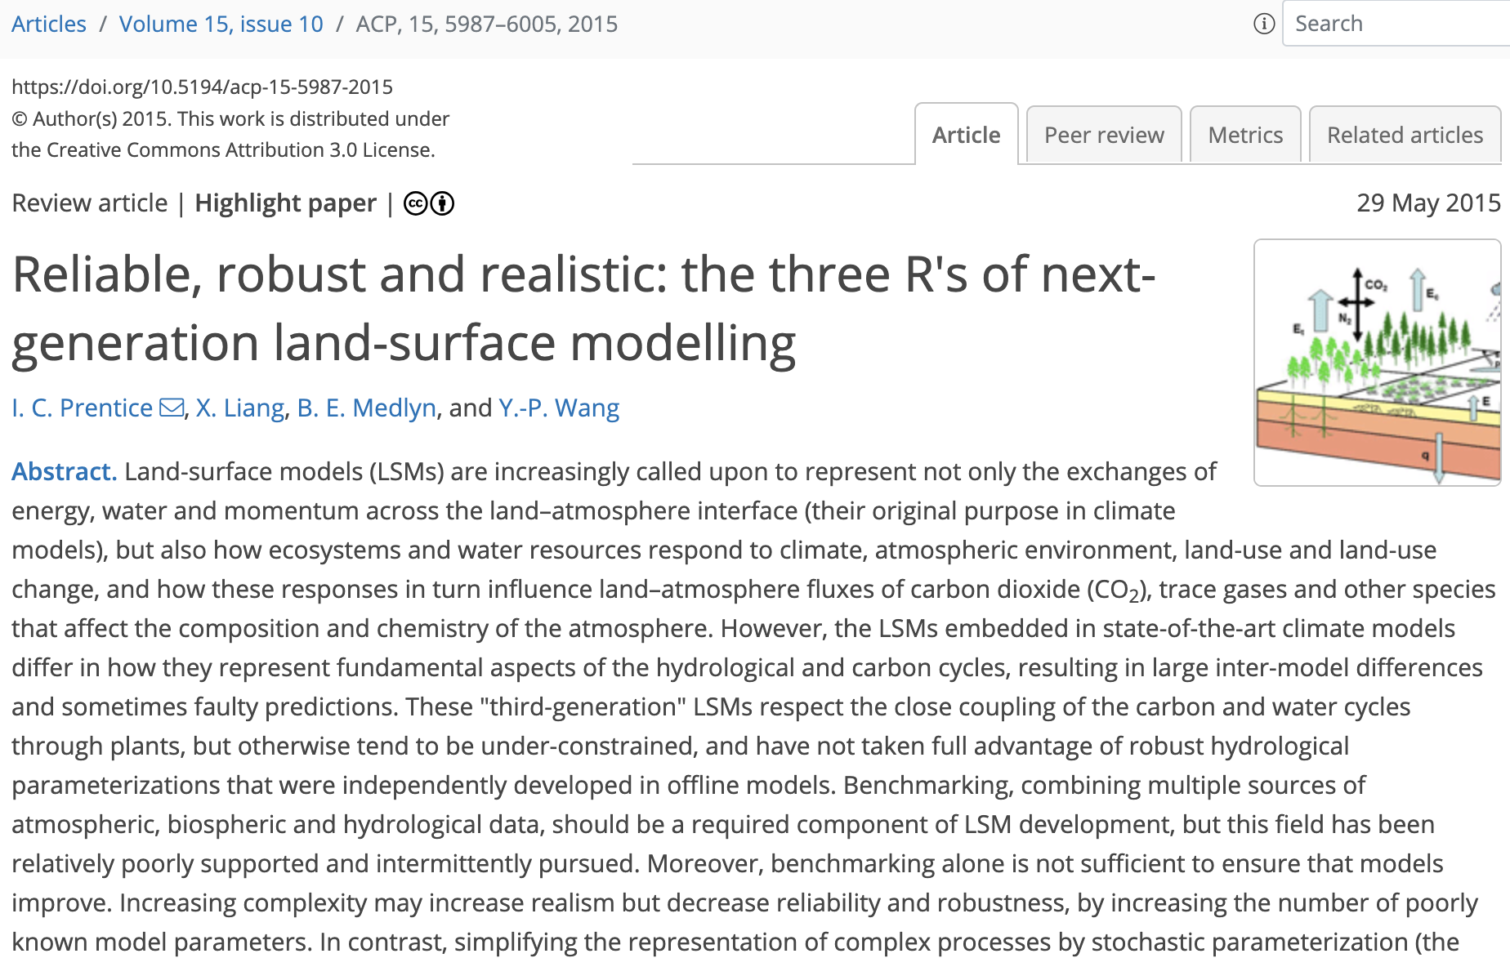

Slide 3
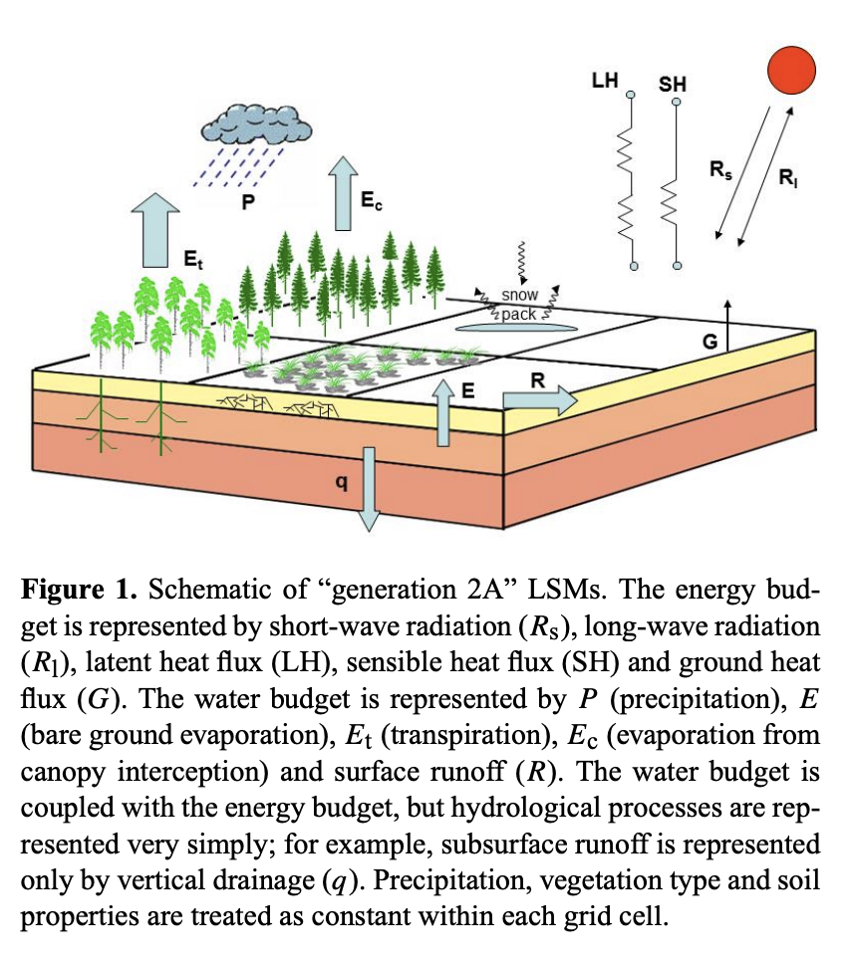
History of LSMs

Slide 4
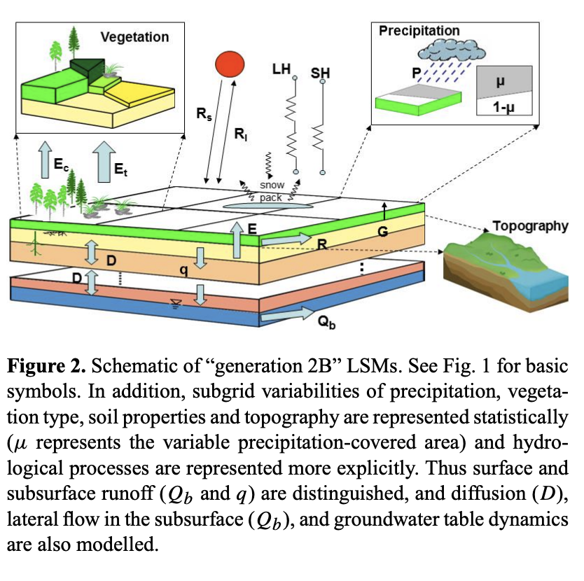
History of LSMs

Slide 5
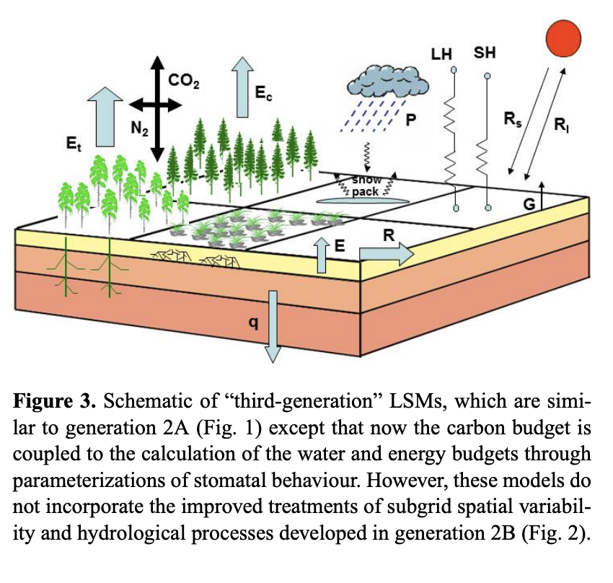
History of LSMs

Slide 6
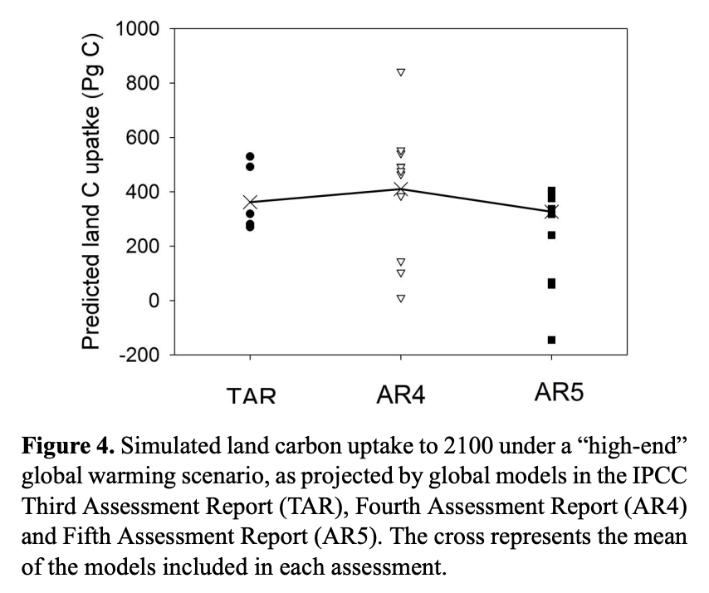
Despite parallel development, LSMs still vary a lot…

Slide 7
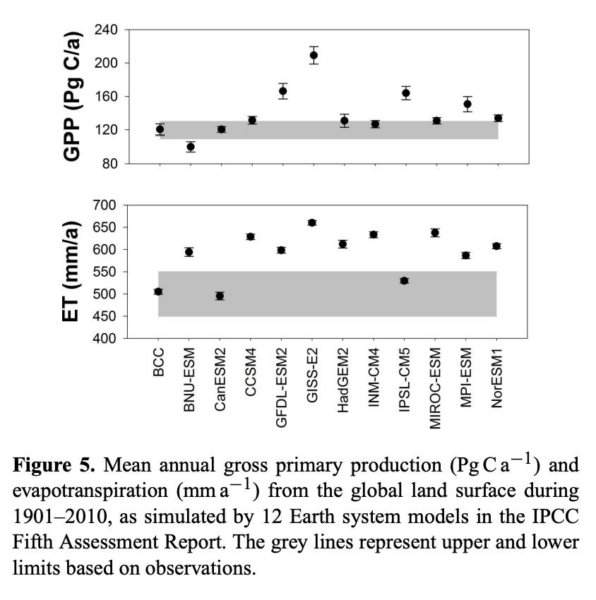
…and none are correct!

Slide 8
“Moreover, complexity can conceal lack of rigour, because it becomes progressively easier to fit observations as more parameters are introduced. Thus, increasing complexity can mask a lack of understanding, resulting in a situation whereby models are tuned to perform well at standard tests but produce widely divergent results when projected beyond the domain of calibration.”

Slide 9
Variability impacts on non-linear models
Example on board

Slide 10
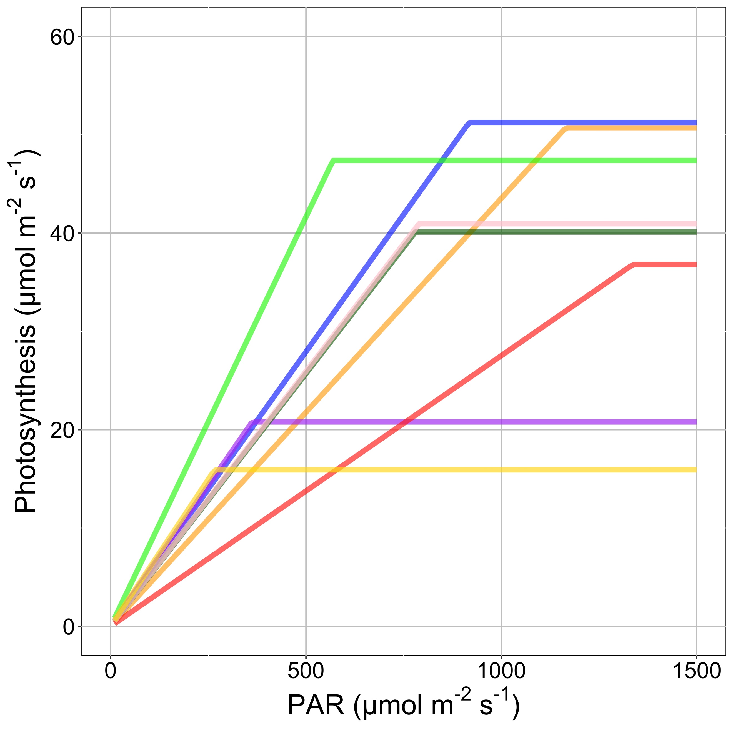
Fixed versus continuous parameters

Slide 11
Next generation models

Slide 12
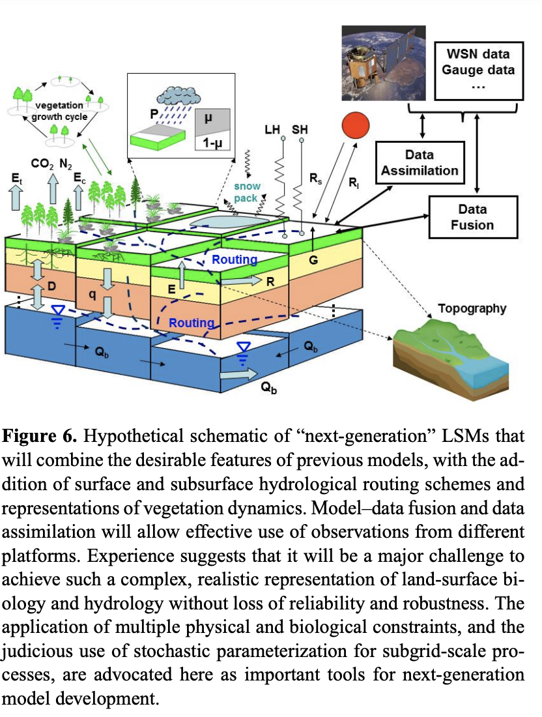

Slide 13
Looks pretty complex?!

Slide 14
Bounding complexity: the use of multiple constraints
Models are becoming increasingly complex
Biological and physical constraints are needed
Reduce parameters
Include physically necessary relationships
Connect processes and parameters in more continuous manner
And compare to data!

Slide 15
Data assimilation
Estimate optimal parameter values
But can sometimes lead to errors
Uncertainty in both model and data!
Need to maintain mass and energy balance (thanks a lot Newton!)
Need big, fancy computers

