Slide 1
Carbon “IN” to terrestrial ecosystems

Slide 2
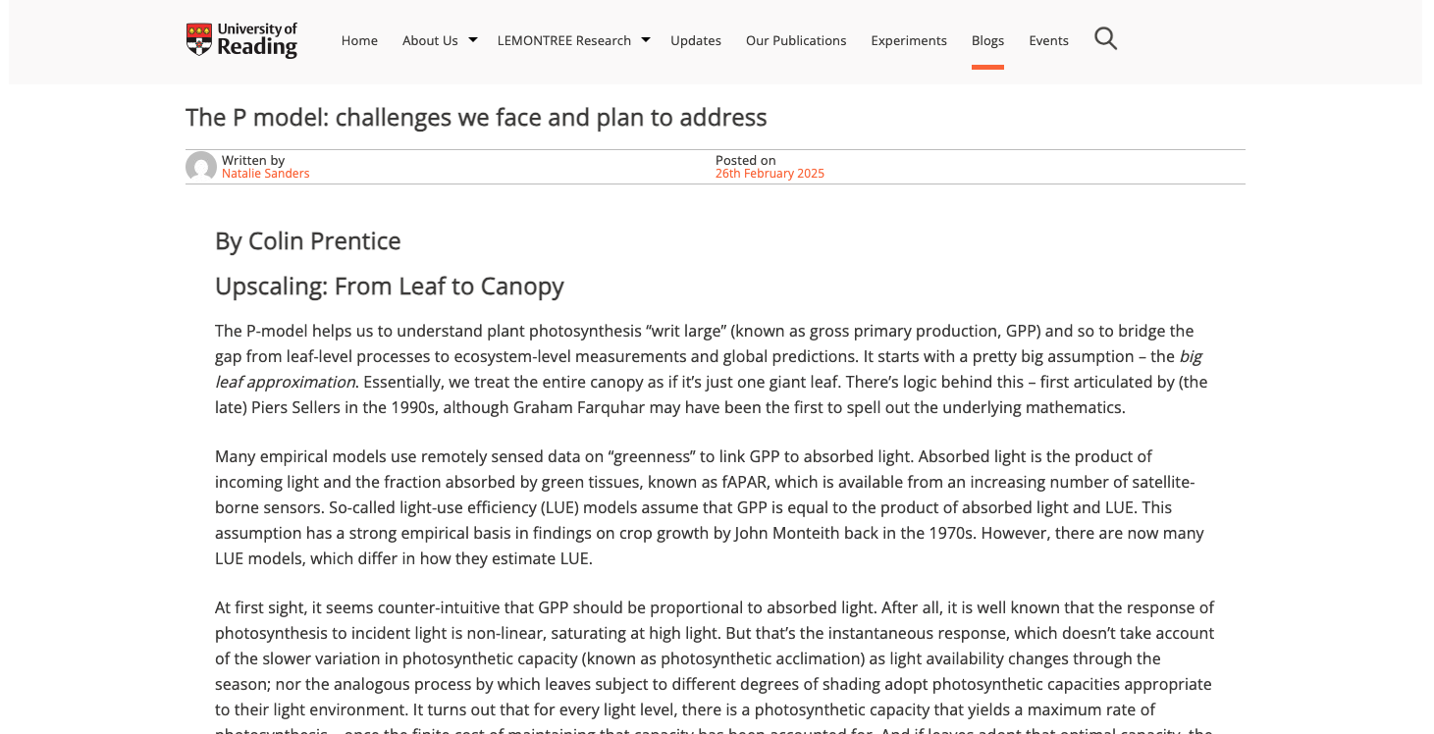
https://research.reading.ac.uk/lemontree/the-p-model-challenges-we-face-and-plan-to-address/

Slide 3
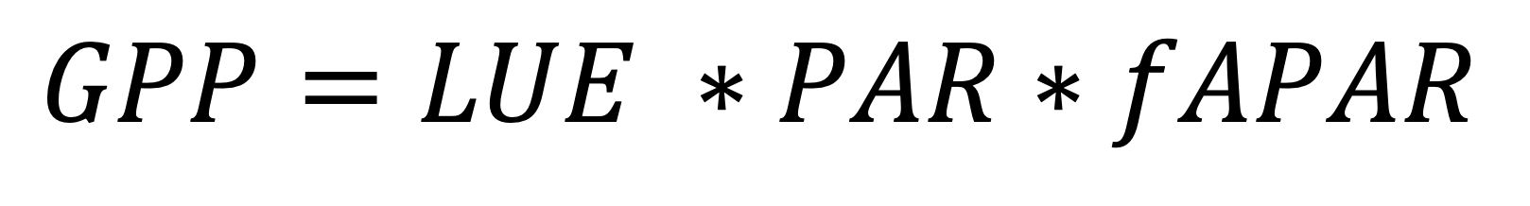
Light use efficiency models
GPP is the product of the absorbed PAR (PAR*fAPAR) and the efficiency by which PAR is converted to carbon (or LUE; µmol CO₂ µmol PAR⁻¹)
$$GPP=LUE ∗PAR∗fAPAR$$

Slide 4
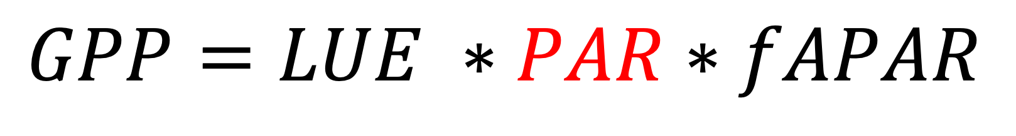
Light use efficiency models
GPP is the product of the absorbed PAR (PAR*fAPAR) and the efficiency by which PAR is converted to carbon (or LUE; µmol CO₂ µmol PAR⁻¹)
$$GPP=LUE ∗PAR∗fAPAR$$

Slide 5
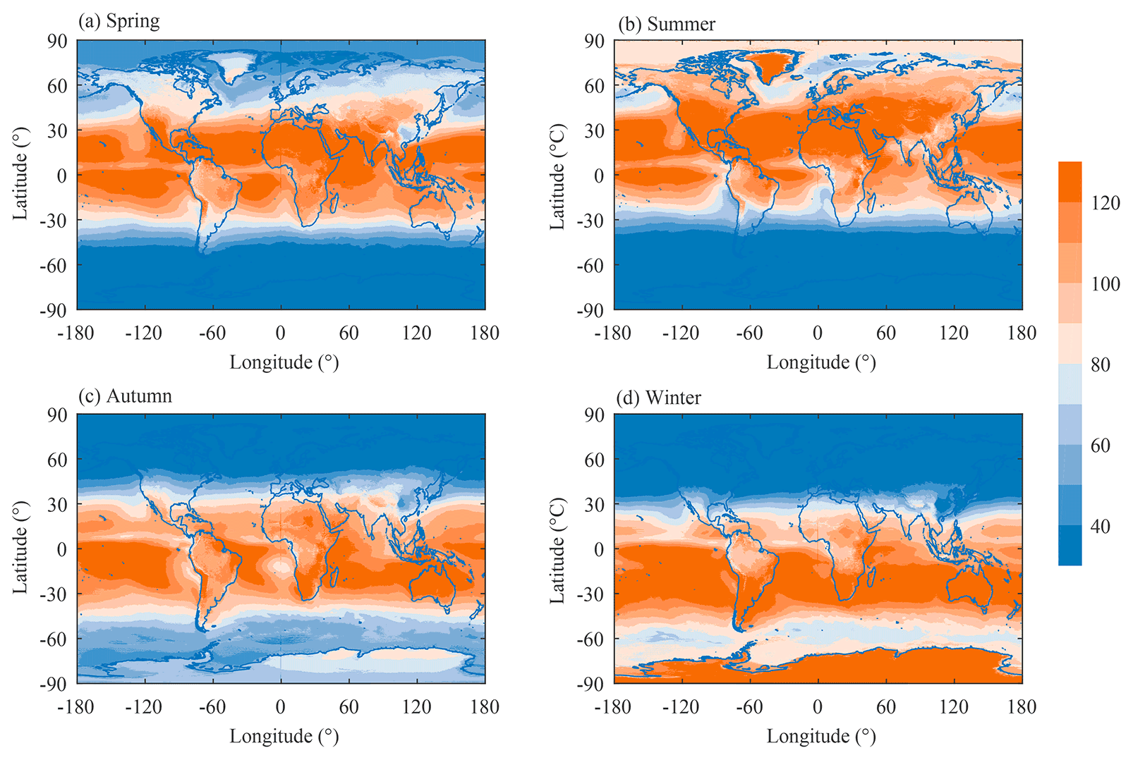
PAR
Photosynthetically active radiation reaching the top of the canopy
Tang et al. (2022)

Slide 6
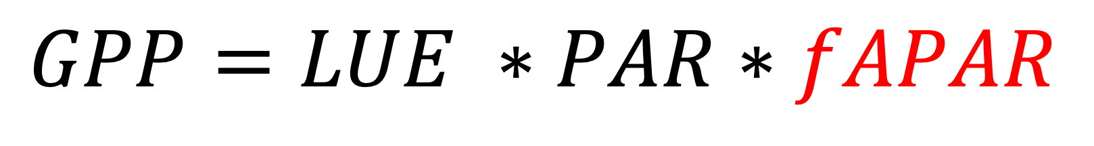
Light use efficiency models
GPP is the product of the absorbed PAR (fAPAR) and the efficiency by which PAR is converted to carbon (or LUE; µmol CO₂ µmol PAR⁻¹)
$$GPP=LUE ∗PAR∗fAPAR$$

Slide 7
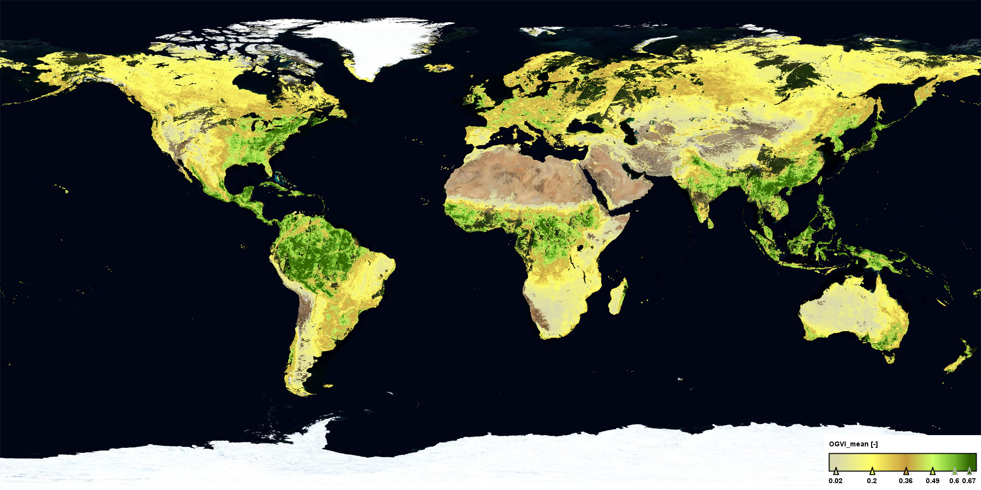
fAPAR
Fraction of absorbed photosynthetically active radiation
How much PAR is absorbed by the canopy relative to how much hits the canopy
Sentinel (ESA)

Slide 8
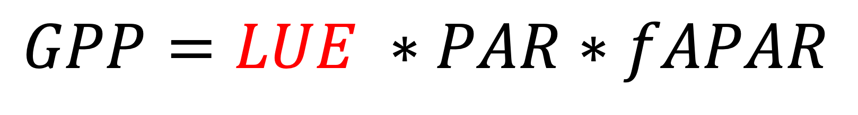
Light use efficiency models
GPP is the product of the absorbed PAR (PAR*fAPAR) and the efficiency by which PAR is converted to carbon (or LUE; µmol CO₂ µmol PAR⁻¹)
$$GPP=LUE ∗PAR∗fAPAR$$

Slide 9
Light use efficiency
This is a critical term in the model that generally tends to:
Increase with decreasing light
Vary parabolically with temperature
Increase with CO₂
Depends on
Photosynthetic biochemistry
Stomatal conductance
Intrinsic quantum efficiency of photosynthesis

Slide 10
An approach for mechanistically modeling GPP across scale: the P-model

Slide 11
The FvCB model

Slide 12
Key trait predictions

Slide 13
Tying back to LUE

