Slide 1
Integrating Ecology into Models

Slide 2
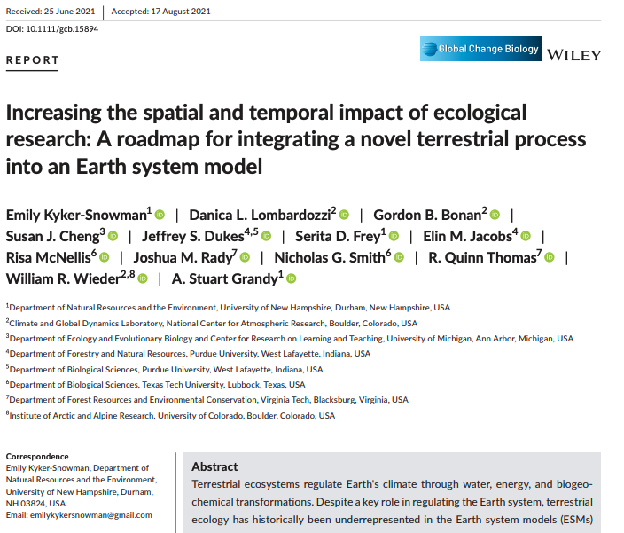

Slide 3
First, a historical perspective…

Slide 4
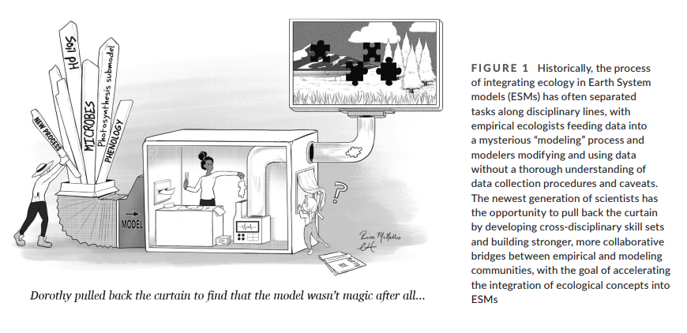

Slide 7
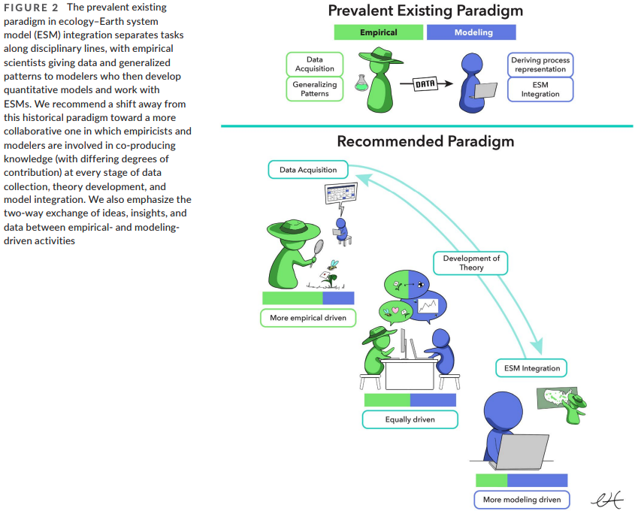

Slide 10
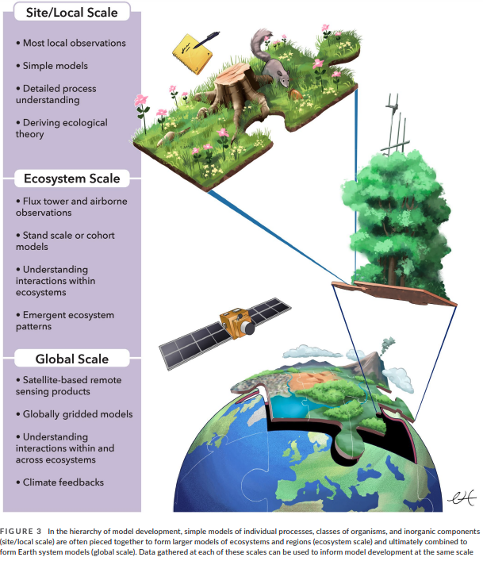
Piecing together model components can both refine and expand the scale of models

Slide 11
New processes enter an ESM if…
The process influences climate on large scales
The process can be reasonably incorporated into present infrastructure
Process understanding and data are available to model the process globally
Mathematics of the process are tractable
There is a community of researchers dedicated to developing, testing, and maintaining the process

Slide 12
Roadmap

Slide 13
Let’s answer these questions in the R script you created for the homework assignment due today

Slide 14
For the purpose of this exercise, let’s consider our future “base model”
Atmosphere (CO₂, temperature, light, humidity)
Vegetation (leaf area, C in leaves and stems)
Soil (moisture, C in roots, C in soil)

Slide 15
1. Identifying and understanding the process
Do you expect your process to respond consistently to environmental drivers, enabling scaling across space and time?

Slide 16
1. Identifying and understanding the process
Is your process already in or related to an existing process in the model?

Slide 17
1. Identifying and understanding the process
Is the process likely to influence climate?

Slide 18
2. Beginning to work with simple models
What would a simple model of your process look like?

Slide 19
2. Beginning to work with simple models
Are there data to parameterize and test your simple model?

Slide 20
3. Integrating processes into ESMs
Something still far away on the horizon…

Slide 21
