Slide 1
Project Title: Storage Data
team members
Azam Shirani
Fall 2017

Slide 2
Storage Data
Servers: order management and table management. They are able to send an order to kitchen quickly and que to start next service and also take reservations and view available tables. For payment, they can split checks.
Managers : Edit menu items, access payroll information, time clocks, and business reports. Detailed sales reports in this system can help provide management with insight into which items are selling the best.
Kitchen, receive order from servers

Slide 3
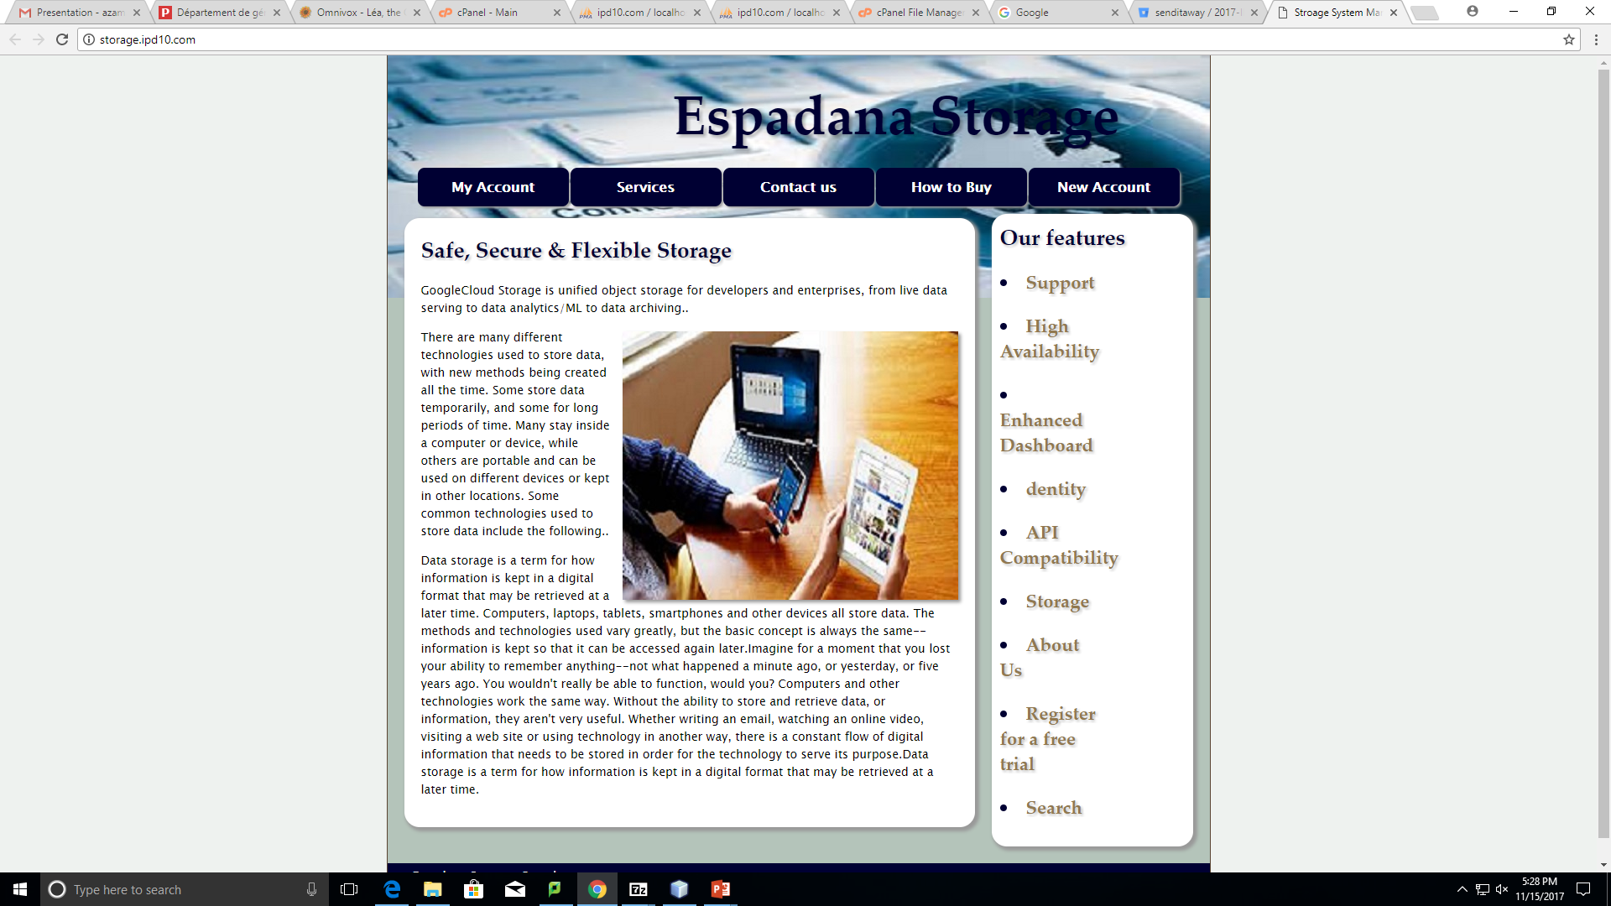
Our solution

Slide 4
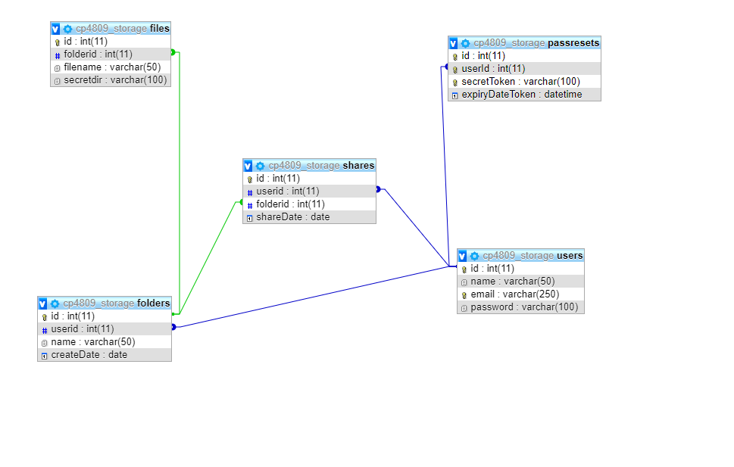
Database

Slide 5
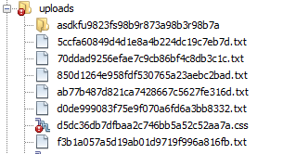
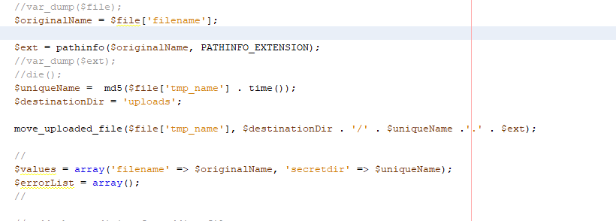
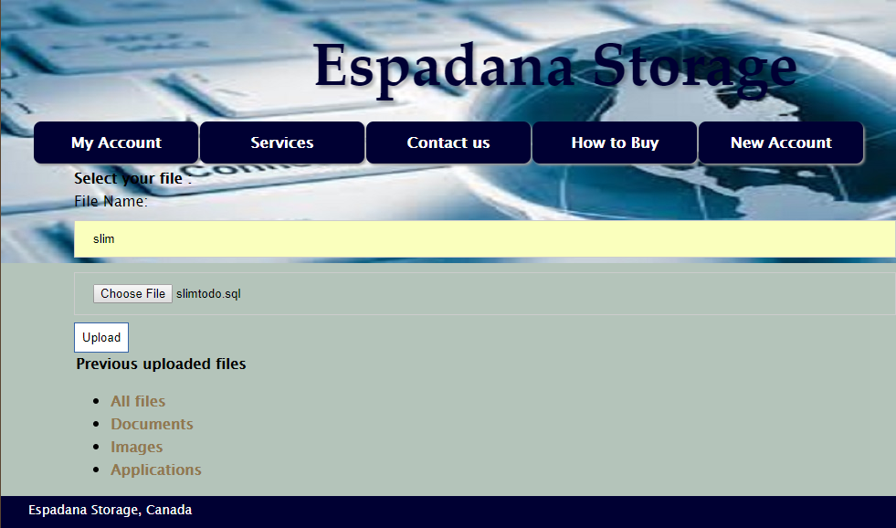
Challenges

Slide 6
challenges

Slide 7
challenges

Slide 8
challenges

Slide 9
Futures
Clock Time for Employee
Table Management
Add seat number in Order(so we can split bill by saatnumber)

Slide 10
Refrences
https://docs.slimframework.com/

Slide 11
Thanks

