Slide 1
Project Title: Storage Space
team members
Azam Shirani
Fall 2017

Slide 2
Solution
This Storage provides upload ,add, modify, delete Files for users.
Users can share Files with others.
Users can see their files and list of share’s file with them.
Objectives:
To improve Storage based file management
Add/Edit/Delete/Modify
To provide Storage based File security.
give a secret name to each file
prevent to duplicate upload
Prevent to duplicate share file

Slide 3
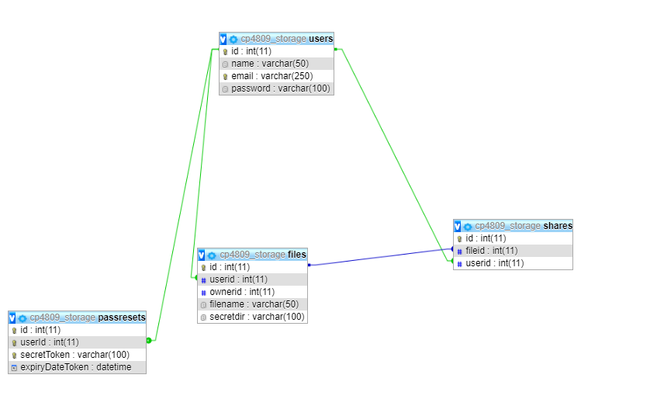
Database

Slide 4
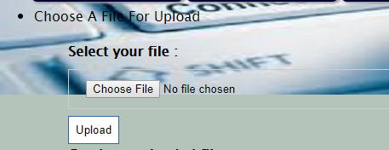
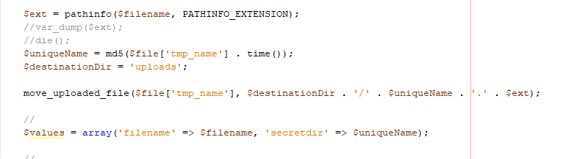
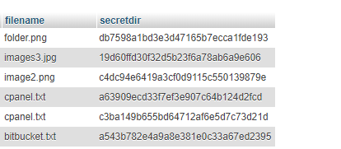
Challenges

Slide 5
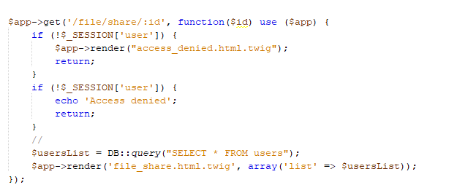

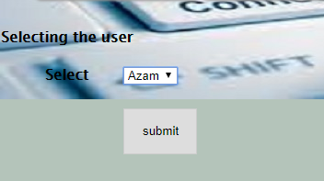

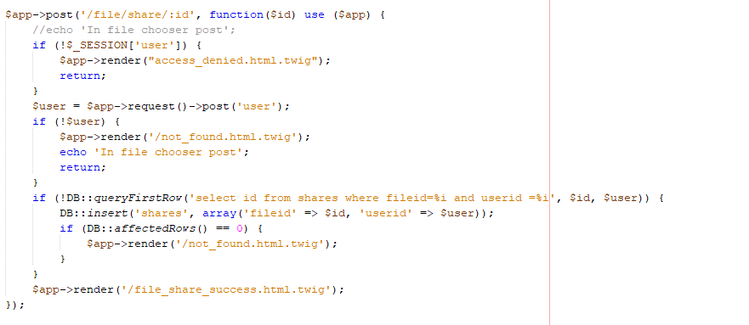
challenge

Slide 6
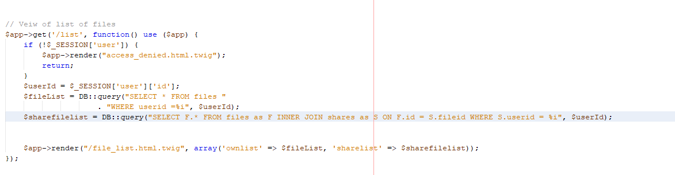
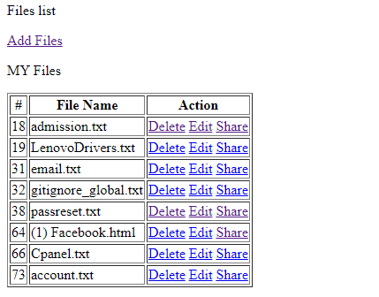
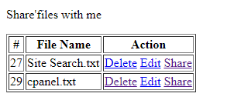
challenges

Slide 7
Futures
Delete in share list
Add some error checking in some parts
Add Rename a file in Edit

Slide 8

Thanks

