Slide 1
Track 01: Synthetic Eye Movement & Virtual Camera Rendering
XR Hackathon
Team Name : MarkovX
College Name : SRM Institute of Science and Technology
Members Details
Azam Ali - aa1721@srmist.edu.in
Tushar Biswas - tb9603@srmist.edu.in

Slide 2
THE PROBLEM
CONTEXT
REQUIREMENTS WE MEET
Gaze estimators for XR headsets need very large sets of eye images with exact gaze labels.
Real capture at extreme angles is slow, costly and privacy-restricted.
Our approach: a calibrated photoreal digital head that renders unlimited labelled frames.
Both Samsung specs are met: the 10-frame calibration task and the textures / videos / .blend deliverable.
Item | Spec
Eye motion | 3D rotation about eyeball centre
Fixation target | 35 cm, +-5 cm
Camera | 40 cm, locked
Render | 1024 x 1024 PNG
Clockwise set | 10 frames, theta = 2*pi*k/10
Inputs | h = sin(theta), v = cos(theta)
Ground truth | metadata.json per frame
Check | Left / Right / Up / Down / Reset

Slide 3
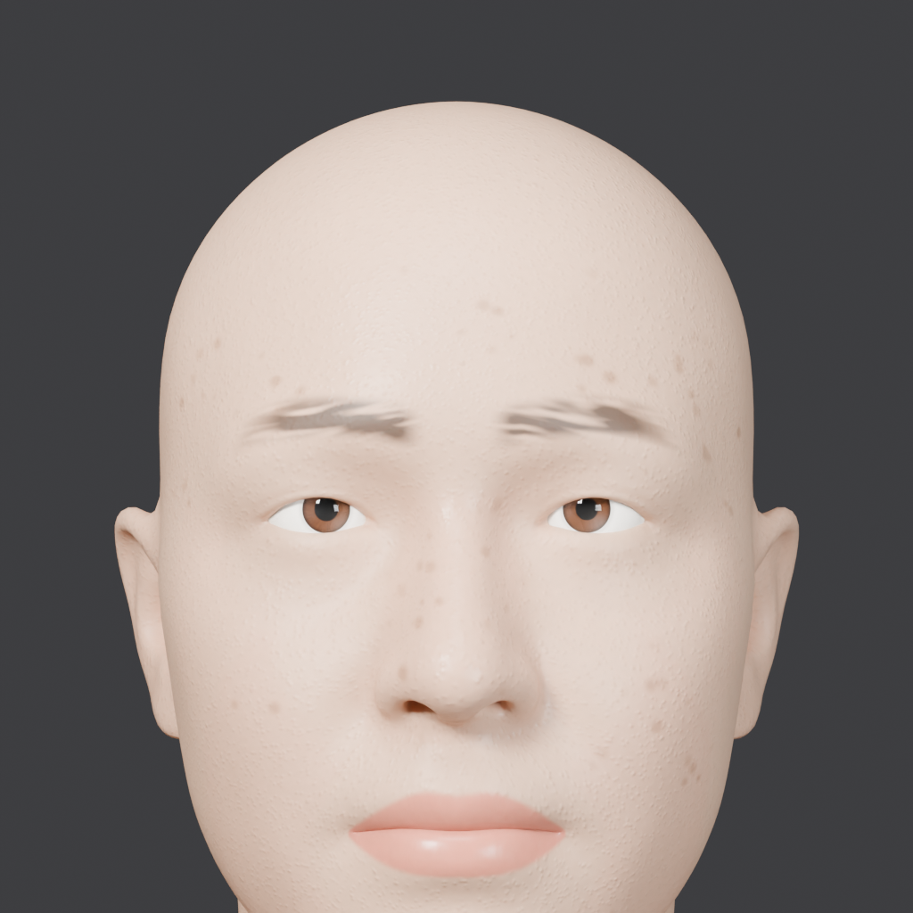
SOLUTION
Head
Google GNM Head v3 (17,821 vertices), converted to a metric world frame, eye midpoint at the origin.
Eye rig
One bone per eyeball at its centre, tracking a shared fixation target: shortest-arc rotation, natural vergence of about 5.1 degrees per eye.
Lids, brows, pupils
Shape keys hinge the lids about the eyeball, so no cornea intersection. Lid-follow drivers use simple expressions only.
Look
8 procedural skin sets in GNM UDIM layout with different left/right irises. Cycles with OIDN denoise, constant lighting.
Portrait render, texture set 01

Slide 4
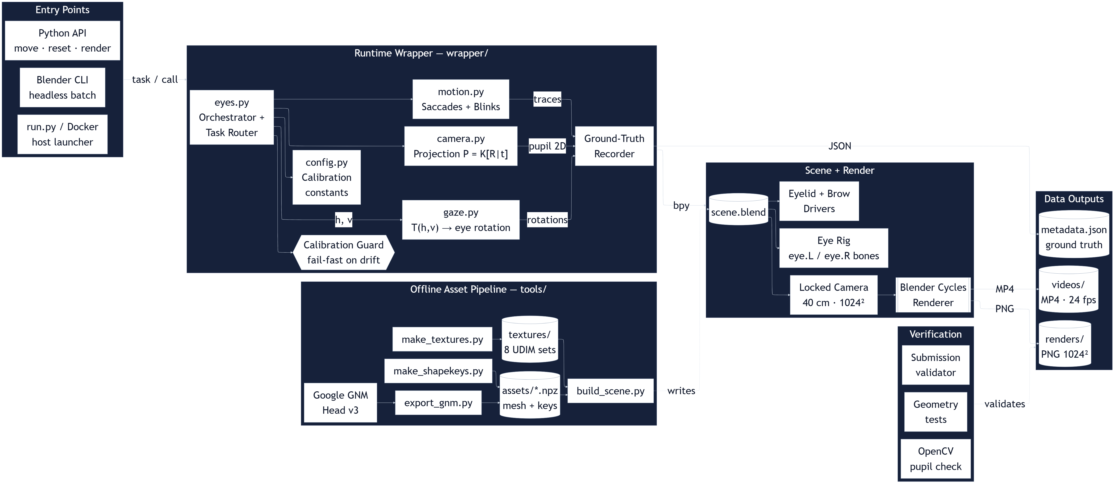
ARCHITECTURE

Slide 5
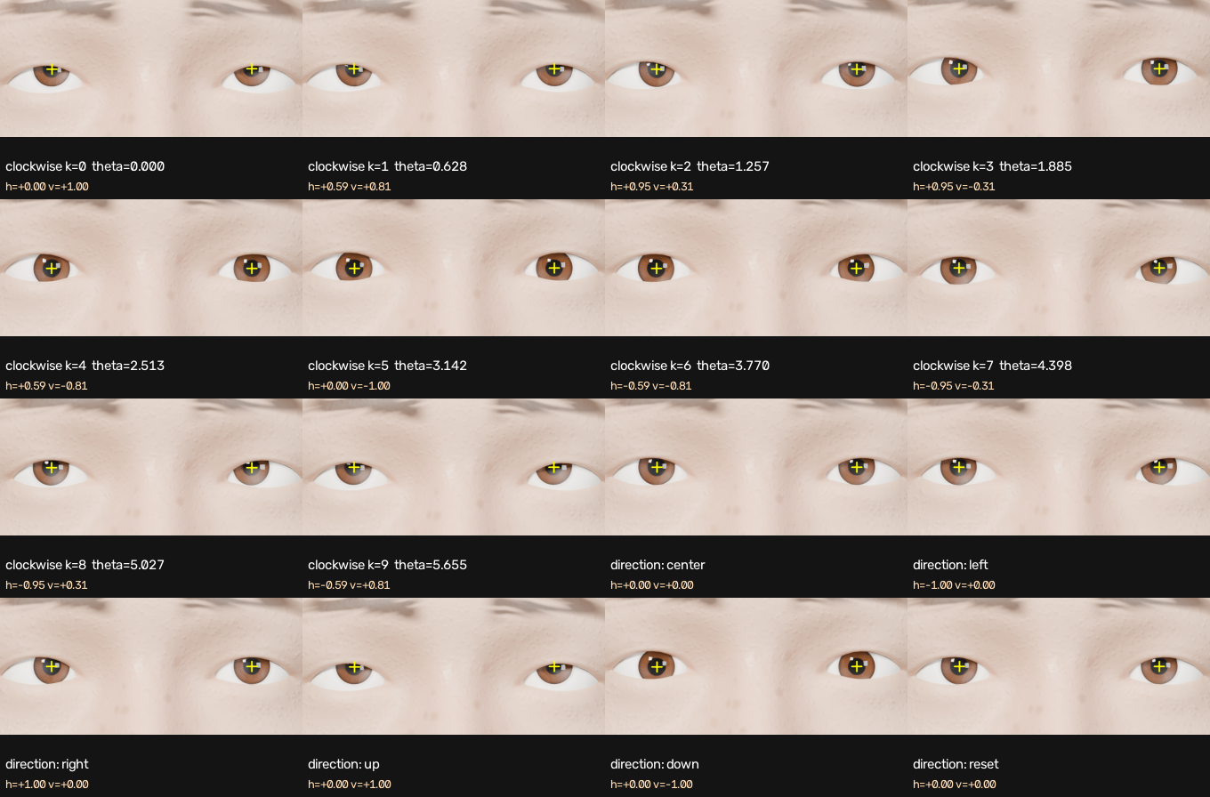
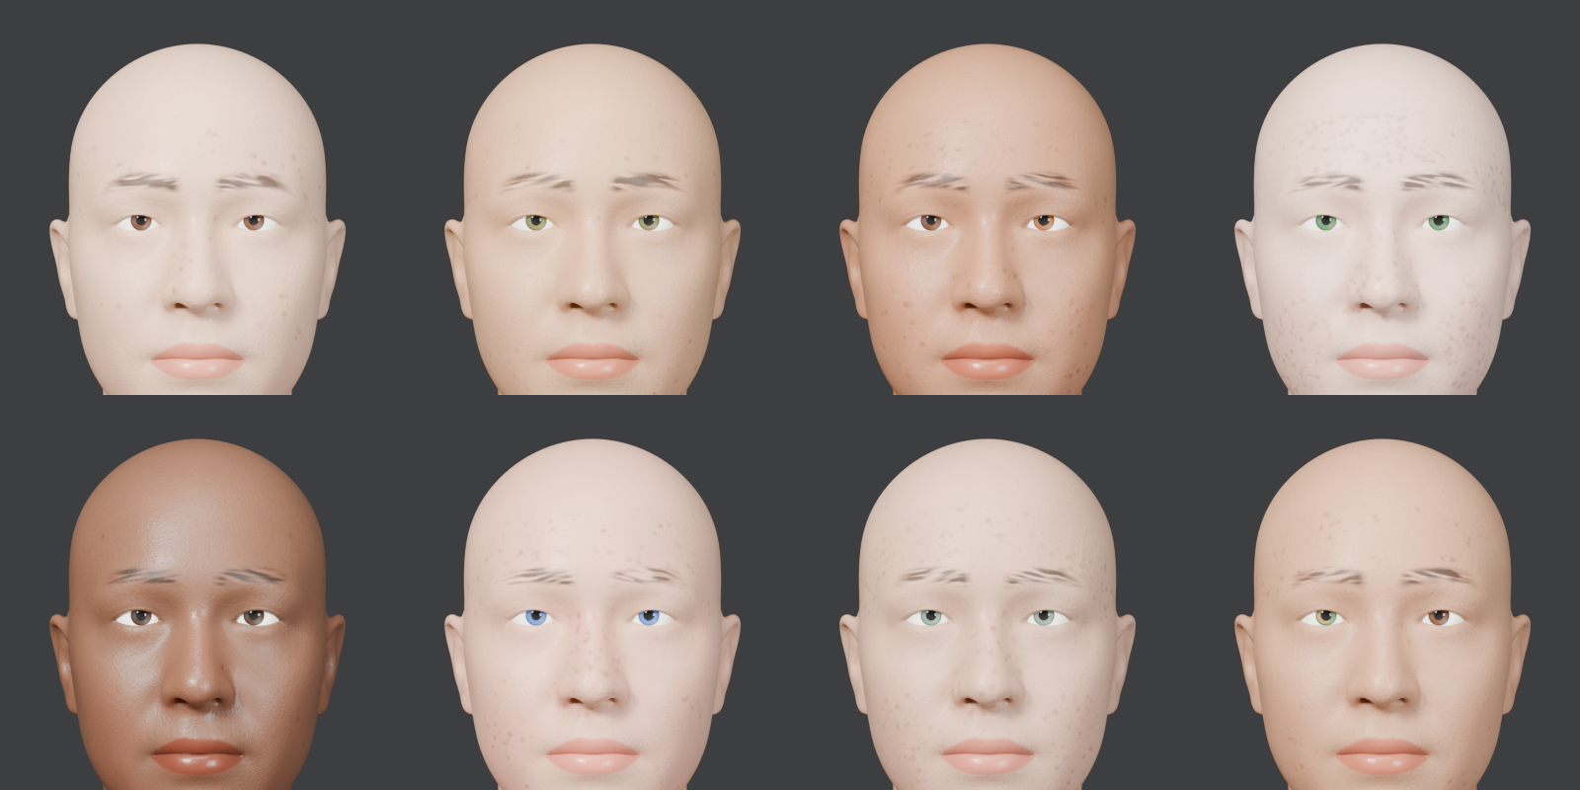
Track Final Output
{ "frame": 3,
"theta": 1.885,
"input": {"h": 0.951, "v": -0.309},
"eye_rotation_L": [rx, ry, rz],
"eye_rotation_R": [rx, ry, rz],
"pupil_center_2D_L": [x, y],
"pupil_center_2D_R": [x, y],
"camera_matrix": 3x4 }
8 texture sets
3 videos, 12 s
10 + 6 renders
Clockwise k=0..9 and Left / Right / Up / Down / Reset. Crosses mark metadata pupil centres.

Slide 6
DIFFERENTIATION
Aspect | Typical approach | Ours
Eye motion | Parallel eyes or 2D pupil slides | True 3D rotation, both eyes converge on one 35 cm target
Verification | Visual check | Independent OpenCV pupil detector, 5 / 5 directions
Calibration | Manual, drifts | Locked and checked at runtime; refuses to render if violated
Eyelids | Static or clipping | Hinge about the eyeball, follow gaze through drivers
Motion | Linear tweens | Min-jerk saccades, blinks, microsaccades, eye roll
Textures | Single skin | 8 sets in GNM UDIM layout, distinct L/R irises

Slide 7
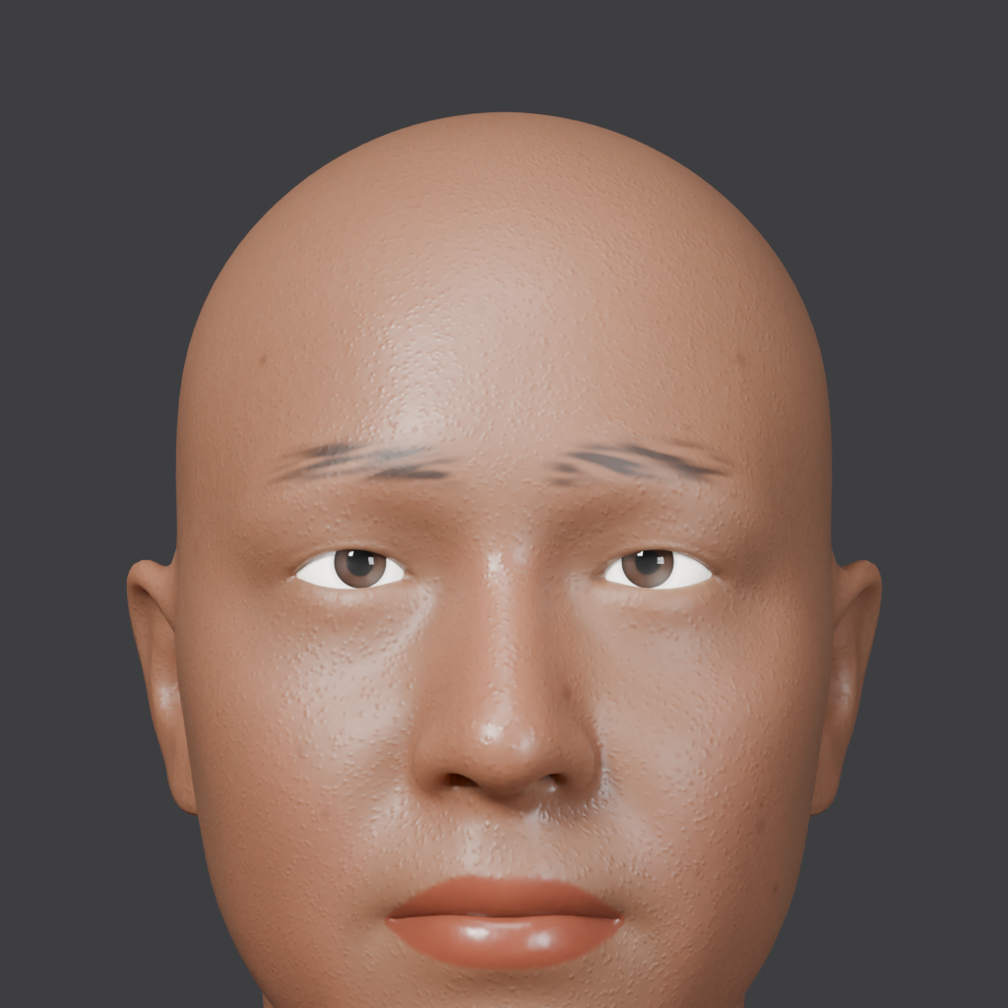
DEMO & LOCAL SETUP
RUN IT (Blender 4.5 LTS)
$ blender -b scene.blend -P wrapper/eyes.py -- clockwise
$ blender -b scene.blend -P wrapper/eyes.py -- directions
$ python run.py --input left | right | generate
$ docker build -t eyes . && docker run --rm eyes --clockwise
PYTHON API
import eyes
eyes.move(h, v) # h, v in [-1, 1]
eyes.reset() # centre, converge on target
eyes.render('out.png')
Videos: Left, Right, Generate Motion, 12 s each
Repo: github.com/AzamAliCodes/synthetic-eye-movement-vcr Demo video: videos/demo_video.mp4

Slide 8
Brownie Slides
Check | Result
Direction check (OpenCV) | 5 / 5 pass
Clockwise order | pass
Pupil centre error | mean 4.5 px, max 7.9 px
Camera / target distance | 0.40 m / 0.35 m
Image size | 1024 x 1024, 10 frames
Submission validator | 25 / 25
Videos | 12 s each (limit 15 s)
LIMITS
CPU Cycles: about 1 to 2 min per still
Procedural skin, bald head, painted brows
About 5 px offset between geometric and detected pupil (corneal refraction)
NEXT
Random identities, lighting and glasses
Full gaze datasets with labels

Slide 9
Thank You
Team MarkovX | SRM Institute of Science and Technology
Team MarkovX | SRM Institute of Science and Technology

