Slide 1

Temporal Modeling for Passive Sonar
Bearing Estimation using a Hybrid CNN-GRU Network
Mohmmad Akeeb (2224CUKmr30)
Bashee Bilal (2224CUKmr42)
Wikis Khursheed (2224CUKmr39)
Guide: Dr. Yash Paul
Department of Information Technology
Central University of Kashmir

Slide 2
Index
Introduction
Problem Statement
Objectives
Scope
Literature Review
Proposed Methodology
Dataset
Hardware & Software Requirements
Project Timeline
Expected Outcomes & Applications
References & Q&A

Slide 3
Introduction
The ocean is one of the most strategically important and least visible environments. Threats beneath the surface are difficult to detect without the right technology.
Passive sonar is a listening system used by submarines and naval vessels to detect nearby underwater threats without revealing their own position by emitting signals.
The key task in passive sonar is Target Bearing Estimation, figuring out which direction a sound is coming from, using an array of underwater microphones called hydrophones.
Deep learning has recently shown strong potential for this task, but existing methods struggle with heavy ocean noise, weak signals at certain angles, and high computational cost.
This project develops a lightweight deep learning model that accurately estimates target bearing in real time, even under severe noise conditions.

Slide 4
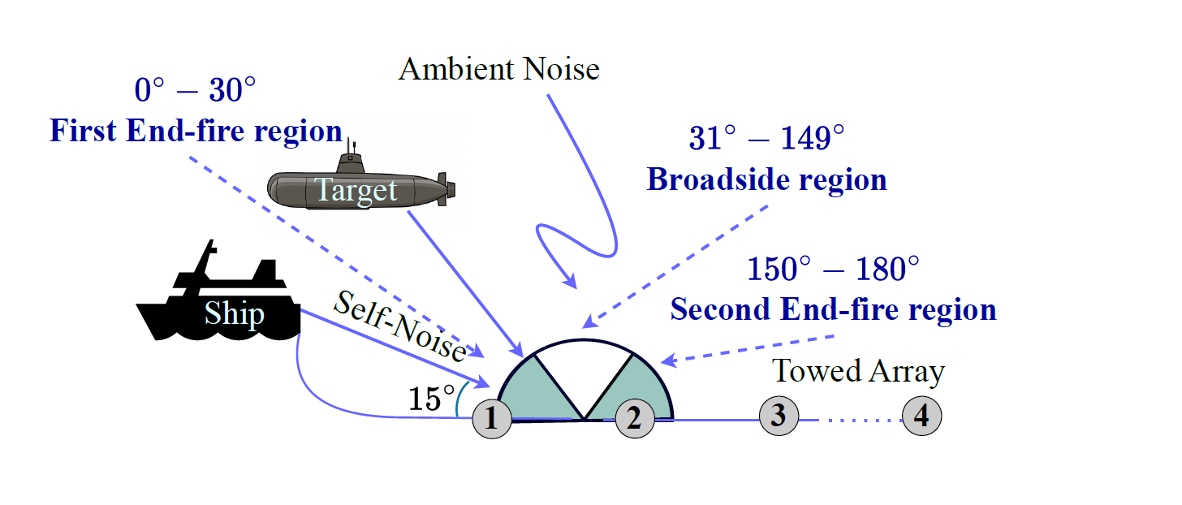

Slide 5
Problem Statement
“How can a passive sonar system accurately identify the direction of an underwater threat in real-time on low-power hardware, when both the target signal and noise have broad band characteristics?”
Underwater environments are filled with noise from propellers, marine life, and water currents, making it extremely difficult to isolate a target's acoustic signal.
Even when a signal is detected, determining its exact direction is hard, especially when the target is nearly in front of or behind the array called the end-fire region (0°–30° and 150°–180°), where the sensors become almost blind.
Current deep learning solutions either treat the signal as a static image losing critical time-based information, or rely on heavy preprocessing steps that are too slow for real-time use.

Slide 6
Objectives
To develop a Hybrid CNN-GRU architecture that processes raw sonar time-series data directly, without requiring any external preprocessing or denoising.
To model the temporal evolution of acoustic signals using Gated Recurrent Units, enabling the system to track a target's trajectory across time rather than analyzing isolated snapshots.
To achieve robust bearing estimation in end-fire regions (0°–30° and 150°–180°) where conventional and existing deep learning methods fail.
To design a lightweight model with linear computational complexity O(T), suitable for real-time deployment on resource-constrained edge sonar platforms.
To outperform existing CNN and CRNN baselines in terms of overall accuracy and end-fire accuracy.

Slide 7
Scope
Single-target bearing estimation from 0° to 180°.
Synthesized wideband sonar data 32-channel, 4096 samples.
Classification into 181 bearing classes Δ = 1° resolution.
Python / PyTorch implementation.
Edge-deployable model profiling.
Outside Scope:
Multi-target simultaneous tracking
Real-world field-recorded datasets

Slide 8
Literature Review
Reference | Objective | Methodology | Contributions | Limitations
Kamal et al., 2021 | Improve passive sonar target classification in shallow waters | End-to-end deep learning using 1D CNN + 2D CNN + BiLSTM with attention; learnable filterbanks on raw signals | Eliminate manual feature engineering; captures spectro-temporal patterns; achieves ~95.2% accuracy on real dataset | High computational complexity; requires large dataset; limited real-time feasibility
Kamal et al., 2021 (Jan) | Enhance NCATR performance under shallow water variability | CNN + BiLSTM with soft attention; spectrogram/log-spectrogram inputs; recursive model elimination | Efficient feature extraction; improved temporal modeling; reduced hyperparameter search cost | Still relies on transformed inputs; computational overhead; sensitivity to noise
Xie & Wang, 2023 | Improve DOA estimation accuracy under low SNR | LSTM + Attention and Transformer-based models on time-series AVS data | Preserves temporal structure; outperforms MUSIC; Transformer improves efficiency | High training cost; risk of overfitting; requires large training data

Slide 9
Literature Review
Reference | Objective | Methodology | Contributions | Limitations
Ji et al., 2023 | Improve underwater acoustic target recognition accuracy and efficiency | Deep Residual Attention CNN (DRACNN) using time-domain signals | High accuracy (97.1%); reduced parameters; good generalization across datasets | Model complexity still non-trivial; depends on labeled datasets
Akbarian & Sedaaghi, 2025 | Achieve efficient UATR with balanced accuracy and speed | Spectrogram + Modified MobileNet CNN | Lightweight architecture; high accuracy (~97.37%); reduced complexity | Information loss due to spectrogram conversion; requires preprocessing
Lightweight NN (2025) | Reduce computational complexity in sonar classification | Simple neural network with spectral features + non-coherent integration | Low complexity; works with small datasets; robust to noise | May sacrifice advanced feature learning; limited scalability for complex scenarios

Slide 10
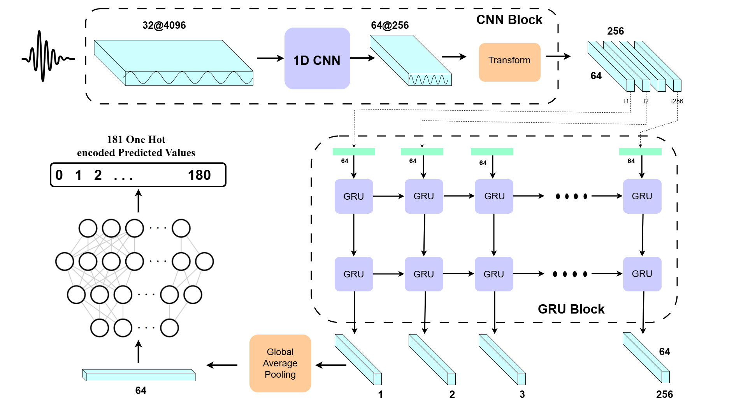
Proposed Methodology
Hybrid CNN-GRU Architecture: Combines Convolutional Neural Networks (CNNs) with Gated Recurrent Units (GRUs).

Slide 11
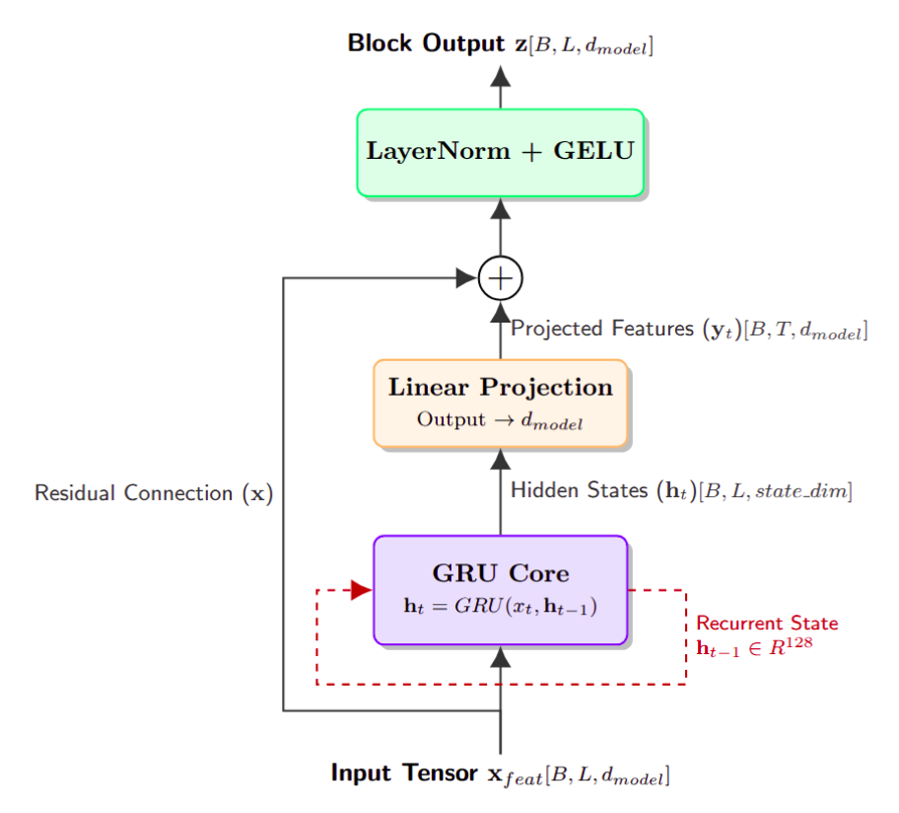
Proposed Methodology
Spatial-Temporal Modeling:
CNN Module: Extracts high-level spatial features from noisy hydrophone array data.
GRU Module: Captures the temporal dependencies and continuous trajectory of the moving target.

Slide 12
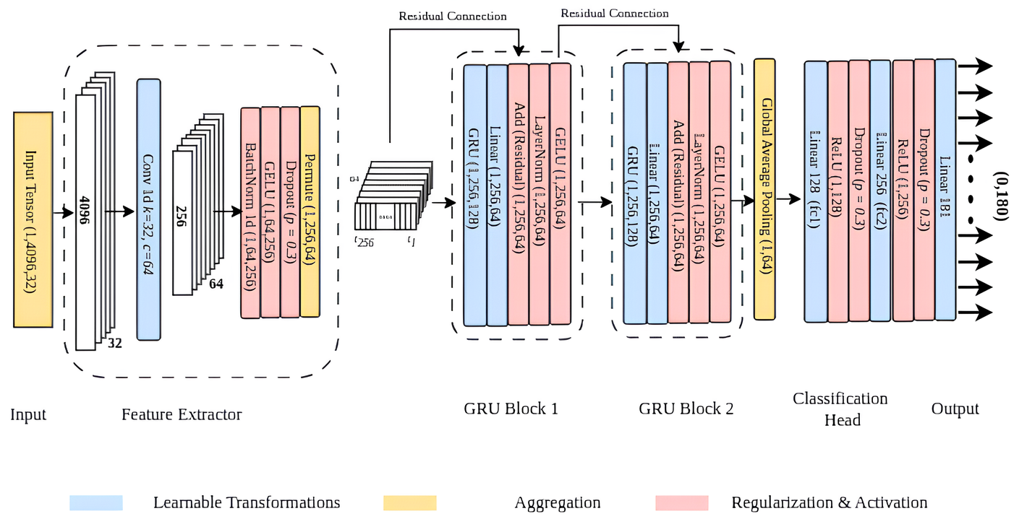
Proposed Methodology

Slide 13
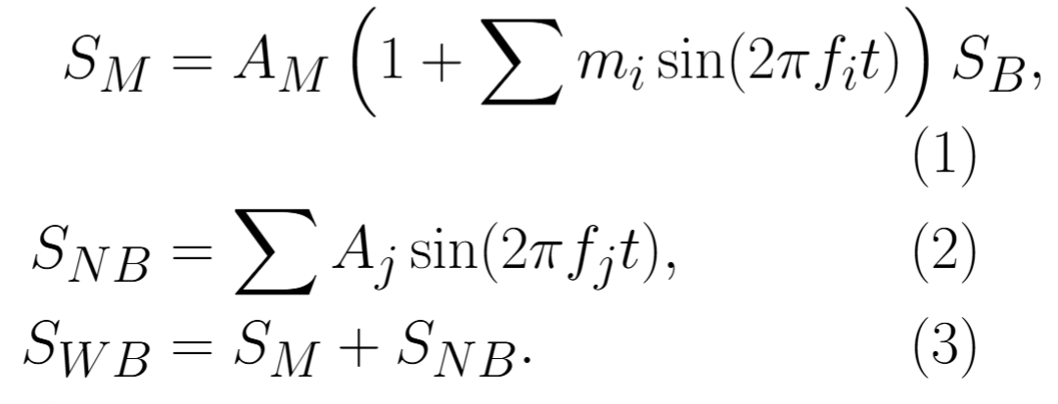
Dataset
Real ocean data is limited → synthetic data generation is used.
NB signals: tonal components (fixed frequencies).
WB signals: combination of modulated + tonal components.
Base signal SB: white Gaussian noise (100–2000 Hz, FIR filtered).
Modulation: 5 Hz and 10 Hz (m = 0.5) → mimics real variations.
Tonal components: 1200 Hz / 1300 Hz → simulate machinery noise.

Slide 14
Hardware & Software Requirements
Software Stack:
Programming Language: Python 3.8+
Deep Learning Framework: PyTorch
Signal Processing: SciPy, NumPy
Environment: Jupyter Notebook, Google Colab
Hardware Requirements:
Training: High-performance GPU (NVIDIA RTX series or cloud equivalent like Google Colab T4/A100).
Deployment/Inference Testing: Low-power edge computing devices (e.g., Raspberry Pi 4, NVIDIA Jetson Nano) to simulate sonar buoy environments.

Slide 15
Progress
Completed
In progress
 | Weeks
 | 1 - 2 | 3 - 4 | 5 - 6 | 7 - 8 | 9 - 10 | 11 - 12
Model Design
Implementation
Training & Tuning
Baseline Comparison
Edge Profiling
Final Submission

Slide 16
Expected Outcomes & Applications
Expected Outcomes:
High Accuracy Targets: Significant reduction in DOA estimation error in the 0◦ –30◦ and 150◦ –180◦ end-fire zones.
Noise Robustness: Stable performance even at low Signal-to-Noise Ratios (SNR).
Edge Suitability: A lightweight model architecture with low latency, suitable for real-time inference without SVD bottlenecks.
Key Applications:
Autonomous Underwater Vehicles (AUVs) navigation.
Expendable passive sonar buoys.
Stealth naval surveillance systems.

Slide 17
References
Kamal, Suraj & Chandran, Satheesh & M H, Supriya. (2021). Passive Shallow Water Automated Target Recognition using Deep Convolutional Bi directional Long Short Term Memory. Defence Science Journal. 71. 117-123. 10.14429/dsj.71.14929.
Xie Y, Wang B. Direction-of-Arrival Estimation Method Based on Neural Network with Temporal Structure for Underwater Acoustic Vector Sensor Array. Sensors (Basel). 2023 May 19;23(10):4919. doi: 10.3390/s23104919. PMID: 37430832; PMCID: PMC10222060.
Suraj Kamal, C. Satheesh Chandran, M.H. Supriya, Passive sonar automated target classifier for shallow waters using end-to-end learnable deep convolutional LSTMs, Engineering Science and Technology, an International Journal, Volume 24, Issue 4, 2021

Slide 18
References
Ji, F.; Ni, J.; Li, G.; Liu, L.; Wang, Y. Underwater Acoustic Target Recognition Based on Deep Residual Attention Convolutional Neural Network. J. Mar. Sci. Eng. 2023, 11, 1626.
Underwater Acoustic Target Recognition in Passive Sonar Using Spectrogram and Modified MobileNet Network Classifier. TechRxiv. 31 October 2023.
Keyhani, Erfan and Amini, Arash, Lightweight Neural Network Architecture for Passive Sonar Signal Classification.

Slide 19
Thank You
Questions & Discussion

