Slide 1


Slide 2

Library Information System

Slide 3
Group Members Introduction
S23022D443
Muhammad Azam BC200202920

Slide 4

INTRODUCTION OF PROJECT
The Library Information System is a web and desktop application designed to provide online access to the library for students, faculty & librarian.
This system automates library’s activities. The best way to maintain, organizes, and handles countless books systematically.

Slide 5
INTRODUCTION OF PROJECT
User can find books in an instant, issue/reissue books quickly, and manage all the data efficiently and orderly using this system. The purpose of a library information system is to provide instant and accurate data regarding any type of book, thereby saving a lot of time and effort.

Slide 6
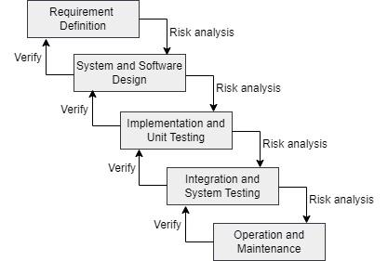
VU Process Model

Slide 7
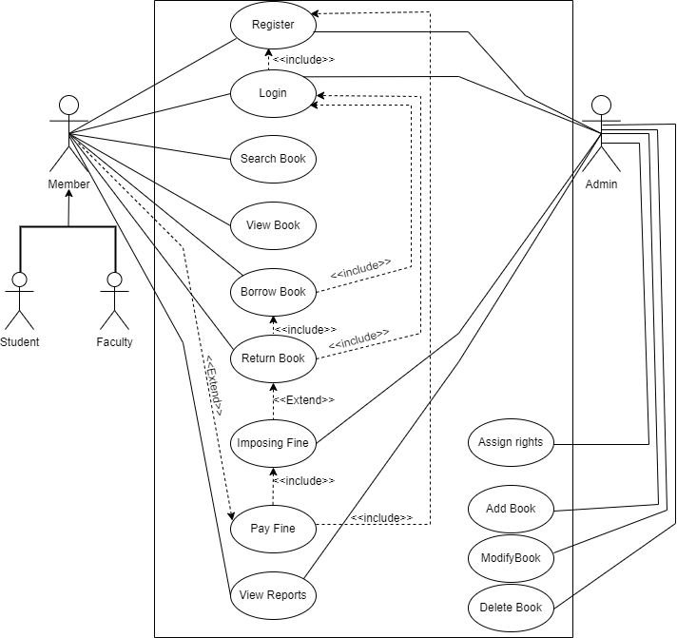
Use Case Diagram

Slide 8
Business Rules Catalog
Functional Requirements
Admin Login
    Member Registration
    Assigning rights to Faculty/ Student’s account
    Admin can add, delete or modify the details of the books.
Members
    Student/ faculty can search for the required book(s) based on author name, book name etc.

Slide 9
Business Rules Catalog
Functional Requirements
Borrow books
    A registered user can borrow the book for particular time.
Return books
    On returning a book the number of books in database should be updated/ increased
    Imposing fine in case of returning the book(s) late

Slide 10
Business Rules Catalog
Functional Requirements
Report generation for checking
    Number of available books in database
    Information regarding remaining copies of a specific book borrowed
    List of Borrowed books
    Displaying all members got fine

Slide 11
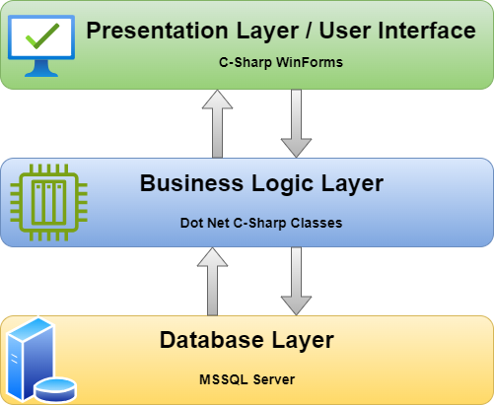
Architectural Design

Slide 12





Team Structure

Slide 13
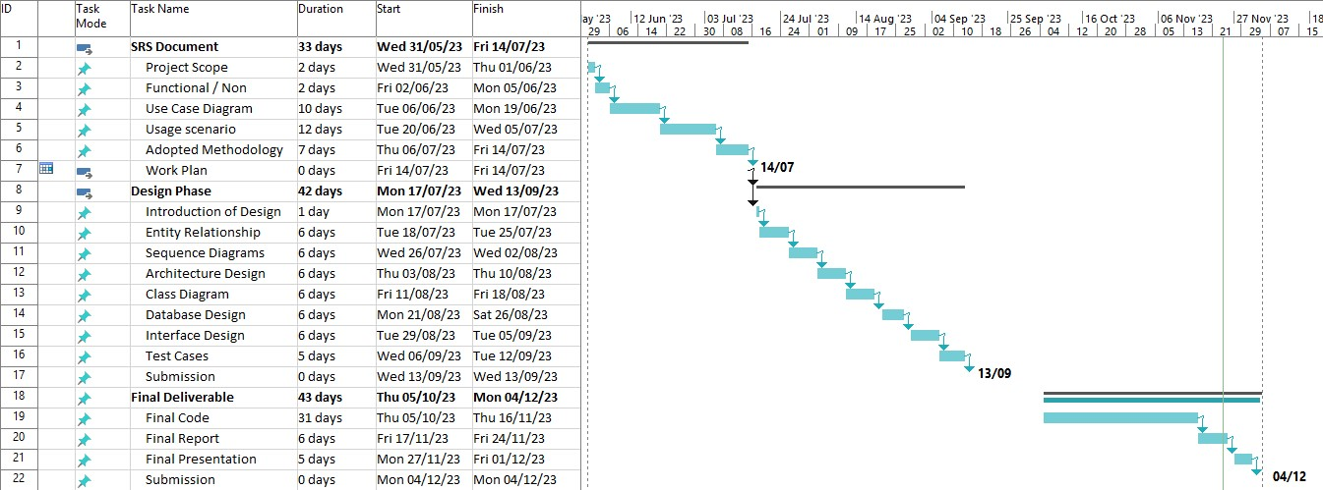
Project Schedule

Slide 14
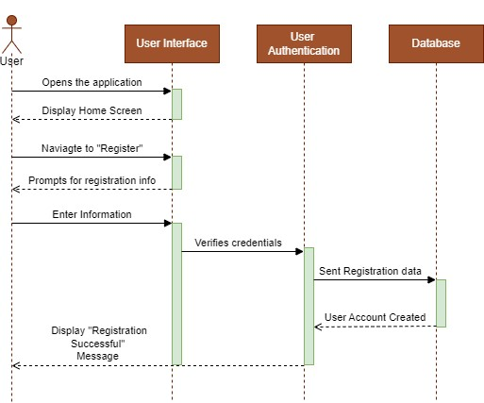
Sequence Diagrams
User Registration

Slide 15
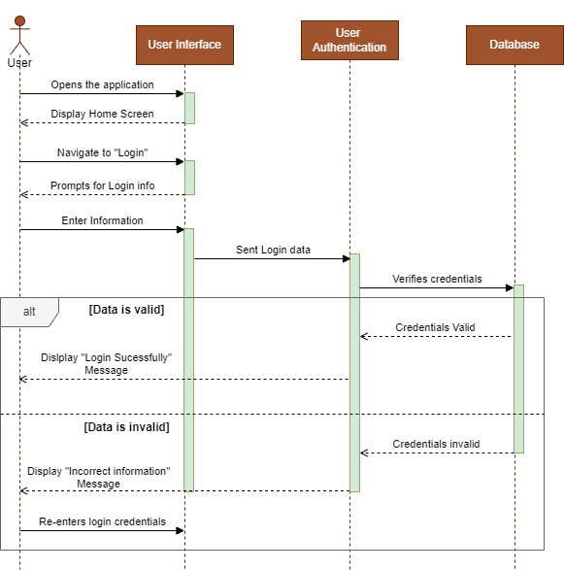
Sequence Diagrams
Login

Slide 16
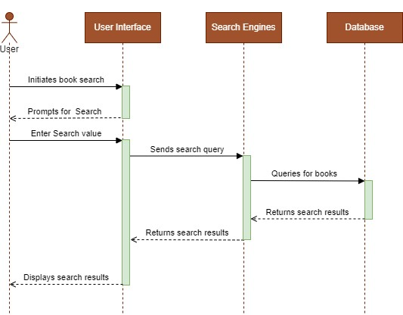
Sequence Diagrams
Search Book

Slide 17
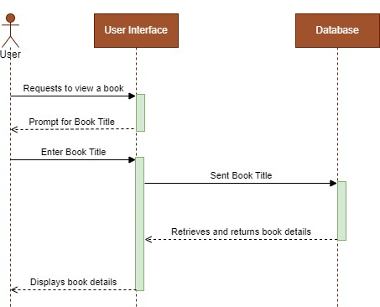
Sequence Diagrams
View Book

Slide 18
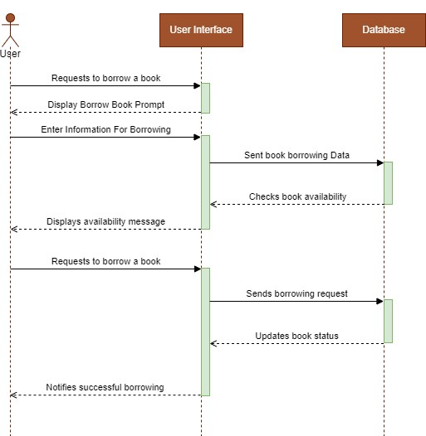
Sequence Diagrams
Borrow Book

Slide 19
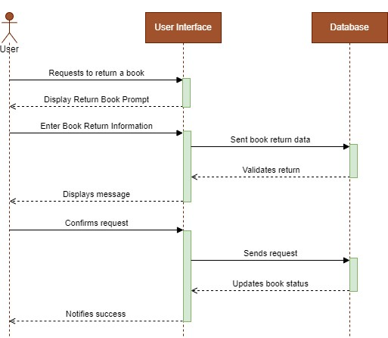
Sequence Diagrams
Return Book

Slide 20
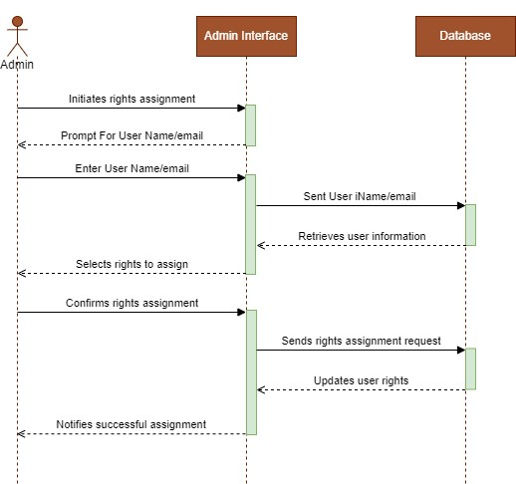
Sequence Diagrams
Assign Rights

Slide 21
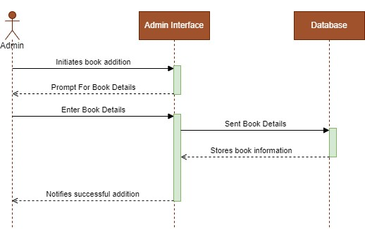
Sequence Diagrams
Add Book

Slide 22
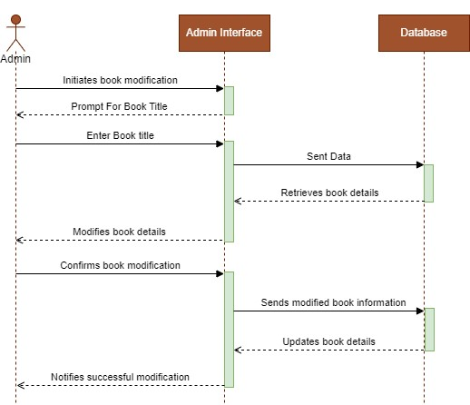
Sequence Diagrams
Modify Book

Slide 23
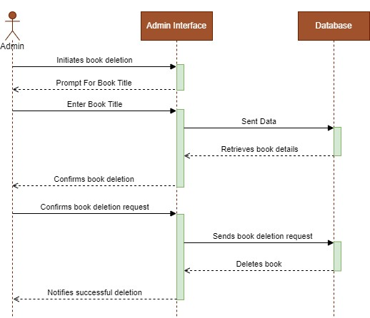
Sequence Diagrams
Delete Book

Slide 24
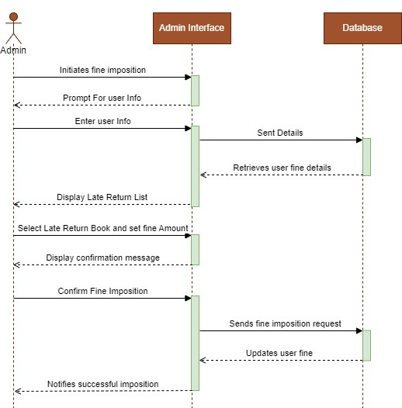
Sequence Diagrams
Impose Fine

Slide 25
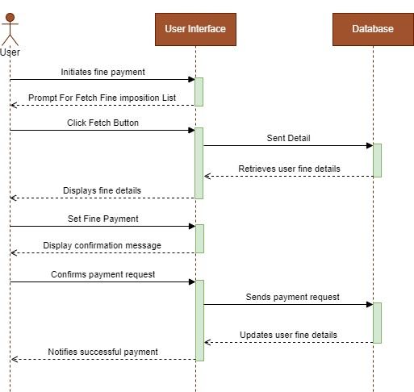
Sequence Diagrams
Pay Fine

Slide 26
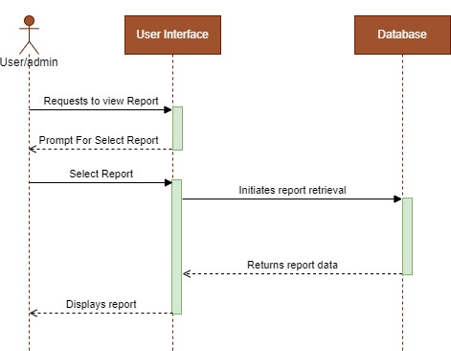
Sequence Diagrams
View Reports

Slide 27
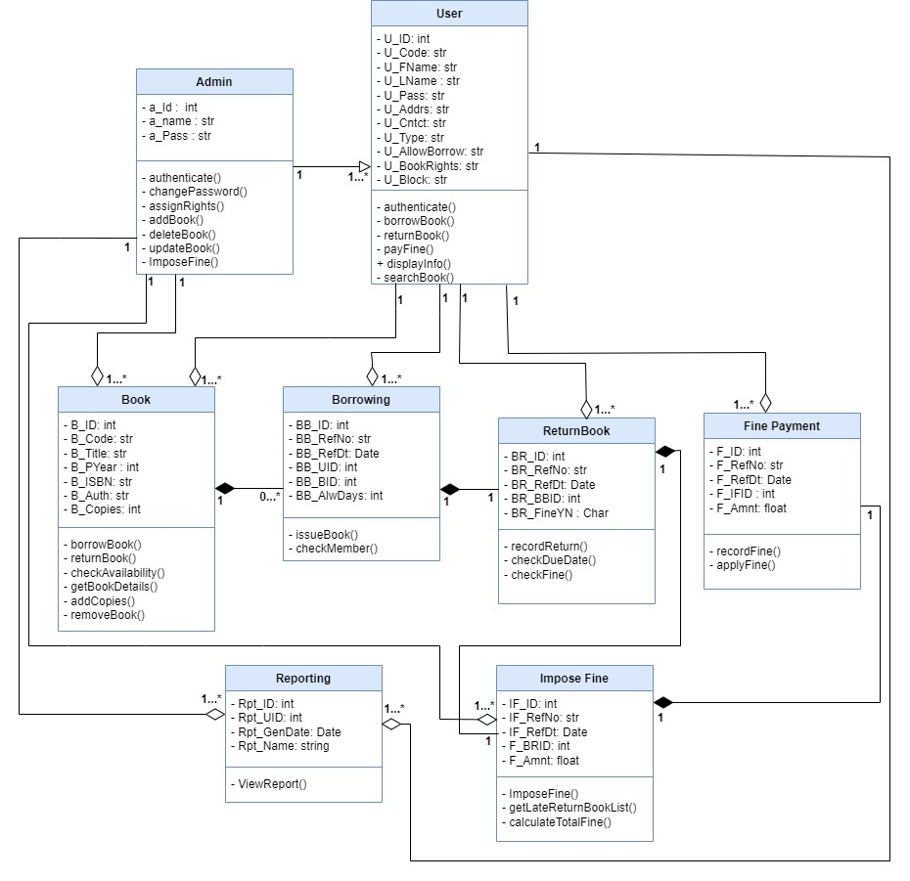
Logical Model/Class Diagram

Slide 28
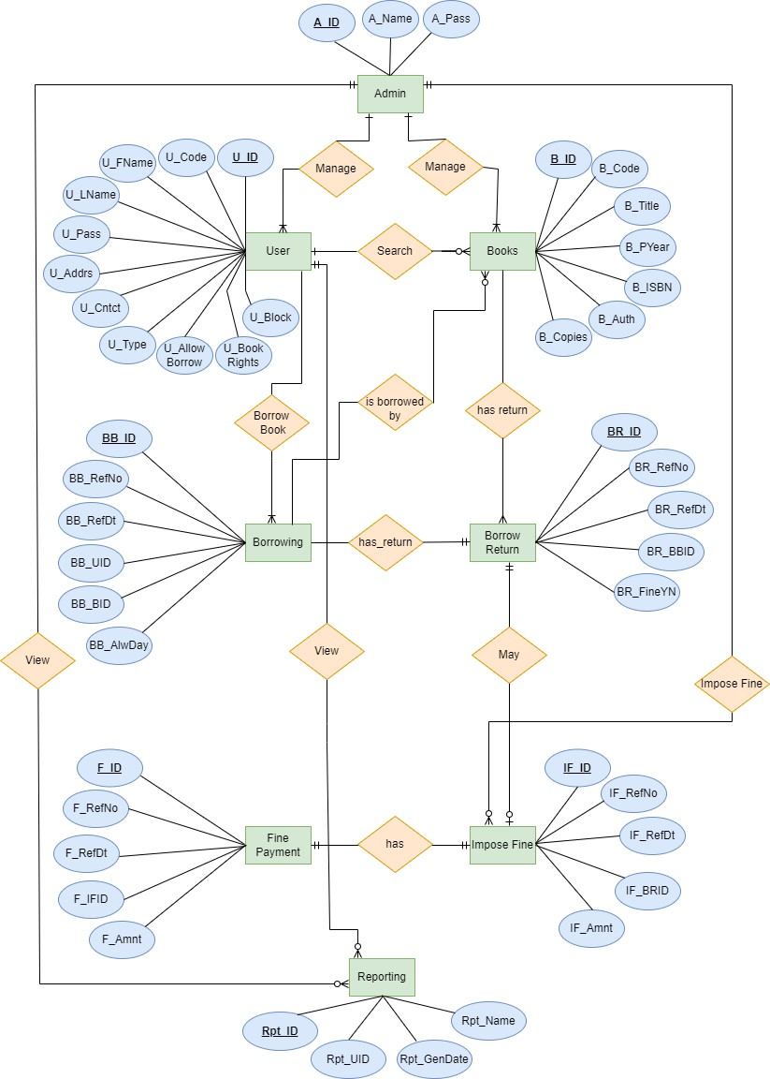
Entity-Relationship Diagram

Slide 29
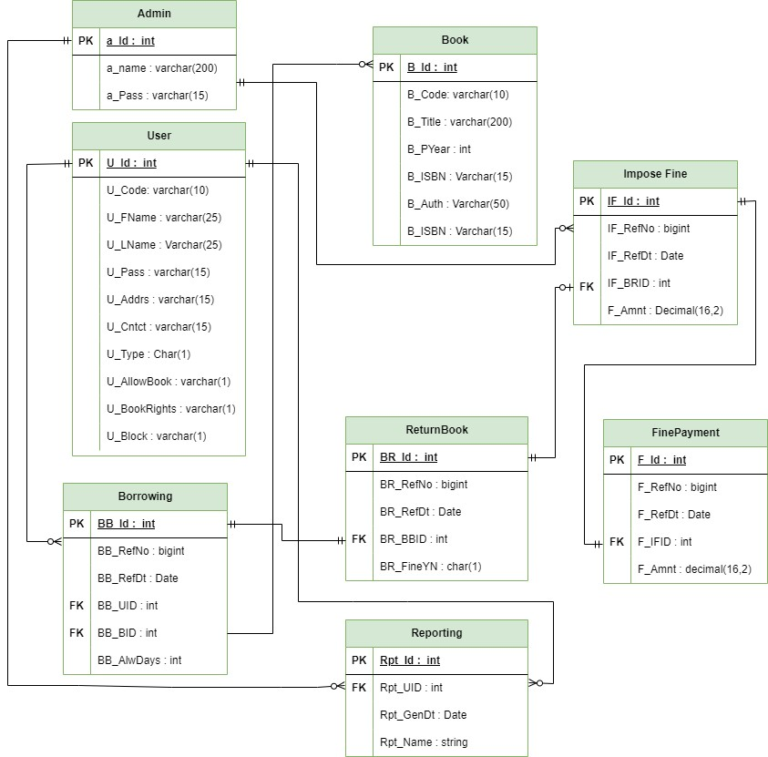
Database Diagram

Slide 30
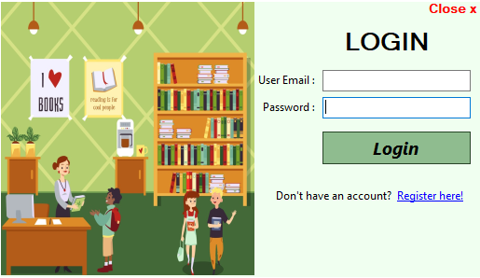
User Interfaces
Login

Slide 31
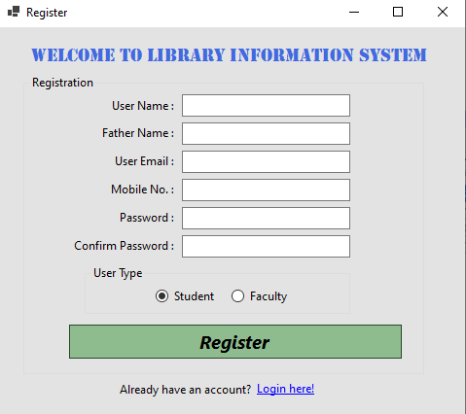
User Interfaces
Register

Slide 32
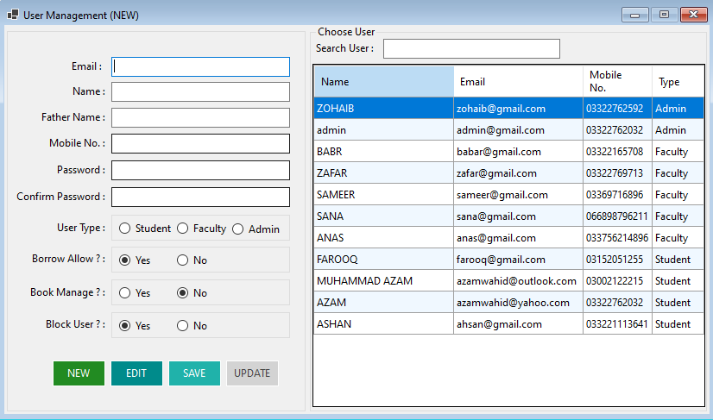
User Interfaces
User Management

Slide 33
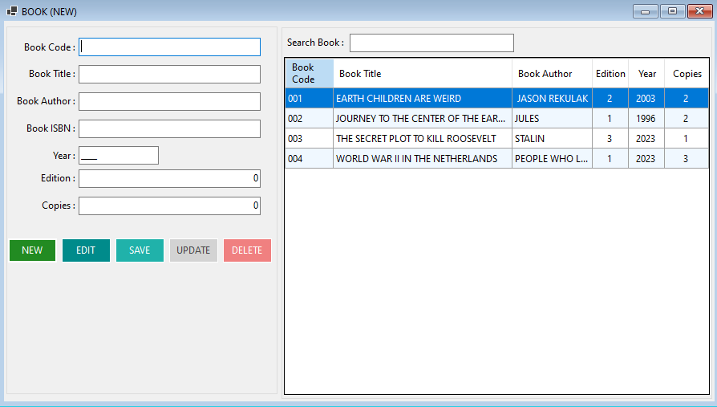
User Interfaces
Add Book

Slide 34
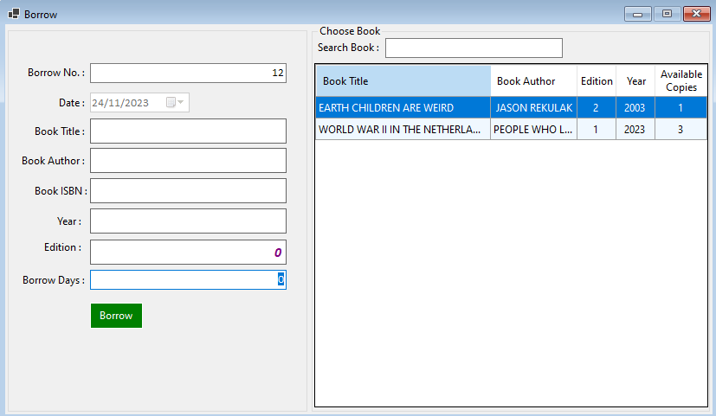
User Interfaces
Borrow Book

Slide 35
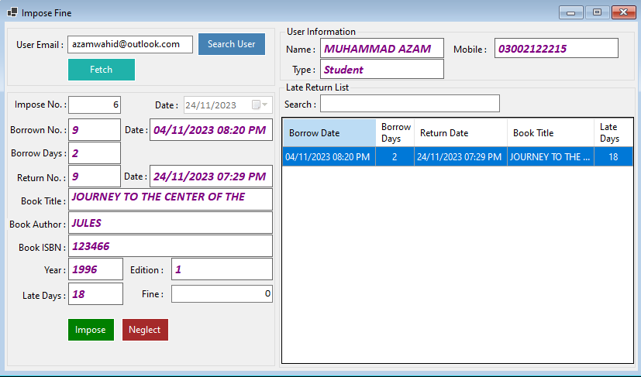
User Interfaces
Impose Fine

Slide 36
Tools
.Net Framework (4.7.2)
C-Sharp
MS SQL Server

