Slide 1
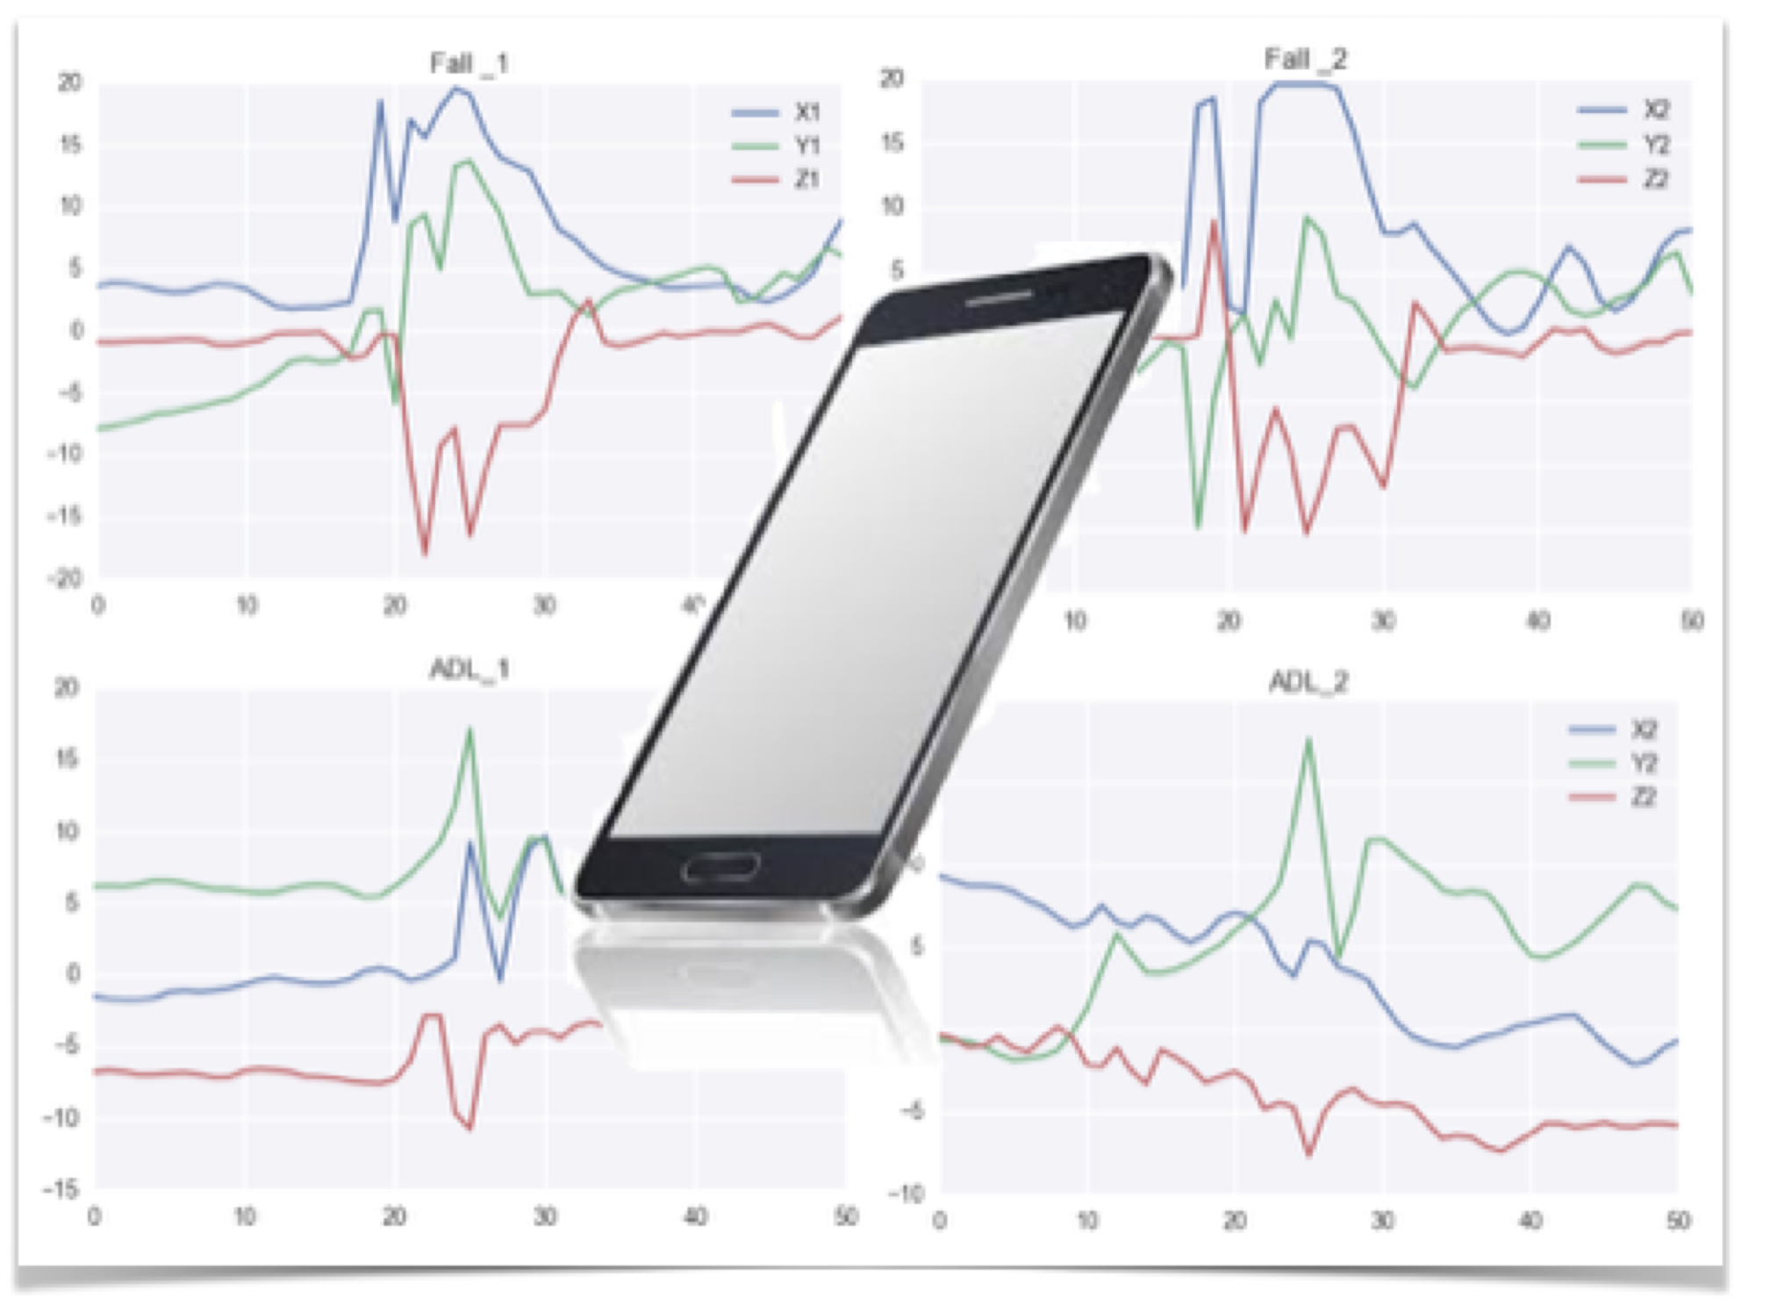
Smartphone-based Fall Detection System
ASSISTIVE TECHNOLOGIES for Bluebird Care

Slide 2
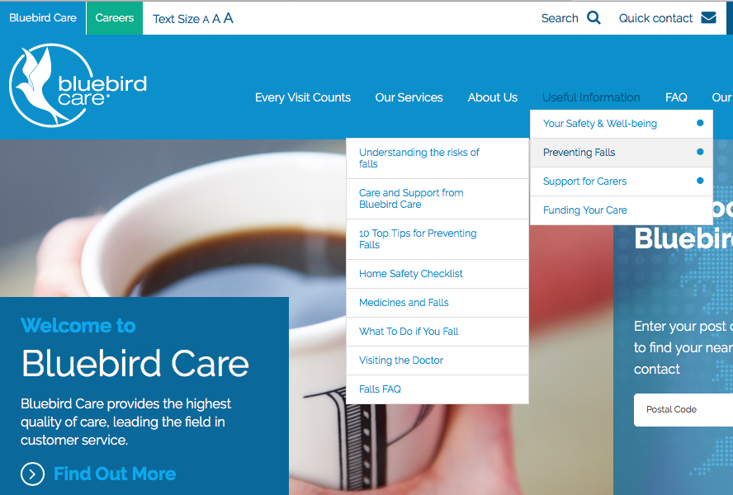
Bluebird Care Services
Support for elderly and less-able people living independently in their own home
Bluebird customers are subject to a higher risk of accidental falls
Bluebird care uses an indoor telecare system for fall notifcation
Looking for a system to be used outdoors
Smartphone-based Fall Detection System

Slide 3
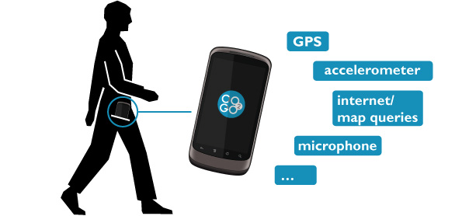
Smartphone-based Fall Detection
Smartphones are a part of everyday life.
have inbuilt sensors: an accelerometer and a gyroscope, data from which can be used for falls detection
In-built location services to automatically navigate needed help
Communication capabilities between a user and caregivers
As a proof of concept we trained a machine-learning algorithm to classify human activities and detect falls using patterns recorded by smartphone accelerometers
Smartphone-based Fall Detection System

Slide 4
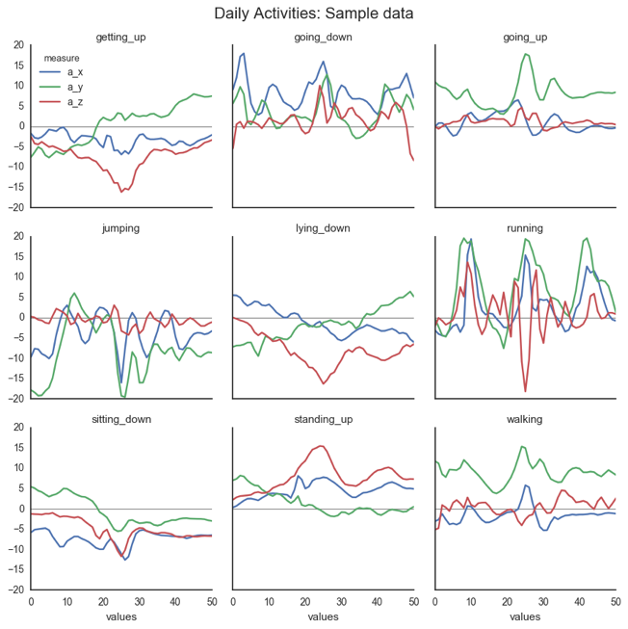
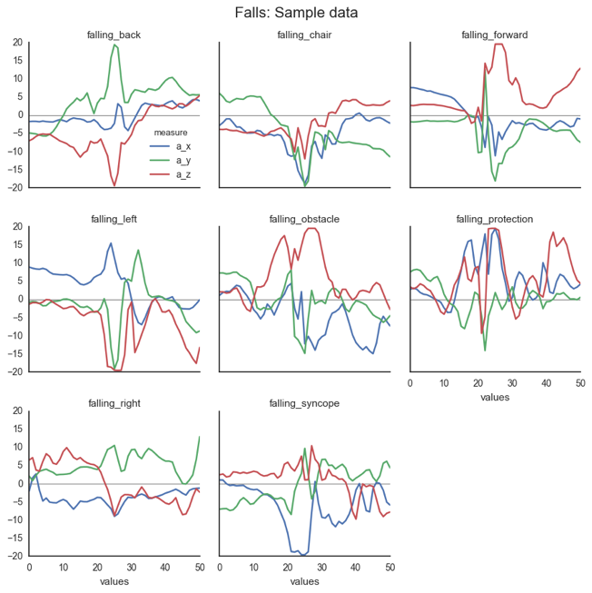
UniMib SHAR Dataset
Triaxial acceleration data captured by smartphones in the pockets
Daily Activities
walking, running , sitting down, ..
Simulated Falls
Smartphone-based Fall Detection System

Slide 5
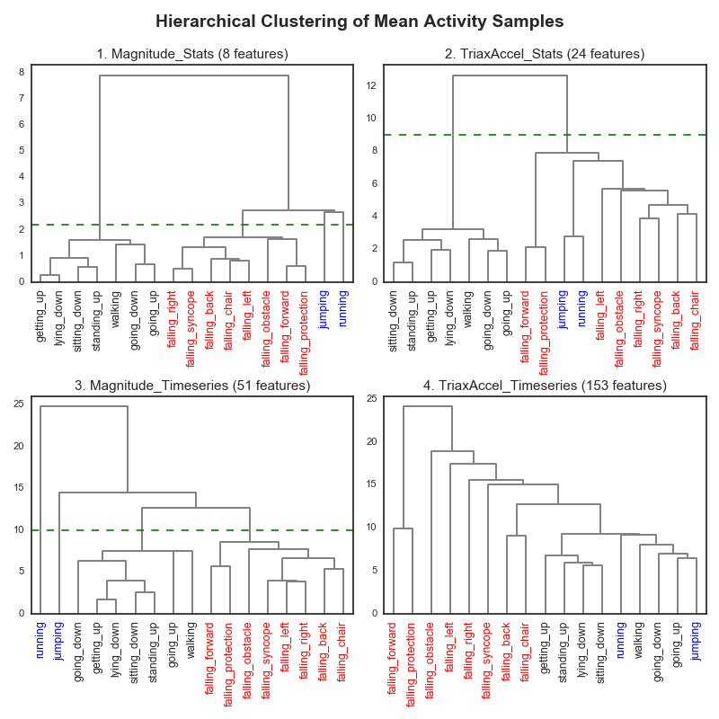
Proximity between classes
Running and jumping form separate classes
Falls and Daily activities are generally apart
Promising segregation for a classification task
Smartphone-based Fall Detection System

Slide 6
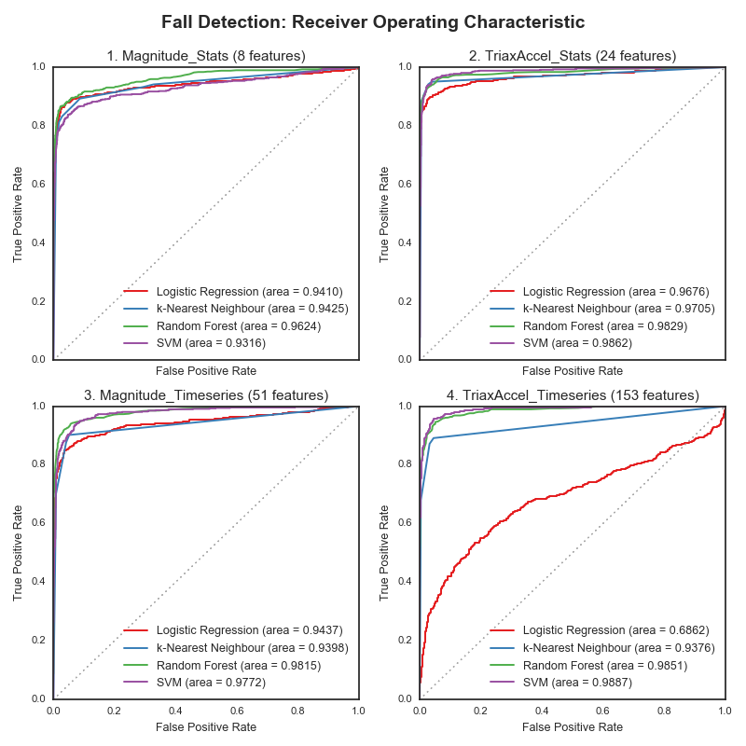
Two class classifiers for fall detection
Classifiers: Logistic Regression, kNN, Random Forest, SVM
Feature space dimensions from 8 to 151
Best performing are Random Forest and SVM
90-93% probability of fall detection
2-4% probability of false alarm
Smartphone-based Fall Detection System

Slide 7
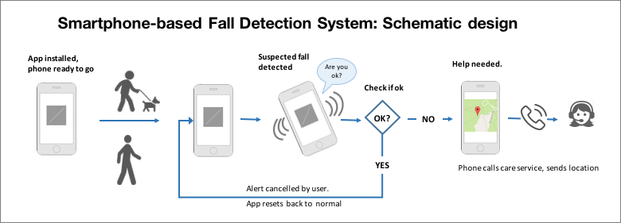
Smartphone based fall detection system
Particularly suitable for outdoor use: inbuilt location service
Communication and interaction with a user: alert messages to cancel false alarms, automatic calling to care service
Iterative machine learning: preloaded with standard model, which then can be adapt to a user
Smartphone-based Fall Detection System

Slide 8
Recommendations
Collect more data using smartphone apps, such as Sensor Kinetics
walking outdoors;
dropping a phone when no actual fall occurs;
data recorded by a phone carried in a bag.
Train a classification model: Random Forest and SVM classifiers on triaxial and magnitude acceleration timeseries
Build a prototype system. A minimal viable product of (a) an app capturing the data and (b) pre-loaded standard classification model. No connectivity to the central service required.
Run pilot studies with healthy participants: carry out daily activities and simulate falls while using the app.
Smartphone-based Fall Detection System

