Slide 1


Department of Information Technology
ABES Engineering College, Ghaziabad, UP
Project: Uber Data Analysis
Domain: Big data
Sec: IT ‘A’
Name:
Azam Ali
Roll No:
2000320130051

Slide 2
Contents
Introduction
Tasks
Requirements of Project
Graphs
Flow
Limitations
Conclusion

Slide 3
Project Introduction
This project is to visualize the Uber dataset for more understanding about the dataset.
With the help of visualization, companies can avail the benefit of understanding the complex data and gain insights that would help them to craft decisions.
This project will help us to learn how to implement the ggplot2 on the Uber Pickups dataset and at the end, master the art of data visualization in R.

Slide 4
Tasks
Plotting the trips by the hours in a day
Plotting data by trips during every day of the month
Number of Trips taking place during months in a year
Finding out the number of Trips by bases
Creating a Heatmap visualization of day, hour and month
Creating a map visualization of rides in New York

Slide 5

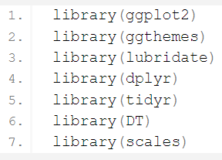

Requirements of Project
R Language
RStudio IDE
Packages: ggplot2, dplyr
Uber Database

Slide 6
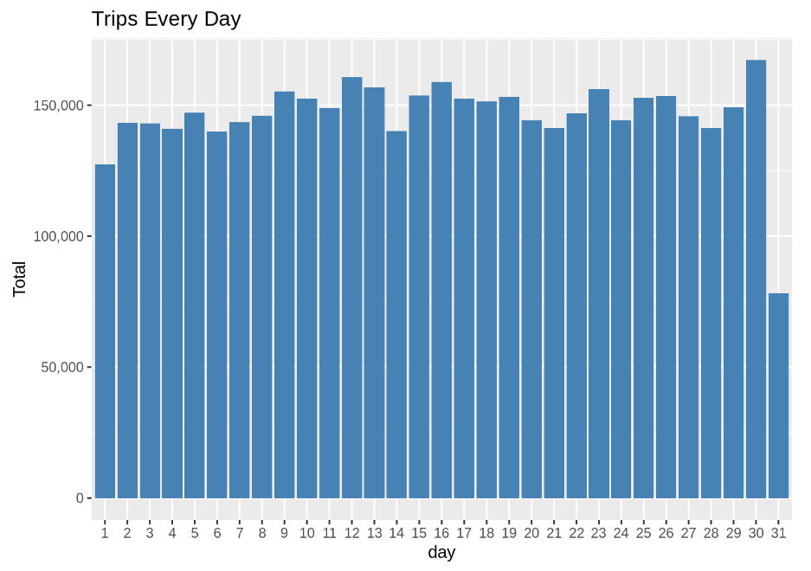
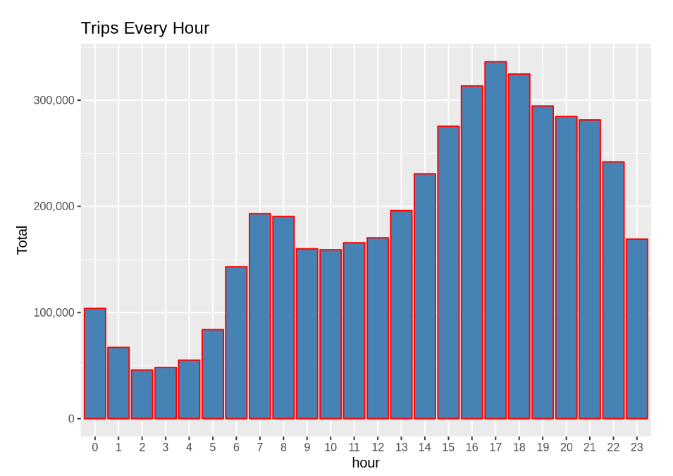
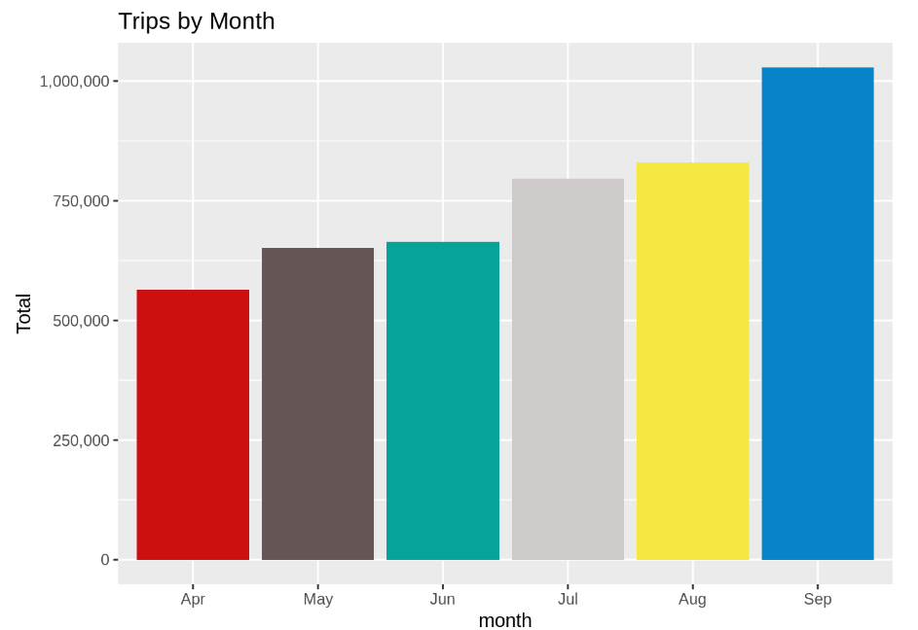
Graphs…

Slide 7
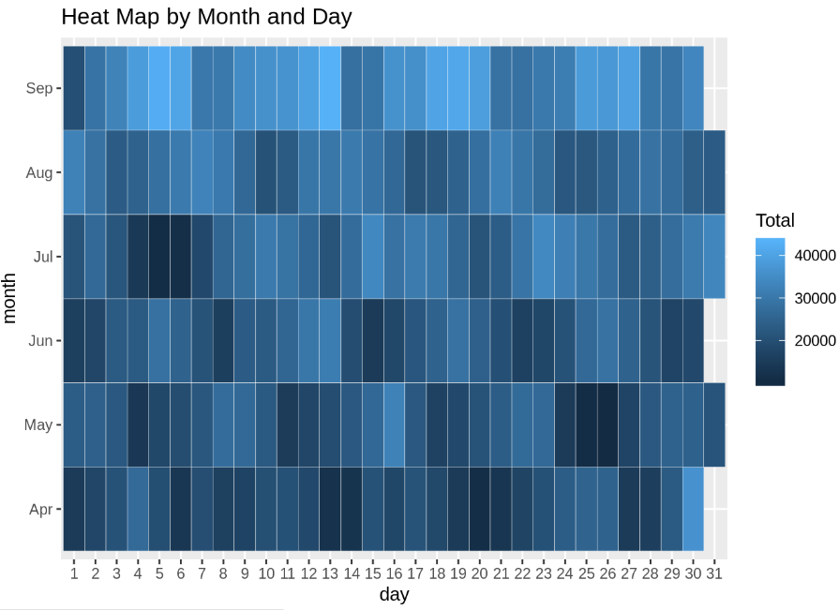
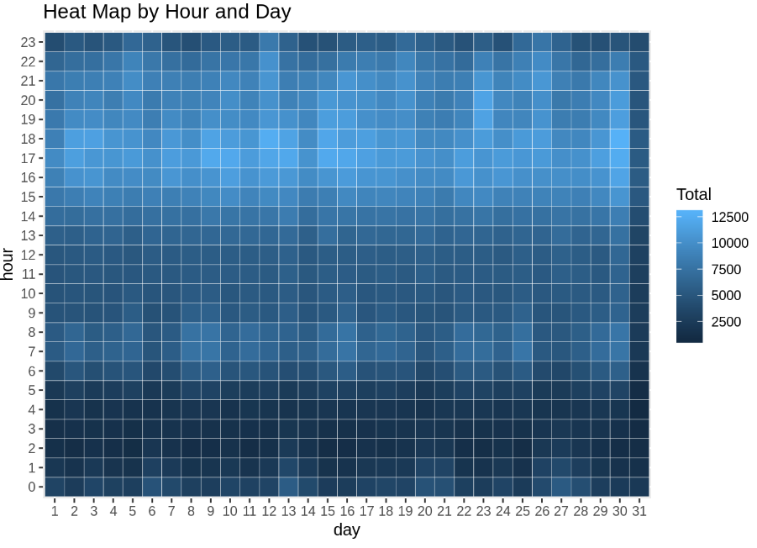
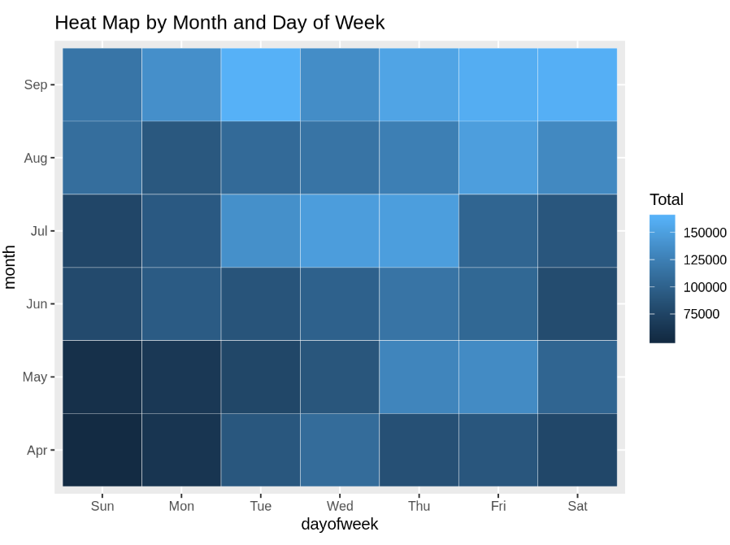
Graphs

Slide 8
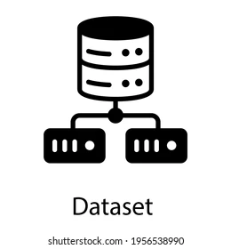
Flow
Import Packages
Collect the data
Data Manipulation
Plot the graphs acc. to given data

Slide 9
Limitations
Low quality of data
Inconsistency in data collection

Slide 10
Conclusion
At the end of the Uber data analysis R project, we observed:-
Data visualization help us for making more understanding about the complex dataset.
how to create data visualizations.
We made use of packages like ggplot2 that allowed us to plot various types of visualizations.
we could conclude how time affected customer trips.

Slide 11
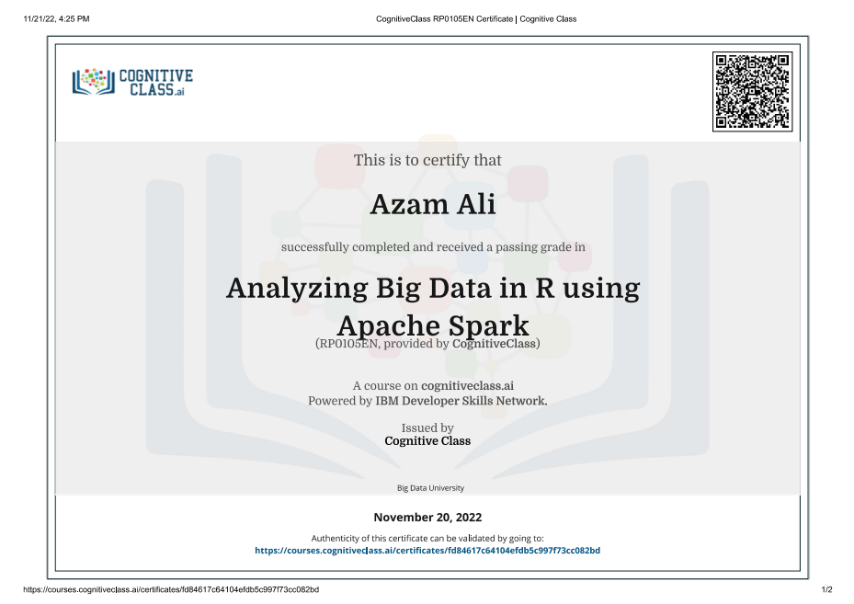
Certificate
I have completed my certification in “Analyzing Big Data in R Using Apache Spark” from “Cognitive Class”.

Slide 12
Thank You!

