Slide 1

Distribution network optimization
© 2023 Actum Digital

Slide 2
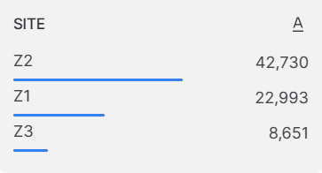
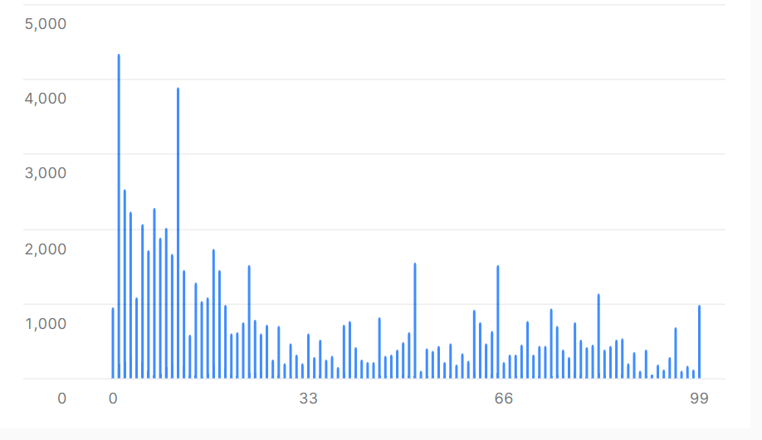
Number of transactions 74374
Client ID 1 has the most orders - 4334
1,08% of data is null
Transportations by Train 45170
Transportations by Truck 29204
100 unique customers
General
Statistics
Number of orders

Slide 3
109 records of SITE is missing
810 records of Weight is missing
Z1 – 64 Distance is missing
Z2 – 67 Distance is missing
Z1 – 83 Distance is missing
DATA EXPLORATION
Expedition Table
Value | Num Of Missing | Method
Site | 109 | Discard
Weight | 810 | Discard
Distance Matrix Table
Customer | Site | Distance | Method
64 | Z1 | 0 | Discard
67 | Z2 | 0 | Discard
83 | Z3 | 0 | Discard

Slide 4
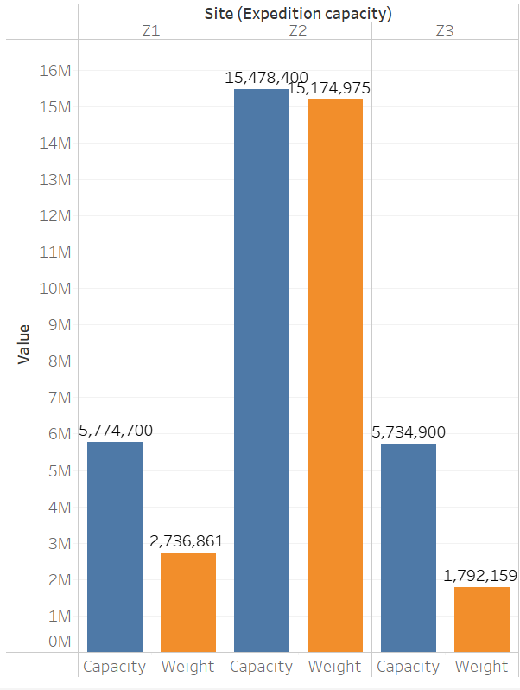
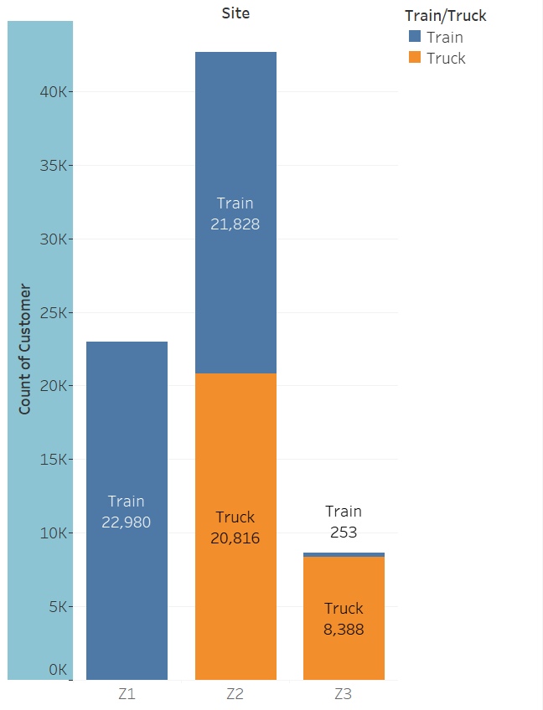
Z1 and Z3 have a lot of unused space which leads to ineffective allocation of resources.
Z2’s capacity is almost full.
Z1 transports materials only by train
Z3 transports materials mostly by trucks
Major issues

Slide 5
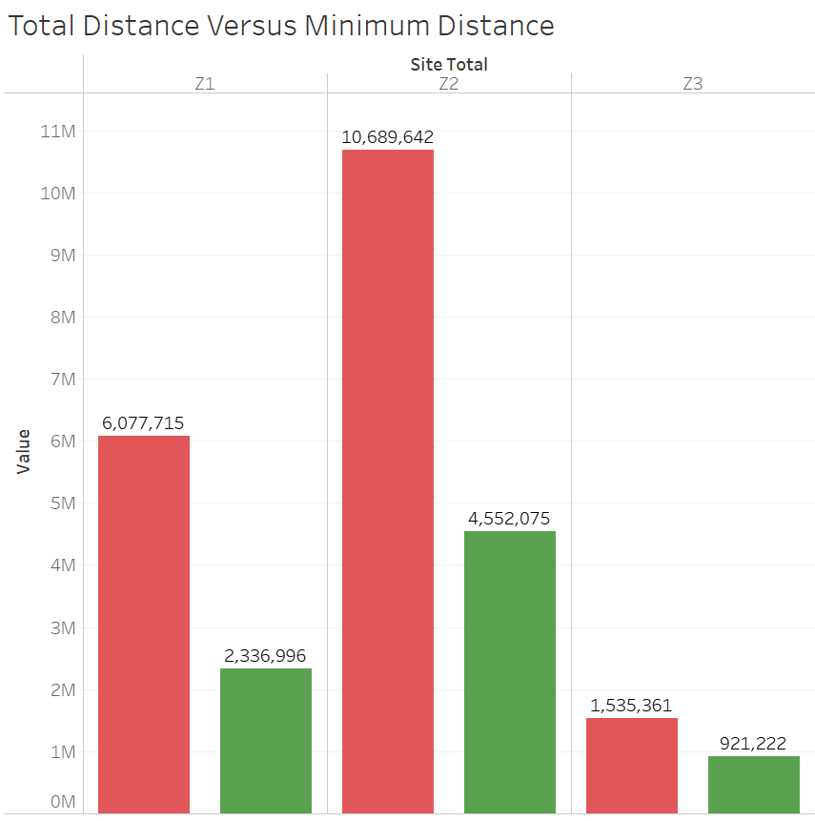
The most important issue:
Production Sites located too far from clients.
By redistributing sites to nearby customers, we can reduce transportation costs and reduce traveled distance.
Distance Difference

Slide 6
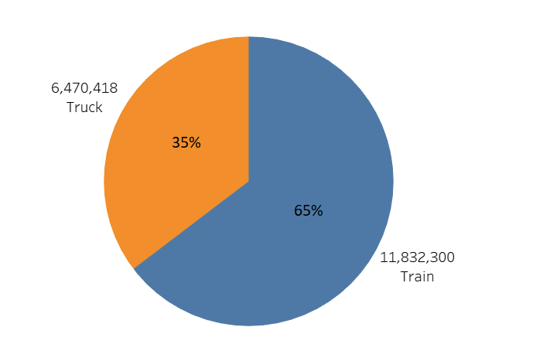
Total Distance: 18.3 mil. km
Cost estimation for 2017: 112.09 mil. EUR
Distance traveled in km
Cost Estimation
Cost Estimation | Distance(km) | Weight(t) | Price per KM | Price estimate
Train | 11832300 | 12333868 | € 8.38 | € 99,154,674.00
Truck | 6470418 | 7395460 | € 2.00 | € 12,940,836.00
Total | 18302718 | 19729328 |  | € 112,095,510.00
Source: DELLA™ Loads and Trucks (direct customers, loads search, backway loads, search load, available and backway transport)
Source: DB_Cargo_Preisliste_SuwB_ENG_2023.indd (dbcargo.com)

Slide 7
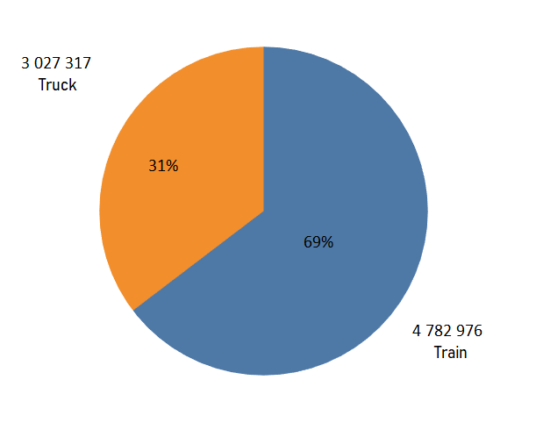
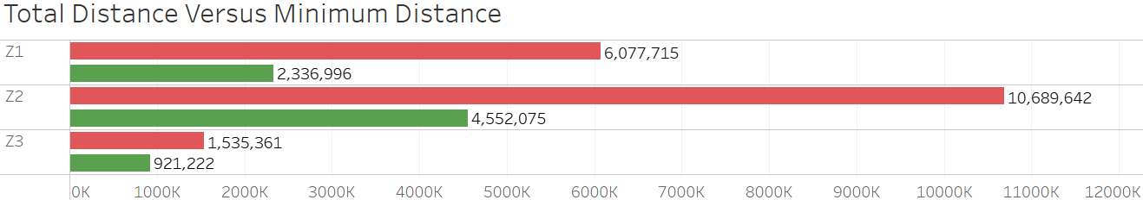
If we consider the ideal scenario, where we will be able to provide each customer with the nearest production site, we will save more than 65 million EUR.
Distance traveled in km
Ideal Scenario
MinDistEst | Distance(km) | Price per KM | Price Estimate
Train | 4782976 | € 8.38 | € 40,081,338.88
Truck | 3027317 | € 2.00 | € 6,054,634.00
Total | 7810293 |  | € 46,135,972.88
Source: DELLA™ Loads and Trucks (direct customers, loads search, backway loads, search load, available and backway transport)
Source: DB_Cargo_Preisliste_SuwB_ENG_2023.indd (dbcargo.com)

Slide 8
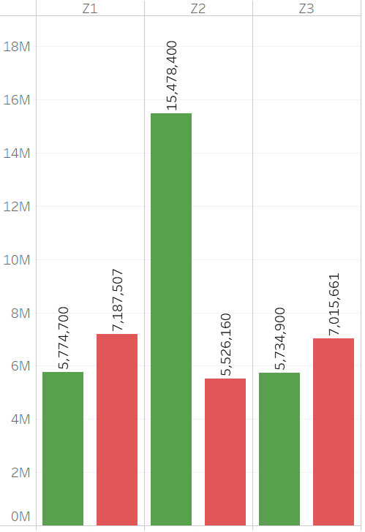
Total weight capacity 26,9 mil. T.
Total weight transported: 19.7 mil. T.
To be able to provide each customer with the nearest production site, we have to increase capacities of Z1 by at least 25% and Z3 by at least 23%
Solution
Weight capacity of Sites in t
In Case of ideal scenario
Site | Capacity (t / year) | SUM(WEIGHT) | Capacity Increase
Z1 | 5774700 | 7187507 | 24.47%
Z2 | 15478400 | 5526160 | No increase required
Z3 | 5734900 | 7015661 | 22.33%

Slide 9
Recommendations
Optimize Space Utilization: To improve operational efficiency, it is recommended to explore strategies for increase space at Z1 and Z3 to be able to provide to each customer with the nearest production site
Diversify Transportation Methods: To optimize transportation costs and logistics, consider diversifying the transportation methods used at each production site. For instance, exploring alternative transportation modes for Z1 beyond trains and for Z3 beyond trucks could lead to cost savings and increased efficiency.
Keep data clean and structured
© 2023 Actum Digital

