Slide 1
A Language Modeling Approach for Temporal Information Needs
Azamat Shora

Slide 2
Main Idea of the paper
Temporal information: dates and time expressions
fifa world cup 1990s != France won the FIFA World Cup in 1998
A significant percentage of queries has temporal information needs behind them
1) about 1.5% of web queries were found to contain an explicit temporal expression
2) about 7% of web queries have an implicit temporal intent

Slide 3
Tasks
Need to improve search results for time-sensitive queries
The goal is to develop a model that can identify and rank documents based on their relevance to a specific time or time range
A novel approach that integrates temporal expressions into a language model retrieval framework
A comprehensive experimental evaluation on the New York Times Annotated Corpus, as a real-world dataset

Slide 4

Model
tb_{l} and tb_{u} - a lower bound and upper bound for the begin boundary of the time interval
te_{l} and te_{u} - a lower bound and upper bound for the end boundary of the time interval
“in 1998”
( 1998/01/01, 1998/12/31, 1998/01/01, 1998/12/31 )
T can refer to any time interval [b, e]
b ∈ [tb_{l}, tb_{u} ]
e ∈ [te_{l}, te_{u} ]

Slide 5
Model
For notational convenience we use the format YYYY/MM/DD
textual part d_{text} and its temporal part d_{time}
inclusive mode - a temporal expression are still included
exclusive mode - no longer included in the textual part
boston july 4 2002,
Inclusive mode
q_{text} = {boston, july, 4, 2002}
Exclusive mode
q_{text} = {boston}

Slide 6



Model
query-likelihood approach:
P ( q_{text} | d_{text} ) - Ponte and Croft model (existing text-based query-likelihood approach)
model is prone to the zero-probability problem: Jelinek-Mercer smoothing

Slide 7
Differences between methods
Model | Focus | Description
Uncertainty-Aware Language Model | Uncertainty in Language | Captures and incorporates the inherent uncertainty and variability in word usage within documents and queries. Aims to improve retrieval performance by better understanding the natural ambiguity in language.
Uncertainty-Ignorant Language Model | Traditional Language Modeling | Standard language model that does not consider uncertainty or ambiguity in word usage. It focuses solely on the relevance of documents to the query based on content, ignoring the uncertainty aspect of language.
LmT (Language Model with Temporal information) | Temporal Information | Focuses on incorporating temporal information to better handle time-sensitive queries. Estimates document relevance based on both content and temporal factors, aiming to improve retrieval performance for queries with temporal aspects.

Slide 8




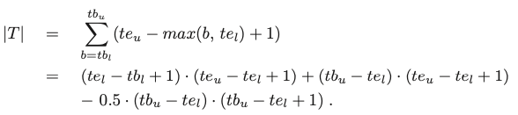
Uncertainty-Aware Language Model

Slide 9
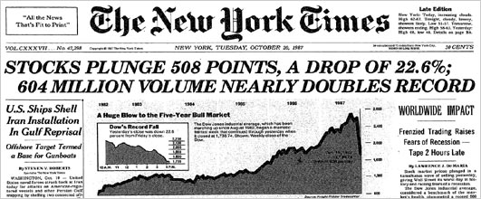
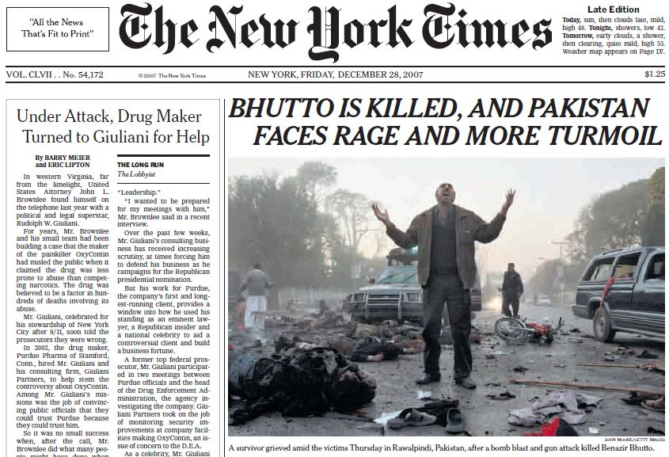
Data
As a dataset for our experimental evaluation we use the publicly-available New York Times Annotated Corpus that contains about 1.8 million articles published in New York Times (NYT) between 1987 and 2007

Slide 10
Methods
Method | Description
Lm(γ) | Unigram language model with Jelinek-Mercer smoothing
LmT-IN(γ, λ) | Uncertainty-ignorant method using inclusive mode
LmT-EX(γ, λ) | Uncertainty-ignorant method using exclusive mode
LmtU-IN(γ, λ) | Uncertainty-aware method using inclusive mode
LmtU-EX(γ, λ) | Uncertainty-aware method using exclusive mode
γ and λ - {0.25, 0.5, 0.75}

Slide 11
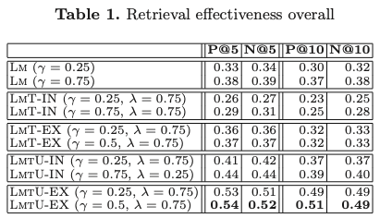
Experimental Results
The exclusive mode outperforms the inclusive mode for both LmT and LmtU,
LmT does not yield improvements over the baseline Lm, but
LmtU is at par with the baseline Lm when the inclusive mode is used and outperforms it significantly when used with the exclusive mode.

Slide 12
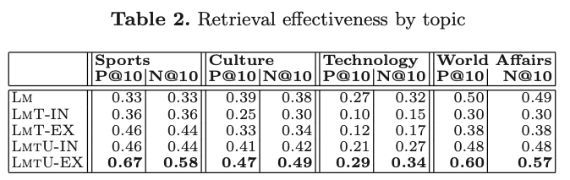
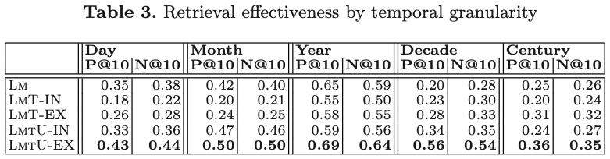
Experimental Results

Slide 13
Evaluation
LmtU-EX consistently achieves the best retrieval performance
considering the uncertainty inherent to temporal expressions is essential
excluding terms that constitute a temporal expression from the textual part of the query is beneficial
These findings are confirmed by a second experiment on a snapshot of the English Wikipedia

Slide 14
Comparison with other approaches/methods
Author(s) - [Proposed] LmT Model | Approach/Method - Language Model with Temporal information
Li and Croft (2003) | Time-based document priors
Jones and Diaz (2007) | Temporal profiles based on the publication times of relevant documents
Alonso et al. (2007) | Modeling temporal expressions using temporal probabilistic models
Metzler et al. (2009) | Implicitly temporal queries - bias ranking functions in favor of documents matching the user’s implicit temporal intent
Dakka et al. (2008) | Time-sensitive query auto-completion
Berberich et al. (2010) | Temporally-aware text classification

Slide 15
Conclusion
Approach substantially improves retrieval effectiveness for temporal information needs
Ongoing and Future Work
implicit temporal expression
Bill Clinton Arkansas
Bill Clinton’s time as Governor of Arkansas between 1971 and 1981

Slide 16
References
Berberich, Klaus, Srikanta Bedathur, Omar Alonso, and Gerhard Weikum. "A language modeling approach for temporal information needs." In Advances in Information Retrieval: 32nd European Conference on IR Research, ECIR 2010, Milton Keynes, UK, March 28-31, 2010. Proceedings 32, pp. 13-25. Springer Berlin Heidelberg, 2010.
Li, X., Croft, W.B.: Time-based language models. In: CIKM (2003)
Alonso, O., et al.: On the value of temporal information in information retrieval. SIGIR Forum (2007)
Dakka, W., et al.: Answering general time sensitive queries. In: CIKM (2008)

