Slide 1
MFBA
Magnet Faculty Battle Arena
A MOBA by Jason Qiu
and Adam Zamlynny

Slide 2
Processing
We used Processing’s Python Mode due to familiarity in structure and draw functions.
We also used OpenGL instead of Processing’s renderer to achieve reasonable framerates.

Slide 3
Use of Classes and OOP
Classes greatly help in complex games with many pieces, and greatly reduce redundancy
For example, since creeps, towers, and players all attack, you can have them all inherit the same basic attack function and modify it, and call it in the same way.

Slide 4
OOP, cont.
For each class, we also have “trackers” for the respective class that runs all calculations, rendering, etc. for them
We also have managers for mouse and keyboard input.

Slide 5
Pathfinding
Player
Creep

Slide 6
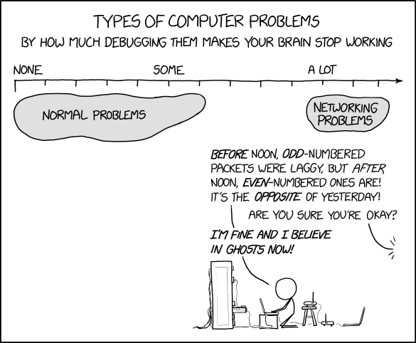
Multiplayer

Slide 7
Multiplayer
Client and Server code
  Server assigns Clients a player number, does calculations, sends all data to Clients
  Client processes player input and interaction, then sends updated data to Server

Slide 8
Controls/Play This Game
Install Processing
  Go to processing.org to download processing, then inside the IDE, select the dropdown menu with “Java.” then “add mode,” “Python”
Clone our repo
  git clone “https://github.com/Azamlynny/MFBA.git”
  You should get all our repo’s files.

Slide 9
Controls/Play This Game cont.
Run Server
  Open /src/Server/Driver/
  Run server code by pressing the play button,
  note your local ip address
    ipconfig in Windows CMD
    ifconfig in Linux/Git Bash/MacOS/BSD/Unix
    Get-NetIPAddress | Format-Table in Windows Powershell
    Usually, looks like ‘192.168.1.*’ where * is any number, but can look different
Run Client
  Replace ip variable in Driver file with your ip address from the server
  Run by clicking the play button
  If you switch tabs back to the IDE, you can see what player you are

Slide 10
Controls/Play This Game, cont.
Mouse
  Right click: move, lock target if clicked on a target
  Left click: use abilities (if selected) or see GUI of other players (if you click them)
  Middle click + drag: pan camera
Keyboard
  Q: select ability 1
  E: select ability 2
  WASD: pan camera
  Space (hold): keep camera locked onto yourself
  Alt (hold): show range circles of towers
The Goal is to make it down the lanes and destroy the enemy’s Nexus. You have to destroy their defensive towers along the way.

