Slide 1
Tortilla Price Analysis
This project analyzes and compares tortilla prices in Mexico between Mom-and-Pop stores and Big Retailers from 2007 to 2023 to uncover pricing trends and regional variations

Slide 2
Introduction
Objective: The project aims to compare tortilla prices in different types of stores and regions in Mexico from 2007 to 2023 to find trends, regional differences, and how store type affects prices.
Background: Tortillas are a key part of Mexican food and culture. Knowing how prices vary between different types of stores and regions helps consumers, retailers, and policymakers. This project looks at how prices at Mom-and-Pop stores compare to Big Retailers over time.
Importance: Understanding price differences is important for everyone involved. This project helps consumers make informed choices, guides retailers in setting prices, and supports policymakers in understanding market conditions and food pricing.

Slide 3
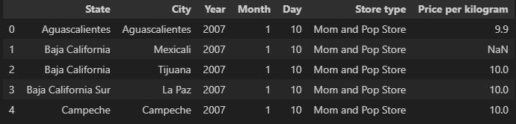
Dataset Description
This dataset contains information on tortilla prices across various states in Mexico from 2007 to 2024. It includes data collected from both small Mom-and-Pop stores and Big Retail.
Key Variables:
State: The Mexican state where the data was collected.
City: The city within the state.
Year: The year of the data entry.
Store Type: The type of store (e.g., Mom-and-Pop, Big Retailer)
Price Per Kilogram: The price of tortillas per kilogram

Slide 4
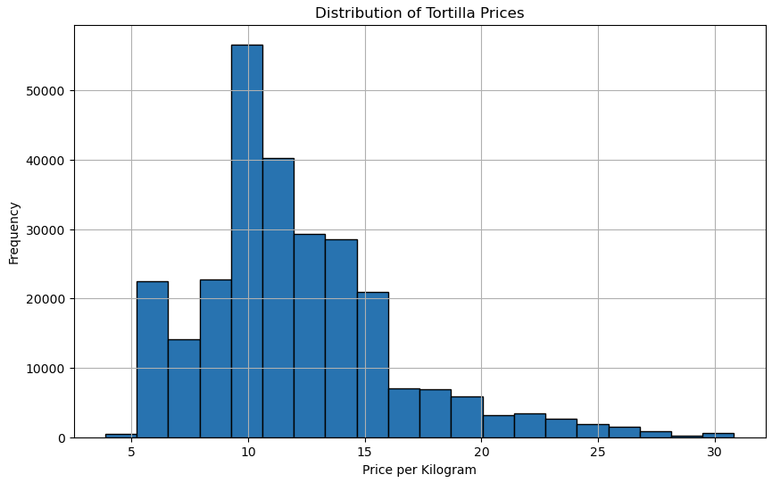
Distribution of Prices
We found that the average price per kilogram was approximately 10 pesos.
Notes:
Overall, our analysis revealed that the average price for tortillas across the various regions and store types was approximately 10 pesos per kilogram. This average reflects a comprehensive overview of tortilla pricing, taking into account the diverse factors influencing costs in different locations and types of retail establishments.

Slide 5
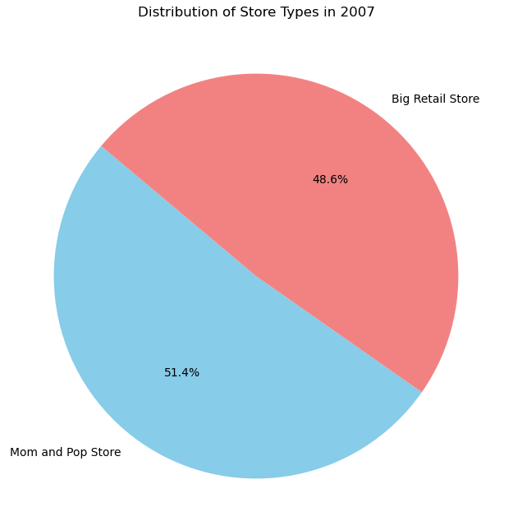
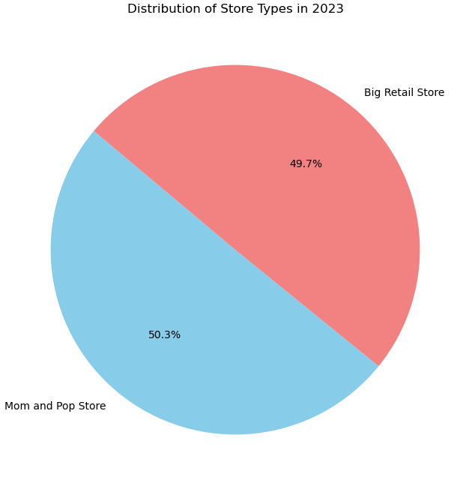
Distribution of Store Types
Big Retail Stores experienced an increase in their number of locations, while Mom-and-Pop Stores saw a decline.* Could pricing be influencing the reduction in Mom-and-Pop stores?
*The dataset used in this analysis is intended for monitoring inflation and may not fully represent the distribution of stores.
Notes:
When comparing the years 2007 and 2023, we observe a notable shift in the retail landscape: the number of Big Retail stores has increased, while the number of mom-and-pop stores has decreased. Specifically, in 2007, the proportion of mom-and-pop stores compared to Big Retail stores was 2.8%, but by 2023, this difference had diminished significantly to just 0.6%. This dramatic change raises the question of whether pricing strategies could be a contributing factor to the reduction in the number of mom-and-pop stores. Could the higher prices charged by mom-and-pop stores compared to their larger counterparts be influencing their decline?
It is important to note that this dataset is designed for monitoring inflation and may not fully capture the accurate distribution of stores.

Slide 6
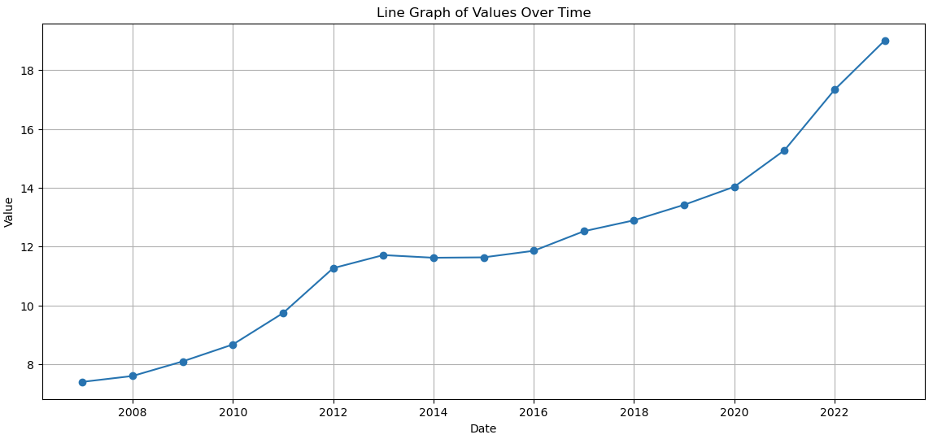
Increase of Tortilla Prices from 2007-2023
The most significant price increase occurred between 2021 and 2023, while there was no notable price change between 2013 and 2015.
Notes:
Analyzing the trends in tortilla prices from 2007 to 2023, we observe that although there were no notable changes in prices between 2013 and 2015, the most significant increase in prices occurred between 2021 and 2023. This upward trend in prices began in 2018, which aligns with the implementation of the United States-Mexico-Canada Agreement in October of 2018. This agreement replaced the previous North American Free Trade Agreement, and its introduction appears to have coincided with the start of rising tortilla prices, marking a pivotal shift in the pricing dynamics observed during this period.

Slide 7
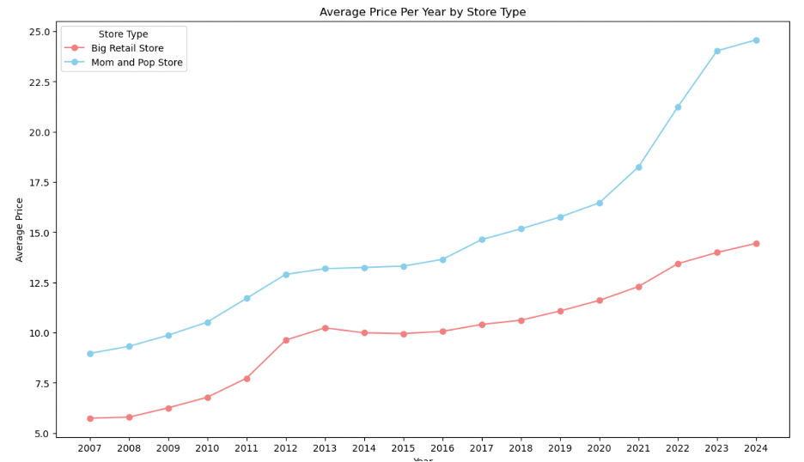
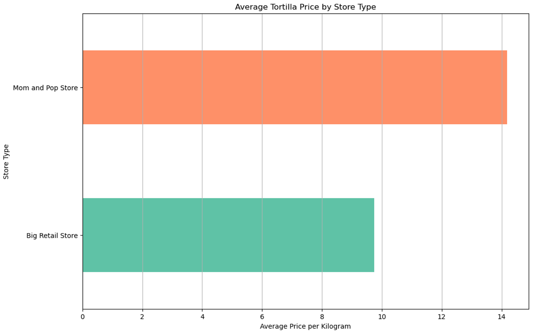
Average Price Per Year by Store Type
Pre-COVID, tortilla prices at mom-and-pop stores were roughly 3 pesos per kilogram higher than those at big retail stores.
Post-COVID, the price difference grew to about 10 pesos per kilogram.
The team anticipated that mom-and-pop store prices would be higher than big retailers to offset lower sales volumes.
Notes:
Before the COVID-19 pandemic, mom-and-pop stores charged approximately 3 pesos more per kilogram for tortillas compared to big retailers. However, following the pandemic, this price disparity widened significantly, reaching around 10 pesos per kilogram. This increase in price difference reflects the team's anticipation that mom-and-pop stores, due to their lower sales volumes, would need to set higher prices to offset their reduced sales and maintain profitability.

Slide 8
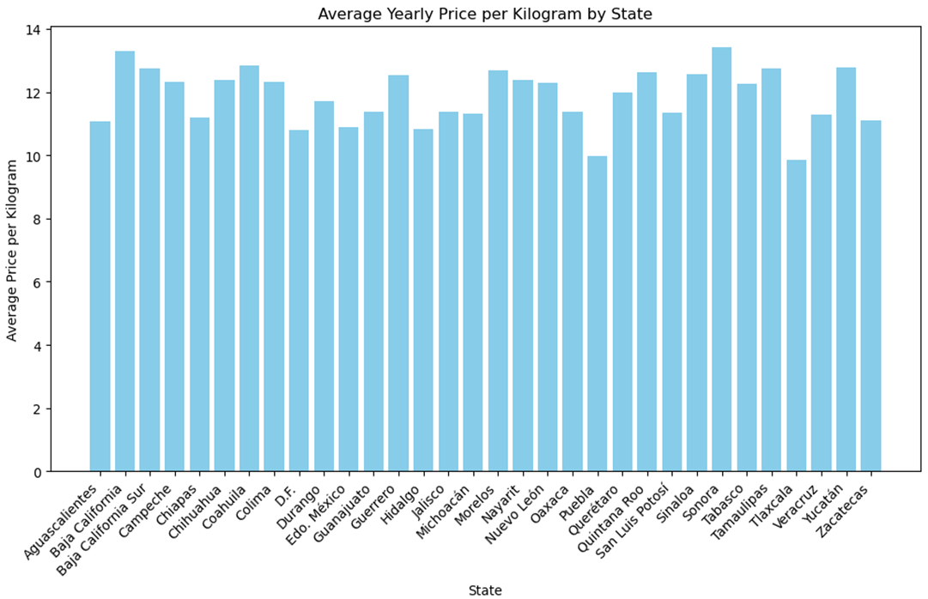
Price Comparison by State
The price range from state to state remains within about 4 pesos.
States bordering the United States have higher prices per kilogram, with spikes near tourist destinations like Cancun.
States further from the U.S. border, particularly those closer to Mexico City, tend to have lower prices per kilogram.
Notes:
Tortilla prices vary across different states in Mexico but generally stay within a range of about 4 pesos per kilogram. States located near the U.S. border and popular tourist destinations, such as Cancun, tend to have higher prices. In contrast, states that are further from the U.S. border, particularly those closer to Mexico City, usually have lower prices per kilogram. This pattern suggests that geographical factors and proximity to major commercial and tourist areas significantly influence tortilla pricing.

Slide 9
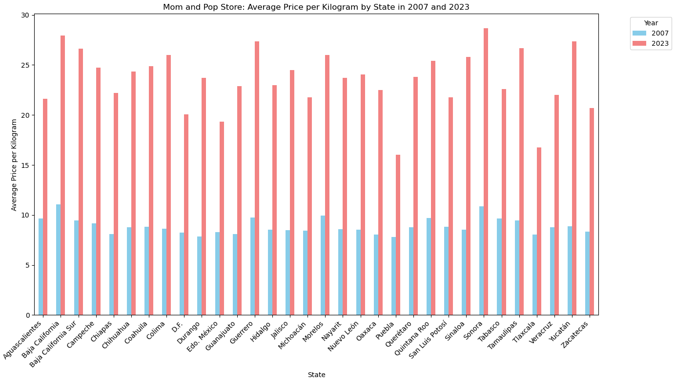
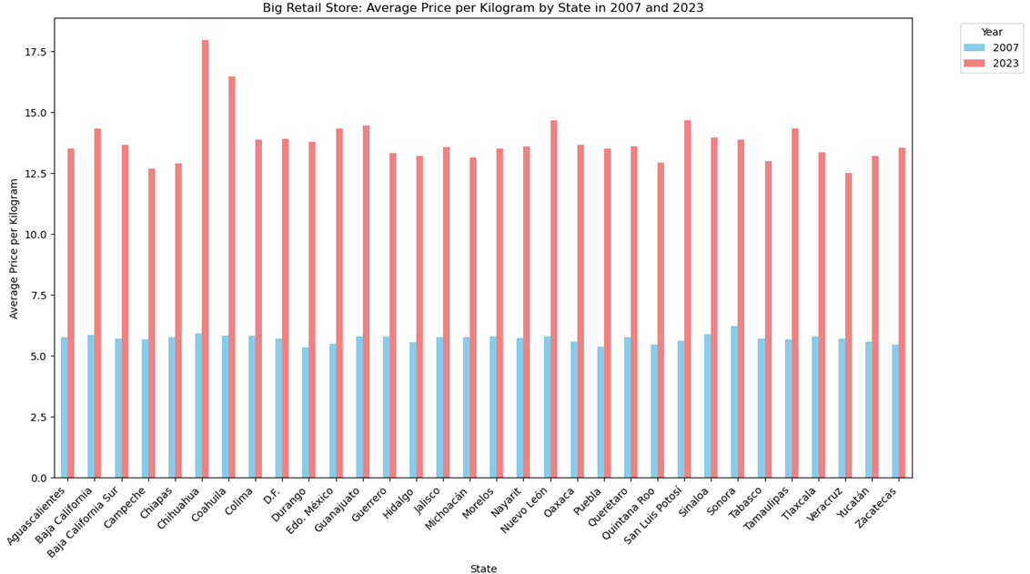
Average Tortilla Price by State and Store Type
There was greater price fluctuation in 2023 at Mom-and-Pop stores.
Prices at big retailer stores remained stable in 2023, ranging from approximately 12.5 to 15 pesos, except in the outlier states of Chihuahua and Coahuila.
Notes:
In 2023, mom-and-pop stores experienced considerable price fluctuations, reflecting more variability in tortilla prices compared to previous years. Conversely, prices at big retailer stores remained relatively stable throughout the year, consistently ranging from approximately 12.5 to 15 pesos per kilogram. However, there were exceptions in the outlier states of Chihuahua and Coahuila (Koh-ah-Wee-lah), where prices deviated from this range.

Slide 10
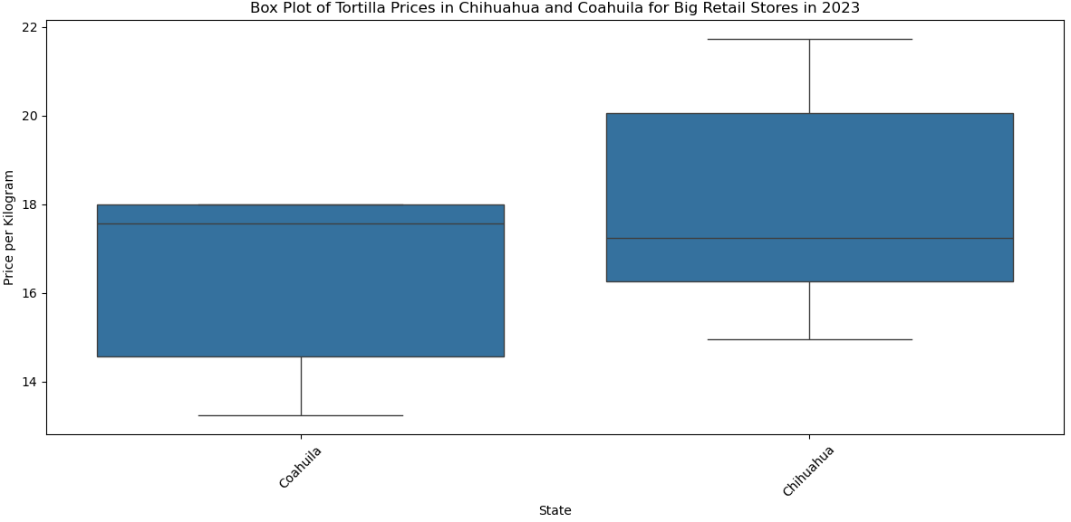
Price Distribution of Tortillas in Chihuahua and Coahuila (2023)
Higher Price Clustering
Narrow Range
Left-Skewed Distribution
Broad Price Variation
Diverse Market
Right-Skewed Distribution
Notes:
In 2023, tortilla prices in Coahuila and Chihuahua displayed distinct patterns that contribute to their higher pricing compared to other states:
Coahuila: Tortilla prices are consistently higher with less variation, indicating that consumers encounter similar prices across different stores. This uniform pricing suggests a stable market environment, but also contributes to higher average prices, which may be influenced by factors such as higher operational costs or market conditions specific to the region.
Chihuahua: Prices exhibit a broader range, with more options available at both lower and higher price points. This greater price diversity reflects varying market conditions or store types, which could include premium offerings or higher operational expenses. The presence of both lower and higher price points, along with potentially greater market variation, contributes to an overall higher price range compared to states with prices averaging between 12.5 to 15 pesos.
Overall, the uniform pricing in Coahuila and the diverse price range in Chihuahua lead to higher average tortilla prices compared to other states where prices are more consistently within the 12.5 to 15 pesos range. These differences highlight how local market dynamics, operational costs, and pricing strategies affect regional tortilla pricing.

Slide 11
Conclusion
The analysis of tortilla prices per kilogram in Mexico reveals distinct differences between mom-and-pop stores and big retailers. Key findings include:
Price Differences: Mom-and-pop stores consistently have higher prices for tortillas compared to big retailers. This disparity increased from about 3 pesos per kilogram pre-COVID to approximately 10 pesos per kilogram post-COVID.
Price Fluctuation: In 2023, mom-and-pop stores exhibited significant price fluctuations, while big retailer prices remained stable, ranging from about 12.5 to 15 pesos per kilogram, with exceptions in Chihuahua and Coahuila.
Impact of Inflation and Post-COVID Effects: Inflation and post-COVID economic conditions notably influenced tortilla prices. Mom-and-pop stores were more affected by these factors compared to big retailers, reflecting their greater sensitivity to market changes.
Regional Price Differences: Price variations generally stayed within 4 pesos per kilogram. Higher prices were observed near the U.S. border and tourist areas, while prices were lower closer to Mexico City.
Overall, the analysis highlights clear trends: mom-and-pop stores faced more pronounced price increases and volatility compared to big retailers. The findings underscore how economic factors and regional differences impact pricing strategies between these two types of stores.
Notes:
In conclusion, our project has highlighted a significant disparity in tortilla prices between mom-and-pop stores and big retailers in Mexico. Throughout the years, mom-and-pop stores have consistently charged higher prices compared to big retailers, with the most notable price fluctuations occurring in 2023 for these smaller stores. Post-COVID inflation, particularly after 2020, has had a more substantial impact on mom-and-pop store prices than on those of big retailers. Major events, such as the United States-Mexico-Canada Agreement, have also influenced price increases for both store types. Additionally, the price range from state to state remains within about 4 pesos, with higher prices in states near the U.S. border and tourist destinations like Cancun, and lower prices in regions closer to Mexico City. Overall, distinct trends and regional differences are evident when comparing tortilla prices across different store types, providing valuable insights for consumers, retailers, and policymakers.

Slide 12





Contributors
Ashley Charles
Azania Hood-Hosten
Leah Mathena
Sarah Sherry
Vanessa Ivarra

