Slide 1
Tortilla Price Analysis
This project analyzes and compares tortilla prices in Mexico between Mom-and-Pop stores and Big Retailers from 2007 to 2023 to uncover pricing trends and regional variations

Slide 2
Introduction
Objective: The project aims to compare tortilla prices in different types of stores and regions in Mexico from 2007 to 2023 to find trends, regional differences, and how store type affects prices.
Background: Tortillas are a key part of Mexican food and culture. Knowing how prices vary between different types of stores and regions helps consumers, retailers, and policymakers. This project looks at how prices at Mom-and-Pop stores compare to Big Retailers over time.
Importance: Understanding price differences is important for everyone involved. This project helps consumers make informed choices, guides retailers in setting prices, and supports policymakers in understanding market conditions and food pricing.

Slide 3
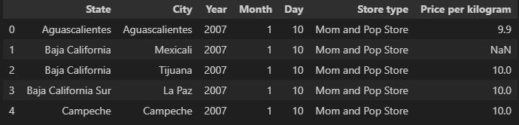
Dataset Description
This dataset contains information on tortilla prices across various states in Mexico from 2007 to 2024. It includes data collected from both small Mom-and-Pop stores and Big Retail.
Key Variables:
State: The Mexican state where the data was collected.
City: The city within the state.
Year: The year of the data entry.
Store Type: The type of store (e.g., Mom-and-Pop, Big Retailer)
Price Per Kilogram: The price of tortillas per kilogram

Slide 4
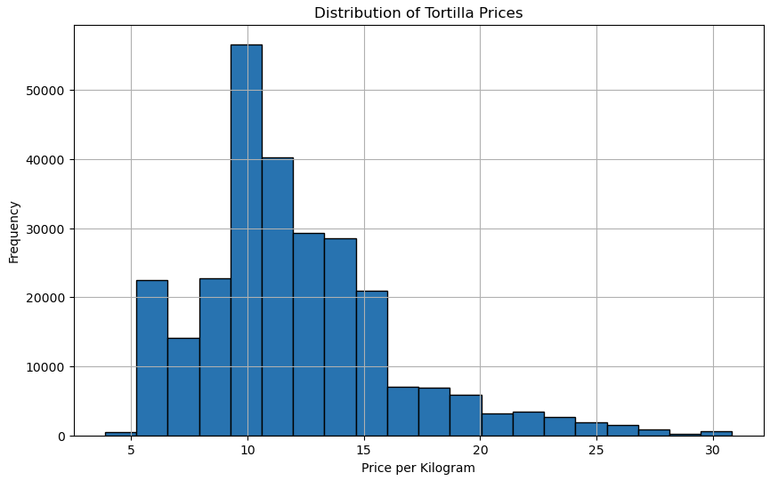
Distribution of Prices
We found that the average price per kilogram was approximately 10 pesos.

Slide 5
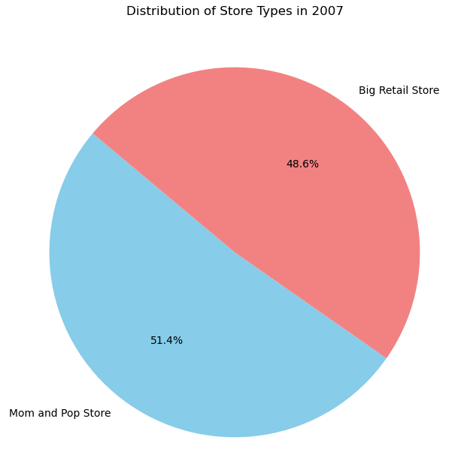
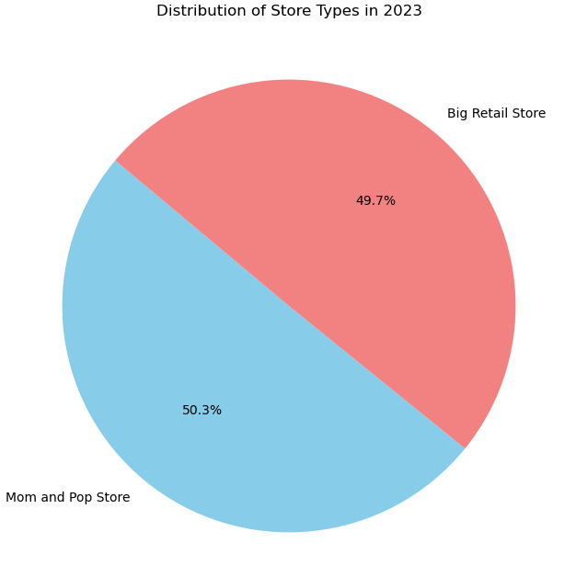
Distribution of Store Types
Big Retail Stores experienced an increase in their number of locations, while Mom-and-Pop Stores saw a decline.* Could pricing be influencing the reduction in Mom-and-Pop stores?
*The dataset used in this analysis is intended for monitoring inflation and may not fully represent the distribution of stores.

Slide 6
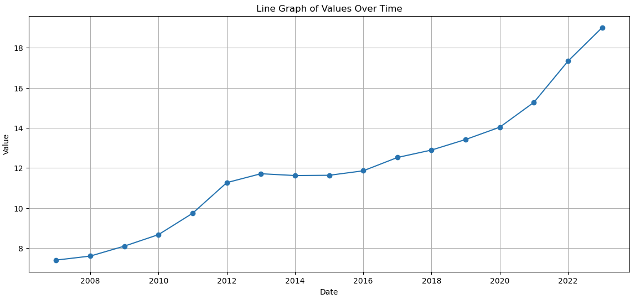
Increase of Tortilla Prices from 2007-2023
The most significant price increase occurred between 2021 and 2023, while there was no notable price change between 2013 and 2015.

Slide 7
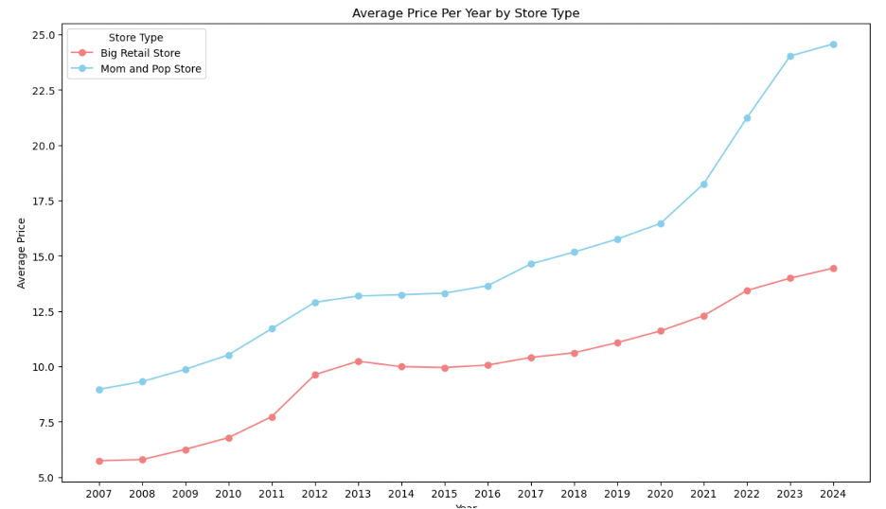
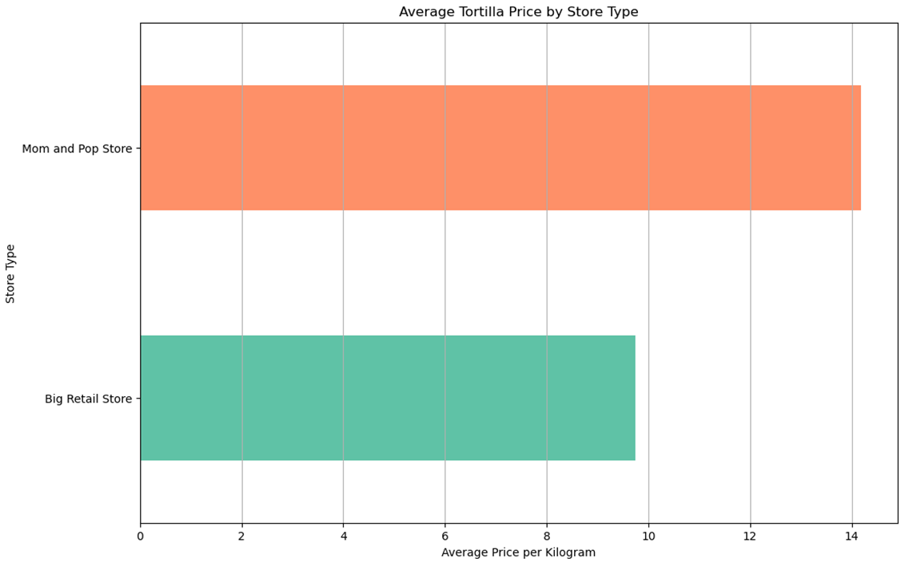
Average Price Per Year by Store Type
Pre-COVID, tortilla prices at mom-and-pop stores were roughly 3 pesos per kilogram higher than those at big retail stores.
Post-COVID, the price difference grew to about 10 pesos per kilogram.
The team anticipated that mom-and-pop store prices would be higher than big retailers to offset lower sales volumes.

Slide 8
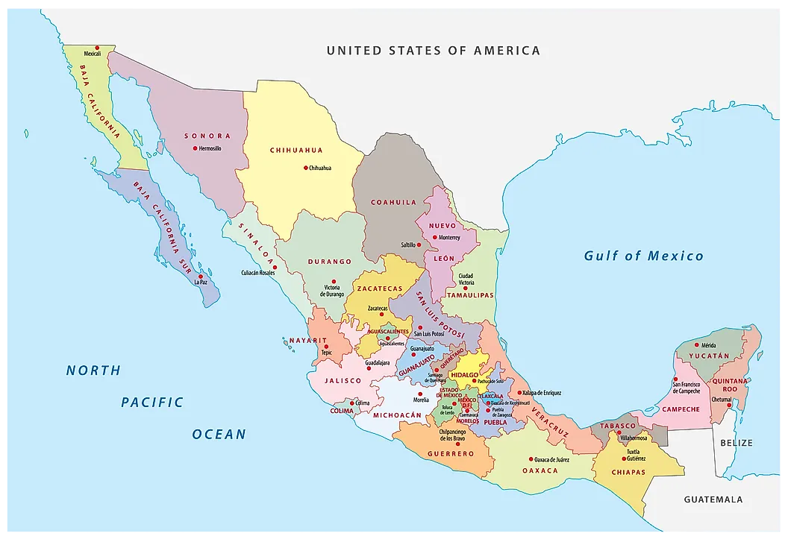
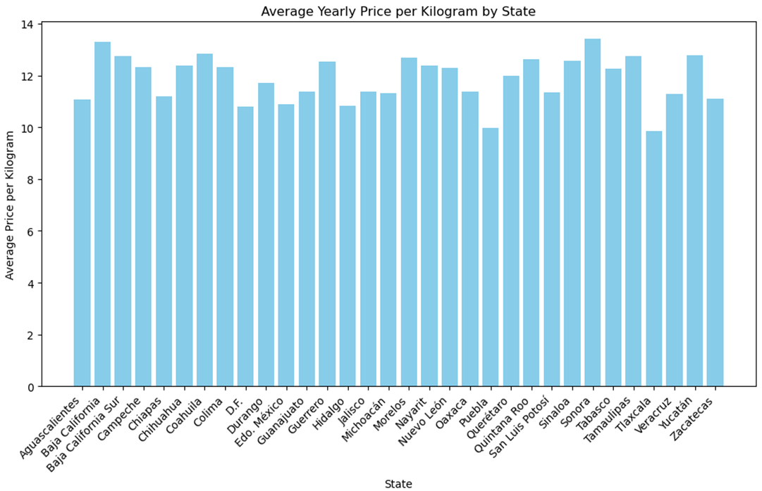
Price Comparison by State
The price range from state to state remains within about 4 pesos.
States bordering the United States have higher prices per kilogram, with spikes near tourist destinations like Cancun.
States further from the U.S. border, particularly those closer to Mexico City, tend to have lower prices per kilogram.

Slide 9
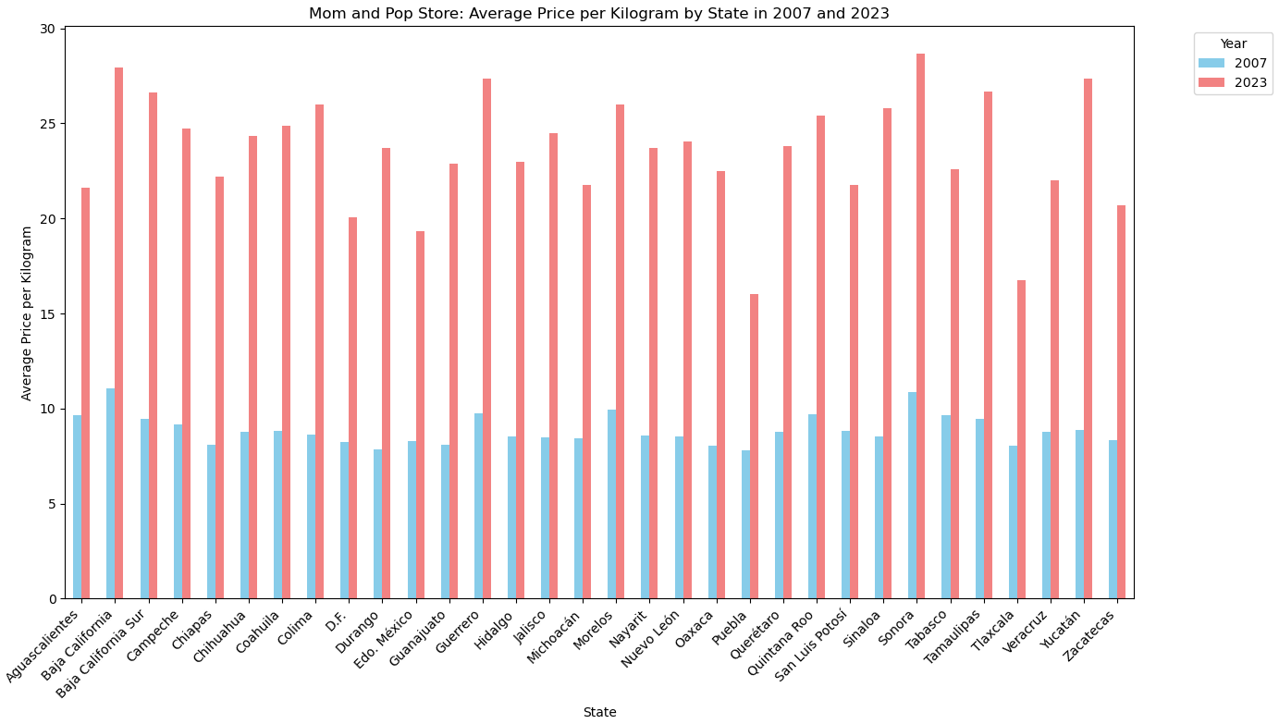
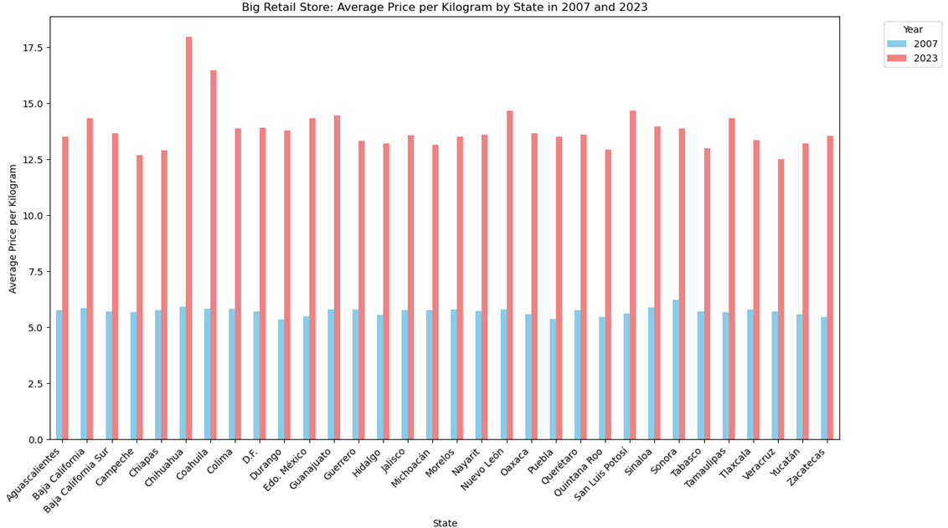
Average Tortilla Price by State and Store Type
There was greater price fluctuation in 2023 at Mom-and-Pop stores.
Prices at big retailer stores remained stable in 2023, ranging from approximately 12.5 to 15 pesos, except in the outlier states of Chihuahua and Coahuila.

Slide 10
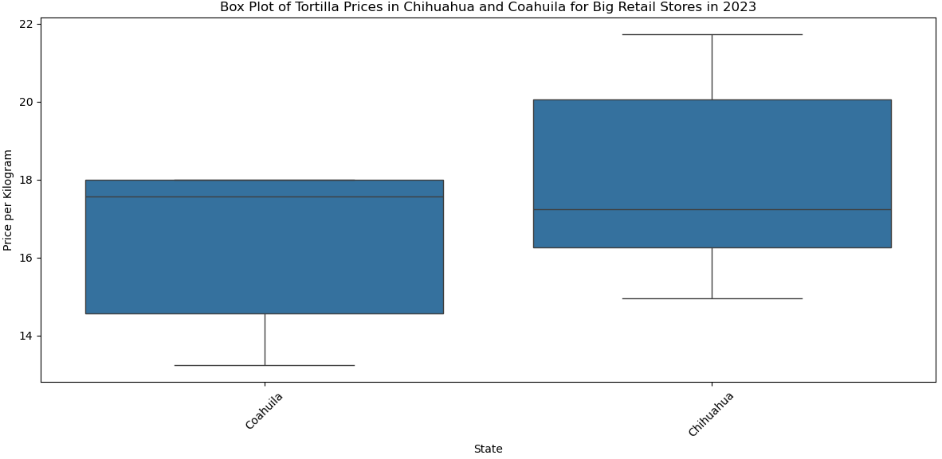
Price Distribution of Tortillas in Chihuahua and Coahuila (2023)
Higher Price Clustering
Narrow Range
Left-Skewed Distribution
Broad Price Variation
Diverse Market
Right-Skewed Distribution

Slide 11
Conclusion
The analysis of tortilla prices per kilogram in Mexico reveals distinct differences between mom-and-pop stores and big retailers. Key findings include:
Price Differences: Mom-and-pop stores consistently have higher prices for tortillas compared to big retailers. This disparity increased from about 3 pesos per kilogram pre-COVID to approximately 10 pesos per kilogram post-COVID.
Price Fluctuation: In 2023, mom-and-pop stores exhibited significant price fluctuations, while big retailer prices remained stable, ranging from about 12.5 to 15 pesos per kilogram, with exceptions in Chihuahua and Coahuila.
Impact of Inflation and Post-COVID Effects: Inflation and post-COVID economic conditions notably influenced tortilla prices. Mom-and-pop stores were more affected by these factors compared to big retailers, reflecting their greater sensitivity to market changes.
Regional Price Differences: Price variations generally stayed within 4 pesos per kilogram. Higher prices were observed near the U.S. border and tourist areas, while prices were lower closer to Mexico City.
Overall, the analysis highlights clear trends: mom-and-pop stores faced more pronounced price increases and volatility compared to big retailers. The findings underscore how economic factors and regional differences impact pricing strategies between these two types of stores.

Slide 12





Contributors
Ashley Charles
Azania Hood-Hosten
Leah Mathena
Sarah Sherry
Vanessa Ivarra

