Slide 1

MODCOM INSTITUTE OF TECHNOLOGY PROJECT GUIDE

Slide 2
NAME:ABDIRISAQ HASSAN KULANE
PROJECT NAME : SOFTWARE DEVELOPMNT NOTES

Slide 3
Problem definition
Main purpose was to get collection of our notes, for now to form such an app How my app may assist my fellow students.
1.This app reduces the gap between student and the notes.
2. My app can also have a feature where students can share notes with each other, creating a community of learners who can collaborate and help each other.
.

Slide 4
Solution
1. With my app, students can access their notes on the go, from their phone or tablet, making it convenient for them to study anytime, anywhere.
2. my app can also help students organize their notes by subject, making it easier for them to find what they need when studying for exams or writing papers.
3. The app can provide a search function, allowing students to quickly find specific notes or topics they need to review.

Slide 5
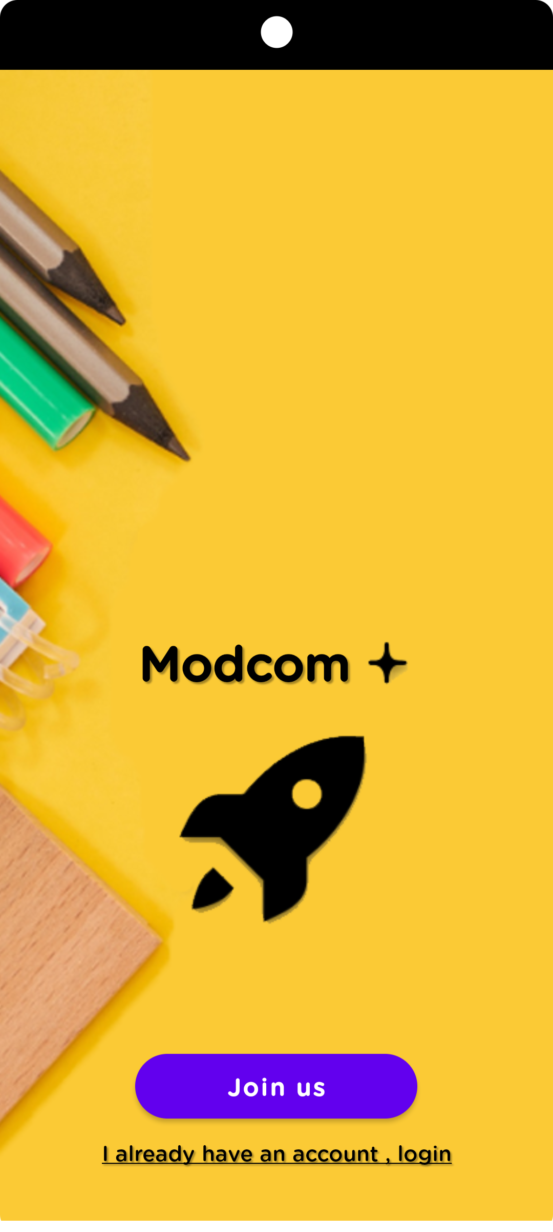
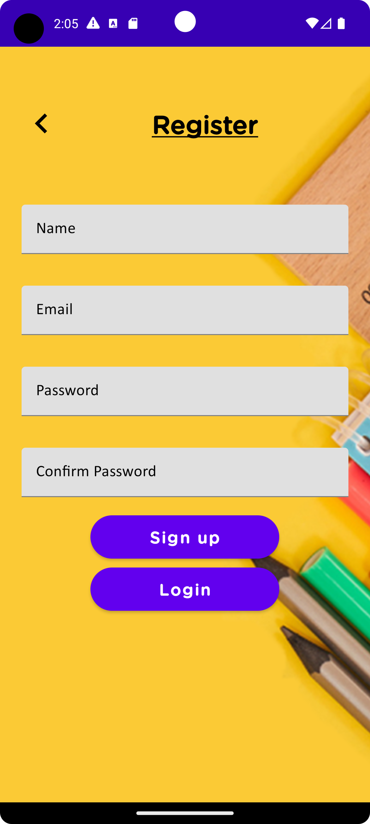
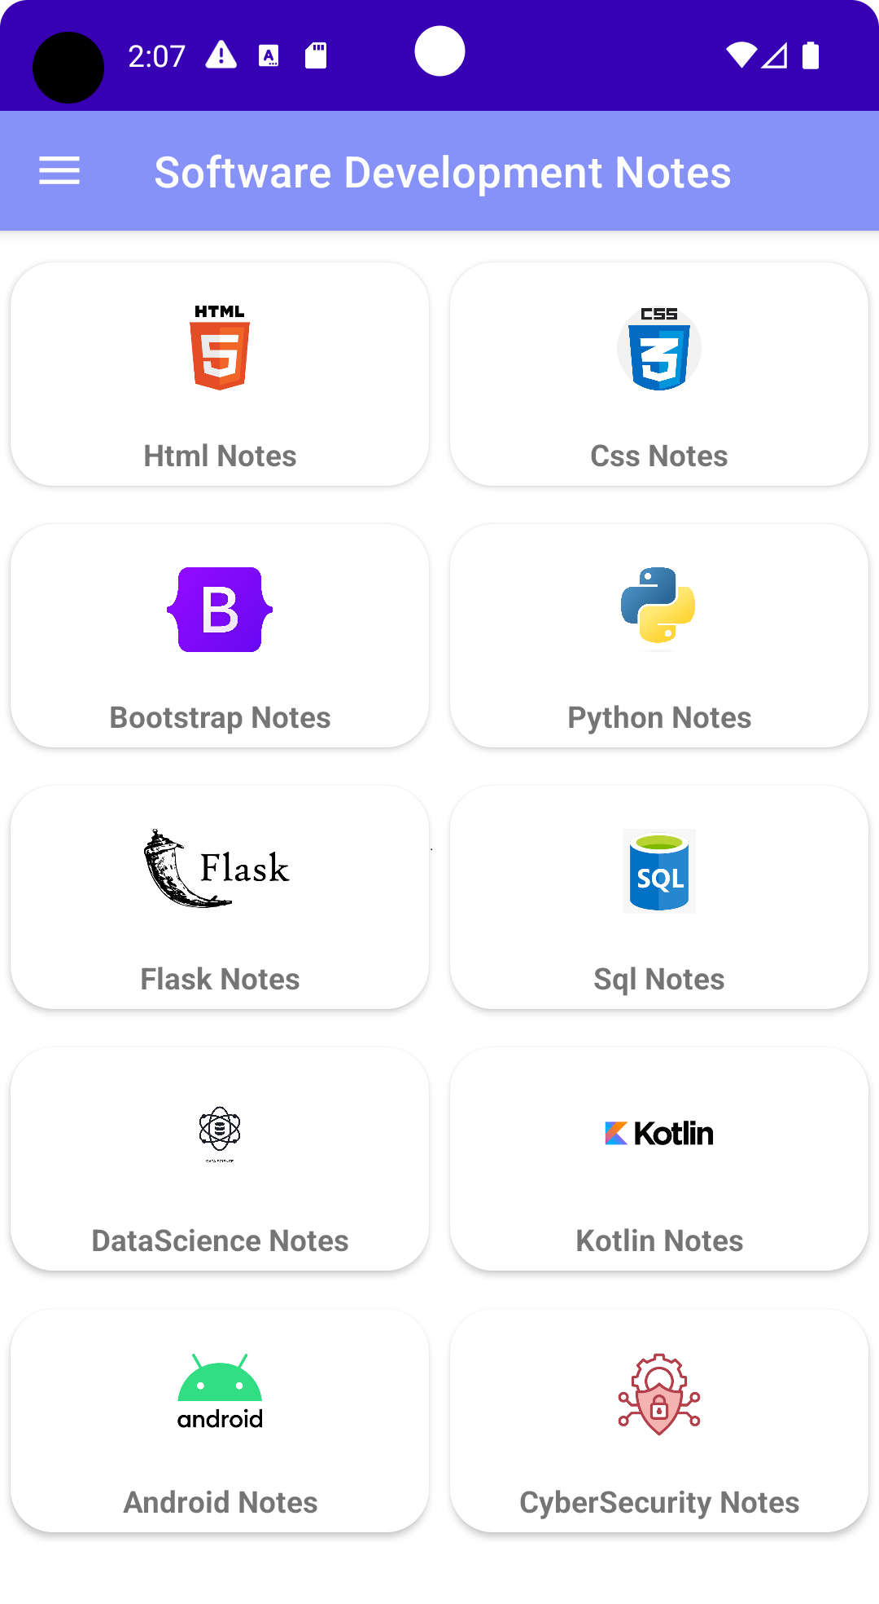
For Android projects, put at least 3 Screenshots
explaining the flow of your Android app. Below is a sample screenshot of an app

Slide 6
Target Audience
→College and University Students: College and university students can greatly benefit from my app. They can use it to manage their extensive course materials, lecture notes, research materials, and assignments. My app will serve as a centralized platform for all their academic resources, promoting efficient studying and preparation.

Slide 7
Conclusion
My app simplifies software development by providing an organized platform for storing and accessing development notes.

Slide 8
Thank you for your valuable feedback. Your insights and comments will be valuable in helping me improve and refine my project. I appreciate your support and contribution.

