Slide 1
E - VOTING
AZARUDDIN A M

Slide 2
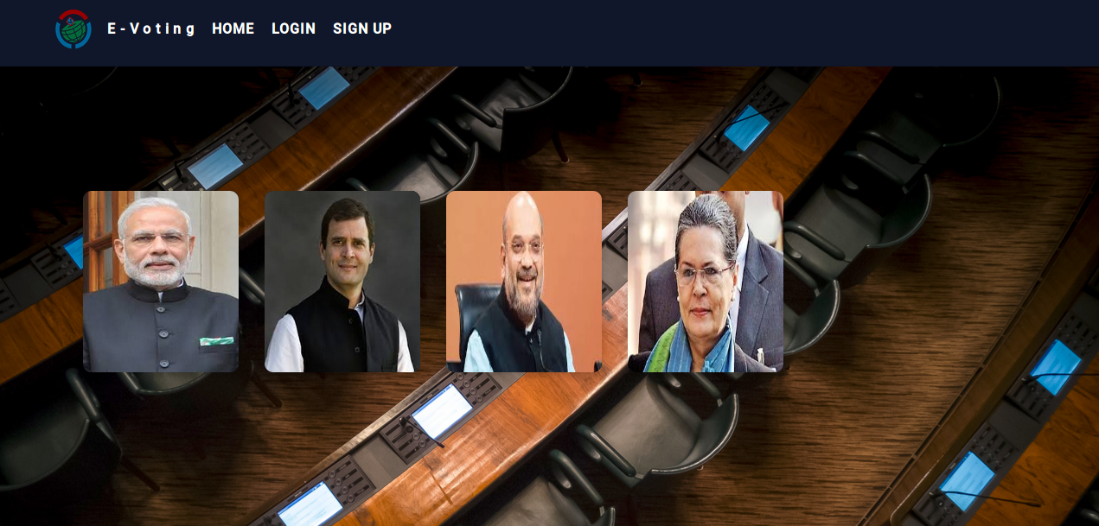

Slide 3
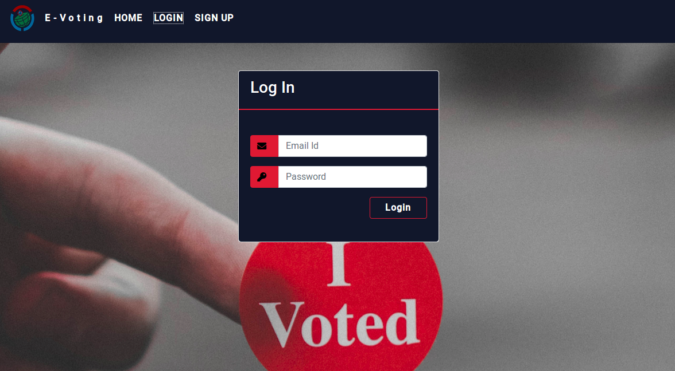

Slide 4
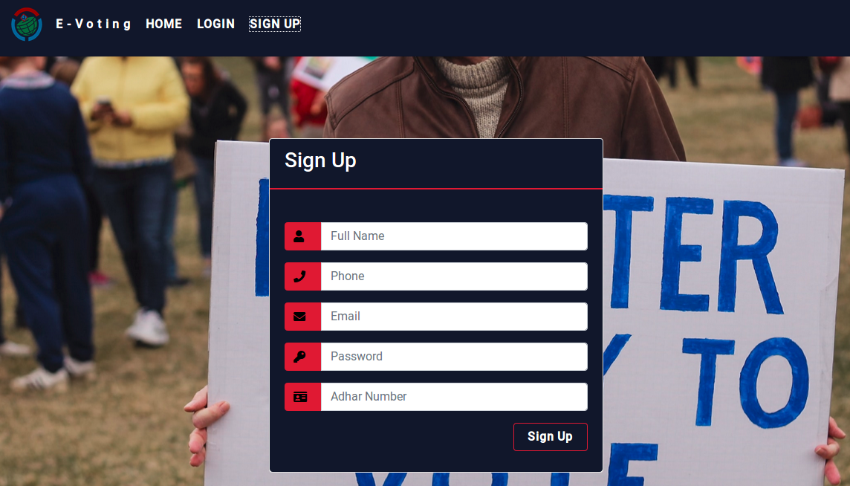

Slide 5
Working
User can vote or login only one time
Admin can reveal result after election
Admin can remove result
Admin verify user and can gave access to logn
Admin can delete users one by one and also having deleteall option there
Admin can add or edit or delete candidate details

Slide 6
Pages

Slide 7
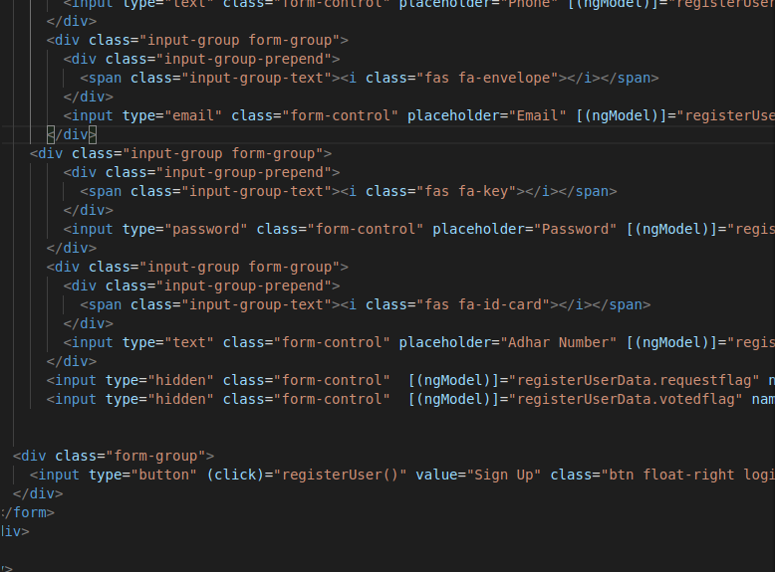
Example html to ts connection

Slide 8
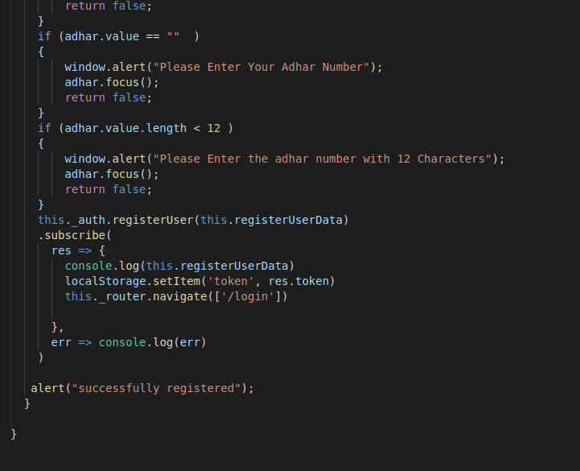
signup page

Slide 9
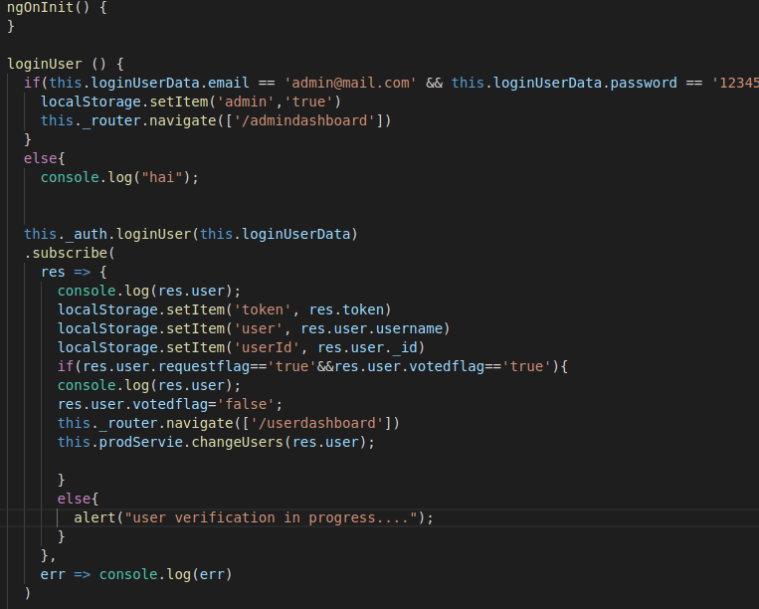
Login page

Slide 10
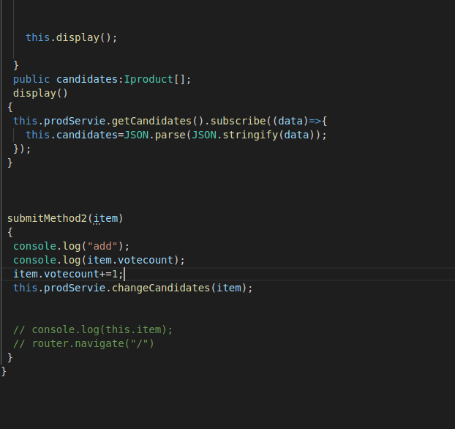
Userdashboard

Slide 11
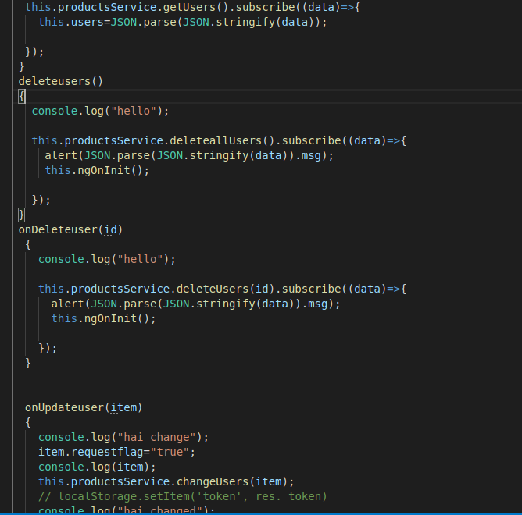
View users

Slide 12
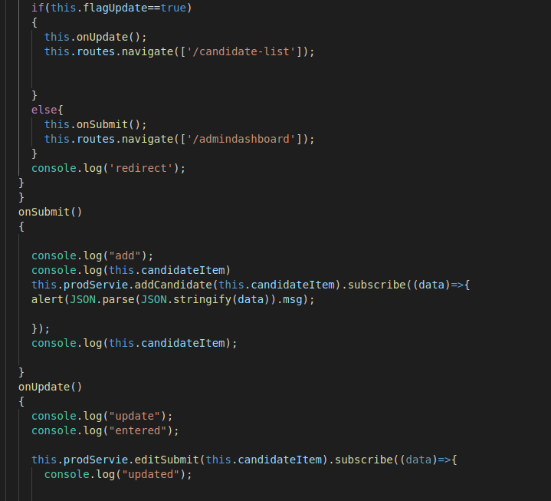
Add candidate

Slide 13
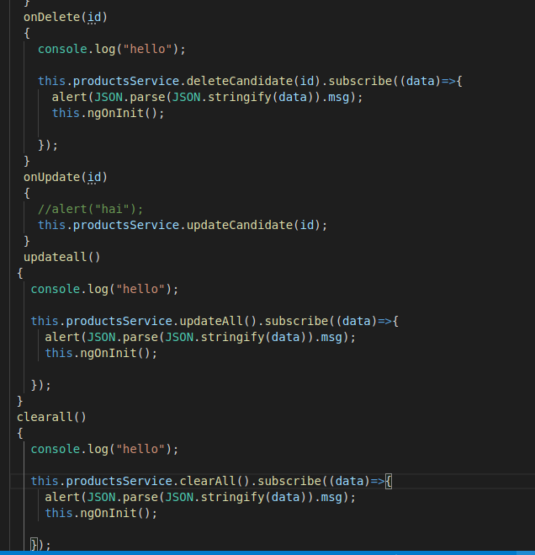
View candidate

Slide 14
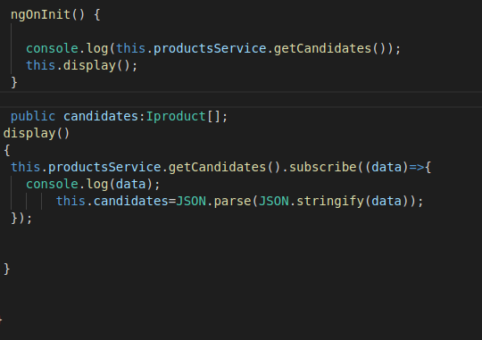
home

Slide 15
Services

Slide 16
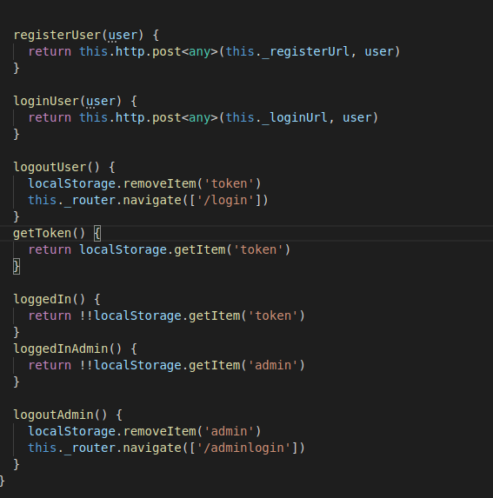
Auth service

Slide 17
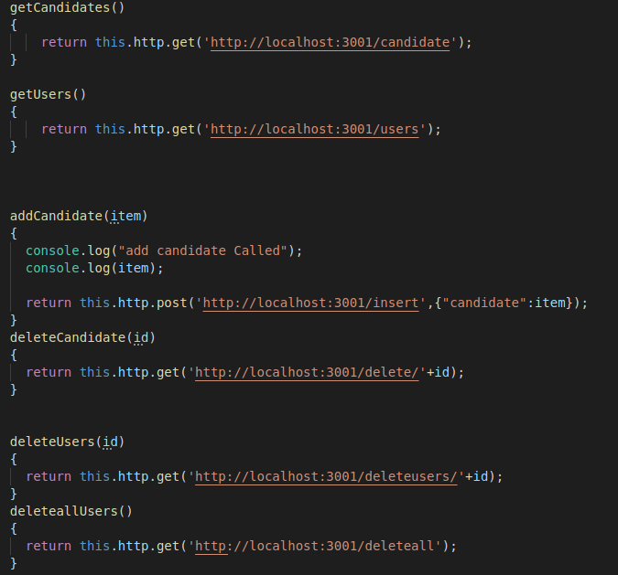
Product service 1

Slide 18
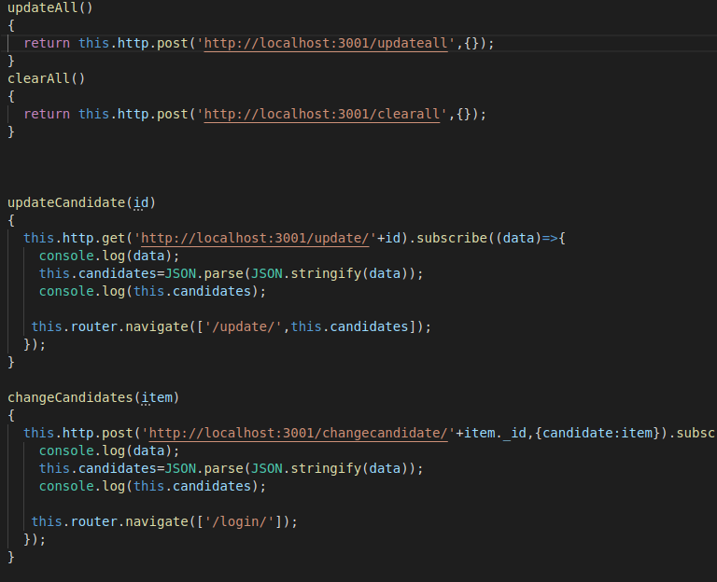
Product service 2

Slide 19
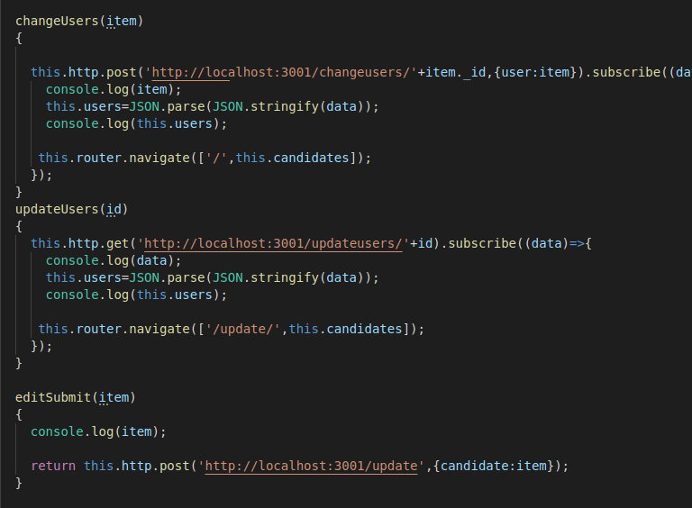
Product service 3

Slide 20
Models

Slide 21
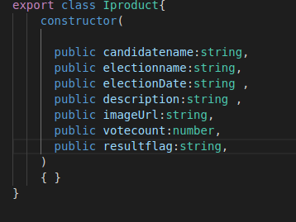
Candidate model

Slide 22
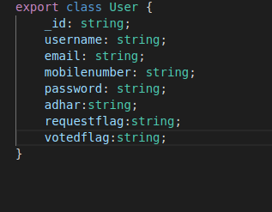
User model

Slide 23
Server side connection to mongodb

Slide 24
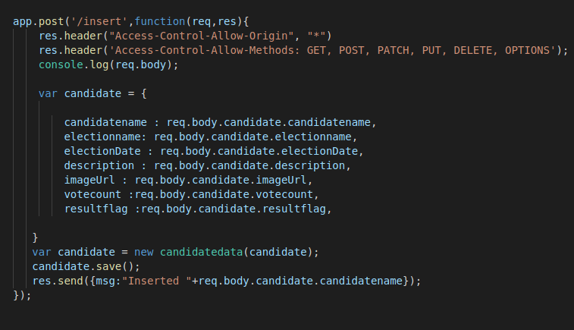
Example for insert

Slide 25
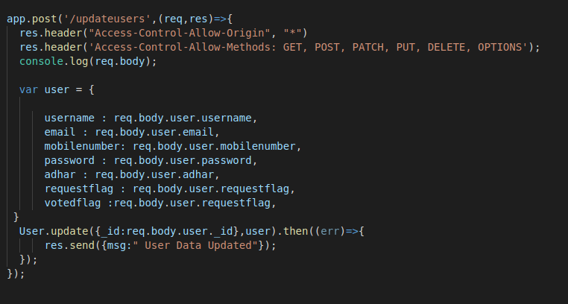
Example for update

Slide 26
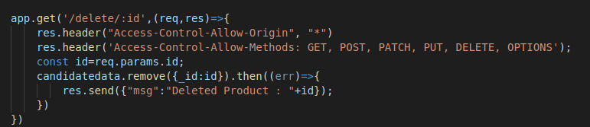
Example for delete

Slide 27
Tank you

