Slide 1

University of Engineering and Technology Peshawar Jalozai Campus

Slide 2
HIGH FREQUENCY TRADING
FYP PRESENTATION
DATED 08/02/2022

Slide 3






team
DR UMER SHARIFF
AZAZ HASSAN KHAN
WAQAS AHMED
MUHAMMAD HARIS
Supervisor
Electrical Department
Electrical Department
8th Semester
Electrical Department
7th Semester
Electrical Department
7th Semester

Slide 4

WHAT IS TRADING???
What is Trading???
Sentimental Analysis
Trading History
Algorithmic Trading
Software Based Algorithmic Trading
Quantitative Analysis
Hardware Based Algorithmic Trading (HFT)
Traditional Techniques
Machine Learning Techniques

Slide 5
TRADING HISTORY
What is Trading
Sentimental Analysis
Trading History
Algorithmic Trading
Software Based Algorithmic Trading
Quantitative Analysis
Hardware Based Algorithmic Trading (HFT)
Traditional Techniques
Machine Learning Techniques

Slide 6
TRADING HISTORY
What is Trading
Sentimental Analysis
Trading History
Algorithmic Trading
Software Based Algorithmic Trading
Quantitative Analysis
Hardware Based Algorithmic Trading (HFT)
Traditional Techniques
Machine Learning Techniques

Slide 7
ALGORITHMIC TRADING OVERVIEW
An automated trading system (ATS) uses a computer program to create buy and sell orders and automatically submits the orders to a market center or exchange.
Traditional Techniques
Machine Learning Techniques
HOST
STOCK MARKET
DATA EXTRACTING
TRADING ALGORITHM
PREDICTIONS
BUY AND SELL ORDER TRANSFER
DATA
STOCK MARKET
BUY / SELL ORDER
Figure 3. Overall trading overview
Figure 4. Overall host process

Slide 8
SOFTWARE BASED TRADING TECHNIQUES
What is Trading
Sentimental Analysis
Trading History
Algorithmic Trading
Software Based Algorithmic Trading
Quantitative Analysis
Hardware Based Algorithmic Trading (HFT)
Traditional Techniques
Machine Learning Techniques

Slide 9
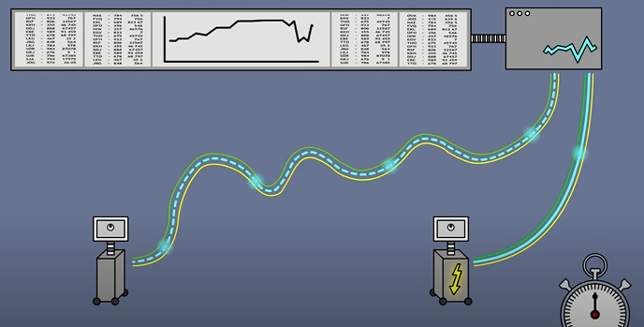
HIGH FREQUENCY TRADING
The core difference between them is that algorithmic trading is designed for the long-term, while high-frequency trading (HFT) allows one to buy and sell at a very fast rate.
The reason we shifted form AT to HFT is Speed.
Usually, the latency should be between 300 – 800 nanoseconds.
Figure 4. High frequency trading system

Slide 10
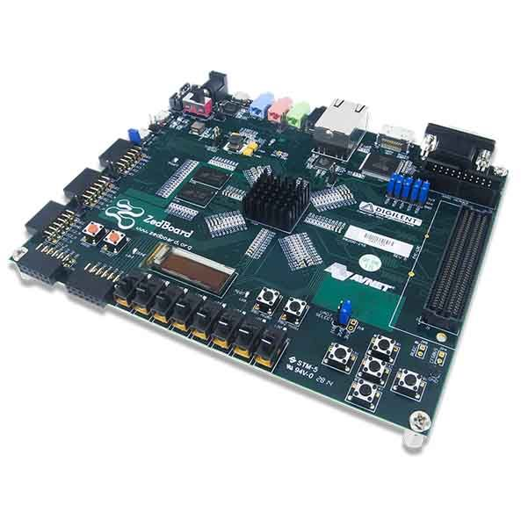
HIGH FREQUENCY EXAMPLE
Stock Market 1
Stock Market 2
Figure 5. Arbitrage Trading System

Slide 11
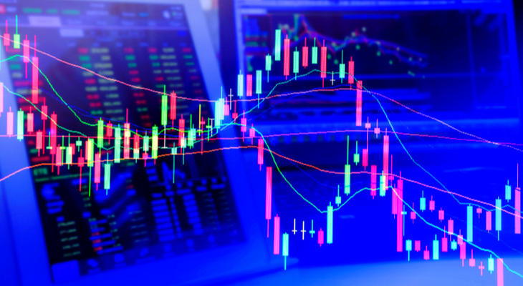

Indicators
TRADITIONAL TRADING TECHNIQUES IMPLEMENTAION
Relative Strength Index
MACD indicator
Stochastic indicator
Bollinger Bands
Aroon indicator
CANDLE STICK PATTERN
Bullish Engulfing
Bearish Engulfing
Three crows
White Soldiers

Slide 12
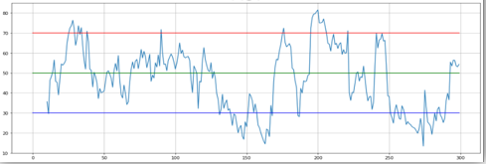
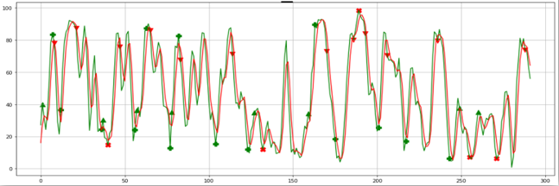
TRADITIONAL A.I TRADING PROCESS
Figure 6. RSI Trading Strategy
Figure 7. Stochastics Trading Strategy

Slide 13
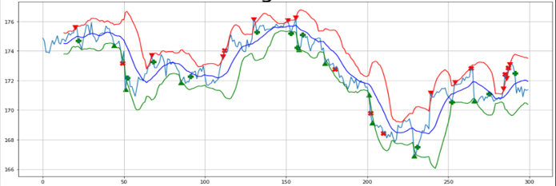
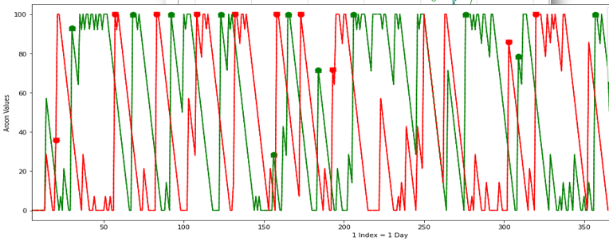
Figure 8. Bollinger Bands Trading Strategy
Figure 9. Aroon Trading Strategy

Slide 14
RESULTS
STOCK
Data Points
Profitability %
Profitable Trades
Stop Lose
BUY
SELL
Total Trades
Execution speed
STOCKASTIC | MACD | RSI | BBANDS | Aroon
Tesla | . | . | . | .
300 | . | . | . | .
68 | 41 | 41.66 | 65.21 | 50
14 | 5 | 5 | 15 | 8
5 | 3 | 6 | 8 | 8
8 | 4 | 7 | 13 | 11
11 | 4 | 4 | 10 | 5
19 | 12 | 11 | 23 | 16
0.2s | 0.1s | 0.3s | 0.1s | 0.4s
Table 1. Comparison of technical indicators

Slide 15
MACHINE LEARNING DESIGN PROCESS
Importing and Visualizating Dataset
Data Preprocessing
Input Feature and Output variables
Overfitting tests
Data Normalization
Test and train Data
Machine Learning Algorithm
Classification metrics
Model Parameters
Start
End
Figure 10. Machine Learning Overview

Slide 16

Machine learning Algorithms
MACHINE LEARNING IMPLEMENTATION
K Nearest Neighbors (KNN).
Support Vector Machine (SVM).
Random Forest.
Logistic regression (LR)
Ada Boost
XG Boost
Naïve Bayes
Decision Tree

Slide 17
TRADITIONAL VS MACHINE LEARNING
 | KNN | SVM | LR | RANDOM FOREST | VS | STOCKASTIC | MACD | RSI | BBANDS | Aroon
STOCK | Tesla | . | . | . | . | . | . | . | . | .
Data Points | 180 | . | . | . | . | 300 | . | . | . | .
Profitability % | 83.11 | 84.41 | 84.41 | 85.96 | . | 68 | 41 | 41.66 | 65.21 | 50
Profitable Trades | 64 | 65 | 65 | 66 | . | 14 | 5 | 5 | 15 | 8
Stop Lose | 13 | 12 | 12 | 11 | . | 5 | 3 | 6 | 8 | 8
BUY | 38 | 40 | 40 | 41 | . | 8 | 4 | 7 | 13 | 11
SELL | 40 | 38 | 38 | 37 | . | 11 | 4 | 4 | 10 | 5
Total Trades | 78 | 78 | 78 | 78 | . | 19 | 12 | 11 | 23 | 16
Execution speed | 0.4s | 2.1s | 0.5s | 3.8s | . | 0.2s | 0.1s | 0.3s | 0.1s | 0.4s
Table 2. Comparison of Machine learning and technical indicators

Slide 18
HARDWARE IMPLEMENTATION
Algorithm using Python Libraries
Algorithm using Matlab
Start
Code Matlab algorithm in VHDL
Synthesis
Simulate
Implement
End
Time report
Accuracy report
Algorithm using Python Libraries
Start
End
Execute on PS
Convert to basic C
Time and accuracy report
Figure 11. Overall FPGA (PL) overview
Figure 12. Overall Microprocessor (PS) overview

Slide 19
PROBLEMS TACKLED
Floating Point
Negative Number
Division
Floating Point:
Stock Market Data
Multiplier
Figure 13. Floating point Problem

Slide 20
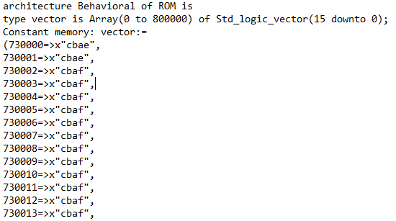
Division:
Rom
Shifting by 2
Series Dividing Algorithm
ROM
Input
Output
Figure 14. ROM
Figure 15. VHDL CODING

Slide 21
RESULTS
Technical Indicator | Total no of Clock | Time Period (ns) | Frequency (MHZ)
MACD | 365 | 23.8 ns | 42.017 MHz
RSI | 365 | 58.1 ns | 17.2 MHz
Aroon | 5856 | 14.1 ns | 70.922 MHz
TABLE 3. Comparative Analysis of fully implementable technical indicators using FPGA (PL)
Technical Indicator | Software execution time (us) | Hardware execution time (us) | Latency Comparison
MACD | 160 us | 8.687 us | Hardware is 18.63 times faster than software
RSI | 221 us | 21.2 us | Hardware is 10.42 times faster than software
Aroon | 528 us | 82.56 us | Hardware is 6.3953 times faster than software
TABLE 4. Comparative analysis of Software (PS) and FPGA (PL)

Slide 22
PAPER PUBLICATIONS
JOURNAL PAPER 1
A Comparative Analysis of Stock Market Prediction Using Various Machine Learning Models on Different Time Frames.
JOURNAL PAPER 2
Price Prediction of Cryptocurrencies Using Momentum Technical Indicators over Ethernet Via ZYNQ SOC Platform.

Slide 23
Thank you!
ALL CODES ARE AVAILABLE ON GITHUB
https://github.com/AzazHassankhan

