Slide 1

Fallen Empire: “Using Tools on A Post Exploited Machine”
CS 4177 – Software Vulnerabilities
Spring 2023 – Dr. Jaime C. Acosta
Gilbert G.
Fernie R.
Jose S.
Hector D.

Slide 2
Construction Technologies
"What will we use to do this?"

Slide 3
Current Construction Tech Investigations
Know It! | Kinda Know It... | What's That?
Virtual Machines | EMPIRE Software | N/A
Packet Sniffing/Finding Networks | Privilege Escalation | N/A
Setting up Networks | Firewall Bypassing | N/A

Slide 4
Poster Rebase
"How did we update our poster?"

Slide 5
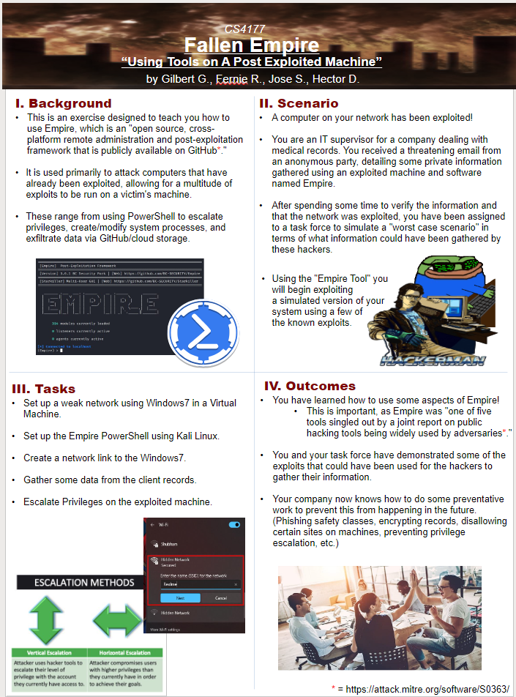
Updated Poster
Background Information Updated!
New Scenario to better fit Empire's Use!
Tasks we want participants to do updated!
Learning Outcomes now clear for peers and audience!
Updated Images!

Slide 6
Moving Forward!
"
"What’s Our Focus?"
"Why is this important?"
"How are going to do it?"
"What do we want our participants to learn?"
"Are we confident in what we want to do?"

Slide 7


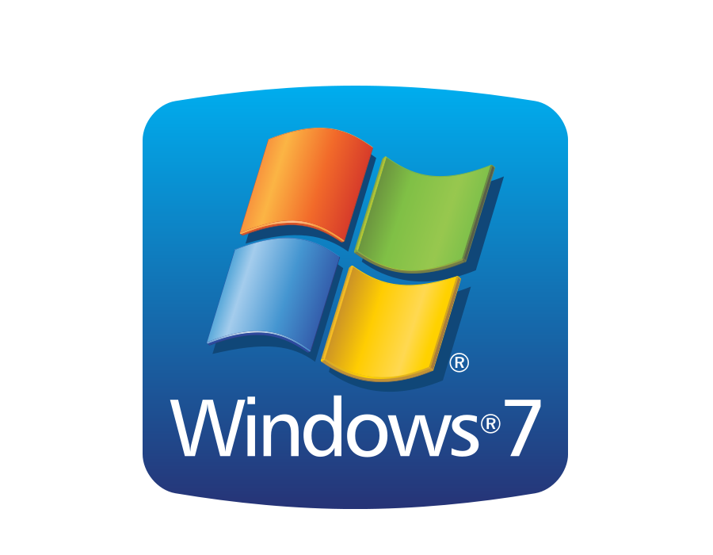

Technologies
Empire: Post exploitation agent
Virtual Machines: Set up "fake" network
Kali Linux
Windows7 Professional Edition

Slide 8


High-Level Idea
Familiarize with the Post-Exploitation Framework Empire. Including but not limited to packet sniffing.
A simulated environment similar to "your" computer network to analyze the worst-case scenario of possible exploitations within your actual network. Any vulnerabilities discovered will be required to be recorded for further analyzation.
Preventing any loss or corruption of your customer's medical records.

Slide 9

Team Tasks
Using a Virtual-Box, you will create a virtual network by executing a unique address.
Execute the Empire Tool, which you will be able to go through its various commands to poke through your network for any unauthorized networks and vulnerabilities.
Record any data information from the client(s).
Escalate Privileges on an exploited machine.

Slide 10

Learning Outcomes
You and your task force will have demonstrated using Empire in collecting data of the exploits that could have been used by the infiltrators to gather information.
You will learn how an open-source platform, Empire, can easily traverse through the network to expose exploits.
In addition, because of this exercise you will learn how to make your companies network more secure.

