Slide 1

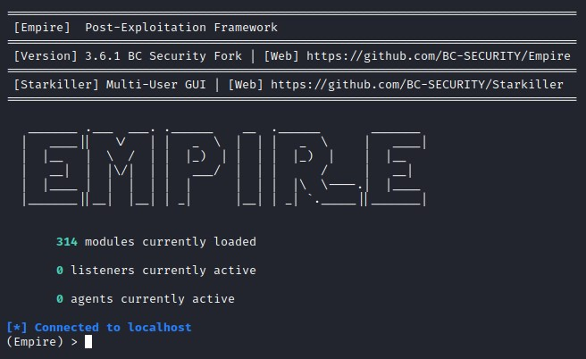


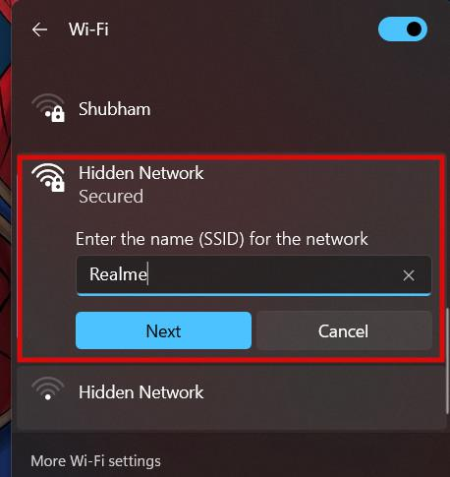
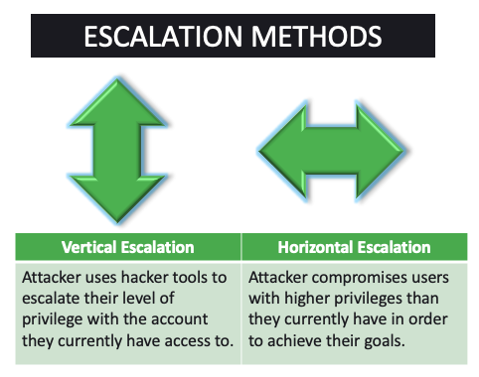

Fallen Empire “Using Tools on A Post Exploited Machine”
CS4177
by Gilbert G., Fernie R., Jose S., Hector D.
I. Background
This is an exercise designed to teach you how to use Poweshell-Empire, which is an "open source, cross-platform remote administration and post-exploitation framework that is publicly available on GitHub*."
It is used primarily to attack computers that have already been exploited, allowing for a multitude of exploits to be run on a victim's machine.
These range from using PowerShell to escalate privileges, create/modify system processes, and exfiltrate data via GitHub/cloud storage.
II. Scenario
A computer on your network has been exploited!
You are an IT supervisor for a company dealing with medical records. You received a threatening email from an anonymous party, detailing some private information gathered using an exploited machine and software named Empire.
After spending some time to verify the information and that the network was exploited, you have been assigned to a task force to simulate a "worst case scenario" in terms of what information could have been gathered by these hackers.
Using the "Empire Tool" you will begin exploiting a simulated version of your system using a few of the known exploits.
You have learned how to use some aspects of Empire!
This is important, as Empire was "one of five tools singled out by a joint report on public hacking tools being widely used by adversaries*."
You and your task force have demonstrated some of the exploits that could have been used for the hackers to gather their information.
Your company now knows how to do some preventative work to prevent this from happening in the future. (Phishing safety classes, encrypting records, disallowing certain sites on machines, preventing privilege escalation, etc.)
III. Tasks
Set up a weak network using Windows7 in a Virtual Machine.
Set up the Empire PowerShell using Kali Linux.
Create a network link to the Windows7.
Gather some data from the client records.
Escalate Privileges on the exploited machine.
IV. Outcomes
* = https://attack.mitre.org/software/S0363/

