Slide 1


“DESIGN & IMPLEMENTATION”_
INFILTR8
Final Build Reflections
TEAM #6
Software Eng: Design & Implmnt [SW2]
CS 4311 == CRN: 11377
Dr. Salamah Salamah
Notes:
Hello!
This presentation was being created in the case that we would have a last demo to showcase INFILTR8 to the customers.
Unfortunately, It looks like that won’t come to pass, but we had already done preliminary work on this presentation, so we used the extra time we had to make this for you all at DEVCOM.
Think of this as a “Bonus Candy”, and as a last hurrah for the semester.
Thank you all for the work you let us do this semester, we are happy to have finished our first real project.
Till Next Time,
Gil. G.

Slide 2

TEAM #6 == “THE 9 BYTES”_
  Table of Contents
Team 6 – “The 9 Bytes”
Alberto Villegas, Quality Manager/Programmer
Brian Mata, Dataflow & Business Manager/Programmer
Christian Garcia, Quality Manager/V&V
Christian Revilla, Analysis Manager/Programmer
Gilbert Guzman, Team Lead/Analyst
Janelle Guzman, Customer Interface Manager/Designer
Jose Luis Rojas, Behavior Model Manager/Designer
Kimberly Kocian, Support Manager/V&V
Luis Sanchez, Planning Manager/Analyst
Guidance Team
Dr. Salamah Salamah – Manager & Lead Instructor
Mr. Scott R. Ledford - TA
Ms. Consuelo Ramirez – TA

Slide 3


CUSTOMERS == “DEVCOM”_
  Table of Contents
Data Analysis Center’s Cyber Experimentation & Analysis Division
Mr. Sebastian Quinones
Ms. Diana Ramirez
Mr. Timothy Hannan
Ms. Lucia Rodriguez-Melgoza
Mr. Thomas Tenorio
Ms. Miriam Olague

Slide 4
TABLE OF CONTENTS_
[1]
[2]
[3]
[4]
PROJECT DESCRIPTION_
SITE FUNCTIONS_
Quick Recap of INFILTR8
What is INFILTR8’s PURPOSE?
What was our PLAN for its Development?
Runthrough of Implementation
Showcase Defined SYSTEM REQUIREMENTS.
DEMO VIDEO_
CONCLUSIONS_
Student Video
Embedded Link of FINAL DEMO VIDEO.
Show TEAM GITHUB & Development Documention.
Team’s Final Thoughts
What did we LEARN?
What did we STRUGGLE with?
How can we IMPROVE?

Slide 5

PROJECT DESCRIPTION_
  Table of Contents
[1]
“What is INFILTR8’s PURPOSE?”
“What was our PLAN for its Development?”

Slide 6
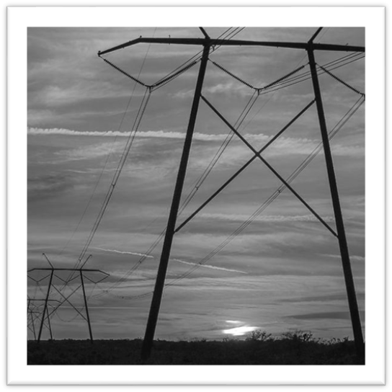
INFILTR8’S PURPOSE_
  Table of Contents
The Intelligent Network Findings with In-Depth Learning for Targeted Reconnaissance (INFILTR8)
system, a project developed for the DoD’s civilian contractor, U.S. Army Combat
Capabilities Development Command (DEVCOM), gives an analyst a way to facilitate and
expedite the penetration testing process.
It’s done by ingesting reconnaissance files and developing a
prioritized list of entry points within the set of machines that are on the network.

Slide 7
BASED ON THE WAY WE WORKED LAST SEMESTER,WE PLANNED TO USE…
  Table of Contents
AGILE Software Development_

Slide 8

HOW DID WE USE AGILE?
  Table of Contents
By using agile development for INFILTR8, we were able to work with enhanced flexibility and adaptability!
  This allowed us to swiftly adjust to the changing requirements and continuously refine INFILTR8 as the semester went along.
Due to this choice, we were able to deliver functional builds frequently for our customer meetings, which in turn provided us with early feedback from the customer.
  This ensured we were able to deliver a version of INFILTR8 that met the Customer’s and the Guidance Team’s expectations.

Slide 9
SITE FUNCTIONS_
  Table of Contents
[2]
“Showcase MAJOR SYSTEM REQUIREMENTS.”
“Showcase Defined SYSTEM REQUIREMENTS.”

Slide 10

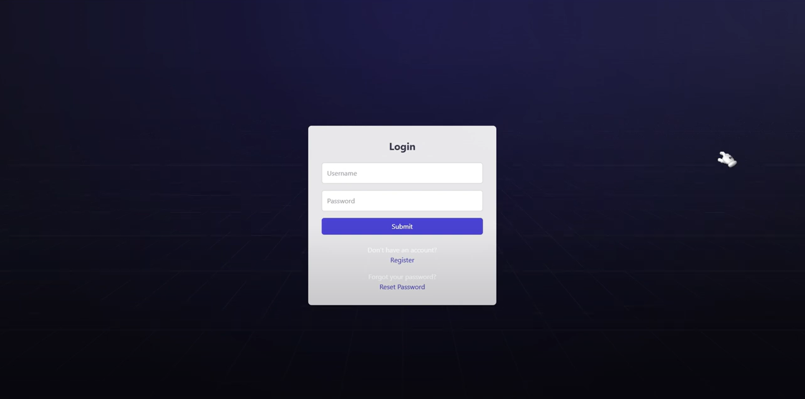
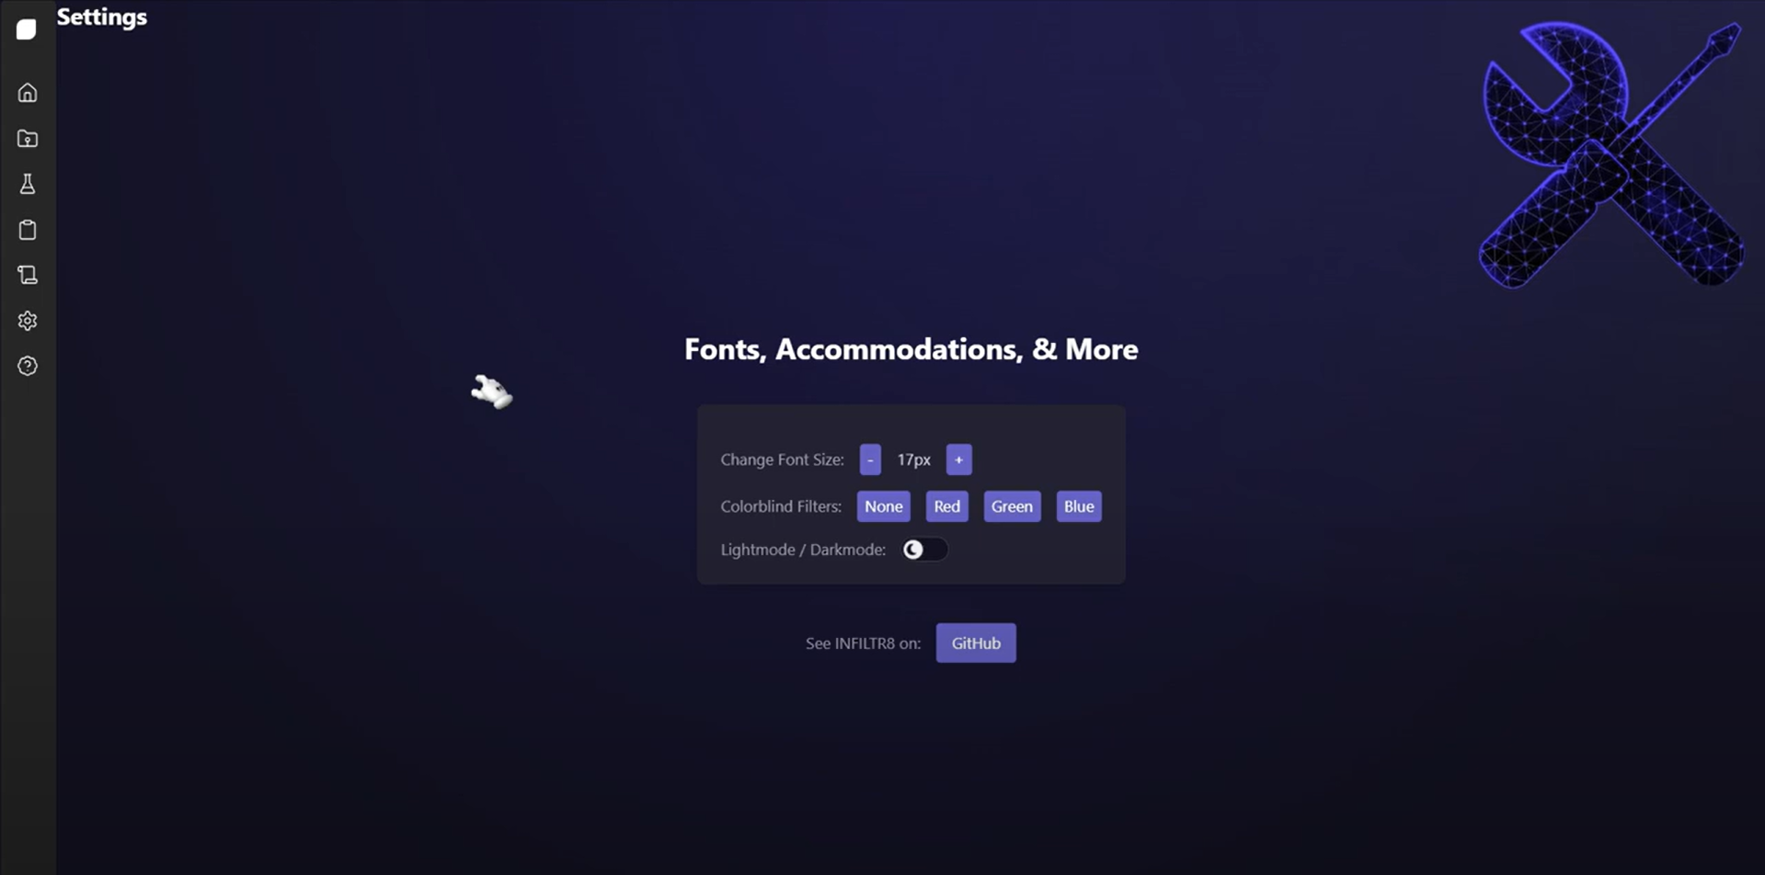
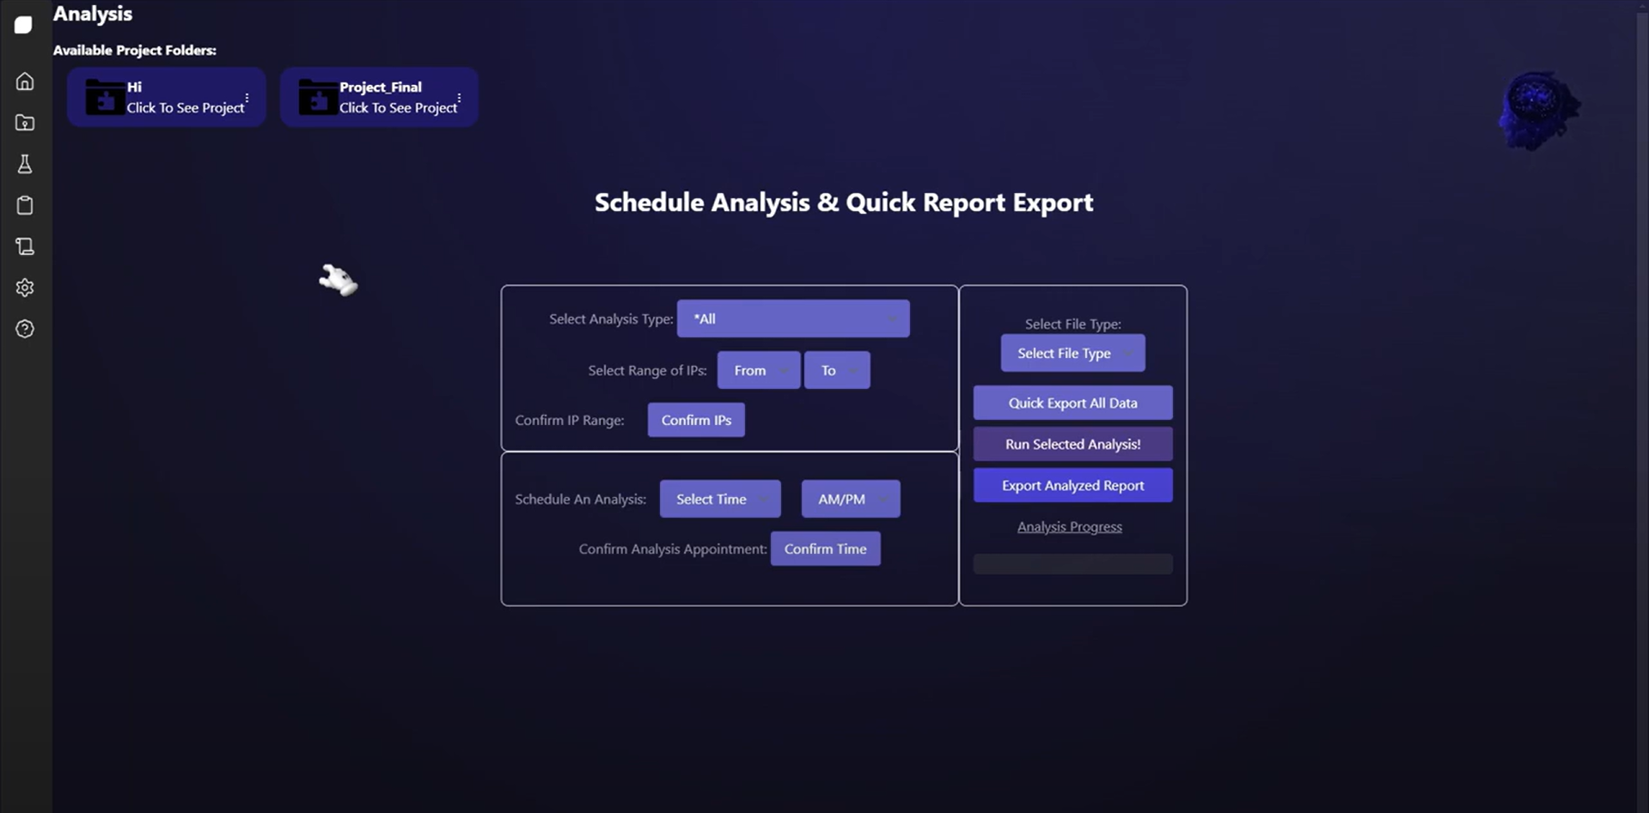
  Table of Contents
FINALIZED UI STYLE_

Slide 11


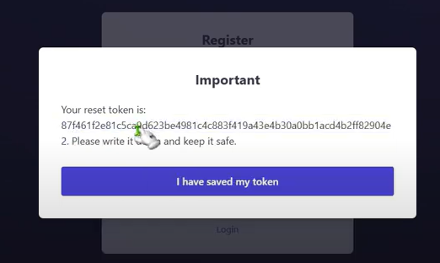
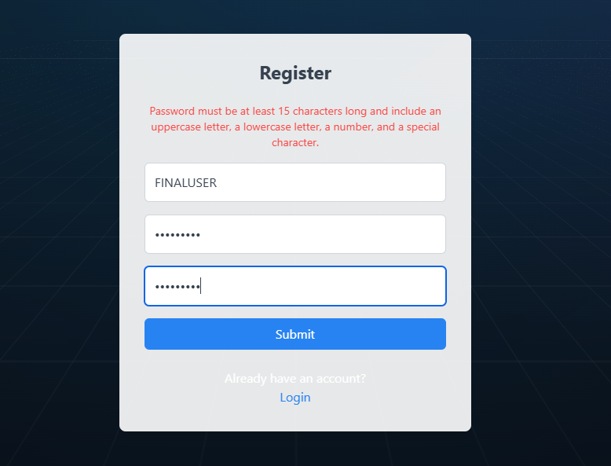
MAJOR SYSTEM REQUIREMENTS_
  Table of Contents
PASSWORD
RESET TOKEN
PASSWORD REQUIRMENTS
EXPORTING & ANALYSIS
NOTE: A SHOWCASE OF ALL FUNCTIONALITY IS IN DEMO!

Slide 12
DEMO VIDEO_
  Table of Contents
[3]
“Embedded Link of FINAL DEMO VIDEO.”
“Showcase TEAM GITHUB & Development Documention.”

Slide 13
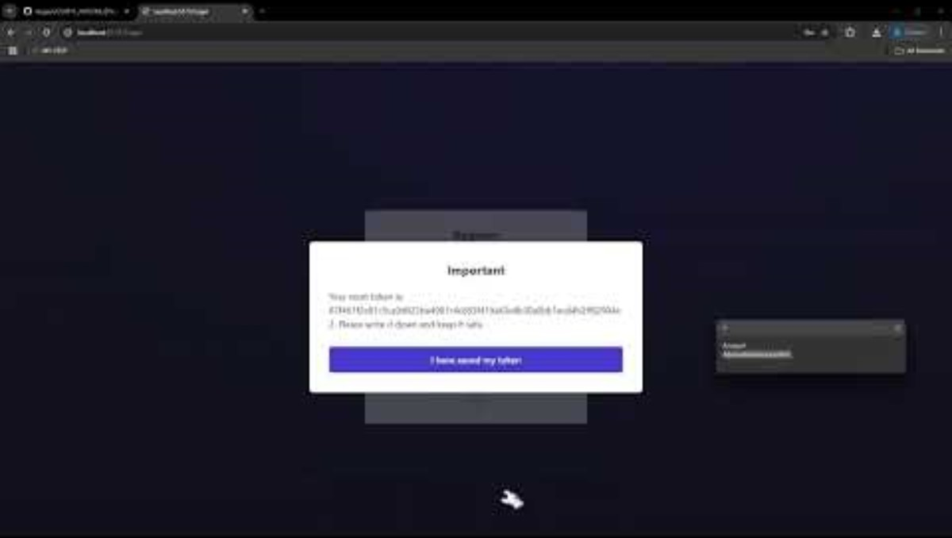
  Table of Contents
FINAL DEMO VIDEO_
NOTE: This Demo Video is 25 Minutes Long!

Slide 14

TEAM GITHUB & DOCUMENTATION_
  Table of Contents
GITHUB
DOCUMENTATION
Access already granted to DEVCOM at start of semester, where all previous code milestones are available.
https://github.com/Azaze7/CS4311_INFILTR8_6TheNine-Bytes_Fall2024
To see how INFILTR8 grew into a full project, see the “Project Milestones & Video Demonstrations” Section of our GitHub.
Additional Diagrams & Documents were created & are available upon request.
These Include:
Subsystems & Protocols
Contracts
CRC Cards
ALL Customer Milestones Have Videos Available!!!

Slide 15
TEAM CONCLUSIONS_
  Table of Contents
[4]
“What did we LEARN?”
“What did we STRUGGLE with?”
“How can we IMPROVE?”

Slide 16

WHAT DID WE LEARN?
  Table of Contents
Through working on this project, our team was able to learn many skills.
Our three main learned skills were:
Improved Customer Communications: We learned to better understand and address customer needs through regular demo interactions.
Improved Team Collaboration: Enhanced our skills by working together seamlessly and frequently, making it possible to leverage each of our member's strengths.
Autonomous Decision-Making: Gained the ability to make team-based decisions without needing constant approval from all members. Being smart as we made decision made puzzle pieces fit together better.

Slide 17
WHAT DID WE STRUGGLE WITH?
  Table of Contents
Although we were able to finish the project with all functionality finished, we did encounter some problems as we developed this software.
The three big problem we faced were as follows:
We faced coordination problems during the initial design phase, which slowed our progress.
There were disagreements on certain elements, such as the sidebar, leading to a few day delays where members would make builds to sell their ideas for the site layout.
We experienced wait times for certain components due to needing clarifications, which led to certain elements being ahead of others.

Slide 18
HOW CAN WE IMPROVE?
  Table of Contents
We think we could have improved this project by doing the following as a team:
Planning Layouts IN-PERSON: If we used a whiteboard to sketch potential GUIs at the start, we would have saved much time instead of trying to implement ideas into svelte.
Flexibility in Roles: If we allowed greater team member crossover in tasks at the start, our team would’ve worked much more efficiency.
Some missing features that would make INFILTR8 better if we had more time:
Combining color filters: Some people are double
color blind, but this would make INFILTR8 more accessible..
Analyze multiple projects at the same time: Improve
Efficiency.
Make a custom logo for the site.

Slide 19
Photo References [APA]_
  Table of Contents
Simple Logo Clipart​
Microsoft. (n.d.). Logo Clipart. Built in Microsoft PowerPoint.​
Stock Photos [Alphabetical Order]
Adobe Stock. (2024). Electronic circuit board close-up on blue background [Photograph]. Retrieved from https://stock.adobe.com/images/electronic-circuit-board-close-up-blue-background/376478081
Dejpknyizje2n. (2024). Pink Human Brain 8 Bit Pixel Art Sticker. Retrieved from https://dejpknyizje2n.cloudfront.net/media/carstickers/versions/pink-human-brain-8-bit-pixel-art- sticker-u20ea-x450.png
DEVCOM. (2024). DEVCOM Logo. [Photograph]. Retrieved from https://www.t2.army.mil/portals/120/ARL_Logo.png?ver=KrVnyUdHsJI%3
Freepik. (2024). Pixel Art Medal Icon 8bit Game White Background. Retrieved from https://www.freepik.com/premium-vector/pixel-art-medal-icon-8bit-game-white-background_16552034.htm
Krasamo. (2023). Understanding Use Cases, Use Case Scenarios, User Stories, and Flow Charts [Photograph]. Retrieved from https://www.krasamo.com/wp-content/uploads/Understanding-Use-Cases-Use-Case- Scenarios-User-strories-and-Flow-Charts-2880x1800.jpg
LinkedIn. (2022). How to Choose a Server Rack: What Factors Should You Consider? [Photograph]. Retrieved from https://media.licdn.com/dms/image/C5612AQHPO9kCUeFDgA/article- cover_imageshrink_720_1280/0/1651560827418?e=2147483647&v=beta&t=8aqHSnOZDWQws4F- 0nnGXjha96HYbescmlb29Wx1jas
Redbubble. (2016). Flat Pink Human Brain Image. Retrieved from https://ih1.redbubble.net/image.513035976.0905/flat,750x,075,f-pad,750x1000,f8f8f8.u3.jpg
Reddit. (2020). Undertale Save Point. Retrieved from https://www.reddit.com/r/CalamityMod/comments/18lhr6u/has_anyone_noticed_that/#lightbox
Wikimedia Commons. (2021). Cell Tower, Richmond Hill [Photograph]. Retrieved from https://upload.wikimedia.org/wikipedia/commons/1/18/CellTowerRichmondHill.jpg

Slide 20

Thank You!
  Table of Contents
Any Questions?
Notes:
Hello!
This presentation was being created in the case that we would have a last demo to showcase INFILTR8 to the customers.
Unfortunately, It looks like that won’t come to pass, but we had already done preliminary work on this presentation, so we used the extra time we had to make this for you all at DEVCOM.
Think of this as a “Bonus Candy”, and as a last hurrah for the semester.
Thank you all for the work you let us do this semester, we are happy to have finished our first real project.
Till Next Time,
Gil. G.

