Slide 1
MECH201 ENGINEERING ANALYSIS
Lecture Notes
(Week 5)
Lecturer: Azdiar Gazder
Based on slides by: Cheng Lu & Hongtao Zhu
Office: 236.101A
Email: azdiar@uow.edu.au
Consultation: Appointment by email

Slide 2
Week 2 – Roots of equations
Week 3 - Linear Algebraic Equations
Week 4 - Optimization

Slide 3
MATLAB example scripts
All lecture scripts uploaded weekly to:
https://github.com/AzdiarGazder/MECH201
Please follow the instructions posted there to download and run your local copy of the scripts.

Slide 4
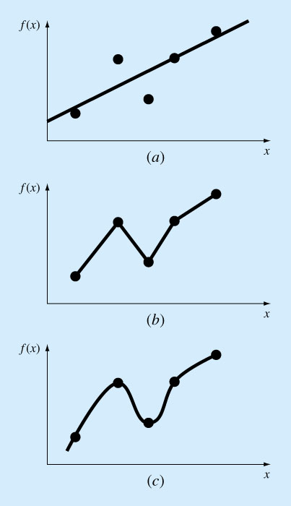
Curve Fitting and Interpolation
There are two approaches: curve fitting & interpolation
Curve fitting by least-squares regression: When the data exhibits a significant degree of error, then the strategy is to derive a single curve that represents the general trend of the data.
Interpolation: when the data is known to be precise, the approach is to fit a curve or a series of curves that pass directly through each of the points. Estimation of values between well-known discrete points is called interpolation.
Curve fitting
Interpolation

Slide 5
Example – Young’s modulus
Hooke’s law:
How do we determine the Young’s modulus (E)?

Slide 6
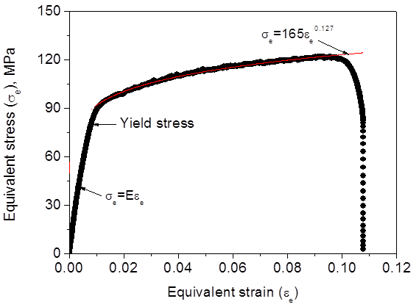
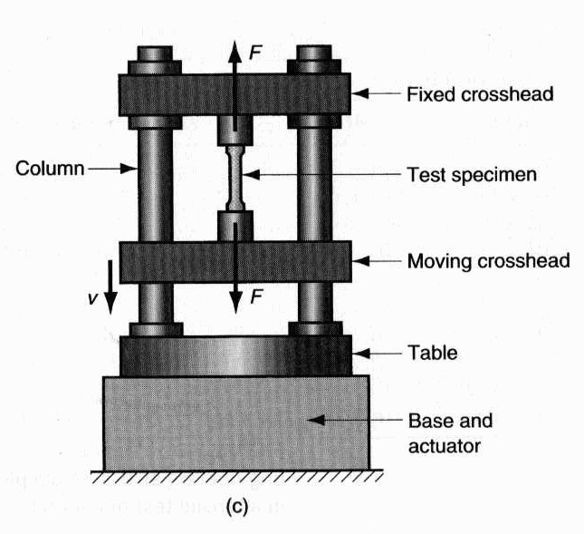
Tensile test
In the elastic region, E is determined by regression.

Slide 7
Regression
(Least-Squares Regression)

Slide 8
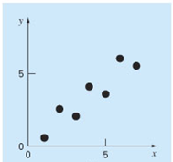
Experimental data (solid points):
(x₁,y₁), (x₂, y₂), …, (x_{i}, y_{i}), … (x_{n}, y_{n}).
are known then…

Slide 9
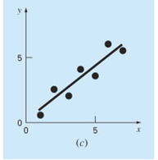
Experimental data
Visual inspection
Linear relationship
But how do we determine a_{0,} a₁ ?

Slide 10
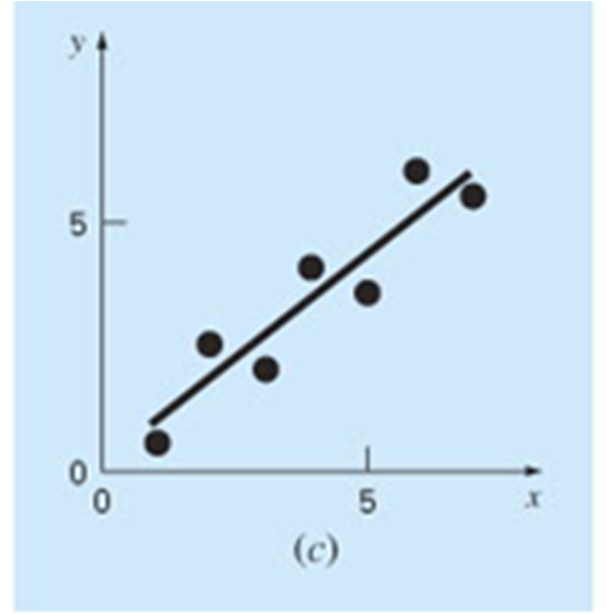
Experimental data (solid points):
(x₁,y₁), (x₂, y₂), …, (x_{i}, y_{i}), … (x_{n}, y_{n}).
Error (residual):
Point on the line:
n is the total number of data.

Slide 11
“Best fit” – Least - Squares Regression
(determination of a₀ and a₁)
The strategy is to minimise the sum of the squares of the residual errors between the measured y_{i} and the calculated y with the linear model (a₀+a₁x_{i}).
Minimise
y
a₁
y_{i} – a₀ – a₁ x_{i}
a₀
x

Slide 12
Determination of a₀ and a₁
a₀ and a₁ are unknowns
The first derivatives are equal to zero.
L05E01_leastSquaresRegression_linearFit.m

Slide 13
L05E01_leastSquaresRegression_linearFit.m

Slide 14
Solution:
L05E01_leastSquaresRegression_linearFit.m

Slide 15
Quantification of error
1) Standard error of the estimate:
S_{y/x} = 0 indicates a perfect fit.
n-2 because 2 degrees of freedom are lost.
2) Correlation coefficient
(coefficient of determination):
r = 1 is a perfect fit signifying that the line explains 100% of data variability. If r = r² = 0, S_{r} = S_{t}, the fit represents no improvement.
L05E01_leastSquaresRegression_linearFit.m

Slide 16
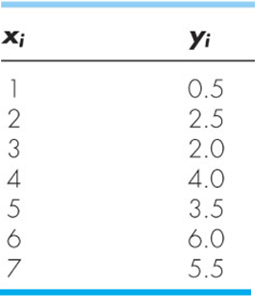
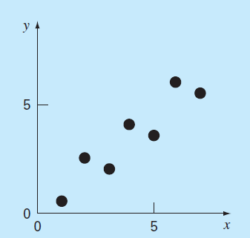
Example 17.1
Fit a straight line to the x and y values given in the following table.
L05E01_leastSquaresRegression_linearFit.m

Slide 17
Solution
L05E01_leastSquaresRegression_linearFit.m

Slide 18
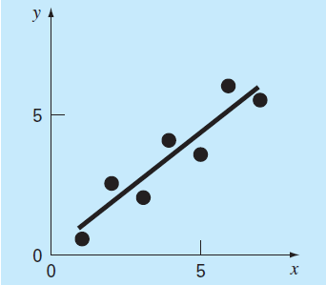
L05E01_leastSquaresRegression_linearFit.m

Slide 19
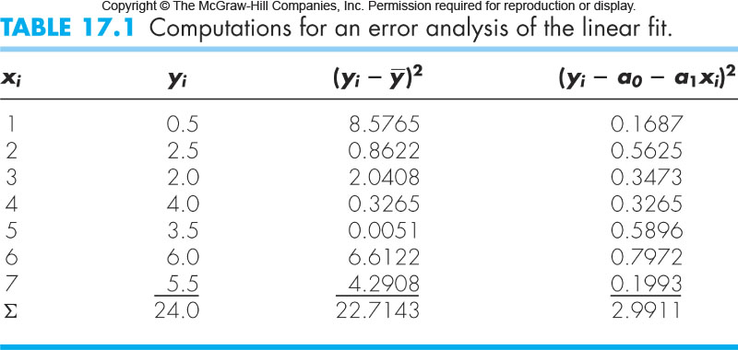
L05E01_leastSquaresRegression_linearFit.m **

Slide 20
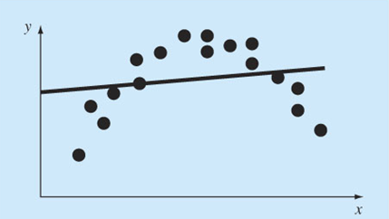
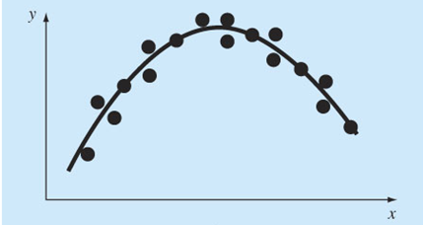
Non-linear relationships
Not a good fit
Is a good fit
How do we determine the coefficients of a non-linear relationship?

Slide 21
Determination of non-linear relationships
Step 1: Linearize a nonlinear relationship.
Step 2: Determine the coefficients of
the linearized relationship in
Step 1.
Step 3: Substitute the coefficients back
into the nonlinear relationship.

Slide 22
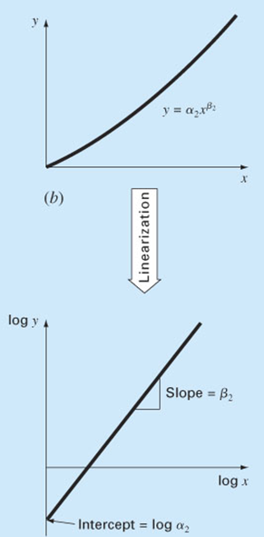
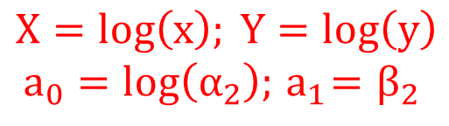



Linearization of nonlinear relationships
(1) Power function:
applying log10 or natural log on both sides
$$log\left(y\right)=log\left(α_{2}\right)+β_{2}log(x)$$
Linear relationship
between X and Y
$$Y=a_{0}+a_{1}X$$
$$X=log\left(x\right); Y=log\left(y\right)$$
$$a_{0}=log\left(α_{2}\right);{ a}_{1}=β_{2}$$
Determine a₀ and a₁ by linear regression
$$α_{2}={10}^{a_{0}}$$
$$β_{2}=a_{1}$$
L05E02_leastSquaresRegression_powerEquationFit. m

Slide 23
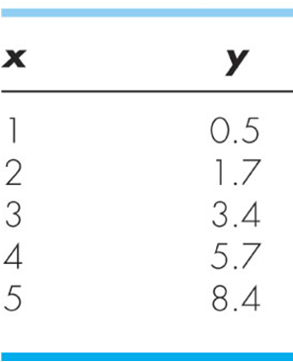
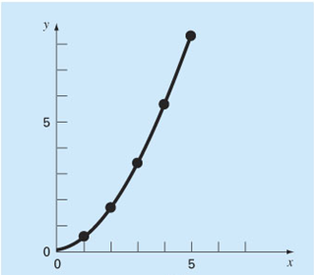
Example
Fit a power equation to the data (x,y).
L05E02_leastSquaresRegression_powerEquationFit.m

Slide 24
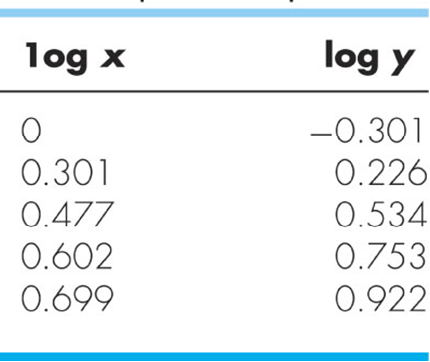
Solution
Power law relationship:
Linearise by applying log10 to both sides:
Linear relationship between log(y) and log(x):
Y
X
L05E02_leastSquaresRegression_powerEquationFit.m

Slide 25
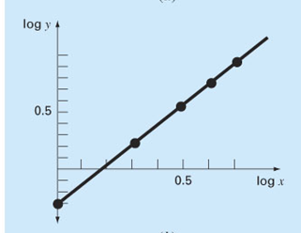
Y
X
Least-squares regression:
L05E02_leastSquaresRegression_powerEquationFit.m

Slide 26


$$α{=10}^{a_{0}}=0.5$$
$$β=a_{1}=1.75$$
L05E02_leastSquaresRegression_powerEquationFit. m **

Slide 27
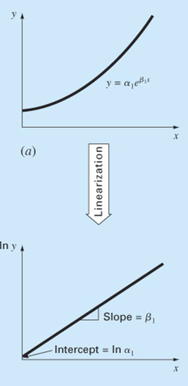
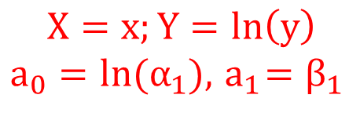




Linearization of other nonlinear relationships
(2) Exponential function:
applying natural log on both sides
$$ln\left(y\right)={ln(α}_{1})+β_{1}∗x$$
Linear relationship
between X and Y.
$$X=x;Y=ln\left(y\right)$$
$$a_{0}=ln(α_{1}),{ a}_{1}=β_{1}$$
$$Y=a_{0}+a_{1}X$$
Determine a₀ and a₁ by linear regression
$$α_{1}=e^{a_{0}}$$
$$β_{1}=a_{1}$$
L05E03_leastSquaresRegression_exponentialEquationFit.m **

Slide 28
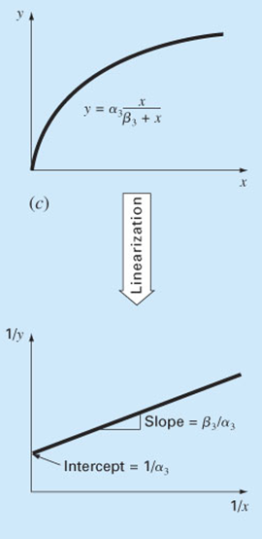

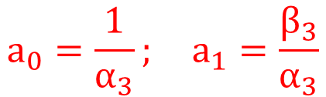
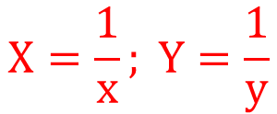


(3) Saturation growth rate function:
invert
Linear relationship
between X and Y
$$X=\frac{1}{x}; Y=\frac{1}{y}$$
$$Y=a_{0}+a_{1}X$$
$$a_{0}=\frac{1}{α_{3}}; a_{1}=\frac{β_{3}}{α_{3}}$$
Determine a₀ and a₁ by linear regression
$$α_{3}=1/a_{0}$$
$$β_{3}=a_{1}α_{3}$$
L05E04_leastSquaresRegression_saturationGrowthRateEquationFit.m **

Slide 29
Polynomial (non-linear) regression
(single x, 2nd order)
If we fit a second-order polynomial or quadratic equation:
Coefficients a₀, a₁ and a₂ can be determined by minimizing:
L05E05_polynomialRegression.m

Slide 30
This is familiar!
Use Gauss elimination or LU decomposition, or Gauss-Seidel iteration from week 3.
L05E05_polynomialRegression.m

Slide 31
Solving AX = B yields the coefficients a₀, a₁ and a₂
1) Standard error of the estimate:
m is the order of polynomial; m = 2 for a quadratic equation.
n-(m+1) because m+1 degrees of freedom lost for a0, a1 and a2…etc
2) Correlation coefficient :
L05E05_polynomialRegression.m

Slide 32
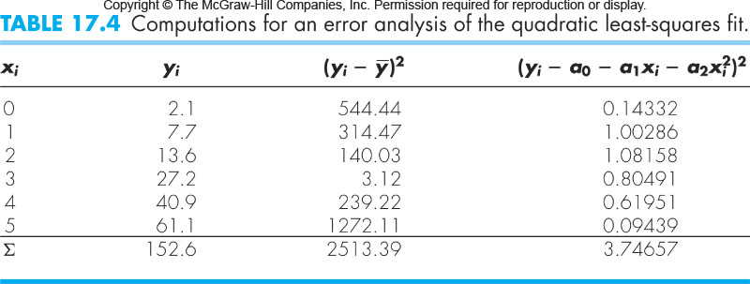
Example of polynomial regression
Fit a second-order polynomial to the data below.
(single x, 2nd order)
L05E05_polynomialRegression.m

Slide 33
Solving AX = B by Gauss elimination.
L05E05_polynomialRegression.m **

Slide 34
Multiple linear regression
(x_{1,} x₂,…, first order)
For example, y might be a linear function of x₁ and x₂:
Coefficients a₀, a₁ and a₂ can be determined by minimizing:
L05E06_polynomialRegression_multipleLinear.m

Slide 35
This is familiar!
Use Gauss elimination or LU decomposition, or Gauss-Seidel iteration from week 3.
L05E06_polynomialRegression_multipleLinear.m

Slide 36
Solving AX = B yields the coefficients a₀, a₁ and a₂.
1) Standard error of the estimate:
m is the dimensionality, m = 2 for the above problem.
2) Correlation coefficient :
L05E06_polynomialRegression_multipleLinear. m **

Slide 37
Regression
(Fourier Approximation
for periodic functions)

Slide 38
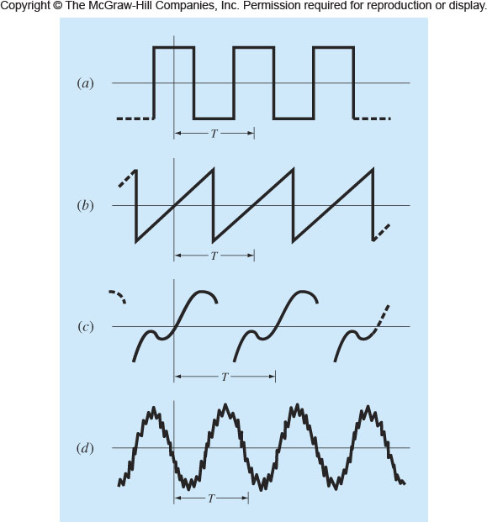
Periodic functions
The periodic function repeats its values at a regular interval (T).
T is defined as the period.
L05E07_sinusoidFunction_example1.m

Slide 39
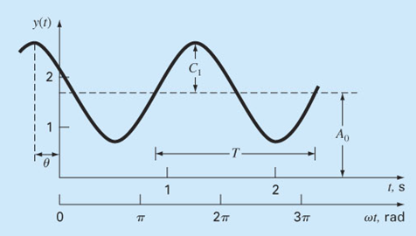
Example 1- Sinusoid function
f = frequency
A₀ = mean value, the average height above the t axis,
C₁ = amplitude, the height of the oscillation,
ω₀ = angular frequency, how often the cycles occur,
= phase angle, the extent to which sinusoid is shifted
horizontally.
L05E07_sinusoidFunction_example1.m

Slide 40
Example 1- Sinusoid function
where:
L05E07_sinusoidFunction_example1.m

Slide 41
Least-squares fit of a sinusoid
Fit the following sinusoid function to the discrete data points (t₁,y₁), (t₂, y₂), …, (t_{i}, y_{i}), … (t_{n}, y_{n}).
The goal is to determine coefficients values A₀, A₁and B₁ that minimize
L05E07_sinusoidFunction_example1.m

Slide 42
Minimization yields:
This is familiar!
Use Gauss elimination or LU decomposition, or Gauss-Seidel iteration from week 3.
L05E07_sinusoidFunction_example1.m **

Slide 43
Example 2- Sinusoid function
If the sinusoid function is as follows:
the coefficients can be determined by
L05E07_sinusoidFunction_example2.m

Slide 44
Continuous Fourier series – Example 1
For a continuous curve function (F(t)) with period T, the continuous Fourier series (with infinite terms) can be written:
The coefficients can be computed via
L05E09_continuousFourierSeries_example1.m

Slide 45
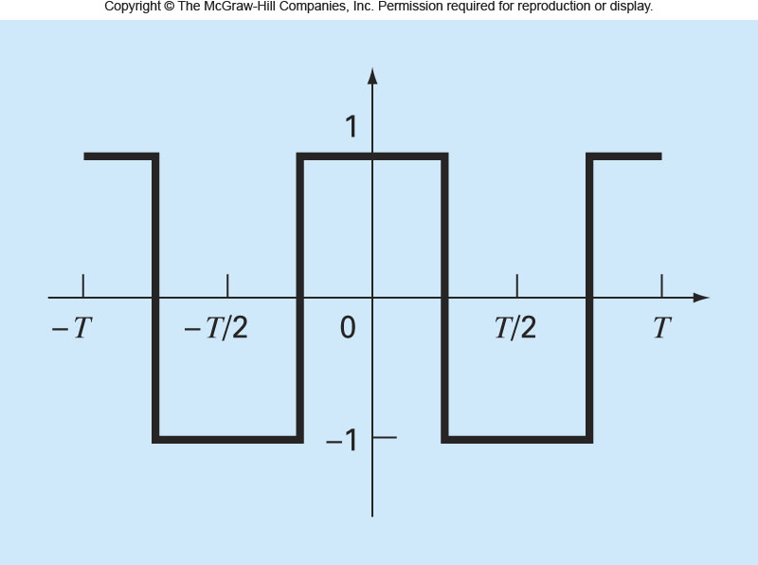
Continuous Fourier series – Example 2
Use the continuous Fourier series to approximate the square of rectangular wave function.
L05E10_continuousFourierSeries_example2.m **

Slide 46
Continuous Fourier (infinite) series
L05E11_infiniteSeries. m **

Slide 47
Interpolation

Slide 48
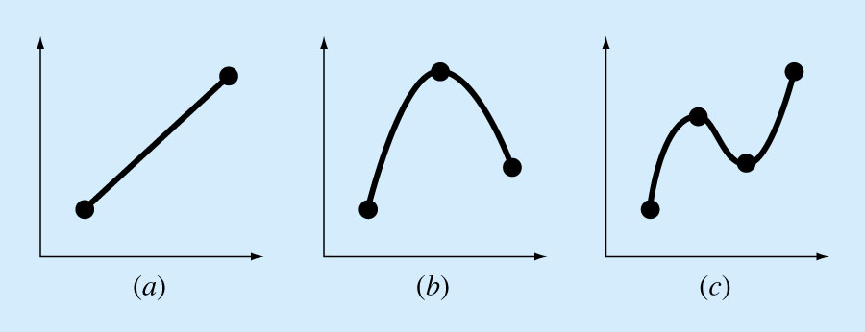
Interpolation
Estimation of intermediate values between precise data points. The most common method is:
Although there is one and only one nth-order polynomial that fits n+1 points, there are 2 common mathematical formats in which this polynomial can be expressed:
The Newton or Lagrange polynomials
(a)
1st order (linear)
connecting 2 points
(c)
3rd order (cubic)
connecting 4
points.
(b)
2nd order (quadratic / parabolic)
connecting 3 points
48

Slide 49
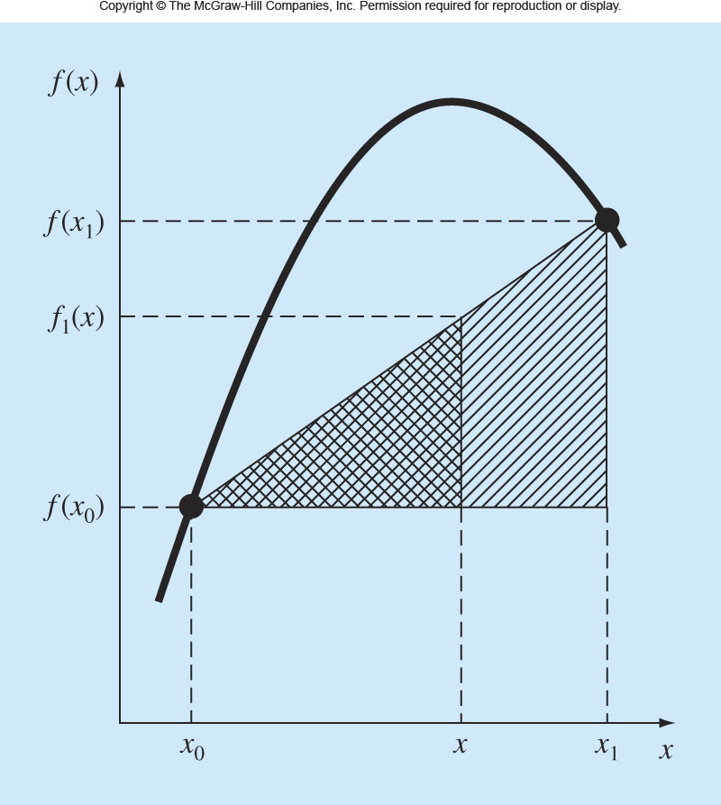
Linear interpolation
If two points (x₀, f(x₀)) and (x₁, f(x₁)) are known, f(x) at x between x₀ and x₁ can be estimated by linear interpolation using similar triangles.
The simplest form of interpolation, connects two data points with a straight line
Function value at the starting data point
Finite-divided difference approximation for the first derivative
L05E12_linearInterpolation.m

Slide 50
Linear interpolation
Estimate the natural log of 2 by linear interpolation. 1. Interpolate between ln(1) = 0 & ln(6) = 1.7918.
2. Repeat using a smaller interval between
ln(1) = 0 & ln(4) = 1.3863.
Solution:
(1) x₀ = 1; f(x₀) = 0; x₁ = 6; f(x₁) = 1.791759.
L05E12_linearInterpolation.m

Slide 51
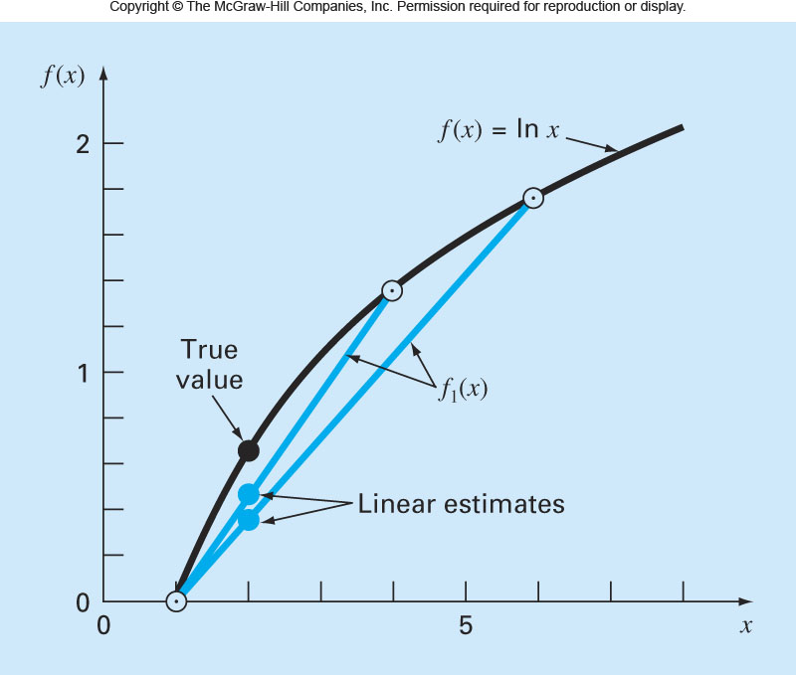
(2) x₀ = 1; f(x₀) = 0; x₁ = 4; f(x₁) = 1.386294.
Smaller intervals improve accuracy!
L05E12_linearInterpolation.m **

Slide 52
Quadratic interpolation
If three points (x₀, f(x₀)), (x₁, f(x₁)) and (x₂, f(x₂)) are known, f(x) at x between x₀ and x₂ can be estimated by quadratic interpolation.
The quadratic formula (Newton equation) can be expressed by:
How do we determine the coefficients b₀, b₁ and b₂?
L05E13_quadraticInterpolation.m

Slide 53
Quadratic interpolation
1) At x = x₀
Function value at starting data point
2) At x = x₁
Finite-divided difference approximation for the first derivative
3) At x = x₂
Finite-divided difference approximation for the second derivative
53
L05E13_quadraticInterpolation.m

Slide 54
General form of Newton’s (quadratic) interpolating polynomials
If n+1 points are available, f(x) can be estimated by polynomial interpolation.
The coefficients b₀, b₁, …, b_{n} can be determined by:
Function value at starting data point
Finite-divided difference of the 1st derivative
Finite-divided difference of the 2nd derivative
Finite-divided difference of the n^{th} derivative
L05E13_quadraticInterpolation.m

Slide 55
Quadratic interpolation - Example
Fit a second-order polynomial to the three points used in Example 18.1.
Use the polynomial to evaluate ln(2).
Solution:
L05E13_quadraticInterpolation.m

Slide 56
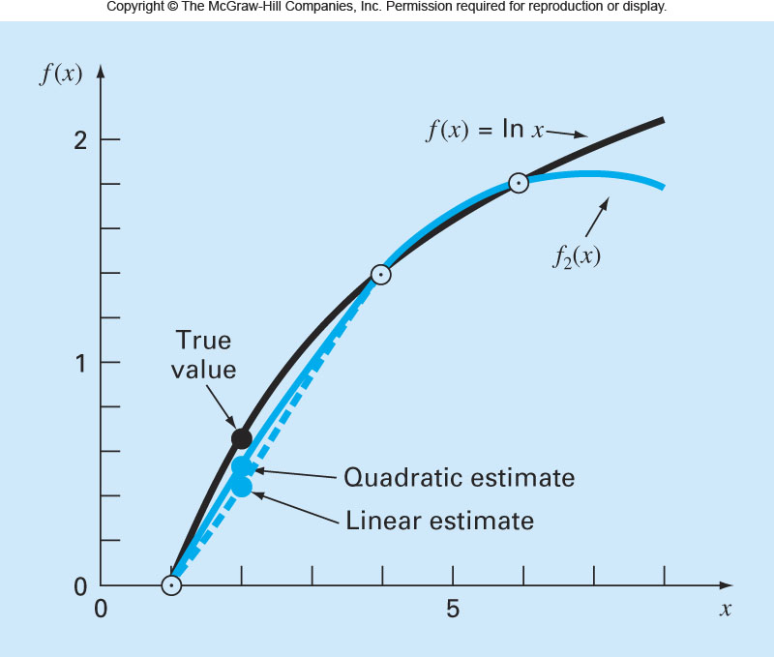
At x = 2
L05E13_quadraticInterpolation.m **

Slide 57
Recursive Nature of Finite Divided Differences
for example, 4 data points, 3 order polynomial (3 derivatives)
i x_{i} f(x_{i})
0 x₀ f(x₀)
1 x₁ f(x₁)
First
Second
Third
f[x₁,x₀]
f[x₂,x₁,x₀]
f[x₃,x₂,x₁,x₀]
f[x₂,x₁]
f[x₃,x₂,x₁]
2 x₂ f(x₂)
f[x₃,x₂]
3 x₃ f(x₃)
f(x) = f(x₀) + f[x₁, x₀](x – x₀)
+ f[x₂, x₁, x₀](x – x₀) (x – x₁)
+ f[x₃, x₂, x₁, x₀](x – x₀)(x – x₁)(x – x₂)
57
L05E14_newtonInterpolation.m

Slide 58
Find the solution using a matrix/table as a guide:
Data points (x, f(x)): (1, 0), (4, 1.386294) and (6, 1.791759)
x
f(x)
1
0
0.4621
4
1.386294
-0.05187
0.2027
6
1.791759
This matrix/table is computed as follows:
after writing down the x and f(x) values in separate columns, move from left to right while calculating the next column,.
58
L05E14_newtonInterpolation.m **

Slide 59
Lagrange’s interpolating polynomials
(a reformulation of Newton’s polynomials to avoid computing divided differences)
Π denotes “the product of”.
For the linear version:
For the second-order version:
59
L05E15_lagrangeInterpolation_example1.m

Slide 60
While the Lagrange interpolating polynomial is a simple reformulation of the Newton’s polynomial, it is computationally EFFICIENT by avoiding the calculation of divided differences entirely.
Newton’s polynomial
Lagrange’s polynomial
60
L05E15_lagrangeInterpolation_example1.m

Slide 61
Lagrange’s interpolating polynomials – Example 1
Find an Lagrange interpolating polynomial for three data points:
(0,1), (2,2), and (3,4)
Solution:
Re-checking the Lagrangian equation of best-fit with the known data points
61
L05E15_lagrangeInterpolation_example1.m **

Slide 62
Lagrange’s interpolating polynomials – Example 2
Find an Lagrange interpolating polynomial for four data points:
((0,2), (1,1), (2,0) and (3,-1)
Solution:
The interpolating polynomials may be 3 or less.
In this example, the data point are co-linear, so the interpolating polynomial degree is 1.
62
L05E16_lagrangeInterpolation_example2.m **

Slide 63
Newton / Lagrange interpolations comprise one function to describe the full range (domain) of data.
If the data domain (range) shows sub-features, is there a better way to interpolate?
Dat divided into 3 sub-domains, with 1 equation describing each subdomain.
One polynomial equation, for e.g.
63

Slide 64
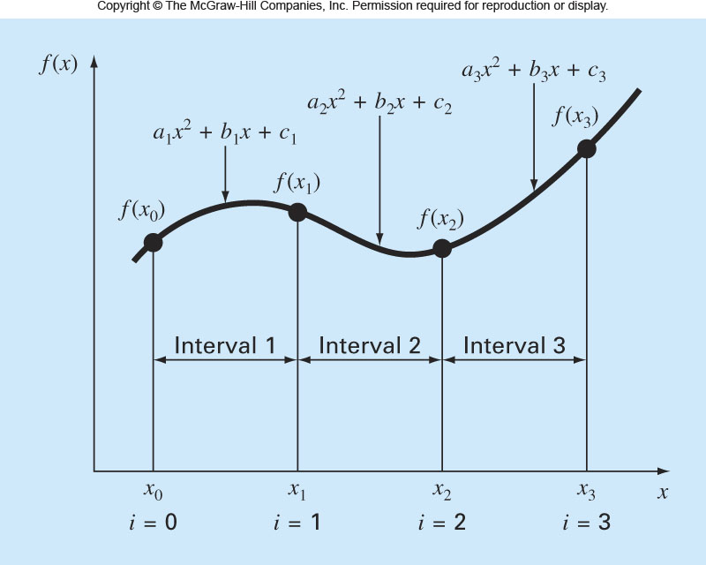
Quadratic splines interpolation
The objective in quadratic splines is to derive a second-order polynomial for each interval between data points. The polynomial for each interval can be represented generally as:
L05E17_quadraticSplinesInterpolation.m

Slide 65
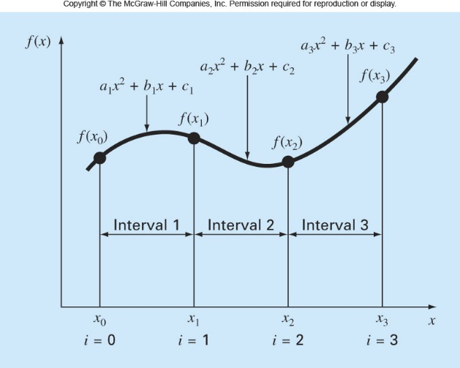
Three unknown coefficients
(a_{i}, b_{i} and c_{i}) for each interval.
For n+1 data points (i = 0, 1, …, n), there are n intervals.
Consequently 3n unknown coefficients.
So 3n equations are required to evaluate the unknowns.
(1) The function values for internal data points (i = 1, 2, …, n-1) are known.
So (2n-2) equations are now known.
For point (i-1):
L05E17_quadraticSplinesInterpolation.m

Slide 66
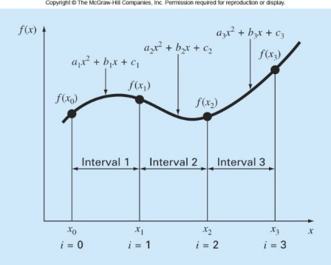
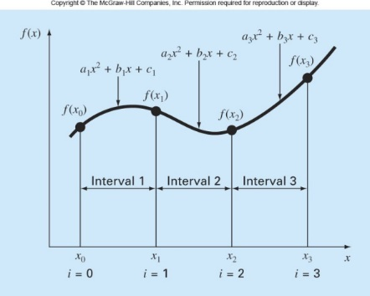
(2) The first derivative for both equations of internal data points are equal.
So (n-1) equations are now known.
(3) The first and last functions must pass through the end points.
So 2 equations are now known.
4) ASSUME the first point extends to the origin. In this case, the second derivative is zero for the first point.
So 1 equation is now known and solved.
The total number of equations = (2n - 2) + (n-1) + 2 + 1 = 3n.
(3n – 1) unknowns with (3n – 1) equations can be solved by spline interpolation!
L05E17_quadraticSplinesInterpolation.m

Slide 67
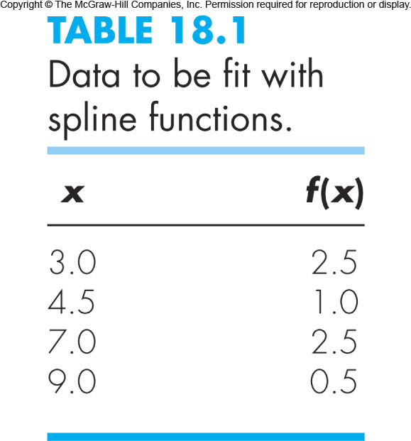
Quadratic splines interpolation - Example
Fit quadratic splines to the following data. Use the results to estimate the value at x = 5.
L05E17_quadraticSplinesInterpolation.m

Slide 68
Solution
4 data points; intervals n = 3.
Hence, there are 3 equations and 9 unknown coefficients
(a₁, b₁, c₁, a₂, b₂, c₂, a₃, b₃, c₃).
The equations for the 2 internal points.
(4 equations)
data point (4.5, 1.0)
data point (7.0, 2.5)
L05E17_quadraticSplinesInterpolation.m

Slide 69
Solution
The first derivatives at internal points are also equal.
(2 equations)
continuous slopes
data point (4.5, 1.0)
data point (7.0, 2.5)
The first and last function must pass through the end points.
(2 equations)
data point (3.0, 2.5)
data point (9.0, 0.5)
L05E17_quadraticSplinesInterpolation.m

Slide 70
Solution
(1) n = 3. The function values for interior data points (i = 1 and 2) are known (4 equations).
2) The first and last functions must pass through the end points (i=0 and i=3) (2 equations).
L05E17_quadraticSplinesInterpolation.m
Notes:
del f

Slide 71
3) The first derivative at interior data points (i=1 and 2) must be equal (2 equations).
4) Assume the second derivative is zero at the first point (1 equation).
All equations:
L05E17_quadraticSplinesInterpolation.m

Slide 72
Solving equations yields:
At x=5
L05E17_quadraticSplinesInterpolation.m **

Slide 73
Cubic splines interpolation
The objective in cubic splines is to derive a third-order polynomial for each interval between data points. The polynomial for each interval can be represented generally as
For n+1 data points (i = 0, 1, …, n), there are n intervals and consequently, 4n unknown constants.
4n equations are required to evaluate the unknown.

Slide 74
Equations for cubic splines interpolation:
(1) The function values for interior data points
(i = 1,2,…,n-1) are known (2n-2 equations).
(2) The first derivative for interior data points
(i = 1,2,…,n-1) are equal (n-1 equations).
(3) The second derivative at interior data points
(i = 1,2,…,n-1) are equal (n-1 equations).
(4) The first and last functions must pass through the
end points (i = 0 and n) (2 equations).
(5) ASSUME the second derivative is zero for the
end points (2 equations).

Slide 75
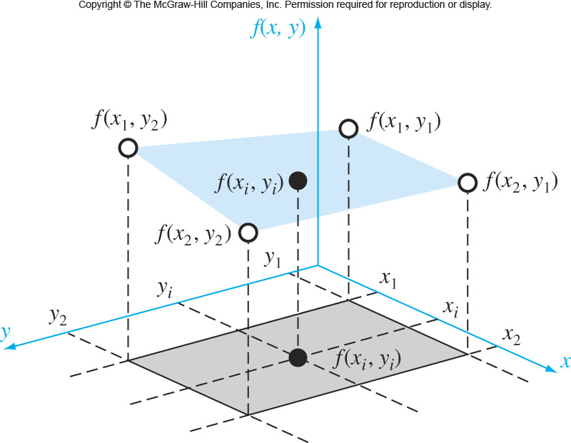
HOME READING
Two-dimensional bilinear interpolation
We have values at four points f(x₁, y₁), f(x₁, y₂), f(x₂, y₁) and f(x₂, y₂). Estimate the value at an intermediate point (f(x_{i},y_{i})).
L05E18_2DbilinearInterpolation.m

Slide 76
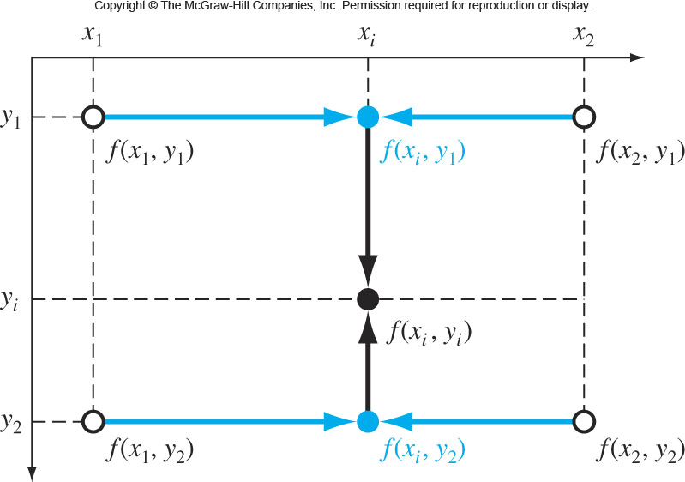
(1) Fix the y-value and apply 1-D linear interpolation in the x-direction. Using the Lagrange form, the result at (x_{i}, y₁) is…
and at (x_{i}, y₂) is.
L05E18_2DbilinearInterpolation.m

Slide 77
(2) (x_{i}, y₁) and (x_{i}, y₂) are used to linearly interpolate along the y direction. Using the Lagrange form, the result at (x_{i}, y_{i}) is…
L05E18_2DbilinearInterpolation.m

