Slide 1
MECH201 ENGINEERING ANALYSIS
Lecture Notes
(Week 5)
Lecturer: Azdiar Gazder
Based on slides by: Cheng Lu & Hongtao Zhu
Office: 236.101A
Email: azdiar@uow.edu.au
Consultation: Appointment by email

Slide 2
Week 2 – Roots of equations
Week 3 - Linear Algebraic Equations
Week 4 - Optimization

Slide 3
MATLAB example scripts
All lecture scripts uploaded weekly to:
https://github.com/AzdiarGazder/MECH201
Please follow the instructions posted there to download and run your local copy of the scripts.

Slide 4
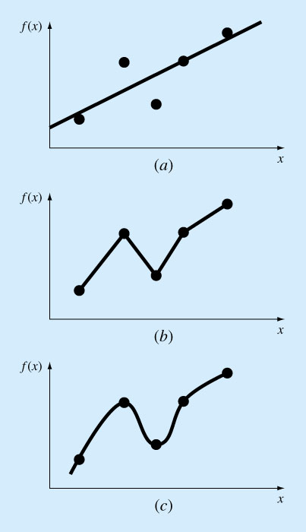
Curve Fitting and Interpolation
There are two approaches: curve fitting & interpolation
Curve fitting by least-squares regression: When the data exhibits a significant degree of error, then the strategy is to derive a single curve that represents the general trend of the data.
Interpolation: when the data is known to be precise, the approach is to fit a curve or a series of curves that pass directly through each of the points. Estimation of values between well-known discrete points is called interpolation.
Curve fitting
Interpolation

Slide 5
Curve fitting by
Least-Squares Regression

Slide 6
Example – Young’s modulus
Hooke’s law:
How do we determine the Young’s modulus (E)?

Slide 7
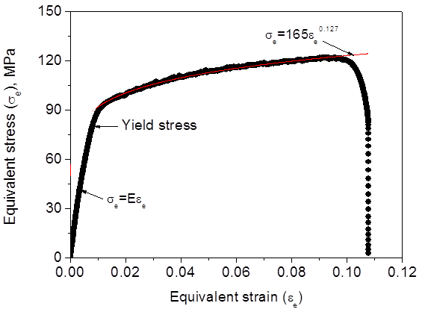
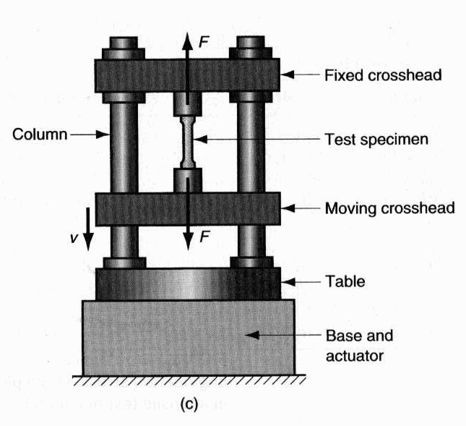
Tensile test
In the elastic region, E is determined by regression.

Slide 8
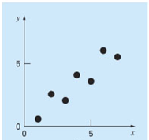
Experimental data (solid points):
(x₁,y₁), (x₂, y₂), …, (x_{i}, y_{i}), … (x_{n}, y_{n}).
are known then…

Slide 9
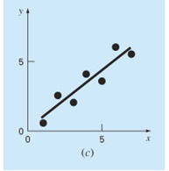
Experimental data
Visual inspection
Linear relationship
But how do we determine a_{0,} a₁ ?

Slide 10
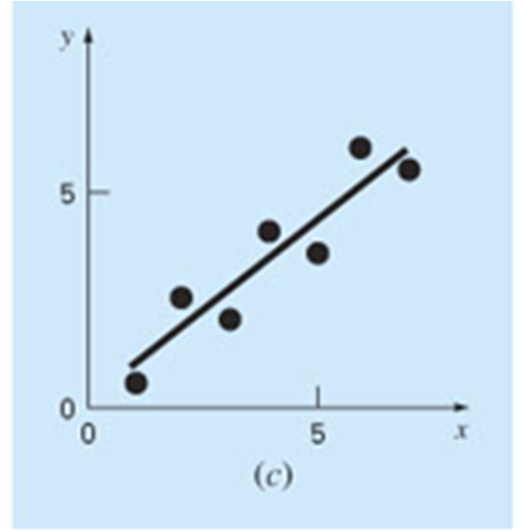
Experimental data (solid points):
(x₁,y₁), (x₂, y₂), …, (x_{i}, y_{i}), … (x_{n}, y_{n}).
Error (residual):
Point on the line:
n is the total number of data.

Slide 11
“Best fit” – Least-Squares Regression
(determination of a₀ and a₁)
The strategy is to minimise the sum of the squares of the residual errors between the measured y_{i} and the calculated y with the linear model (a₀+a₁x_{i}).
Minimise
y
a₁
y_{i} – a₀ – a₁ x_{i}
a₀
x

Slide 12
Determination of a₀ and a₁
where,
a₀ and a₁ are unknowns
The first derivatives are equal to zero.
L05E01_leastSquaresRegression_linearFit.m

Slide 13
L05E01_leastSquaresRegression_linearFit.m

Slide 14
Solution:
L05E01_leastSquaresRegression_linearFit.m

Slide 15
Quantification of error
1) Standard error of the estimate:
S_{y/x} = 0 indicates a perfect fit.
n-2 because 2 degrees of freedom are lost.
2) Correlation coefficient
(coefficient of determination):
r = 1 signifies a perfect fit with the line explaining 100% of data variability.
If r = r² = 0, S_{r} = S_{t}, the fit represents no improvement.
L05E01_leastSquaresRegression_linearFit.m

Slide 16
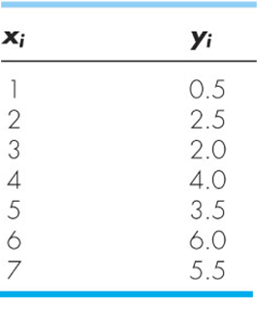
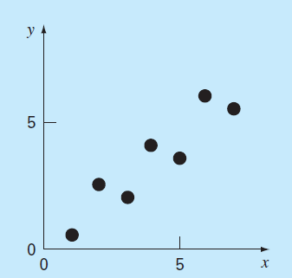
Example – Least-Squares Regression
Fit a straight line to the x and y values given in the following table.
L05E01_leastSquaresRegression_linearFit.m

Slide 17
Solution
L05E01_leastSquaresRegression_linearFit.m

Slide 18
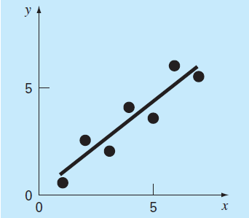
L05E01_leastSquaresRegression_linearFit.m

Slide 19
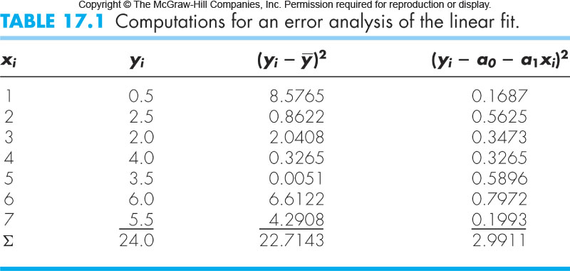
L05E01_leastSquaresRegression_linearFit.m **

Slide 20
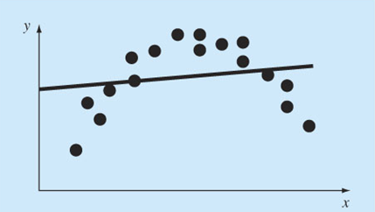
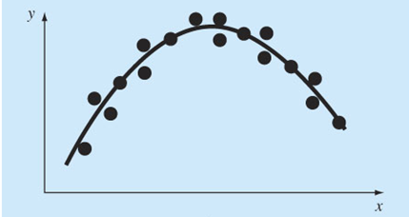
Non-linear relationships
Not a good fit
Is a good fit
How do we determine the coefficients of a non-linear relationship?

Slide 21
Determination of non-linear relationships
Step 1: Linearize a nonlinear relationship.
Step 2: Determine the coefficients of
the linearized relationship in
Step 1.
Step 3: Substitute the coefficients back
into the nonlinear relationship.

Slide 22
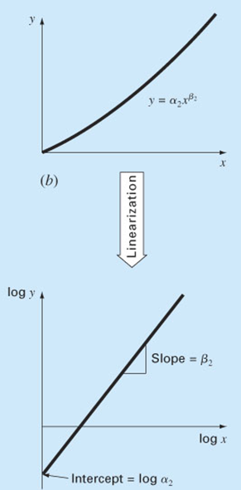
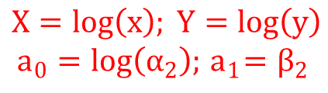




Linearization of nonlinear relationships
(1) Power function:
applying log10 or natural log on both sides
$$log\left(y\right)=log\left(α_{2}\right)+β_{2}log(x)$$
Linear relationship
between X and Y
$$Y=a_{0}+a_{1}X$$
$$X=log\left(x\right); Y=log\left(y\right)$$
$$a_{0}=log\left(α_{2}\right);{ a}_{1}=β_{2}$$
Determine a₀ and a₁ by linear regression
$$α_{2}={10}^{a_{0}}$$
$$β_{2}=a_{1}$$
L05E02_leastSquaresRegression_powerEquationFit. m

Slide 23
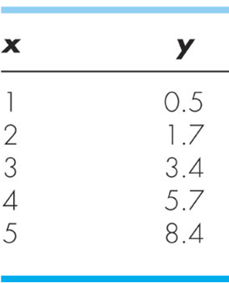
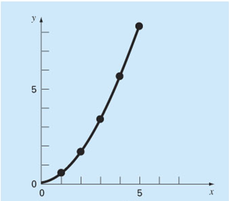
Example - Linearization of nonlinear relationships
Fit a power equation to the (x, y) data.
L05E02_leastSquaresRegression_powerEquationFit.m

Slide 24
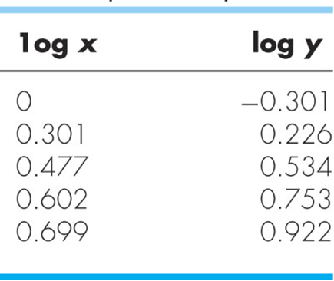
Solution
Power law relationship:
Linearise by applying log10 to both sides:
Linear relationship between log(y) and log(x):
Y
X
L05E02_leastSquaresRegression_powerEquationFit.m

Slide 25
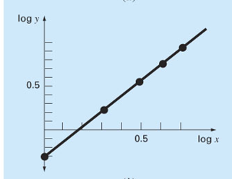
Y
X
Least-squares regression:
L05E02_leastSquaresRegression_powerEquationFit.m

Slide 26


$$α{=10}^{a_{0}}=0.5$$
$$β=a_{1}=1.75$$
L05E02_leastSquaresRegression_powerEquationFit. m **

Slide 27
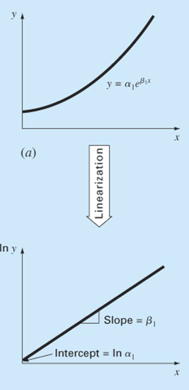
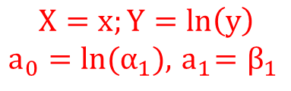




Linearization of other nonlinear relationships
(2) Exponential function:
applying natural log on both sides
$$ln\left(y\right)={ln(α}_{1})+β_{1}∗x$$
Linear relationship
between X and Y.
$$X=x;Y=ln\left(y\right)$$
$$a_{0}=ln(α_{1}),{ a}_{1}=β_{1}$$
$$Y=a_{0}+a_{1}X$$
Determine a₀ and a₁ by linear regression
$$α_{1}=e^{a_{0}}$$
$$β_{1}=a_{1}$$
L05E03_leastSquaresRegression_exponentialEquationFit.m **

Slide 28
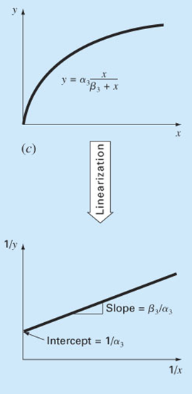

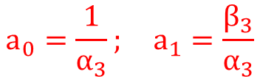
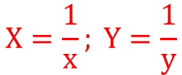


(3) Saturation growth rate function:
invert
Linear relationship
between X and Y
$$X=\frac{1}{x}; Y=\frac{1}{y}$$
$$Y=a_{0}+a_{1}X$$
$$a_{0}=\frac{1}{α_{3}}; a_{1}=\frac{β_{3}}{α_{3}}$$
Determine a₀ and a₁ by linear regression
$$α_{3}=1/a_{0}$$
$$β_{3}=a_{1}α_{3}$$
L05E04_leastSquaresRegression_saturationGrowthRateEquationFit.m **

Slide 29
Curve fitting by
Polynomial Regression

Slide 30
Polynomial (non-linear) regression
(single x, 2nd order)
If we fit a second-order polynomial or quadratic equation:
Coefficients a₀, a₁ and a₂ can be determined by minimizing:
L05E05_polynomialRegression.m

Slide 31
This is familiar!
Use Gauss elimination or LU decomposition, or Gauss-Seidel iteration from week 3.
L05E05_polynomialRegression.m

Slide 32
Solving AX = B yields the coefficients a₀, a₁ & a₂
1) Standard error of the estimate:
m is the order of polynomial; m = 2 for a quadratic equation.
n-(m+1) because m+1 degrees of freedom lost for a0, a1 and a2…etc
2) Correlation coefficient :
L05E05_polynomialRegression.m

Slide 33
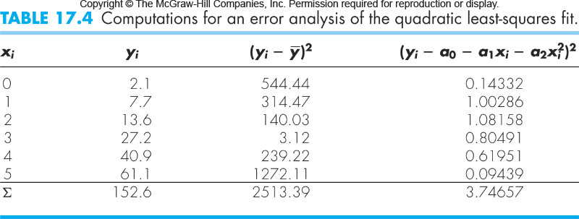
Example - Polynomial regression
Fit a second-order polynomial to the data below.
(single x, 2nd order)
L05E05_polynomialRegression.m

Slide 34
Solving AX = B by Gauss elimination.
L05E05_polynomialRegression.m **

Slide 35
Multiple linear regression
(x_{1,} x₂,…, first order)
For example, y might be a linear function of x₁ and x₂:
Coefficients a₀, a₁ and a₂ can be determined by minimizing:
L05E06_polynomialRegression_multipleLinear.m

Slide 36
This is familiar!
Use Gauss elimination or LU decomposition, or Gauss-Seidel iteration from week 3.
L05E06_polynomialRegression_multipleLinear.m

Slide 37
Solving AX = B yields the coefficients a₀, a₁ & a₂.
1) Standard error of the estimate:
m is the dimensionality, m = 2 for the above problem.
2) Correlation coefficient :
L05E06_polynomialRegression_multipleLinear. m **

Slide 38
Fitting periodic functions
by Regression
(Fourier Approximation)

Slide 39
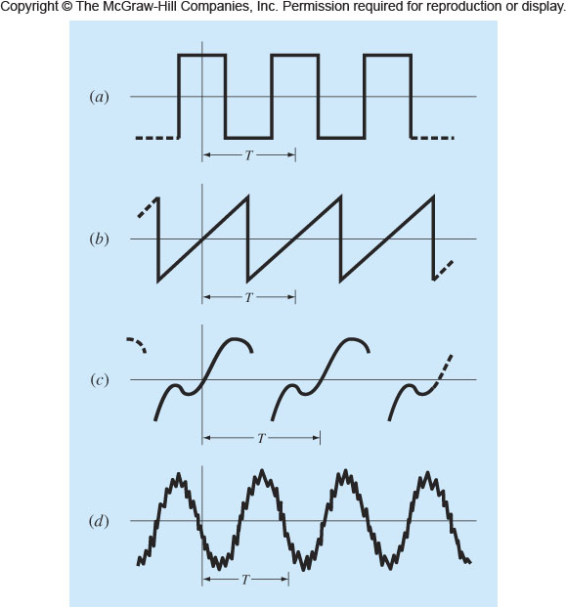
Periodic functions
The periodic function repeats its values at a regular interval (T).
T is defined as the period.
L05E07_sinusoidFunction_example1.m

Slide 40
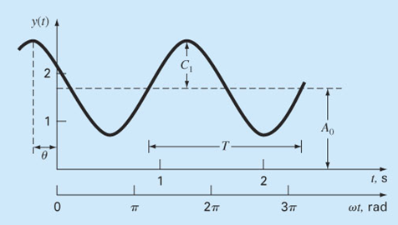
Example 1- Sinusoid function
f = frequency
A₀ = mean value, the average height above the t axis,
C₁ = amplitude, the height of the oscillation,
ω₀ = angular frequency, how often the cycles occur,
= phase angle, the extent to which sinusoid is shifted
horizontally.
L05E07_sinusoidFunction_example1.m

Slide 41
Rewriting the function as…
where:
L05E07_sinusoidFunction_example1.m

Slide 42
Least-squares fit of a sinusoid
Fit the following sinusoid function to the discrete data points (t₁,y₁), (t₂, y₂), …, (t_{i}, y_{i}), … (t_{n}, y_{n}).
The goal is to determine coefficients values A₀, A₁ and B₁ that minimize
L05E07_sinusoidFunction_example1.m

Slide 43
Minimization yields:
This is familiar!
Use Gauss elimination or LU decomposition, or Gauss-Seidel iteration from week 3.
L05E07_sinusoidFunction_example1.m **

Slide 44
Example 2 - Sinusoid function
If the sinusoid function is as follows:
…the coefficients can be determined by:
L05E07_sinusoidFunction_example2.m **

Slide 45
Example – Continuous Fourier series
For a continuous curve function (F(t)) with period T, the continuous Fourier series (with infinite terms) can be written:
The coefficients can be computed via
L05E09_continuousFourierSeries_example1.m **

Slide 46
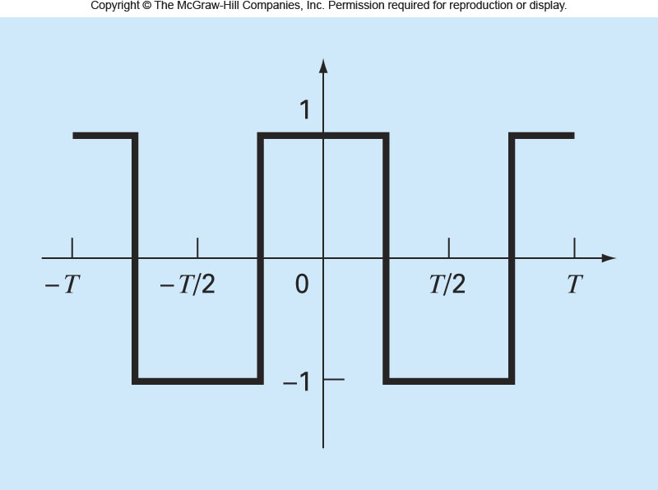
Continuous Fourier series – Example 2
Use the continuous Fourier series to approximate the square of rectangular wave function.
L05E10_continuousFourierSeries_example2.m **

Slide 47
Continuous Fourier (infinite) series
L05E11_infiniteSeries. m **

Slide 48
Interpolation

Slide 49
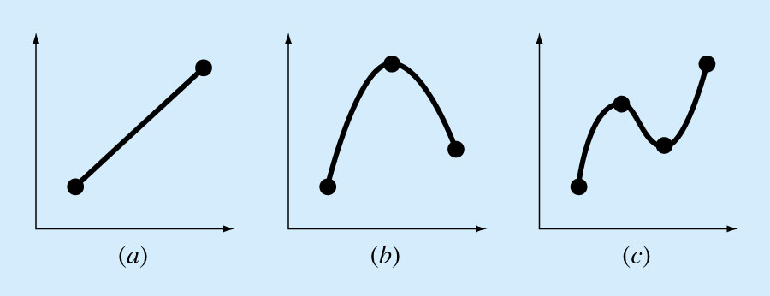
Interpolation
Estimation of intermediate values between precise data points. The most common method is:
Although there is one and only one nth-order polynomial that fits n+1 points, there are 2 common mathematical formats the polynomial can be expressed:
The Newton or Lagrange polynomials
(a)
1st order (linear)
connecting 2 points
(c)
3rd order (cubic)
connecting 4
points.
(b)
2nd order (quadratic / parabolic)
connecting 3 points
49

Slide 50
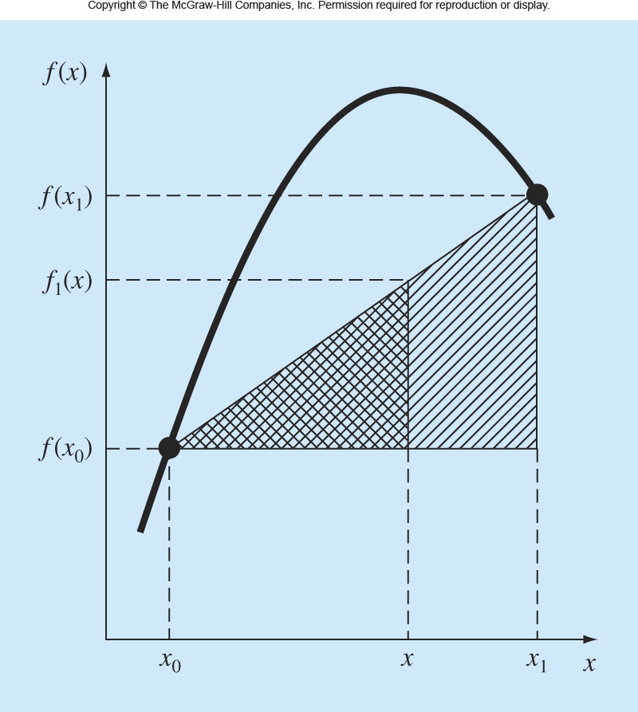
Linear interpolation
If two points (x₀, f(x₀)) and (x₁, f(x₁)) are known, f(x) at x between x₀ and x₁ can be estimated by linear interpolation using similar triangles.
The simplest form of interpolation, connects two data points with a straight line
Function value at the starting data point
Finite-divided difference approximation for the first derivative
L05E12_linearInterpolation.m

Slide 51
Linear interpolation
Estimate the natural log of 2 by linear interpolation.
1. Interpolate between ln(1) = 0 & ln(6) = 1.7918.
2. Repeat using a smaller interval between
ln(1) = 0 & ln(4) = 1.3863.
Solution:
(1) x₀ = 1; f(x₀) = 0; x₁ = 6; f(x₁) = 1.791759.
L05E12_linearInterpolation.m

Slide 52
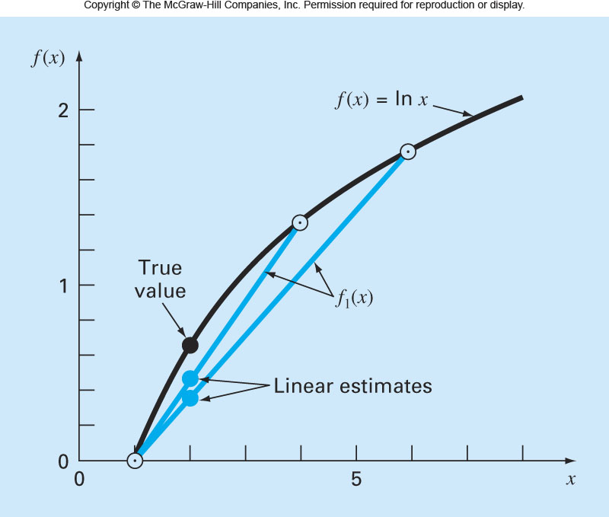
(2) x₀ = 1; f(x₀) = 0; x₁ = 4; f(x₁) = 1.386294.
Smaller intervals improve accuracy!
L05E12_linearInterpolation.m **

Slide 53
Quadratic interpolation
If three points (x₀, f(x₀)), (x₁, f(x₁)) and (x₂, f(x₂)) are known, f(x) at x between x₀ and x₂ can be estimated by quadratic interpolation.
The quadratic formula (Newton equation) can be expressed by:
How do we determine the coefficients b₀, b₁ and b₂?
L05E13_quadraticInterpolation.m

Slide 54
Quadratic interpolation
1) At x = x₀
Function value at starting data point
2) At x = x₁
Finite-divided difference approximation for the first derivative
3) At x = x₂
Finite-divided difference approximation for the second derivative
54
L05E13_quadraticInterpolation.m

Slide 55
General form of Newton’s (quadratic) interpolating polynomials
If n+1 points are available, f(x) can be estimated by polynomial interpolation.
The coefficients b₀, b₁, …, b_{n} can be determined by:
Function value at starting data point
Finite-divided difference of the 1st derivative
Finite-divided difference of the 2nd derivative
Finite-divided difference of the n^{th} derivative
L05E13_quadraticInterpolation.m

Slide 56
Example - Quadratic interpolation
Fit a second-order polynomial to the three points:
Use the polynomial to evaluate ln(2).
Solution:
L05E13_quadraticInterpolation.m

Slide 57
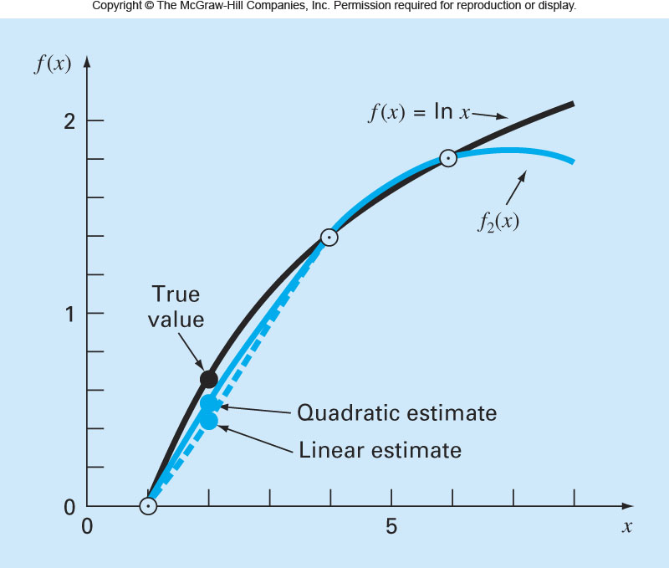
At x = 2
L05E13_quadraticInterpolation.m **

Slide 58
Recursive Nature of Finite Divided Differences
for example, 4 data points, 3 order polynomial (3 derivatives)
i x_{i} f(x_{i})
0 x₀ f(x₀)
1 x₁ f(x₁)
First
Second
Third
f[x₁,x₀]
f[x₂,x₁,x₀]
f[x₃,x₂,x₁,x₀]
f[x₂,x₁]
f[x₃,x₂,x₁]
2 x₂ f(x₂)
f[x₃,x₂]
3 x₃ f(x₃)
f(x) = f(x₀) + f[x₁, x₀](x – x₀)
+ f[x₂, x₁, x₀](x – x₀) (x – x₁)
+ f[x₃, x₂, x₁, x₀](x – x₀)(x – x₁)(x – x₂)
58
L05E14_newtonInterpolation.m

Slide 59
Find the solution using a matrix/table as a guide:
Data points (x, f(x)): (1, 0), (4, 1.386294) and (6, 1.791759)
x
f(x)
1
0
0.4621
4
1.386294
-0.05187
0.2027
6
1.791759
This matrix/table is computed as follows:
after writing down the x and f(x) values in separate columns, move from left to right while calculating the next column,.
59
L05E14_newtonInterpolation.m **

Slide 60
Lagrange’s interpolating polynomials
(a reformulation of Newton’s polynomials to avoid computing divided differences)
Π denotes “the product of”.
For the linear version:
For the second-order version:
60
L05E15_lagrangeInterpolation_example1.m

Slide 61
While the Lagrange interpolating polynomial is a simple reformulation of the Newton’s polynomial, it is computationally EFFICIENT by avoiding the calculation of divided differences entirely.
Newton’s polynomial
Lagrange’s polynomial
61
L05E15_lagrangeInterpolation_example1.m

Slide 62
Example 1 – Lagrange’s interpolating polynomials
Find an Lagrange interpolating polynomial for three data points:
(0,1), (2,2), and (3,4)
Solution:
Re-checking the Lagrangian equation of best-fit with the known data points
62
L05E15_lagrangeInterpolation_example1.m **

Slide 63
Example 2 – Lagrange’s interpolating polynomials
Find an Lagrange interpolating polynomial for four data points:
((0,2), (1,1), (2,0) and (3,-1)
Solution:
The interpolating polynomials may be 3 or less.
In this example, the data point are co-linear, so the interpolating polynomial degree is 1.
63
L05E16_lagrangeInterpolation_example2.m **

Slide 64
Newton / Lagrange interpolations comprise one function to describe the full range (domain) of data.
If the data domain (range) shows sub-features, is there a better way to interpolate?
One polynomial equation
Data divided into 3 sub-domains.
1 equation describes each subdomain.
64

Slide 65
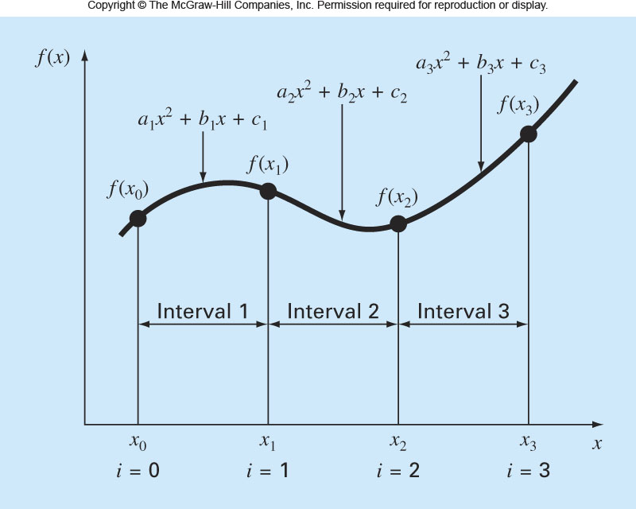
Quadratic splines interpolation
The objective in quadratic splines is to derive a second-order polynomial for each interval between data points.
The polynomial for each interval is generally represented as:
L05E17_quadraticSplinesInterpolation.m

Slide 66
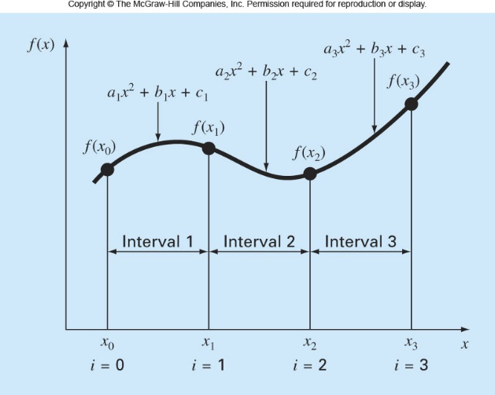
Three unknown coefficients
(a_{i}, b_{i} and c_{i}) for each interval.
For n+1 data points (i = 0, 1, …, n), there are n intervals.
Consequently 3n unknown coefficients.
So 3n equations are required to evaluate the unknowns.
(1) The function values for internal data points (i = 1, 2, …, n-1) are known.
So (2n-2) equations are now known.
For point (i-1):
L05E17_quadraticSplinesInterpolation.m

Slide 67
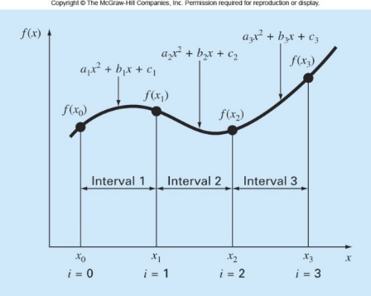
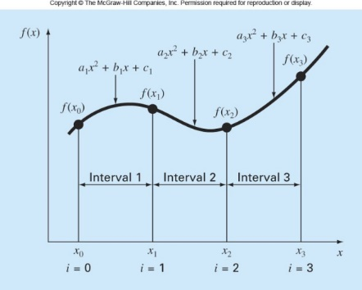
(2) The first derivative for both equations of internal data points are equal.
So (n-1) equations are now known.
(3) The first and last functions must pass through the end points.
So 2 equations are now known.
4) ASSUME the first point extends to the origin. In this case, the second derivative is zero for the first point.
So 1 equation is now known and solved.
The total number of equations = (2n - 2) + (n-1) + 2 + 1 = 3n.
(3n – 1) unknowns with (3n – 1) equations can be solved by spline interpolation!
L05E17_quadraticSplinesInterpolation.m

Slide 68
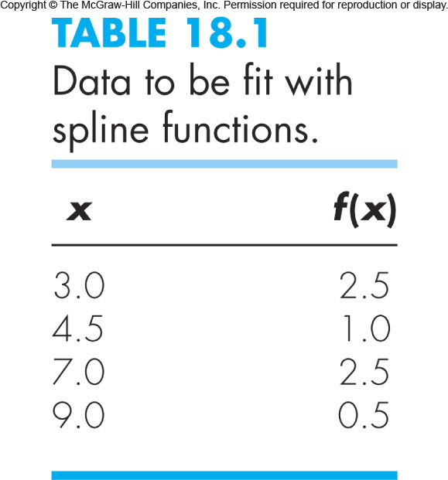
Example - Quadratic splines interpolation
Fit quadratic splines to the following data. Use the results to estimate the value at x = 5.
L05E17_quadraticSplinesInterpolation.m

Slide 69
Solution
4 data points; intervals n = 3.
Hence, there are 3 equations and 9 unknown coefficients
(a₁, b₁, c₁, a₂, b₂, c₂, a₃, b₃, c₃).
The equations for the 2 internal points.
(4 equations)
For point (4.5, 1.0)
For point (7.0, 2.5)
L05E17_quadraticSplinesInterpolation.m

Slide 70
Solution
The first derivatives at internal points are also equal.
(2 equations)
continuous slopes
For point (4.5, 1.0)
For point (7.0, 2.5)
The first and last function must pass through the end points.
(2 equations)
For point (3.0, 2.5)
For point (9.0, 0.5)
L05E17_quadraticSplinesInterpolation.m

Slide 71
Solution
(1) n = 3. The function values for interior data points (i = 1 and 2) are known (4 equations).
2) The first and last functions must pass through the end points (i = 0 and i = 3) (2 equations).
L05E17_quadraticSplinesInterpolation.m
Notes:
del f

Slide 72
3) The first derivative at interior data points (i = 1 and 2) must be equal (2 equations).
4) Assume the second derivative is zero at the first point (1 equation).
Assemble all equations:
L05E17_quadraticSplinesInterpolation.m

Slide 73
Solving equations yields:
At x = 5
L05E17_quadraticSplinesInterpolation.m **

Slide 74
Cubic splines interpolation
The objective in cubic splines is to derive a third-order polynomial for each interval between data points.
The polynomial for each interval is generally represented as:
For n+1 data points (i = 0, 1, …, n), there are n intervals and consequently, 4n unknown constants.
4n equations are required to evaluate the unknown.

Slide 75
Equations for cubic splines interpolation:
(1) The function values for interior data points
(i = 1,2,…,n-1) are known (2n-2 equations).
(2) The first derivative for interior data points
(i = 1,2,…,n-1) are equal (n-1 equations).
(3) The second derivative at interior data points
(i = 1,2,…,n-1) are equal (n-1 equations).
(4) The first and last functions must pass through the
end points (i = 0 and n) (2 equations).
(5) ASSUME the second derivative is zero for the
end points (2 equations).

Slide 76
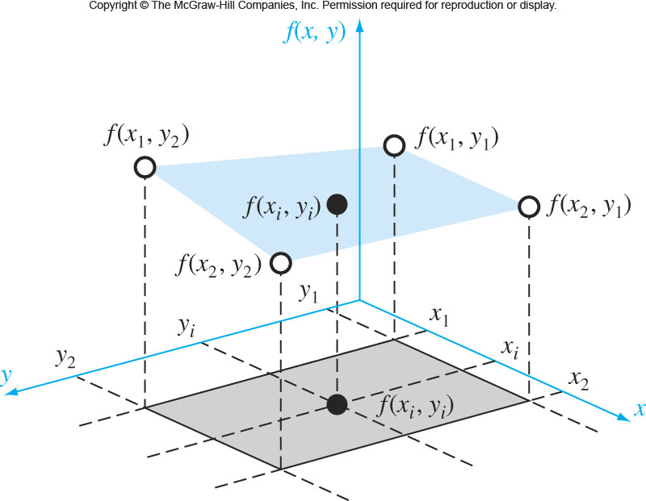
HOME READING
Two-dimensional bilinear interpolation
We have values at four points f(x₁, y₁), f(x₁, y₂), f(x₂, y₁) and f(x₂, y₂). Estimate the value at an intermediate point (f(x_{i},y_{i})).
L05E18_2DbilinearInterpolation.m

Slide 77
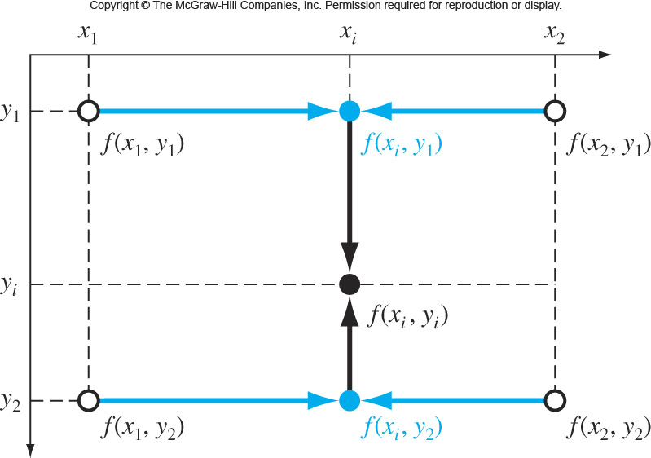
(1) Fix the y-value and apply 1-D linear interpolation in the x-direction. Using the Lagrange form, the result at (x_{i}, y₁) is…
and at (x_{i}, y₂) the result is…
L05E18_2DbilinearInterpolation.m

Slide 78
(2) (x_{i}, y₁) and (x_{i}, y₂) are used to linearly interpolate along the y direction. Using the Lagrange form, the result at (x_{i}, y_{i}) is…
L05E18_2DbilinearInterpolation.m

