Slide 1


What is GitHub?
GitHub is a powerful version control system and collaborative platform that allows developers to store, manage, and track changes to their code. It provides a centralized hub for teams to work together on software projects, share code, and contribute to open-source initiatives.

Slide 2
GitHub Features
Version Control
Collaborative Workflow
Open-Source Community
GitHub enables you to track changes to your code over time, collaborate with others, and easily revert to previous versions if needed.
GitHub facilitates teamwork by allowing multiple developers to work on the same codebase, review each other's contributions, and merge changes seamlessly.
GitHub hosts a vast ecosystem of open-source projects, enabling developers to discover, contribute to, and learn from a global community of programmers.

Slide 3

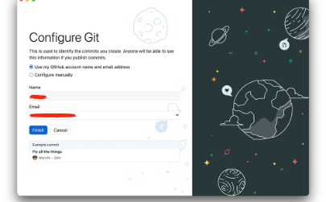

Getting Started with GitHub
Create GitHub Account
Download GitHub Desktop
Create a Repository

Slide 4
Preparing Power BI for GitHub
Configuring Settings
1
go to options and settings on powerbi,then open options.
2
Saving File
on the new screen open preview features and make sure to check Power Bi Project (.pbip) save option.
Save your Power BI reports by changing the save as from .pbix to .pbip, which can be easily added to a GitHub repository and tracked over time.
Connecting to GitHub
3
Link your Power BI projects to a GitHub repository, enabling you to push changes, merge updates, and collaborate with your team.

Slide 5
Repositories
Repositories are places where you can store and organize your code projects. They can hold all the files, folders, and version history of your project. It's like a digital workspace for your code.

Slide 6
Clone Project from Organization
1
Locate the Repository
2
Copy Repository URL
Find the GitHub organization or user that hosts the repository you want to work on.
Copy the repository's URL, typically found on the repository's main page.
3
Clone using GitHub Desktop
4
Select Local Path
Choose the local folder on your computer where you want to save the cloned repository.
Open GitHub Desktop, click "File" > "Clone Repository", and paste the repository URL.

Slide 7
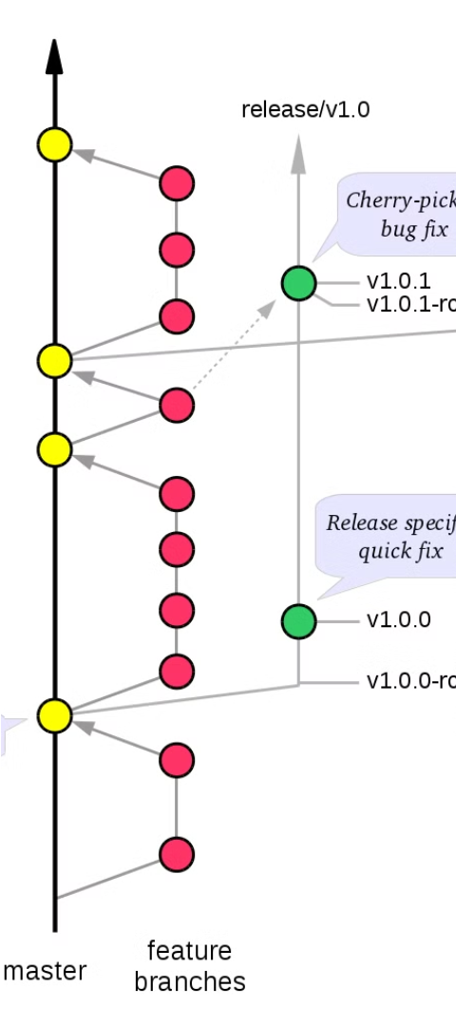
Branches and Commits
1
Branches
Branches allow developers to experiment with new features or bug fixes without affecting the main codebase.
2
Commits
Commits are snapshots of your code at a specific point in time, allowing you to track changes and revert if needed.
3
Merging
Merging branches back into the main codebase integrates the changes, enabling collaboration and iteration on the project.

Slide 8
Resolving Conflicts
Identify the Conflict
1
Carefully review the changes and understand where the conflicts arise between branches or collaborators.
2
Communicate with Team
Discuss the issues with your team to gain alignment on the best path forward and avoid misunderstandings.
Merge Strategically
3
Use Git's merge tools to selectively incorporate the desired changes from each branch, resolving any contradictions.

Slide 9

Always Pull Before Push
Before pushing your local changes to the remote repository, it's crucial to always pull the latest updates first. This ensures you have the most up-to-date codebase and can resolve any conflicts before they become an issue.
Pulling the latest changes allows you to merge your work with the contributions of your team, preventing versioning issues and ensuring a smooth collaborative workflow.

Slide 10
Getting Started Summery
Sign Up
Create a new GitHub account to start using the platform.
Create a Repository
Set up a new repository to store your project's files and track changes.
Commit Changes
Use Git commands to add, commit, and push your code to the repository.
Collaborate
Invite teammates to contribute to your project and manage pull requests.

