Slide 1
MEDTRACK DV
Hospital Operations & Patient Analytics
Turning hospital data into actionable operational insights
Python + Tableau
Healthcare Analytics
Data Visualization
Mohammed Azeem | B.Tech CSE
Project Presentation • 2026

Slide 2
Agenda
A quick journey from problem → solution → proof
01
Problem
Why hospital operations need better visibility
02
Solution
How MedTrack DV processes and visualizes data
03
Results
Dashboards, KPIs and key insights
04
Next
Challenges, learnings and future scope
MEDTRACK DV | 2

Slide 3
Problem Statement
Hospital data can be available without being decision-ready
Fragmented data
Manual analysis
Limited visibility
Admissions, discharges, outcomes and hospital resources are difficult to analyze together.
Repeated spreadsheet work makes trend analysis slower and increases the risk of inconsistent calculations.
Decision-makers need quick views of patient flow, departments and resource utilization.
Goal: move from raw records → trusted KPIs → interactive decisions
MEDTRACK DV | 3

Slide 4
Objective & Outcomes
Build a practical analytics layer for hospital operations
Clean
Calculate
Visualize
Decide
Prepare consistent hospital and patient data
Engineer operational and patient KPIs
Create interactive Tableau dashboards
Make trends and bottlenecks easier to spot
Core KPIs
Admissions
ALOS
Occupancy
Readmission
Mortality
MEDTRACK DV | 4

Slide 5
Approach / Architecture
A simple pipeline from raw records to interactive dashboards
DATA INPUT
PROCESSING
KPI ENGINEERING
OUTPUT
Hospital + patient records
Pandas / NumPy Cleaning + validation
LOS • occupancy readmission • mortality
Tableau dashboards & interactive analysis
MEDTRACK DV | 5

Slide 6
Tools & Technology Stack
Technologies used across the data-to-dashboard workflow
Python
Pandas
NumPy
Data processing & KPI engineering
Cleaning, transformation & analysis
Numerical calculations
Tableau
Git / GitHub
Interactive dashboards & storytelling
Version control & project tracking
MEDTRACK DV | 6

Slide 7
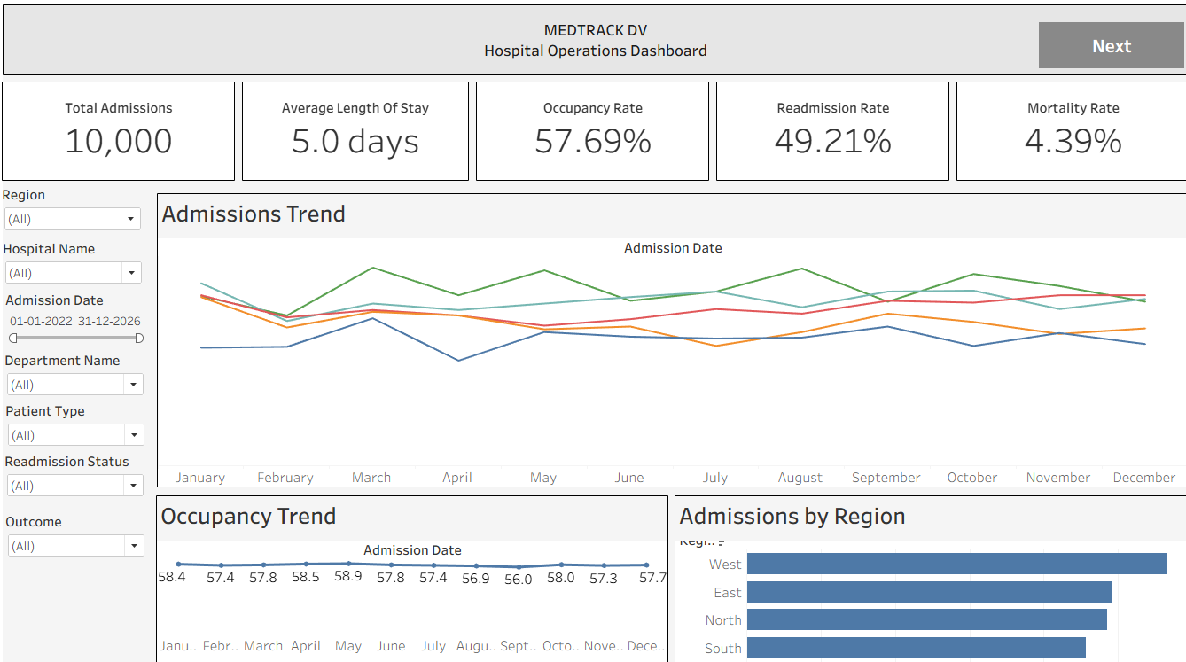
Key Results & Features
The dashboard suite turns metrics into an operational story
Hospital Overview
Executive KPIs and trends
Patient Flow
Admissions → discharges → outcomes
Department & Resources
Department performance and utilization
MEDTRACK DV | 7

Slide 8
Challenges & Learnings
The most important part was making the metrics trustworthy
Challenge 1 — KPI mismatch
Challenge 2 — Date-based metrics
Tableau values did not initially match the Python calculations. Learning: define one KPI formula and validate the same logic across tools.
Admissions, discharges and length of stay depend on correct date handling. Learning: standardize date fields and validate calculations before dashboarding.
Result: a repeatable data → KPI → visualization workflow
MEDTRACK DV | 8

Slide 9
Conclusion & Future Scope
From descriptive reporting toward smarter hospital operations
What MedTrack DV delivers
What's next
• Centralized operational visibility
• Consistent KPI-driven analysis
• Interactive Tableau dashboards
• Predictive patient demand
• Early readmission risk alerts
• Real-time hospital integration
MedTrack DV: turning hospital data into actionable insight.
MEDTRACK DV | 9

Slide 10
THANK YOU
Questions & Live Demo
I’ll now demonstrate the dashboard workflow and key interactions.
Mohammed Azeem
B.Tech CSE | MedTrack DV
GitHub: github.com/AzeemMohammed03/infys_MedTrack_DV

