Slide 1
RISC-V ARCHITECTURE
Azeem R Gadkari

Slide 2
Breadth First Search Algorithm
Breadth First Search (BFS) algorithm traverses a graph in a breadthward motion and uses a queue to remember to get the next vertex to start a search, when a dead end occurs in any iteration.

Slide 3
Graph Chosen
3
4
0
5
6
1
2
14
7
8
9
10
13
11
12

Slide 4
STEPS INVOLVED
Step 1: Take an Empty Queue.
Step 2: Select a starting node (visiting a node) and insert its neighbour nodes into the Queue.
Step 3: Provided that the Queue is not empty, extract the node from the Queue and insert its child nodes (exploring a node) into the Queue.
Step 4: Print the extracted node.

Slide 5
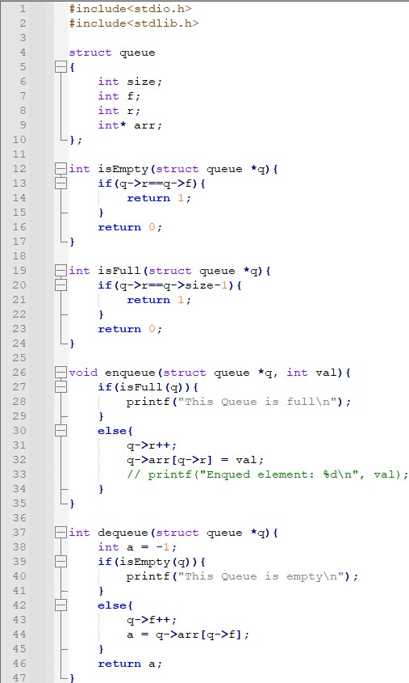
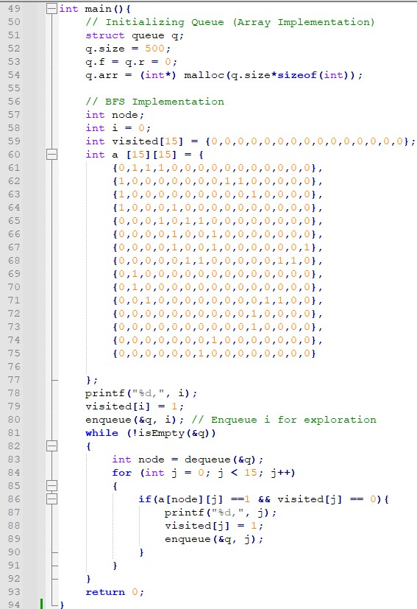
CODE

Slide 6
Using codasip for analysis
Create a new C project and assign sdk (which is generated already)
Go to Explorer and a source C file in the project created
Make changes in codal config (Profiling is enabled)
Go to Compiler setting , choose respective optimization level and give the following flags
-lnxssys -lm -lcomp
- WI,--defsym,_HEAP_SIZE= size
Compile and Profile to get a Profiling report
Analyse Clock Cycles and instructions count

Slide 7
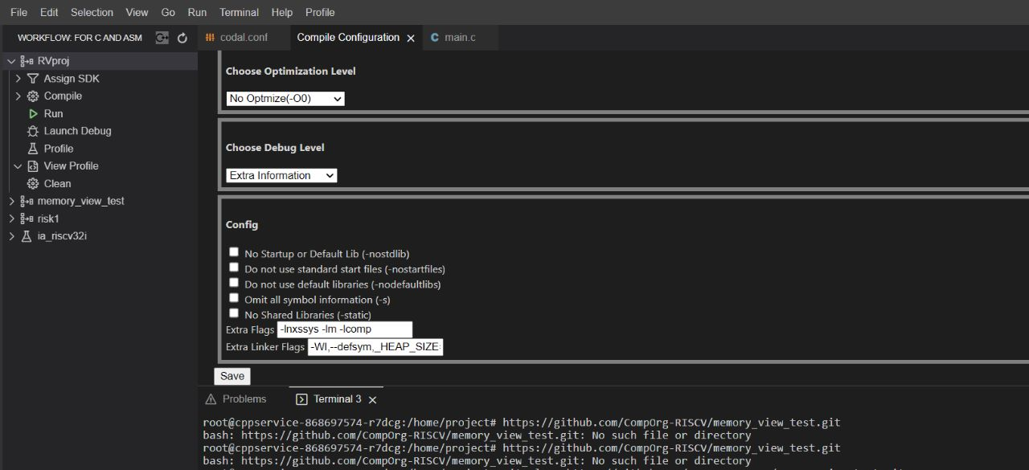
Compiler Setting
Using no optimization

Slide 8
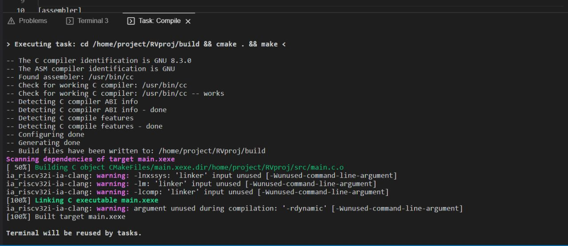
Compilation

Slide 9
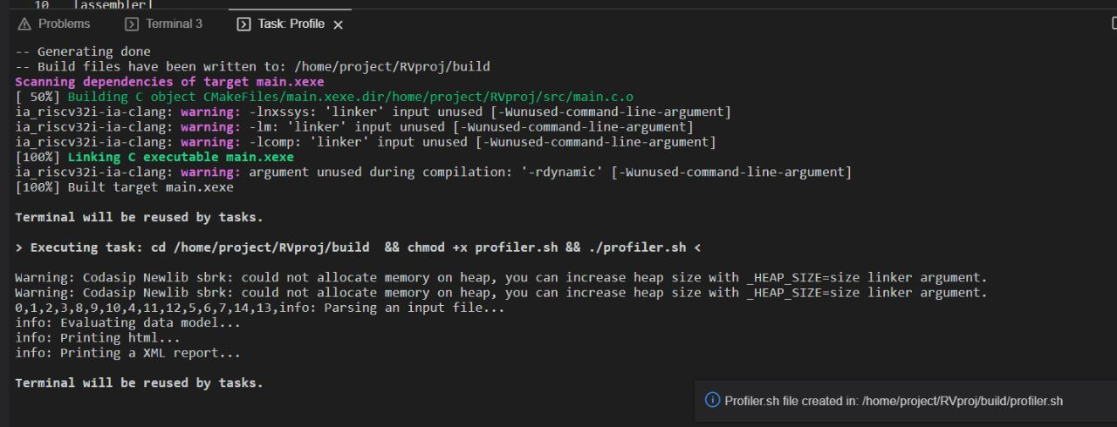
Profiling

Slide 10
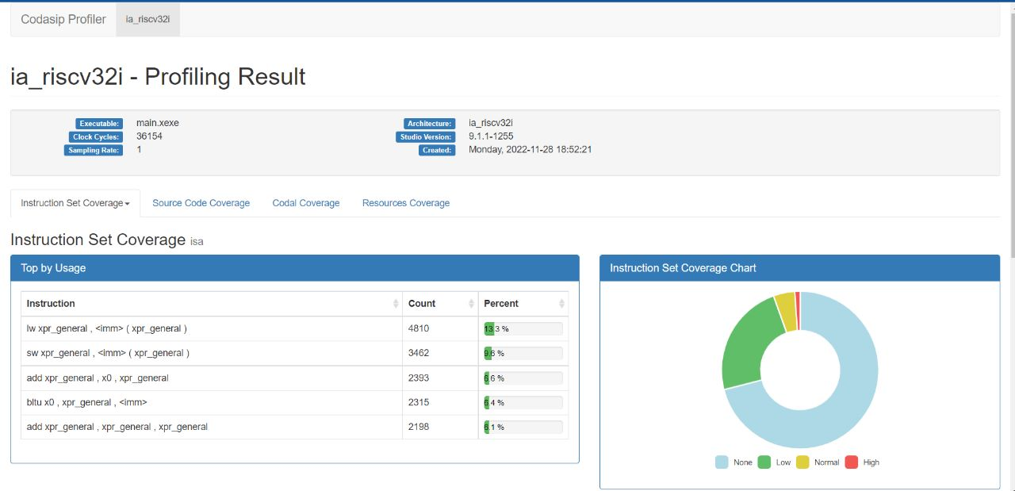
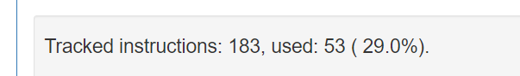
Profile report

Slide 11
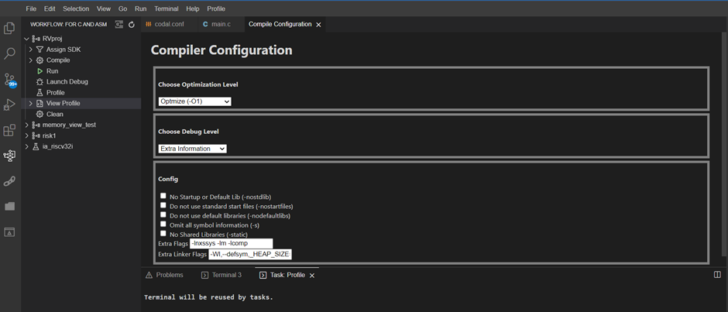
Using -O1
Compiler Settings

Slide 12
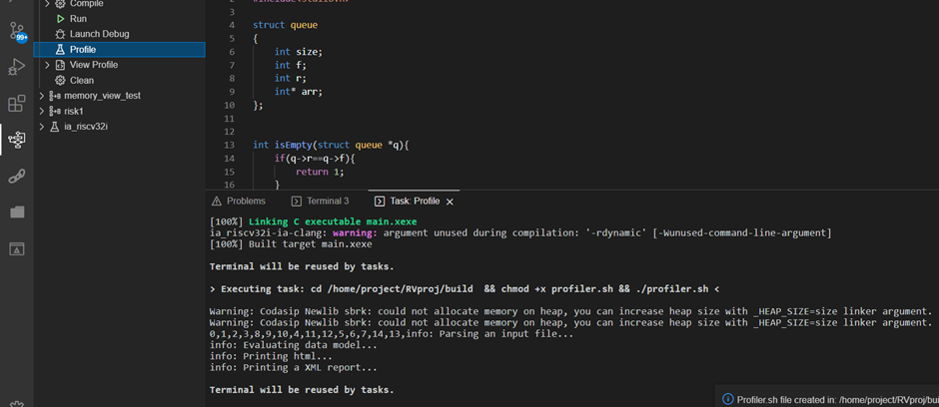
Compilation and Profiling

Slide 13
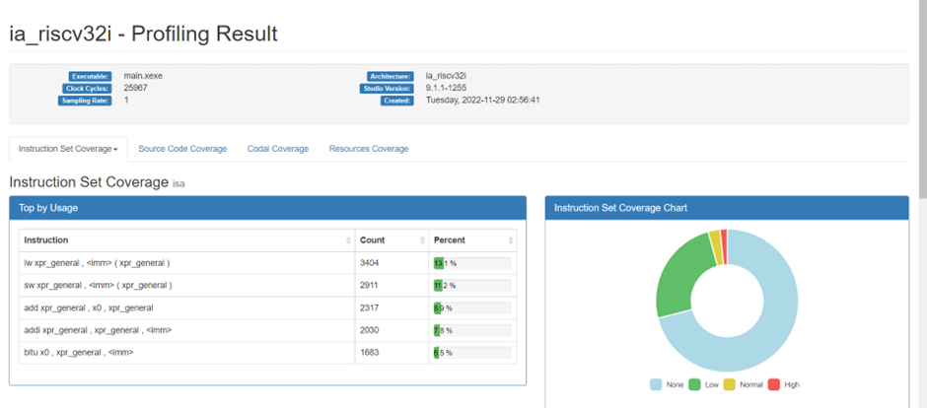

Profiling Report

Slide 14
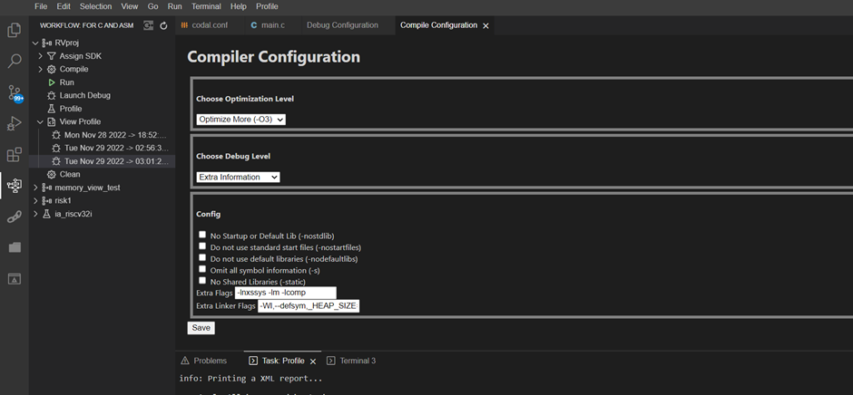
Using -O3
Compiler Settings

Slide 15
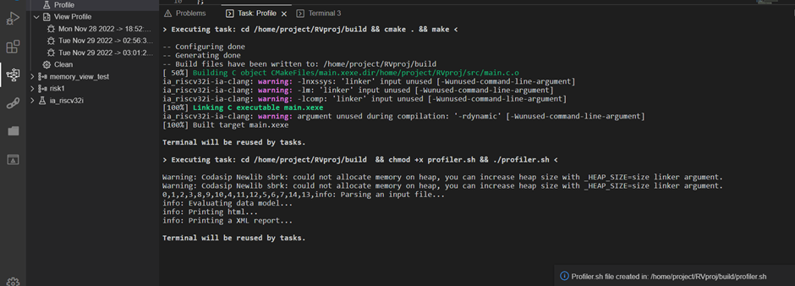
Compilation and Profiling

Slide 16
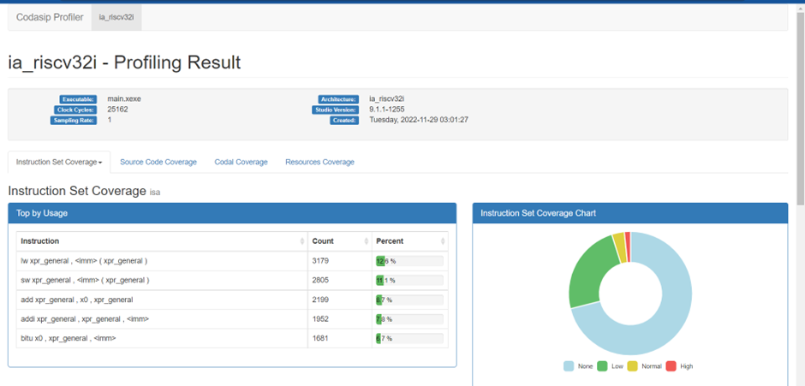
Profiling Report

Slide 17
Analysis and Comments
With no optimization : Clock cycles = 36154 and Instructions : 183(53)
With -O1 : Clock cycles = 25967 ( reduced by 10187 ) where as instruction count remains same
With -O3 : Clock cycles = 25162 (further reduced by 805) instruction count still remains same
O3 is the highest level of optimization where optimization techniques are used (including loop unrolling)
We can see that maximum instruction which is being used is load and store because of the process of
Enqueue and Dequeue
Further we used ripes to use M extension and results are compared

Slide 18
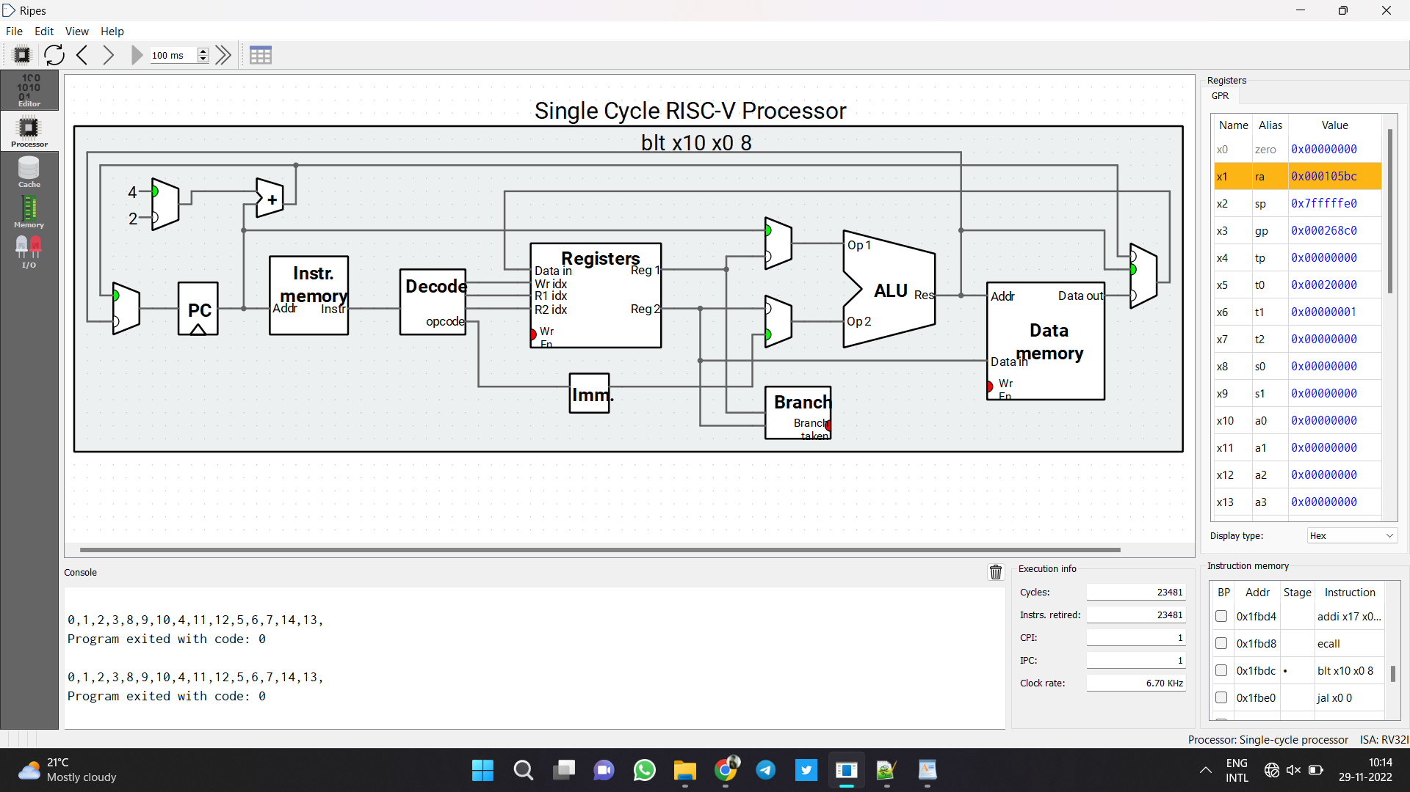
Analysis Using Ripes
Without Using M extension
Cycles: 23481
Clock rate: 6.7KHz

Slide 19
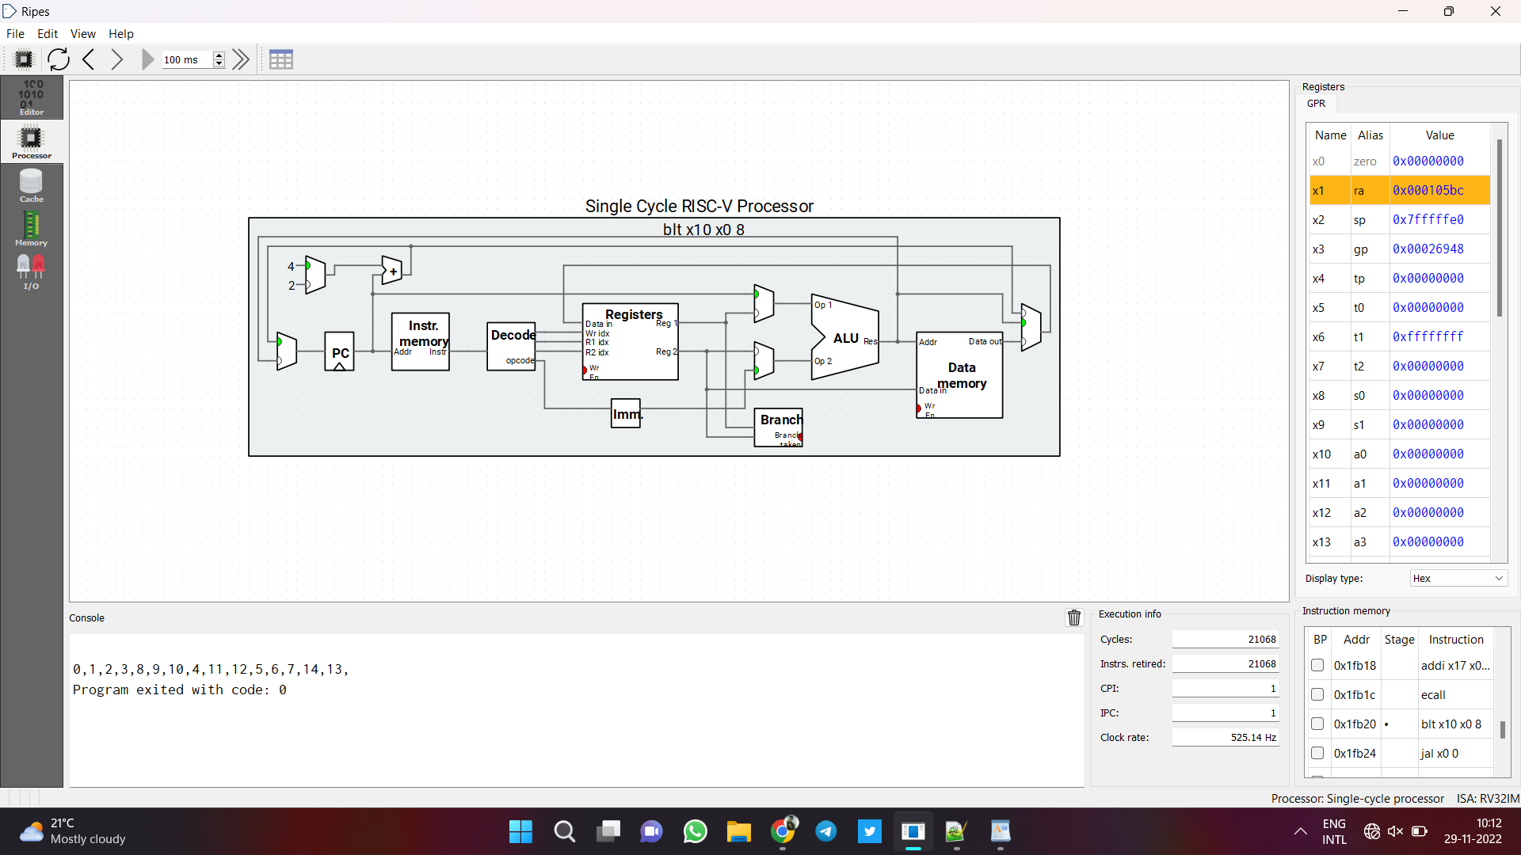
Using M extension
Cycles: 21068
Clock rate: 525.14 Hz

Slide 20
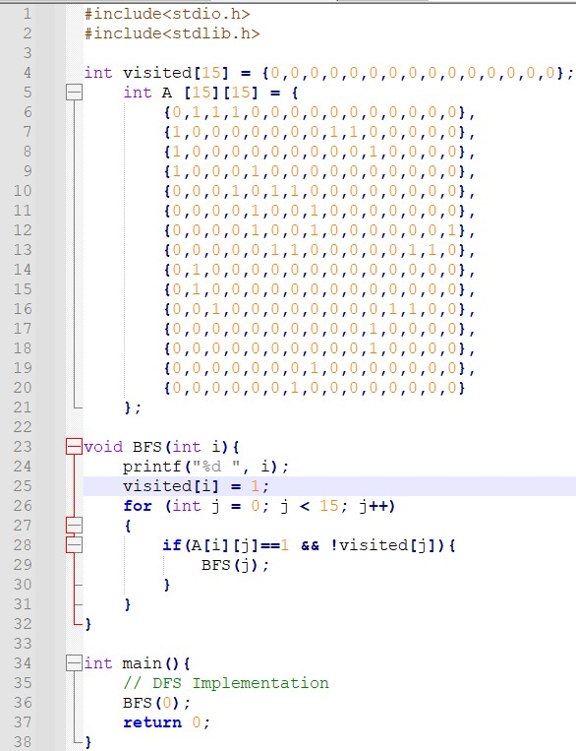
Changes make in the code to optimize

Slide 21
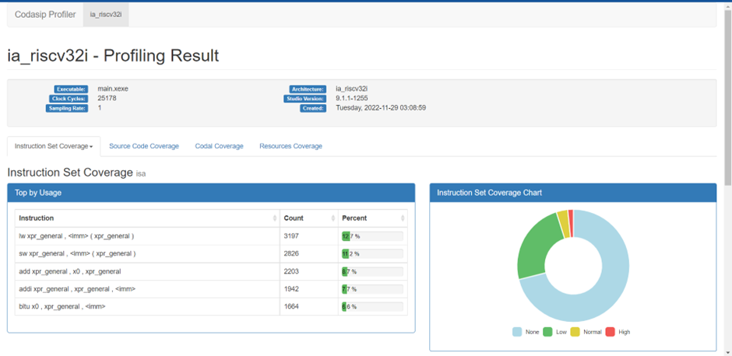
Profiling Report of Optimized Code

Slide 22
Analysis
By using inbuilt BFS function Cycle count is reduced by approx 10K
There a difference of 3k cycles if we use M extension when compared

Slide 23
Risc-V implementation
I - type logical operations only
Instructions Performed: addi,ori,xori,srli,slli
Modules Used: IFU , CONTROL MODULE , DATAPATH MODULE
Inside IFU : PC and Instruction memory
Inside DATAPATh MODULE: RegisterFile , Imm generator , ALU ;
I type format : imm(12) | rs1 (5)| func3 (3)| rd (5)| opcode(7 )
Flow status and Compilation Reports are pasted..
Zero flag is grounded

Slide 24
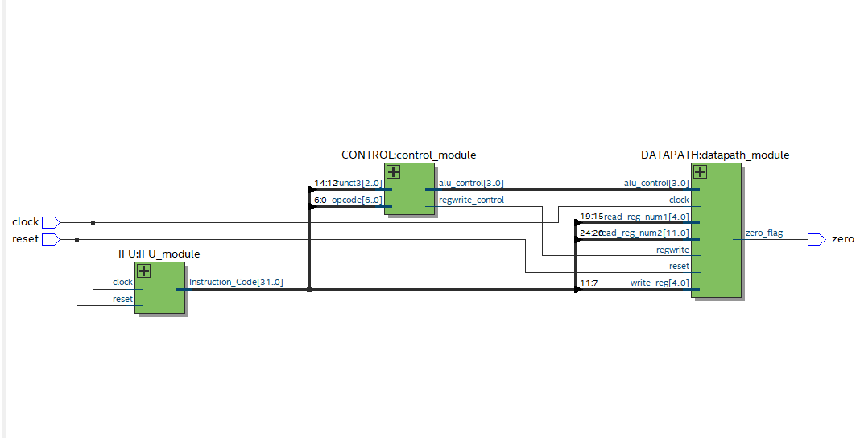
Single-cycle processor for I-type format
RTL-view

Slide 25
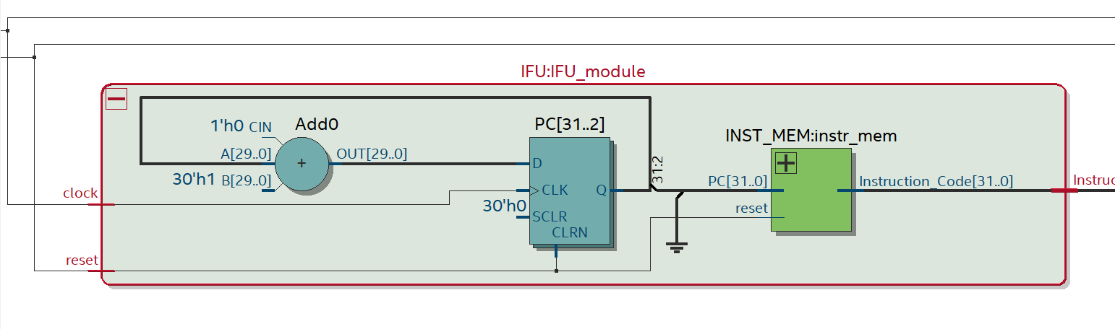
Expanding IFU

Slide 26
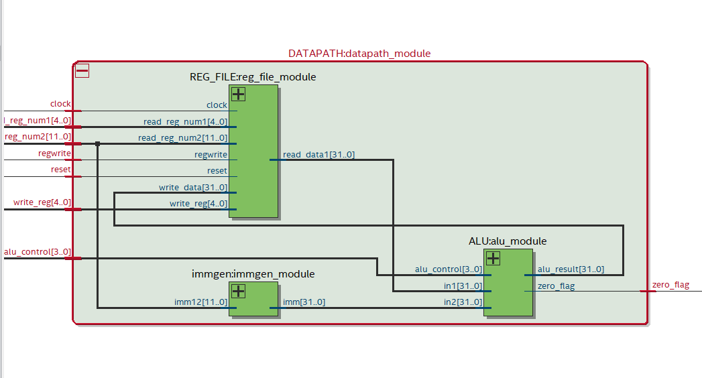
Expanding Datapath
Data Path

Slide 27
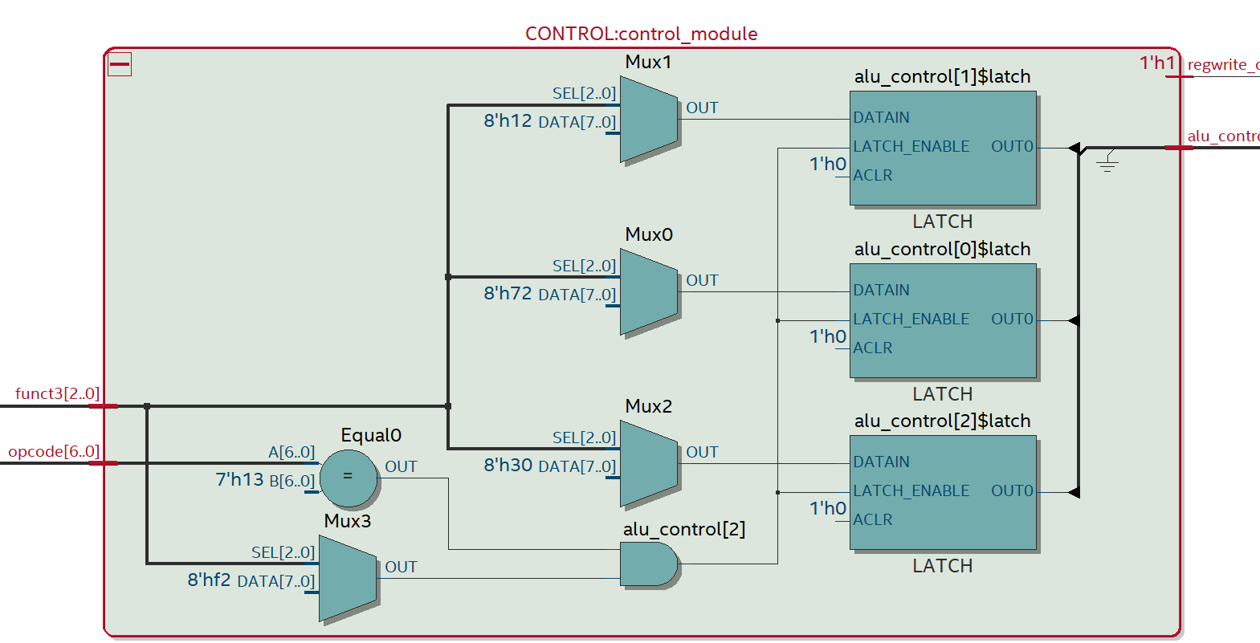
Expanding CONTROL

Slide 28
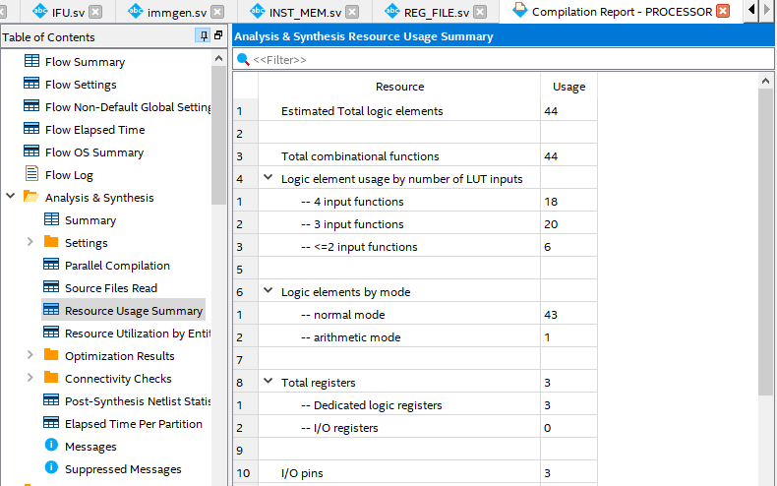

Slide 29
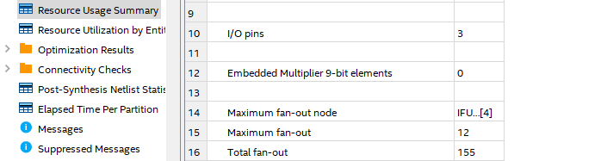

Slide 30
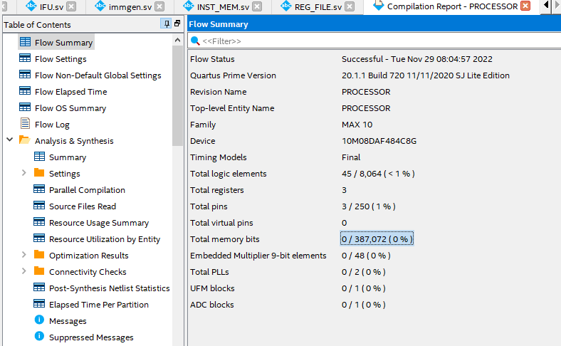
Compilation Report outputs

Slide 31
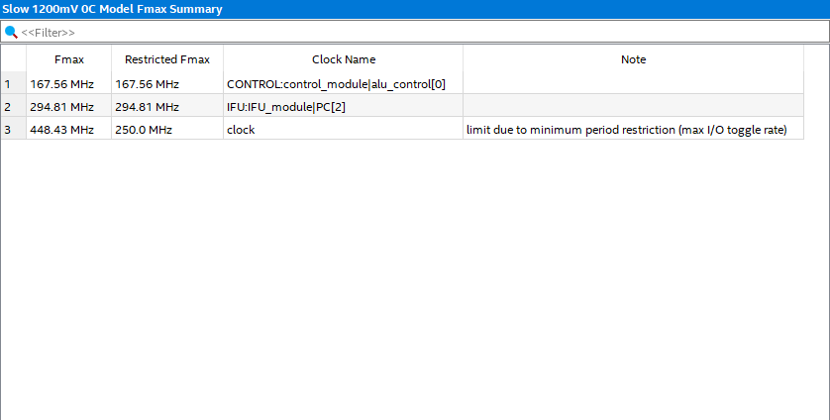

Slide 32


Slide 33
Analysis
Total register and I/O pins are 3 each
Total Logic Elements used are 44
Frequency is displayed in above slides by two separate models
THANK YOU…

Slide 34
Analysis
Total register and I/O pins are 3 each
Total Logic Elements used are 44
Frequency is displayed in above slides by two separate models
THANK YOU…

