Slide 1
VERIFICATION of DIGITAL SYSTEM FINITE STATE MACHINE
FSM USED : MOORE FSM
Tool Used : EDA PLAYGROUND
AZEEM R GADKARI

Slide 2
Two traffic sensors, TA and TB, Each sensor indicates TRUE if students are present and FALSE if the street is empty.
Two traffic lights, LA and LB, to control traffic. Each light receives digital inputs specifying whether it should be green, yellow, or red. Hence, his FSM has two inputs, TA and TB, and two outputs, LA and LB.
A clock with a 5-second period. On each clock tick (rising edge), the lights may change based on the traffic sensors.

Slide 3
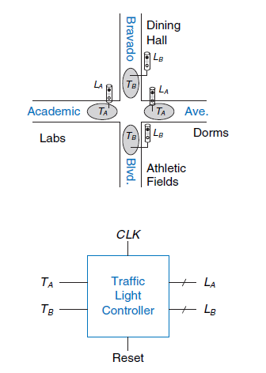
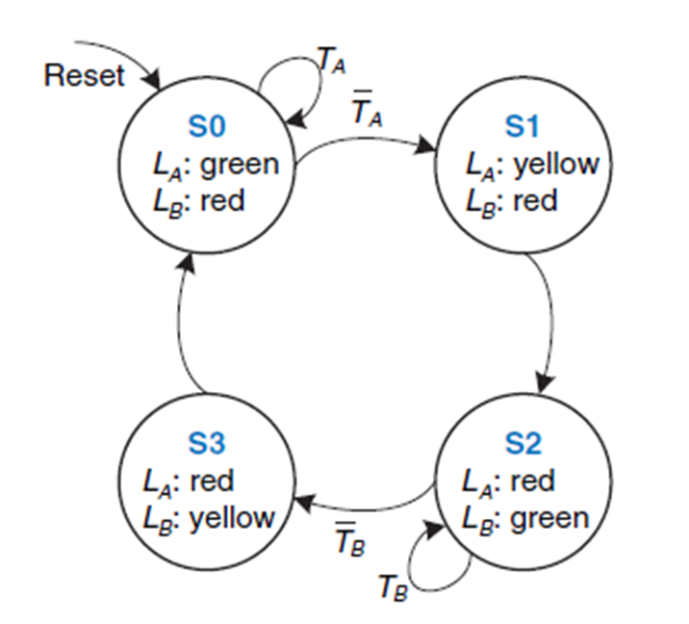
Block and state transition diagram

Slide 4
DUT FILE
always_comb
case (state)
so: if (ta) nextstate = so;
else nextstate = s1;
s1 : nextstate = s2;
s2 : if(tb) nextstate = s2;
else nextstate = s3;
s3: nextstate = so;
endcase
always_comb
begin
case(state)
so: {la,lb} = {green,red};
s1: {la,lb} = {yellow,red};
s2: {la,lb} = {red,green};
s3: {la,lb} = {red,yellow};
endcase
$display("la = %b",la);
end
endmodule
module traffic(clk,reset,ta,tb,la,lb);
input bit clk,reset;
input logic ta,tb;
output bit [1:0] la,lb;
typedef enum logic [1:0] {so,s1,s2,s3} statetype;
statetype state , nextstate;
parameter green = 2'b00;
parameter yellow = 2'b01;
parameter red = 2'b10;
always_ff @(posedge clk,posedge reset)
if (reset)
state <= so;
else
state <= nextstate;

Slide 5
Interface and transaction
class transaction;
rand logic ta;
rand logic tb;
bit [1:0] la;
bit [1:0]lb;
rand bit clk;
rand bit reset;
function void display(string traffic);
$display("-------------------------");
$display("- %s ",traffic);
$display("-------------------------");
$display("- ta = %d, tb = %d",ta,tb);
$display("- la = %b",la);
$display("- lb = %b",lb);
$display("clk = %b reset = %b",clk,reset);
$display("-------------------------");
endfunction
endclass
interface intf(input logic clk,reset);
logic ta;
logic tb;
bit [1:0]la;
bit [1:0]lb;
clocking cb @(posedge clk);
output ta,tb;
input la,lb;
endclocking
modport DUT (input ta,tb , output la,lb);
modport TB (clocking cb);
endinterface

Slide 6
Generator and Driver
class generator;
rand transaction trans;
int repeat_count;
mailbox gen2driv;
event ended;
function new(mailbox gen2driv);
this.gen2driv = gen2driv;
endfunction
task main();
repeat(repeat_count)
begin
trans = new();
trans.randomize();
trans.display("Generator");
gen2driv.put(trans);
end
-> ended;
endtask
endclass
class driver;
int no_transaction;
virtual intf vif;
mailbox gen2driv;
function new(virtual intf vif,mailbox gen2driv);
this.vif = vif;
this.gen2driv = gen2driv;
endfunction
task reset;
wait(vif.reset);
$display("[ DRIVER ] ----- Reset Started -----");
vif.ta<=0;
vif.tb<=0;
wait(!vif.reset);
$display("[ DRIVER ] ----- Reset Ended -----");
endtask
task main;
forever begin
transaction trans;
gen2driv.get(trans);
@(posedge vif.clk);
vif.ta <= trans.ta;
vif.tb <= trans.tb;
@(posedge vif.clk);
trans.la = vif.la;
trans.lb = vif.lb;
@(posedge vif.clk);
trans.display("[Driver]");
no_transaction++;
end
endtask
endclass

Slide 7
monitor
class monitor;
virtual intf vif;
mailbox mon2scb;
function new(virtual intf vif,mailbox mon2scb);
this.vif = vif;
this.mon2scb = mon2scb;
endfunction
task main;
forever begin
transaction trans;
trans = new();
@(posedge vif.clk);
trans.ta = vif.ta;
trans.tb = vif.tb;
@(posedge vif.clk);
trans.clk = vif.clk;
//trans.reset = vif.reset;
trans.la = vif.la;
trans.lb = vif.lb;
@(posedge vif.clk);
mon2scb.put(trans);
trans.display("Monitor");
end
endtask
endclass

Slide 8
SCOREBOARD
class scoreboard;
mailbox mon2scb;
int no_transaction;
function new(mailbox mon2scb);
this.mon2scb = mon2scb;
endfunction
task main;
transaction trans;
forever begin
mon2scb.get(trans);
else if((trans.clk==1 && trans.reset==0) && (trans.la==2'b10 && trans.lb==2'b00))
$display("la = red and lb = green");
else if((trans.clk==1 && trans.reset==0) && (trans.la==2'b10 && trans.lb==2'b01))
$display("la = red and lb = yellow");
else if(trans.clk==1 && trans.reset==1)
$display("la = green and lb = red");
else if(trans.clk==0)
$display("la = red and lb = red");
else
$display("Wrong output");
no_transaction++;
trans.display("Scoreboard");
end
endtask
endclass
if((trans.clk==1 && trans.reset==0) && (trans.la==2'b00 && trans.lb==2'b10))
$display("la = green and lb =red");
else if((trans.clk==1 && trans.reset==0) && (trans.la==2'b01 && trans.lb==2'b10))
$display("la = yellow and lb = red");

Slide 9
ENVIRONMENT
`include "transaction.sv"
`include "generator.sv"
`include "driver.sv"
`include "monitor.sv"
`include "scoreboard.sv“
class environment;
generator gen;
driver driv;
monitor mon;
scoreboard scb;
mailbox gen2driv;
mailbox mon2scb;
virtual intf vif;
function new(virtual intf vif);
this.vif = vif;
gen2driv = new();
mon2scb = new();
gen = new(gen2driv);
driv = new(vif,gen2driv);
mon = new(vif,mon2scb);
scb = new(mon2scb);
endfunction
task pre_test();
driv.reset();
endtask
task test();
fork
gen.main();
driv.main();
mon.main();
scb.main();
join_any
endtask
task post_test();
wait(gen.ended.triggered);
wait(gen.repeat_count==driv.no_transaction);
wait(gen.repeat_count==scb.no_transaction);
endtask
task run;
pre_test();
test();
post_test();
$finish;
endtask
endclass

Slide 10
TESTBENCH AND TOP MODULE
`include "interface.sv"
`include "top.sv"
module tbench_top;
bit clk,reset;
intf i_intf(clk,reset);
test t1(i_intf);
always
begin
#5 clk = ~clk;
end
initial begin
reset =1;
#5 reset =0;
end
traffic DUT (
.clk(i_intf.clk),
.reset(i_intf.reset),
.ta(i_intf.ta),
.tb(i_intf.tb),
.la(i_intf.la),
.lb(i_intf.lb)
);
initial begin
$dumpfile("dump.vcd"); $dumpvars;
end
endmodule
`include "env.sv"
program test(intf i_intf);
environment env;
initial
begin
env = new(i_intf);
env.gen.repeat_count=4;
env.run();
end
endprogram

Slide 11
OUTPUT
- Monitor ------------------------- - ta = 0, tb = 0 - la = 10 - lb = 01 clk = 1 reset = 0 ------------------------- la = red and lb = yellow ------------------------- - Scoreboard ------------------------- - ta = 0, tb = 0 - la = 10 - lb = 01 clk = 1 reset = 0
[ DRIVER ] ----- Reset Started ----- [ DRIVER ] ----- Reset Ended ----- ------------------------- - Generator ------------------------- - ta = 1, tb = 0 - la = 00 - lb = 00 clk = 1 reset = 0 ------------------------- ------------------------- - [Driver] ------------------------- - ta = 1, tb = 0 - la = 10 - lb = 01 clk = 1 reset = 0 ------------------------- -------------------------
$finish called from file "env.sv", line 50. $finish at simulation time 35 V C S S i m u l a t i o n R e p o r t Time: 35 ns CPU Time: 0.820 seconds; Data structure size: 0.0Mb

Slide 12
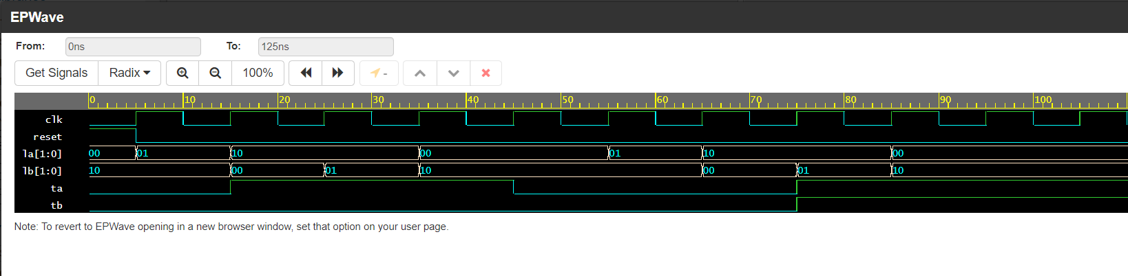
OUTPUT WAVEFORM
THANK YOU ….

