Slide 1

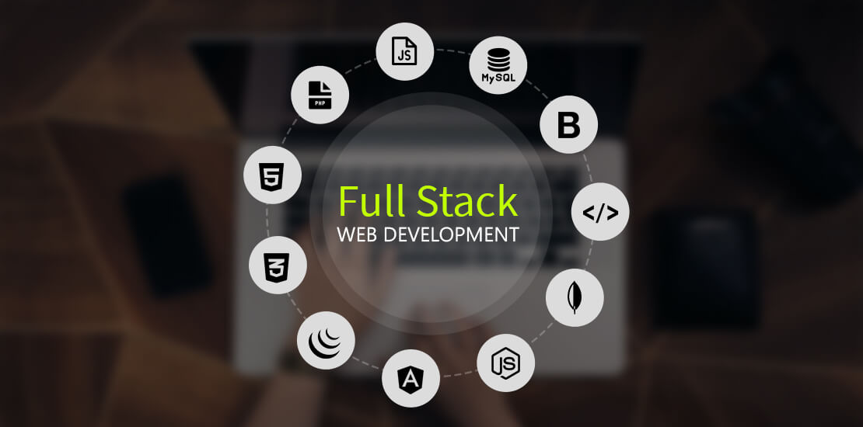
Presented by Muhammad Azeem - 310 Muzammil Ahmad - 276 Umar Farooq - 309 Presented To Sahar Moin
Project
Blood Donation Web App

Slide 2


Slide 3
WHAT HAVE I LEARNT FROM DOING PROJECT
Basic Syntax (Clauses, DDL, TCL, DCL)
CRUD Quarries (Insert, Update, Delete, Select)
Handle Foreign Key (ON DELETE CASCADE, ON DELETE SET NULL)
Store Procedures
Joins (Inner Join, Left OR Right Join)
Views
Sub Quarries
ER – Designs (cardinalities)
Sessions

Slide 4
FEATURES OF MY PROJECT
Registration
FEATURES
Generate API
Find Donner
Problems?
Sessions & Online system
Events, Gallery & Hero's
User, Admin
Manager Panels
Manage By CRUD
Encryption

Slide 5
DATABASE CIRCLE
Admin Panel
Control
Manager Panel
Admin
User Panel
Control
Managers
Gallery
ADD
Event
Users
Issues

Slide 6

PROJECT DEVELOPMENT TOOLS
Visual Studio Code
XAMP Server
Photoshop
PowerPoint + Ms Word
Git Hub (Open Source)

Slide 7
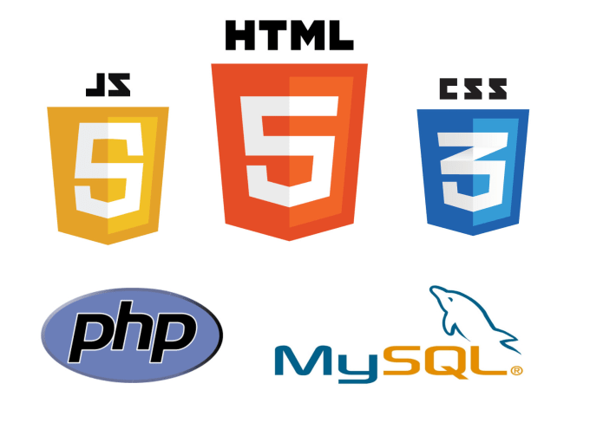

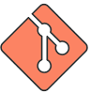

LANGUAGES
HTML-5
CSS-3 + Bootstrap-5
Java Script (Counter.JS, Leaflet.JS, typed.js, etc.)
jQuery (Data Tables)
PHP (Vendor, Mpdf)
MySQL
Git (Commands)

Slide 8
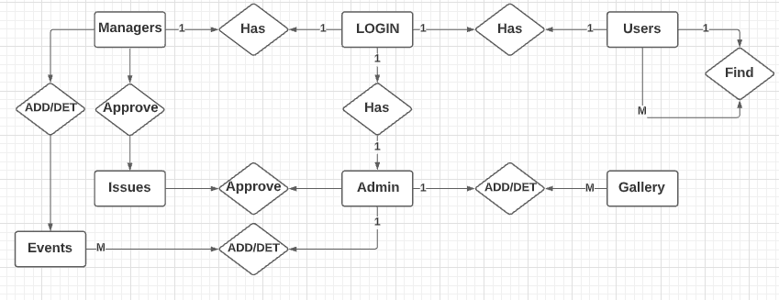
ER-DIAGRAM

Slide 9

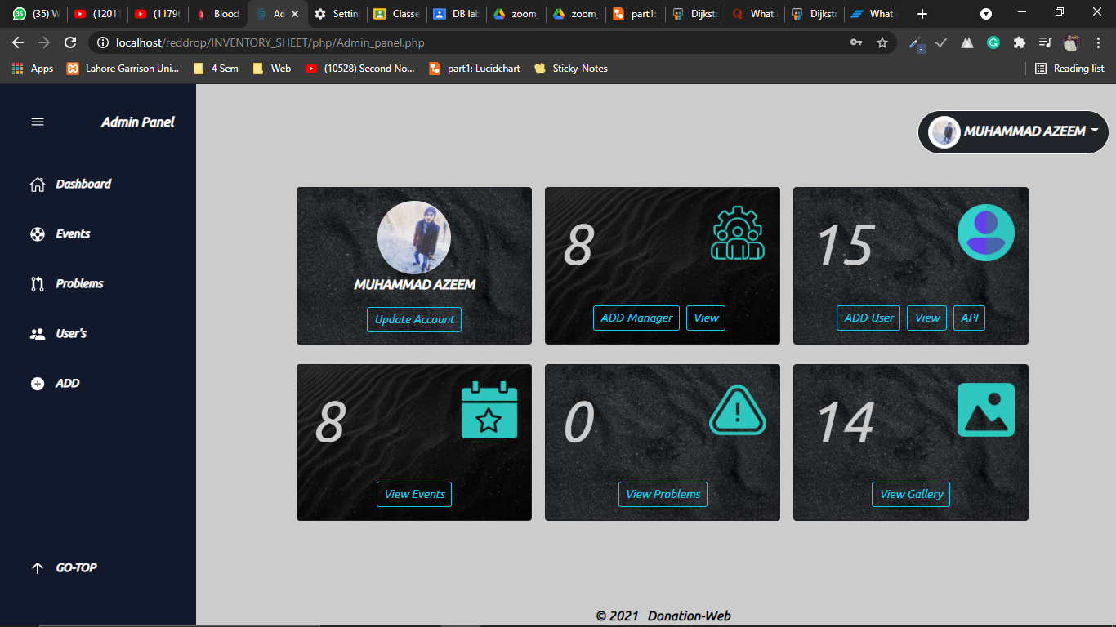
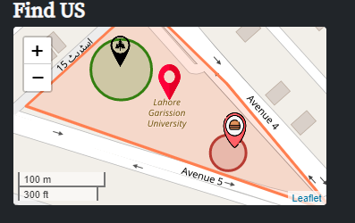
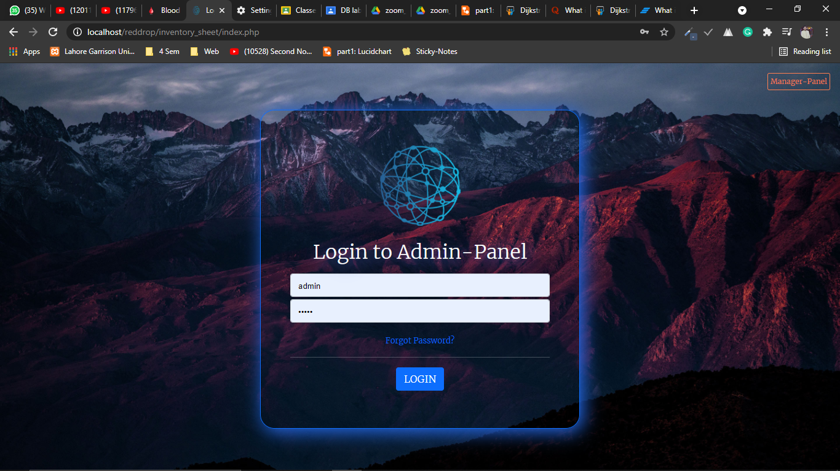
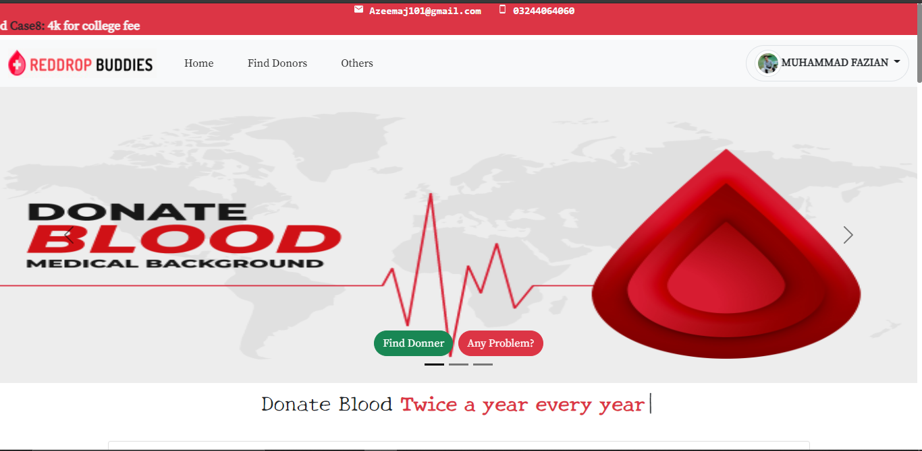

Slide 10
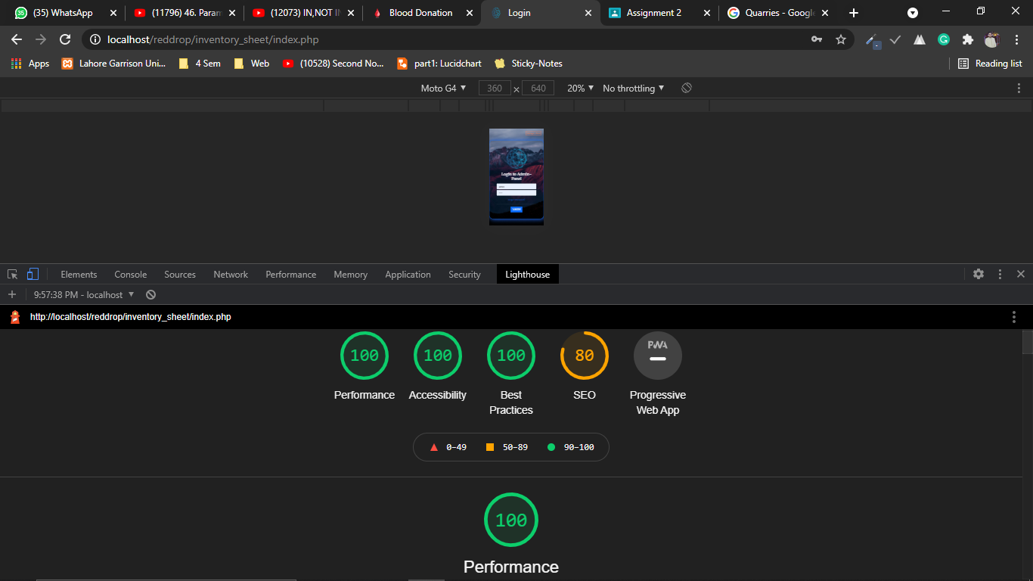
Search Engine Optimization
https://github.com/Azeemaj101, https://github.com/Muzammil786-beep, https://github.com/umarfarooq1088

Slide 11

I would like to express my special thanks to my teacher (Sahar Moin & Basit Ali) who gave me the golden opportunity to do this wonderful Project. Which also helped me in doing a lot of learning and I came to know about so many new things I am really thankful to them.
Thank you !

Slide 12


Slide 13


