Slide 1




GESIR.AI
By Team Hrissa
Azer Hamdaoui
Tarek ben slimen
Ilyes Hassine
Omar bouhlel
Moetez soltani

Slide 2





THE PROBLEM
Small and medium painting businesses waste time on back-and-forth WhatsApp communication, scattered customer enquiries, and inconsistent follow-ups.
CUSTOMER SENDS A MESSAGE
OWNER ASKS SEVERAL QUESTIONS
DETAILS ARE COPIED MANUALLY
QUOTATION IS DELAYED

Slide 3
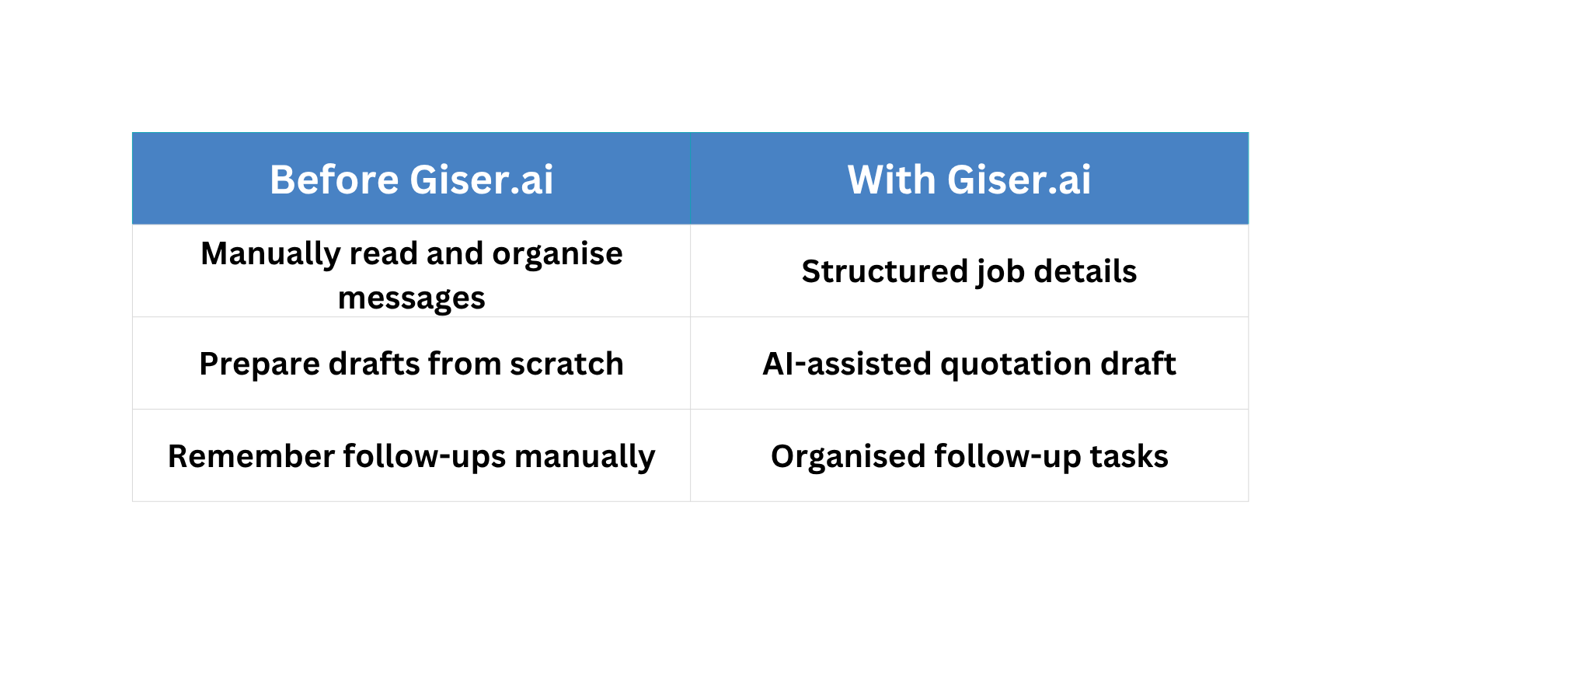
OUR SOLUTION
Giser.AI uses AI to analyze customer messages, voice notes, and images, extract job requirements, and identify missing details. It generates job briefs with estimated costs, materials, and available time slots, enabling managers to accept or decline jobs with one click.

Slide 4
HOW GESIR.AI WORKS?
Connected data
Human approval
Retrieve available service details, pricing rules and job information
The owner checks and approves the draft before it is sent.
5
1
2
3
4
5
Trigger
AI & decision logic
Visible outcome & activity log
A customer enquiry arrives through WhatsApp or a simulated chat input.
Extract details, identify missing information and prepare a quotation draft using defined rules.
Display the result and record the draft, approval and action status.

Slide 5
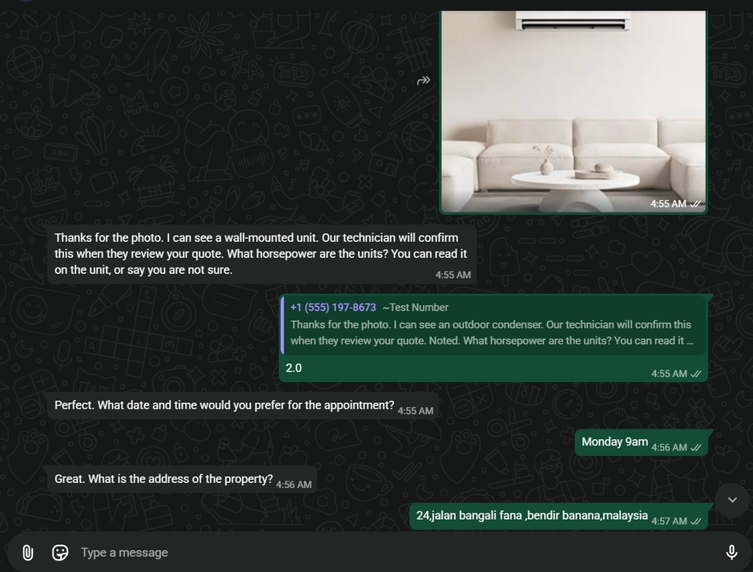
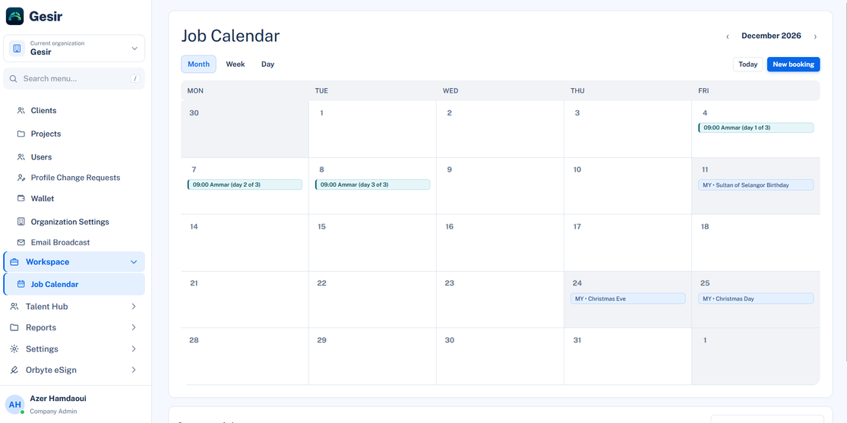
1)
TRIGGER:
2)
CONNECTED DATA:
A customer sends a painting enquiry. Gesir.AI receives it through WhatsApp integration, creates a new enquiry record and starts processing it.
Gesir.AI retrieves predefined pricing rules, paint types and material information, available appointment slots, and business quotation templates.

Slide 6
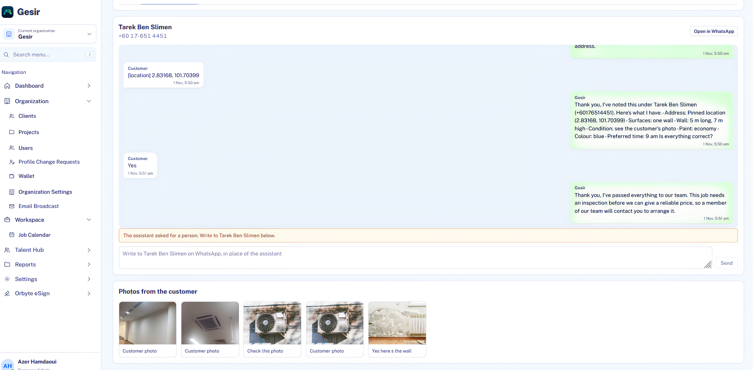
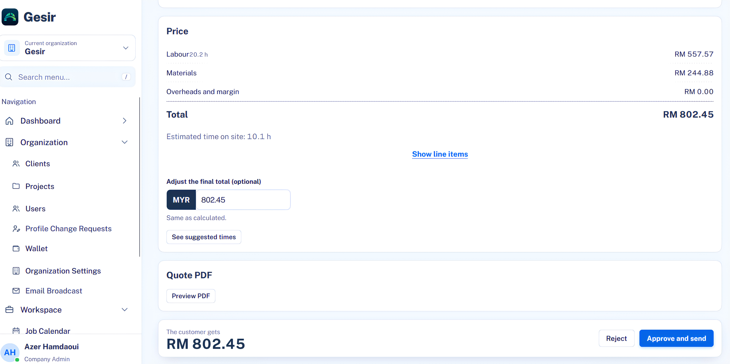
3)
AI & DECISION LOGIC
4)
HUMAN APPROVAL
AI extracts the service and preferred date,Rules check finds missing room size and location, then asks the customer before quoting.
The owner reviews job details and costs, and can approve, reject or request edits.

Slide 7
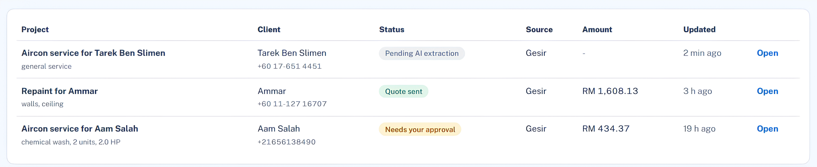
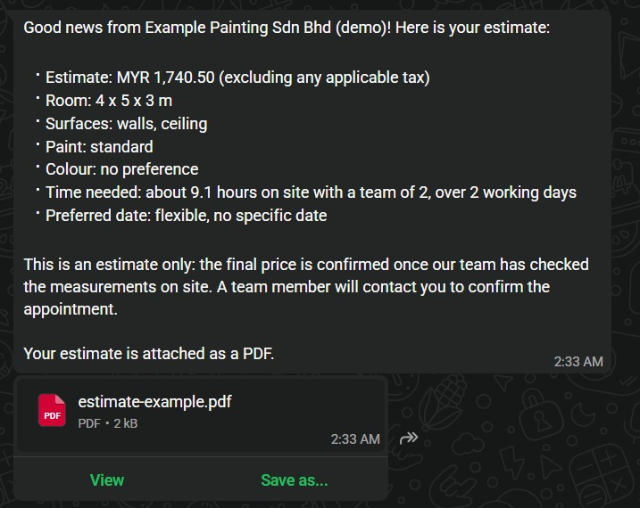
5) ACTIVITY LOG & OUTCOME
The system records:
  What action occurred.
  When it occurred.
  Whether the quotation was approved or rejected.
  The resulting status.

Slide 8
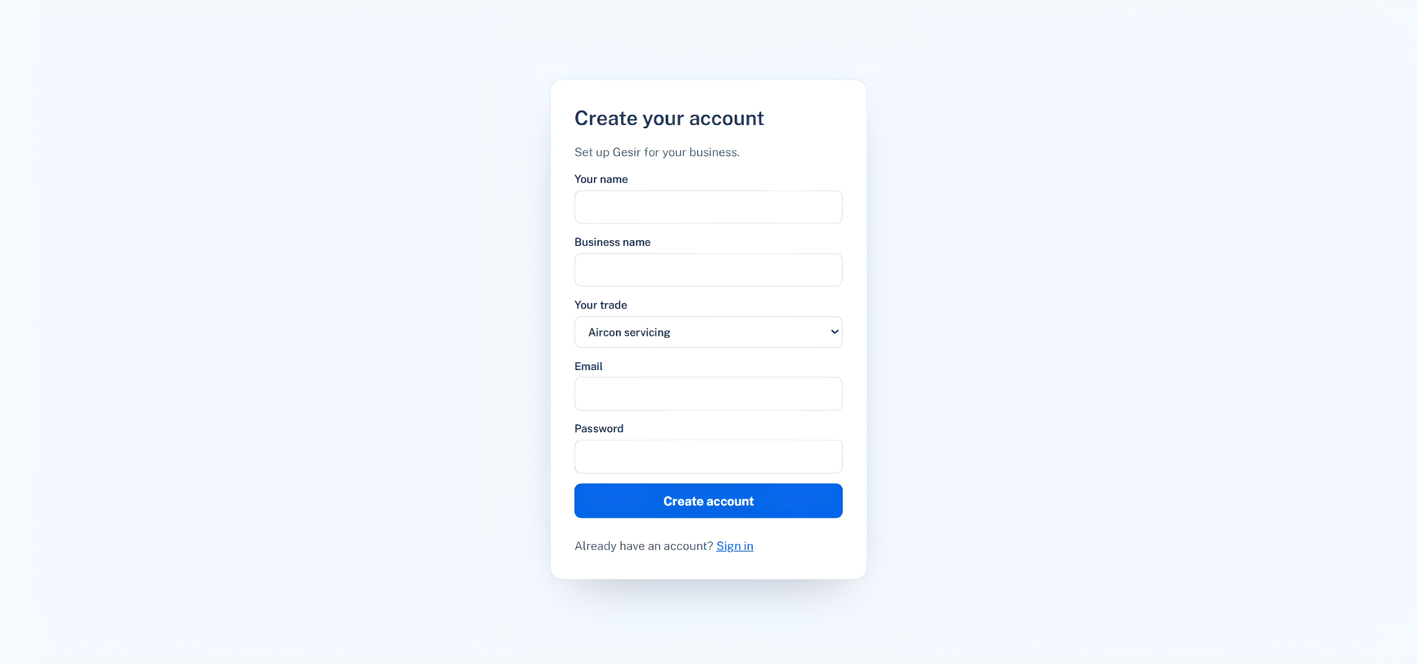
6)A SECOND BUSINESS:
Aircon Servicing Adaptation:
  Intake: Captures unit count, horsepower, and service type (chemical vs. normal wash).
  Setup: Select trade dropdown, input rate card, launch immediately.
  Architecture: 100% same pipeline, only extraction schema and pricing rules swap.

Slide 9
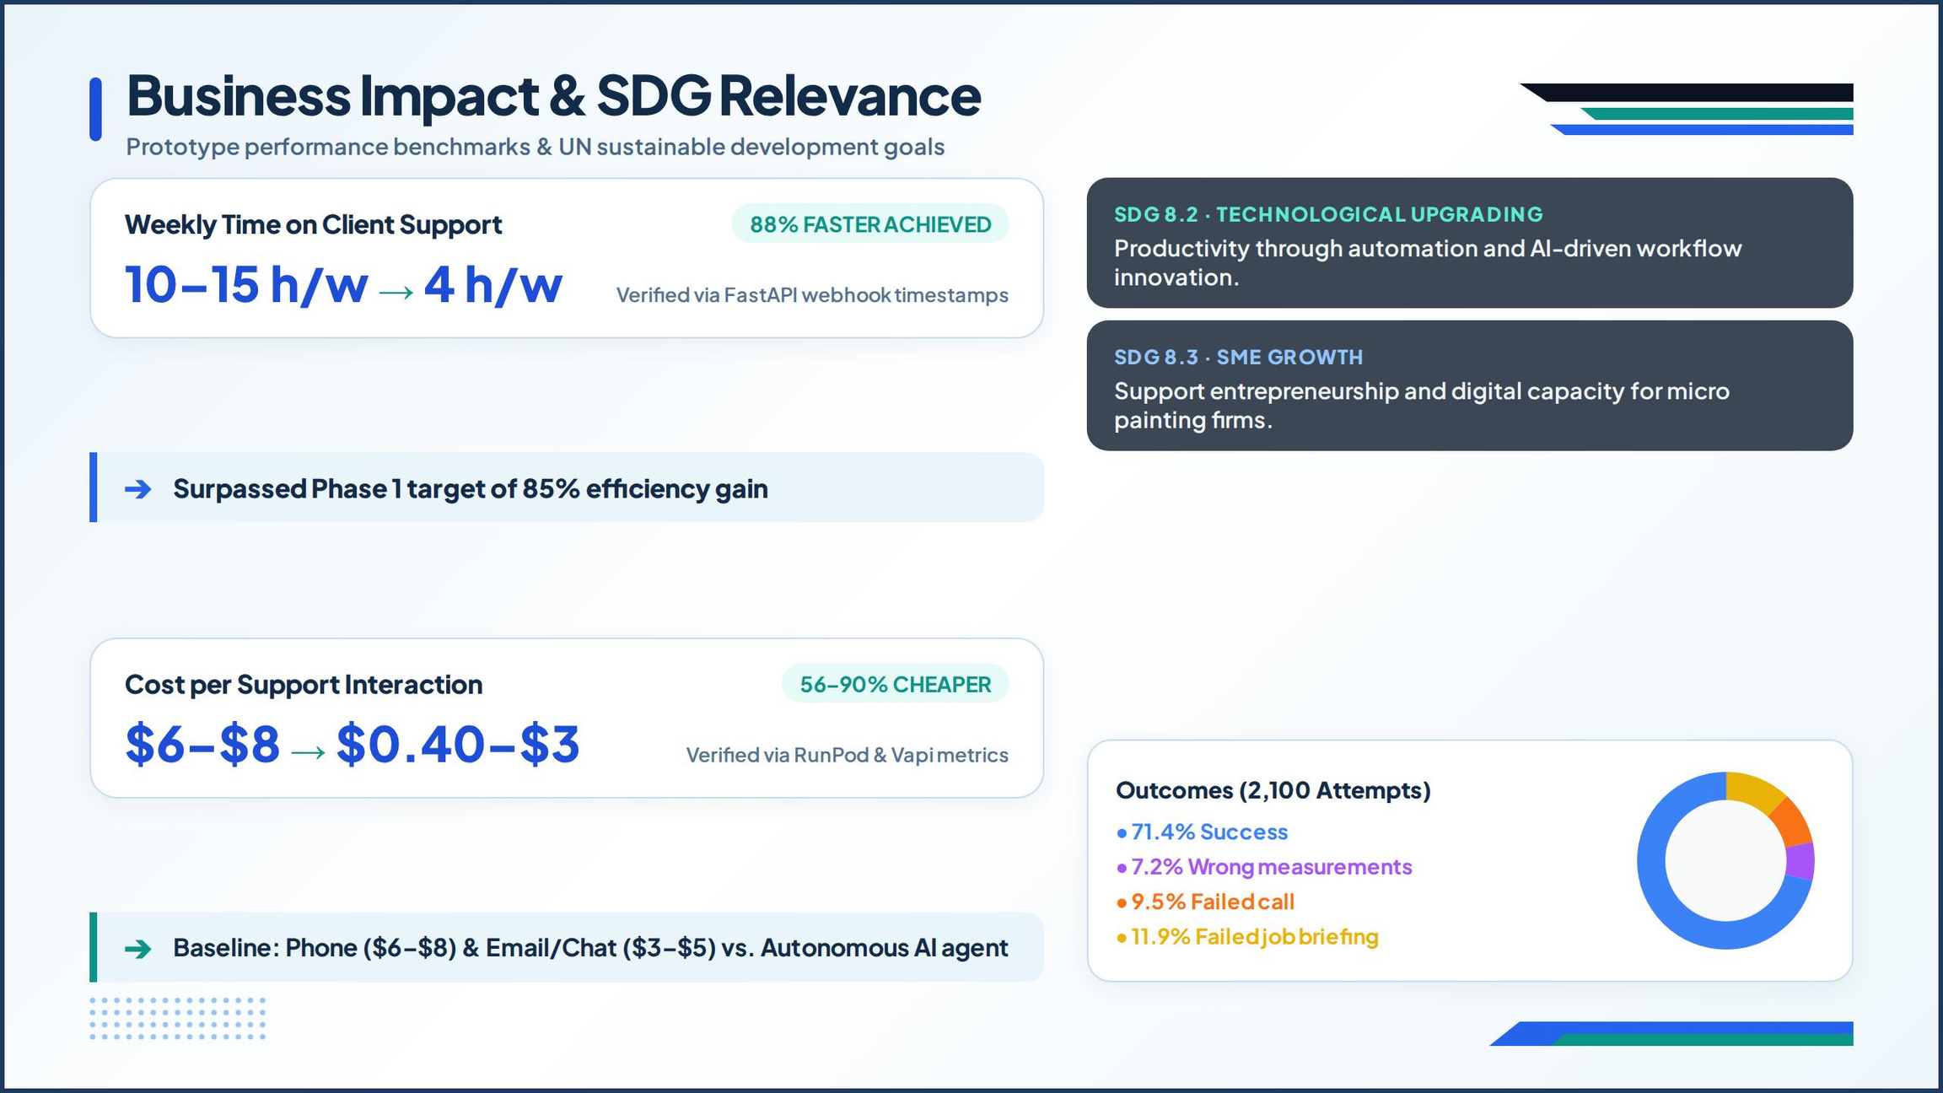

Slide 10
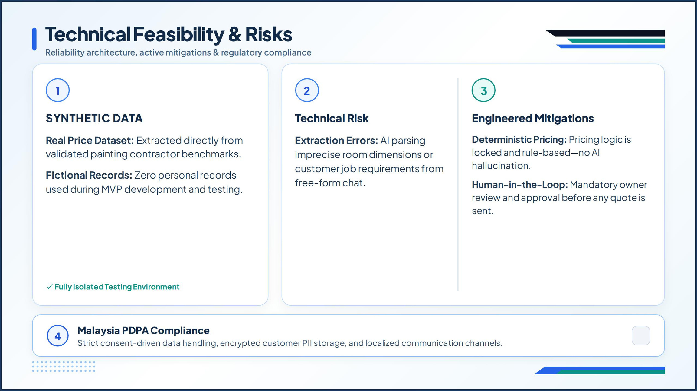

Slide 11
BUSINESS MODEL
Revenue Model:
Customer Value:
Target(s):
  Primary: Painting shops
Monthly subscription with usage-based tiers
Less repetitive admin and faster quotation turnaround.
  Secondary: home-service ecosystem

Slide 12


CONCLUSION
"Gesir.ai doesn’t replace trade contractors, it handles the midnight admin so they can grow their business while staying 100% in control."
Q&A?
Session
https://github.com/Azer884/Bridge-app

Slide 13


Thank you
For your attention
Team Hrissa
Contact US on:
azer.hamdaoui.07@gmail.com
+21656138490

