Slide 1
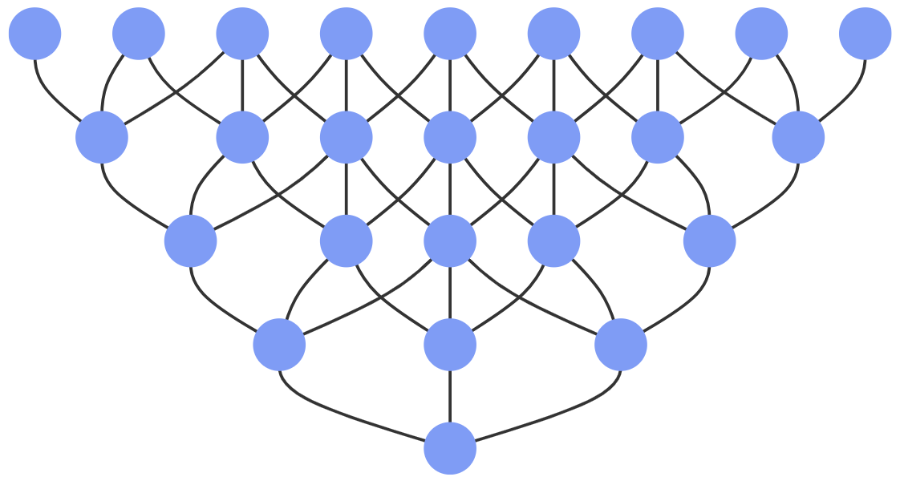
Dynamic Programming

Slide 2

What is Dynamic Programming (DP)
Dynamic Programming (DP) is a programming paradigm that can systematically and efficiently explore all possible solutions to a problem. As such, it is capable of solving a wide variety of problems that often have the following characteristics:
The problem can be broken down into "overlapping subproblems" - smaller versions of the original problem that are re-used multiple times.
The problem has an "optimal substructure" - an optimal solution can be formed from optimal solutions to the overlapping subproblems of the original problem.

Slide 3
DP Approaches
Recursive backtracking
Top-down DP (memoization)
Bottom-up DP (tabulation)
Bottom-up no memory DP

Slide 4

Dynamic Programming

Slide 5

Dynamic Programming

Slide 6
E-OLYMP 1560. Decreasing number
There are three types of operations you can perform on an integer:
If it’s divisible by 3, divide it by 3;
If it’s divisible by 2, divide it by 2;
Subtract 1.
Given a positive integer n, find the minimal number of operations needed to produce the number 1.
Input. Each line contains the positive integer n (1 ≤ n ≤ 10⁶).
Output. For each value of n print in a separate line the minimal number of operations needed to produce the number 1.
Sample input
1
5
10
Sample output
0
3
3
Let f(n) contains the minimum number of operations to convert the number n to 1. For example,
f(1) = 0, since we already have number 1;
f(2) = 1, perform operations 2 → 1;
f(5) = 3, perform operations 5 → 4 → 2 → 1;
What is the value of f(10)?

Slide 7
E-OLYMP 1560. Decreasing number
f(10) = 3, perform operations 10 → 9 → 3 → 1;
In the case of n = 10 it is better to subtract 1 first than to use the greedy idea and divide by 2.
Consider the process of calculating the function f(n).
If we divide number n by 3 (if n is divisible by 3), then
f(n) = f(n / 3) + 1
If we divide number n by 2 (if n is divisible by 2), then
f(n) = f(n / 2) + 1
If we subtract 1 from n, then
f(n) = f(n – 1) + 1

Slide 8
E-OLYMP 1560. Decreasing number
From the number n we can get one of three numbers: n / 3, n / 2 or n – 1. The number of operations for which each of these numbers we can be reduced to 1, equals to f(n / 3), f(n / 2) and f(i – 1) respectively. Since we are interested in the smallest number of operations, we have the relation:
f(n) = min(f(n – 1), f(n / 2), f(n / 3)) + 1,
f(1) = 0
Moreover, if n is not divisible by 2 (or by 3), then the corresponding element (f(n / 2) or f(n / 3)) is absent in the function min. For example, for n = 8 we have:
f(8) = min(f(7), f(4)) + 1
For n = 7 we get:
f(7) = min(f(6)) + 1 = f(6) + 1
The values of the function f(n) will be stored in the cells of array d[MAX], where MAX = 10⁶ + 1. Fill the cells of array d from 1 to 10⁶ according to the given recurrence relation. For example, the following table shows the values of d[i] for 1 ≤ i ≤ 11:
For example, d[10] = min(d[9], d[5]) + 1 = min(2, 3) + 1 = 3. It means that it is more efficient to subtract 1 from 10, rather than divide it by 2.

Slide 9
E-OLYMP 9628. Frog
There are n stones, numbered 1, 2, ..., n. For each i (1 ≤ i ≤ n), the height of stone i is h_{i}. There is a frog who is initially on stone 1. It will repeat the following action some number of times to reach stone n: if the frog is currently on stone i, jump to stone i + 1 or stone i + 2. Here, a cost of | h_{i} − h_{j} | is incurred, where j is the stone to land on.
Find the minimum possible total cost incurred before the frog reaches stone n.
Input. The first line contains number n (2 ≤ n ≤ 10⁵). Second line contains integers h₁, h₂, ..., h_{n} (1 ≤ h_{i} ≤ 10⁴).
Output. Print the minimum possible total cost for frog to reach stone n.
Sample input
4
10 30 40 20
Sample output
30

Slide 10
E-OLYMP 9628. Frog
Let dp[i] be the smallest cost of moving the frog to stone i. Then:
dp[1] = 0 (do not need to move anywhere),
dp[2] = | h₂ − h₁ |;
The frog can jump onto the i-th platform (i ≥ 3):
either from (i – 1)-th with cost |h_{i} – h_{i-1}|;
or from (i – 2)-th with cost |h_{i} – h_{i-2}|;
Hence
dp[i] = min( dp[i – 1] + |h_{i} – h_{i-1}| , dp[i – 2] + |h_{i} – h_{i-2}| )

Slide 11
E-OLYMP 44. The number of ones
In arithmetic expression you are allowed to use the number 1, operations of addition, multiplication and parenthesis. What is the minimum number of ones you need to obtain the positive integer n?
Input. One number n (1 ≤ n ≤ 5000).
Output. The required number of ones.
Sample input
7
Sample output
6
How to represent 7 with minimum number of ones?

Slide 12
E-OLYMP 44. The number of ones
Let f(n) equals to the smallest number of ones, with which you can get a number n.
Obviously that f(1) = 1.
Number 2 can only be represented as the sum of two ones: 2 = 1 + 1. Therefore, f(2) = 2.
Number 3 can only be represented as the sum of three ones: 3 = 1 + 1 + 1. Therefore, f(3) = 3.
Number 4 can be represented either as 4 = 1 + 1 + 1 + 1, or 4 = (1 + 1) * (1 + 1). However, in both cases, 4 ones are used. Hence f(4) = 4.
Compute the answer for n = 7:
f(7) = f(6) + f(1) = (f(2) + f(3)) + f(1) = 2 + 3 + 1 = 6
Number 7 can be represented with 6 ones:
7 = (1 + 1) * (1 + 1 + 1) + 1

Slide 13
E-OLYMP 44. The number of ones
Consider the required expression with result n.
1. Let the last executed operation be addition. Let for example, the first term i contains f(i) ones, and the second term n – i contains f(n – i) ones. The value of i must be chosen so that the sum f(i) + f(n – i) is minimized.
The value of i is enough to iterate up to n / 2, since it can be assumed that the first term is not greater than the second one. Thus, we have the relation:
f(n) =

Slide 14
E-OLYMP 44. The number of ones
2. Let the last executed operation in expression was multiplication. Let for example, the first term i contains f(i) ones, and the second term n / i contains f(n / i) ones. This case occurs if n is divisible by i.
The value of i must be chosen so that the sum f(i) + f(n / i) is minimized. The value of i is enough to iterate up to sqrt(n). Thus, we have the relation:
f(n) =
So
f(n) =

Slide 15
E-OLYMP 806. Platforms – 3
In older games one can run into the next situation. The hero jumps along the platforms that hang in the air. He must move himself from one side of the screen to the other. When the hero jumps from one platform to the neighboring, he spends |y₂ – y₁|² energy, where y₁ and y₂ are the heights where these platforms hang. The hero can make a super jump that allows him to skip one platform, but it takes him 3 * |y₃ – y₁|² energy.
You are given the heights of the platforms in order from the left side to the right. Find the minimum amount of energy to get from the 1-st (start) platform to the n-th (last).
Input. The first line contains the number of platforms n (2 ≤ n ≤ 10⁵). The second line gives n integers – the heights of the platforms, which absolute values are not grater than 4000 by absolute value.
Output. Print one integer – the minimum amount of energy.
Sample input
4
1 2 3 30
Sample output
731

Slide 16
E-OLYMP 806. Platforms – 3
With given energy functions sometimes, it is optimal for the hero to make one move backwards. Consider the following example. Suppose we have 4 platforms with heights of 1, 10, 2, 11. We calculate the energy that hero should spent to reach the last platform in different ways.
As we can see, the optimal way is to jump from 1-st platform to the 3-rd using super jump, then return to the 2-nd and using super jump once more, to appear on the last, 4-th platform. The total spent energy equals to 3 + 64 + 3 = 70.

Slide 17
E-OLYMP 806. Platforms – 3
Let dp[i] be the minimal amount of energy enough to get from the 1-st platform to the i-th. Let dp[1] = 0, because initially we are on the first platform. We can get to the second platform either from the first only (if n = 2), or in two ways:
from 1-st to the 2-nd using |y₂ – y₁|² energy;
from 1-st to the 3-rd and then to the 2-nd spending 3 * |y₃ – y₁|² + |y₂ – y₃|² energy;
So, if n > 2 then dp[2] = min(|y₂ – y₁|², 3 * |y₃ – y₁|² + |y₂ – y₃|²).
Now consider the calculation of dp[i]. One can get into i-th platform either from (i – 1)-th or from (i – 2)-th using super jump. But when i < n, one can get into the i-th platform from the (i + 1)-th, where we jumped from the (i – 1)-th. So dp[i] equals to minimum among the values:
dp[i – 1] + |y_{i} – y_{i-1}|² : normal jump from the (i – 1)-th platform;
dp[i – 2] + 3 * |y_{i} – y_{i-2}|² : super jump from the (i – 2)-th platform;
dp[i – 1] + 3 * |y_{i+1} – y_{i-1}|² + |y_{i} – y_{i+1}|² : one jumps from the (i – 1)-th to (i + 1)-th, and then to i-th platform. This movement possible only if i < n.

Slide 18
E-OLYMP 5101. Hodja Nasreddin
Hodja Nasreddin is located in the upper left corner of the table of the size n × n, and his donkey is located in the lower right corner. Hodge goes only to the right or down, a donkey goes only to the left or up.
In how many ways they can meet in one cell? (Two ways are considered different if Hodja or donkey has different routes).
Input. One integer n (1 ≤ n ≤ 50).
Output. Print one number – the number of ways Hodja and donkey can meet. This number can be big, so print its value modulo 9929.
Sample input
3
Sample output
30

Slide 19
E-OLYMP 5101. Hodja Nasreddin
Let a[i][j] contains the number of ways for Hodja Nasreddin to go from (1, 1) to (i, j).
Let b[i][j] contains the number of ways for donkey to go from (n, n) to (i, j).
The number of ways for Hodja Nasreddin and donkey to meet in the cell (i, j) equals to a[i][j] * b[i][j]. To get the answer you need to find the sum of products modulo 9929:
Let’s build the arrays for n = 3:
= (6 + 3 + 1) + (3 + 4 + 3) + (1 + 3 + 6) = 30

Slide 20
E-OLYMP 5854. Maximum sum basic
There is a rectangular grid of size n rows and m columns. Each cell of the grid contains one integer. You can start the route from any cell of the top row. Each time you can move to one of the “lower neighboring” cells (in other words, from the cell number (i, j) it’s possible to go either to (i + 1, j – 1), or to (i + 1, j) or to (i + 1, j + 1); in the case j = m the last of the three options becomes impossible, in the case j = 1 the first option becomes impossible). And you can finish the route at any cell of the bottom row.
Write a program that finds the maximum possible sum of the values on the cells traversed among all the possible paths.
Input. The first line contains numbers n and m (1 ≤ n, m ≤ 200) – the number of rows and columns. Each of the next n lines contains m integers (each number is no more than 10⁶ by absolute value) – the values of the cells in the grid.
Output. Print one number – the maximum possible sum.
Sample input
4 3
1 15 2
9 7 5
9 2 4
6 9 -1
Sample output
42

Slide 21
E-OLYMP 5854. Maximum sum basic
Let a[i][j] be the input table. Let dp[i][j] stores the maximum sum of numbers on the way from any cell of the first line to cell (i, j). Then
dp[i][j] = max(dp[i – 1][j – 1], dp[i – 1][j], dp[i – 1][j + 1]) + a[i][j]
For the correct calculation of the values of the first and last columns, one should set
dp[i][0] = dp[i][m + 1] = -∞
The first row of the dp array is initialized with the values of the first row of the table а:
dp[1][i] = a[1][i], 1 ≤ i ≤ m
The answer to the problem will be the maximum number in the last (n-th) row of the dp table.

