Slide 1

INTRODUCTION TO DATA STRUCTURES AND ALGORITHMS
DATA STRUCTURES AND ALGORITHMS
DATA STRUCTURES AND ALGORITHMS

Slide 2
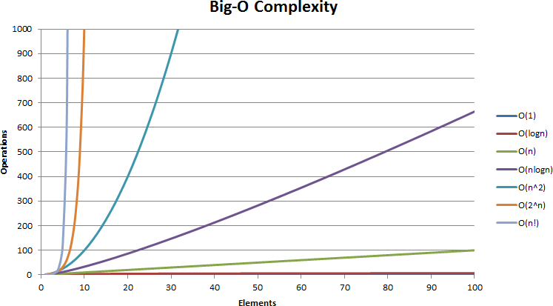
DATA STRUCTURES AND ALGORITHMS
INTRODUCTION TO DATA STRUCUTRES AND ALGORITHMS
Content
Concept of Algorithms and Data structures
Algorithms
Complexity analyses
Big O notation
Calculation

Slide 3



DATA STRUCTURES AND ALGORITHMS
THE CONCEPT OF ALGORITHMS AND DATA STRUCTURES
Algorithms
sorting
Data structures
Calculation tasks
Analyzing a task
Select optimal data structure
Select optimal algorithm
compare with other approaches and complexity analysis
Stack
Software developing
searching
List
parsing
Processing
Not calculation task
Queue
File system organizing
Objects relations
Design Patterns
Refactoring
Network
Message passing
Protocols and standards.
Transactions and Databases
Testing ……
traversing
Matrix
BST, Heap, AVL…
Data structures and Algorithms used to solve calculation tasks
transforming
Encoding & hashing
Graphs

Slide 4

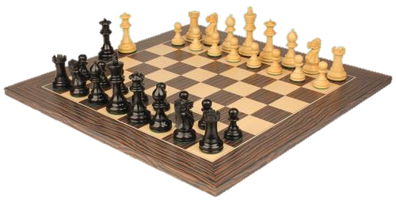
WHY STUDY ALGORITHMS
DATA STRUCTURES AND ALGORITHMS
Internet
Web search, packet routing, distributed file sharing, ...
Automation
Chain of process analysis, simulation, …
Biology
Human genome project, protein folding, …
Computers
Circuit layout, databases, caching, networking,
compilers, …
Computer graphics
Movies, video games, virtual reality, …
Security
Cell phones, e-commerce, voting machines, …
Multimedia
Cell phones, e-commerce, voting machines, …
Social Networks
Recommendations, news feeds, advertisements, …
Physics
N-body simulation, particle collision simulation, …

Slide 5

COMPLEXITY AND ASYMPTOTIC NOTATION
DATA STRUCTURES AND ALGORITHMS
DATA STRUCTURES AND ALGORITHMS

Slide 6
DATA STRUCTURES AND ALGORITHMS
RAM MODEL
The RAM (Random Access machine) model of computation
𝐴 = 𝐵 + 𝐶 X = 𝐴 ∗ 2
Z = 𝑋 ∗ 𝐶 + 𝐴 ∗ 𝐵
Each simple operation (+, *, –, =, if, call) takes exactly 1
one time step.
Loops and subroutines are not considered simple operations. Instead, they are the composition of many single-step operations.
𝑓𝑜𝑟 𝑖 = 0; 𝑖 < 𝑛; 𝑖 + +
A = B + 𝐶
𝑓𝑜𝑟 𝑖 = 0; 𝑖 < 𝑛; 𝑖 + +
𝑓𝑜𝑟 𝑗 = 0; 𝑗 < 𝑛; 𝑗 + +
A = B + 𝐶
𝑛
_{𝑛}2
Each memory access takes exactly one time step. Further, we have as much memory as we need.The RAM model takes no notice of whether an item is in cache or on the disk
Machine-independent algorithm design depends upon a hypothetical computer called the Random Access Machine or RAM. Under this model of computation, we are confronted with a computer where:

Slide 7
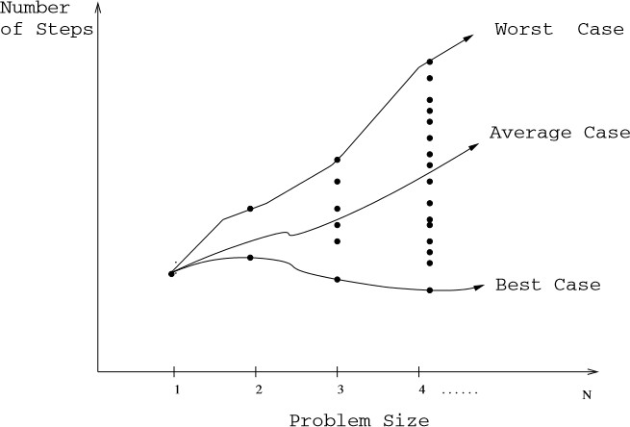
DATA STRUCTURES AND ALGORITHMS
BEST,WORST, AND AVERAGE-CASE COMPLEXITY
Algorithms classification by speed
The worst-case complexity of the algorithm is the function deﬁned by the maximum number of steps taken in any instance of size n.This represents the curve passing through the highest point in each column
The best-case complexity of the algorithm is the function deﬁned by the minimum number of steps taken in any instance of size n.This represents the curve passing through the lowest point of each column.
The average-case complexity of the algorithm, which is the function deﬁned by the average number of steps over all instances of size n.
Using the RAM model of computation, we can count how many steps our algorithm takes on any given input instance by executing it

Slide 8
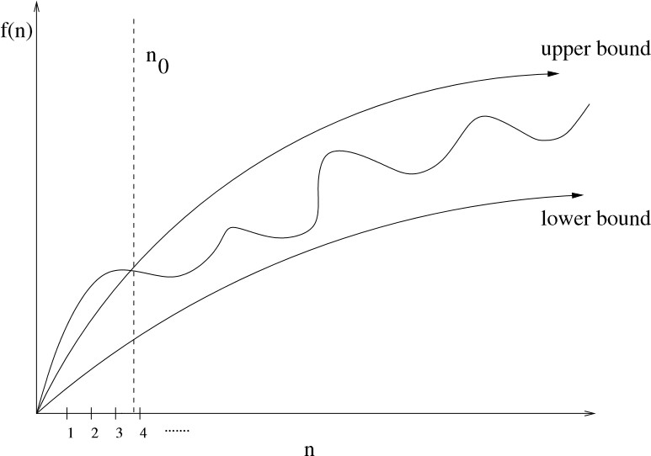
DATA STRUCTURES AND ALGORITHMS
THE BIG O NOTATION
Formal Notation
𝑓(𝑛) = 𝑂(𝑔(𝑛)) means 𝑐 · 𝑔(𝑛) is an upper bound on 𝑓(𝑛).Thus there exists some constant c such that
𝑓(𝑛) is always ≤ 𝑐 · 𝑔(𝑛), for large enough n (i.e. ,
𝑛 ≥ 𝑛0 for some constant 𝑛0).
𝑓(𝑛) = Ω( 𝑔(𝑛)) means 𝑐 · 𝑔(𝑛) is a lower bound on 𝑓(𝑛).Thus there exists some constant c such that
𝑓(𝑛) is always ≥ 𝑐 · 𝑔(𝑛), for all 𝑛 ≥ 𝑛0.
𝑓(𝑛) = Θ( 𝑔(𝑛)) means 𝑐1 · 𝑔(𝑛) is an upper bound on 𝑓(𝑛) 𝑎𝑛𝑑𝑐2 · 𝑔(𝑛) is a lower bound on
𝑓(𝑛), for all 𝑛 ≥ 𝑛0.Thus there exist constants c1
and c2such that 𝑓 𝑛 ≤ 𝑐1 · 𝑔 𝑛 𝑎𝑛𝑑 𝑓(𝑛) ≥ 𝑐2 ·
𝑔(𝑛).This means that 𝑔(𝑛) provides a nice, tight bound on 𝑓(𝑛).
Upper and lower bounds valid for n>n 0 smooth out the behavior of complex functions

Slide 9
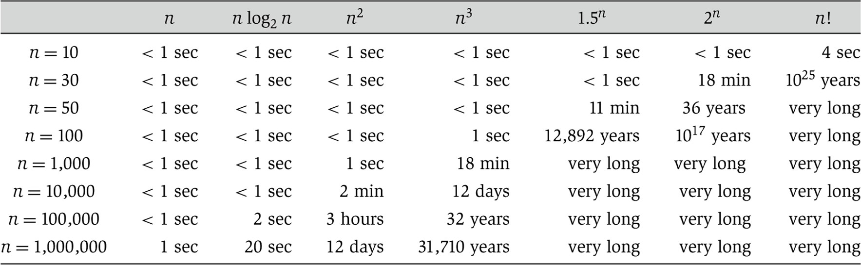
DATA STRUCTURES AND ALGORITHMS
WHY IT’S MATTER
The running times (rounded up) of different algorithms on inputs of increasing size, for a processor performing A million Hight-level instructions per second. In case, were the running time exceeds 10²⁵ years, we simply record the algorithm as taking a very long time

Slide 10
ANALYSIS OF ALGORITHMS
DATA STRUCTURES AND ALGORITHMS
1) 𝑂(1):Time complexity of a function (or set of statements) is considered as 𝑂 (1) if it doesn’t contain loop, recursion and call to any other non- constant time function. A loop or recursion that runs a constant number of times is also considered as 𝑂(1). For example the following loop is 𝑂(1).
2) 𝑂(𝑛):Time Complexity of a loop is considered as
𝑂(𝑛) if the loop variables is incremented / decremented by a constant amount. For example following functions have 𝑂(𝑛) time complexity.
// Here c is a positive integer constant
for (int i = 1; i <= n; i += c) {
// some O(1) expressions
}
for (int i = n; i > 0; i -= c) {
// some O(1) expressions
}
// Here c is a constant
for (int i = 1; i <= c; i++) {
// some O(1) expressions
}

Slide 11
ANALYSIS OF ALGORITHMS
DATA STRUCTURES AND ALGORITHMS
3) 𝑂(𝑛^{𝑐}): Time complexity of nested loops is equal to the number of times the innermost statement is executed. For example the following sample loops have
𝑂(𝑛²) time complexity
4) 𝑂(𝐿𝑜𝑔𝑛) Time Complexity of a loop is considered as 𝑂(𝐿𝑜𝑔𝑛) if the loop variables is divided / multiplied by a constant amount.
for (int i = 1; i <=n; i += c) {
for (int j = 1; j <=n; j += c) {
// some O(1) expressions
}
}
for (int i = 1; i <=n; i *= c) {
// some O(1) expressions
}
for (int i = n; i > 0; i += c) {
for (int j = i+1; j <=n; j += c) {
// some O(1) expressions
}
for (int i = n; i > 0; i /= c) {
// some O(1) expressions
}
}

Slide 12
ANALYSIS OF ALGORITHMS
DATA STRUCTURES AND ALGORITHMS
5) 𝑂(𝐿𝑜𝑔𝐿𝑜𝑔𝑛) Time Complexity of a loop is considered as
𝑂(𝐿𝑜𝑔𝐿𝑜𝑔𝑛) if the loop variables is reduced / increased exponentially by a constant amount.
// Here c is a constant greater than 1
for (int i = 2; i <=n; i = pow(i, c)) {
// some O(1) expressions
}
//Here fun | is sqrt or cuberoot or any | other | constant root
for (int i | = n; i > 0; i = fun(i)) {
// some | O(1) expressions
}

Slide 13
COMBINE OF TIME COMPLEXITIES IN CONSECUTIVE LOOPS
DATA STRUCTURES AND ALGORITHMS
When there are consecutive loops, we calculate time complexity as sum of time complexities of individual loops
for } | (int i // | = 1; some | i <=m; i += c) { O(1) expressions
for } | (int i // | = 1; some | i <=n; i += c) { O(1) expressions
Time complexity of above code is 𝑂(𝑚) + 𝑂(𝑛) which is
𝑂(𝑚 + 𝑛) If m == n, the time complexity becomes
𝑂(2𝑛) which is 𝑂(𝑛).

