Slide 1
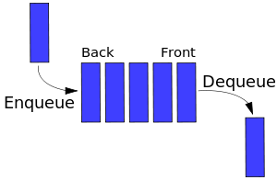
Queue
Queues are a type of container, specifically designed to operate in a FIFO context (first-in first-out), where elements are inserted into one end (back) of the container and extracted from the other (front).
Queue supports the following operations:
empty – test whether container is empty;
size – return size;
front – access first element
back – access last element
push – insert element to the back;
pop – remove front element;

Slide 2
Dequeue
Deque or Double Ended Queue is a generalized version of Queue data structure that allows insert and delete at both ends.
Dequeue supports the following operations:
empty – test whether container is empty;
size – return size;
clear – clear the deque;
front – access first element
back – access last element
push_back – insert element to the back;
push_front – insert element to the front;
pop_back – remove back element;
pop_front – remove front element

Slide 3
E-OLYMP 8355. Book shelf
The shelf where the books are placed represents itself a double ended queue. In this problem you must simulate the next operations:
push_front(x) – put the book number x from the left side;
push_back(x) – put the book number x from the right side;
pop_front() – remove the book from left side;
pop_back() – remove the book from right side;
The books are removed from the shelf in the following order:
pop_front() – book number 3;
pop_back() – book number 9;
pop_front() – book number 1;
pop_front() – book number 2;
pop_back() – book number 7;

