Slide 1

SORTING AND SEARCHING
DATA STRUCTURES AND ALGORITHMS
DATA STRUCTURES AND ALGORITHMS

Slide 2





DATA STRUCTURES AND ALGORITHMS
SORTING AND SEARCHING
Content
Sorting Algorithms
Bubble Sort
Selection Sort
Insertion Sort
Quick Sort
Merge Sort
Search Algorithms
Linear search
Binary search

Slide 3

SORTING: BUBBLE SORT
DATA STRUCTURES AND ALGORITHMS
DATA STRUCTURES AND ALGORITHMS

Slide 4

DATA STRUCTURES AND ALGORITHMS
BUBBLE SORT
Bubble sort is a simple sorting algorithm that works by repeatedly stepping through the list to be sorted, comparing each pair of adjacent items and swapping them if they are in the wrong order.The pass through the list is repeated until no swaps are needed, which indicates that the list is sorted.
Pseudocode
Complexity
Best-Case O( n )
Worst Case O(n2)
Average Case O(n2)
Space complexity O(1)
bubblesort(data[],n)
for I = 0 to n-1
for j = n-1 down to i+1
swap elements in positions j and j-1 if they are out of order;

Slide 5
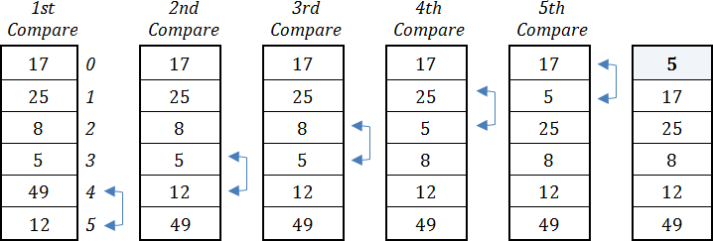
DATA STRUCTURES AND ALGORITHMS
BUBBLE SORT
Work Principles

Slide 6
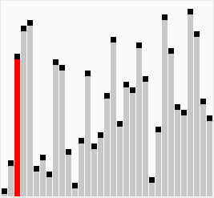
BUBBLE SORT
DATA STRUCTURES AND ALGORITHMS
void bubble_sort(int a[], int length){
int temp;
for (int i = 0; i < length-1; i++)
{
for (int j = length-1; j >= i+1; j--)
{
if(a[j] < a[j-1]){ temp = a[j-1]; a[j-1] = a[j]; a[j] = temp;
}
}
}
}

Slide 7
SORTING: SELECTION SORT
DATA STRUCTURES AND ALGORITHMS
DATA STRUCTURES AND ALGORITHMS

Slide 8
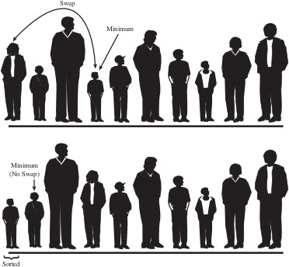
DATA STRUCTURES AND ALGORITHMS
SELECTION SORT
selection sort is a sorting algorithm, specifically an in-place comparison sort. It has O(n2) time complexity, making it inefficient on large lists, and generally performs worse than the similar insertion sort. Selection sort is noted for its simplicity, and it has performance advantages over more complicated algorithms in certain situations, particularly where auxiliary memory is limited.
Complexity
Pseudocode
selectionsort(data[ ],n) for I = 0 to n-1
select the smallest element among data[i], . . . , data[n-1]; swap it with data[i];
Best-Case O( n )
Worst Case O(n2)
Average Case O(n2)
Space complexity O(1)

Slide 9
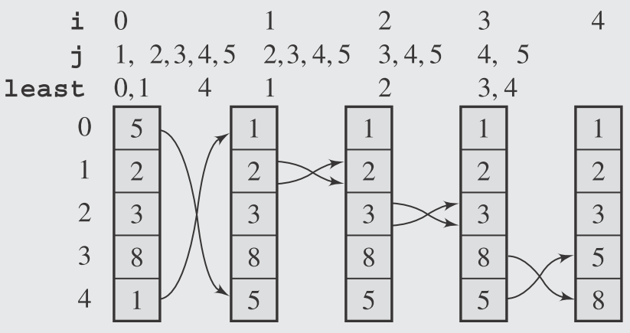
DATA STRUCTURES AND ALGORITHMS
SELECTION SORT
Work Principles

Slide 10
SELECTION SORT
DATA STRUCTURES AND ALGORITHMS
void selection_sort(int a[], int length){
int temp, min;
for (int i = 0; i < length-1; i++)
{
min = i;
for (int j = i+1; j < length; j++)
{
if(a[j] < a[min])
min = j;
}
temp = a[i]; a[i] = a[min]; a[min] = temp;
}
}

Slide 11
SORTING: INSERTION SORT
DATA STRUCTURES AND ALGORITHMS
DATA STRUCTURES AND ALGORITHMS

Slide 12
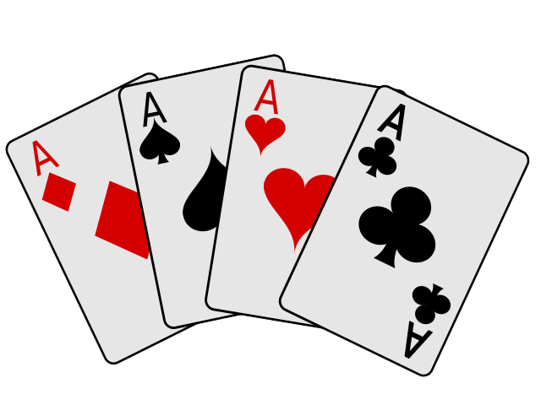
DATA STRUCTURES AND ALGORITHMS
INSERTION SORT
Properties
Efficient for small data sets.
Average and Worst case: O(n^2)
It is in-place sorting. It only requires a constant amount O(1) of additional memory space.
Pseudocode
insertionsort(data[ ],n) for I = 1 to n-1
move all elements data[j] greater than data[i] by one position;
place data[i] in its proper position;

Slide 13
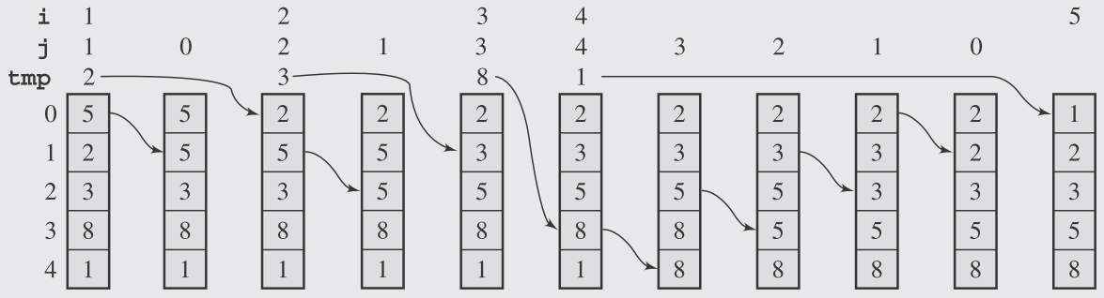
DATA STRUCTURES AND ALGORITHMS
INSERTION SORT
Work Principles

Slide 14
INSERTION SORT
DATA STRUCTURES AND ALGORITHMS
void insertion_sort(int a[], int length){
for(int i = 1; i < len; i++)
{
int insertValue = arr[i];
int j;
for(j = i - 1; j >= 0; j--)
{
if(arr[j] > arr[j+1])
arr[j+1] = arr[j];
else
break;
}
arr[j+1] = insertValue;
}
}

Slide 15
SORTING: QUICK SORT
DATA STRUCTURES AND ALGORITHMS
DATA STRUCTURES AND ALGORITHMS

Slide 16

DATA STRUCTURES AND ALGORITHMS
QUICK SORT
Properties
Quick Sort is a Divide and Conquer algorithm. It picks an element as pivot and partitions the given array around the picked pivot. There are many different versions of quick Sort that pick pivot in different ways.
The key process in quick Sort is partition(). Target of partitions is, given an array and an element x of array as pivot, put x at its correct position in sorted array and put all smaller elements (smaller than x) before x, and put all greater elements (greater than x) after x.
Pseudo code
quicksort(array[])
if length(array) > 1
Complexity
Best Case O(nlog n)
Worst-case O(n2)
Average-Case O(n log n)
Space complexity log n
choose bound; // partition array into subarray1 and subarray2
while there are elements left in array
include element either in subarray = {el: el ≤ bound}
or in subarray2 = {el: el ≥ bound};
quicksort(subarray1));
quicksort(subarray2);

Slide 17
QUICK SORT
DATA STRUCTURES AND ALGORITHMS
int partition(int arr[], int low, int high)
{
int pivotValue = arr[low];
int pivotIndex = low;
for (int i = low + 1; i <= high; i++)
{
if(arr[i] < pivotValue)
{
pivotIndex++;
swap(arr[i], arr[pivotIndex]);
}
}
swap(arr[low], arr[pivotIndex]);
return pivotIndex;
}
void quickSort(int arr[], int low, int high)
{
if(low < high)
{
int pivotLocation = partition(arr, low, high);
quickSort(arr, low, pivotLocation - 1);
quickSort(arr, pivotLocation + 1, high);
}
}

Slide 18

SORTING: MERGE SORT
DATA STRUCTURES AND ALGORITHMS
DATA STRUCTURES AND ALGORITHMS
19

Slide 19

DATA STRUCTURES AND ALGORITHMS
MERGE SORT
Properties
Merge Sort is a Divide and Conquer algorithm. It divides input array in two halves, calls itself for the two halves and then merges the two sorted halves. The merge() function is used for merging two halves.The merge(arr, l, m, r) is key process that assumes that arr[l..m] and arr[m+1..r] are sorted and merges the two sorted sub-arrays into one. See following C implementation for details.Complexity
Pseudo code
mergesort(data[])
if data have at least two elements
mergesort(left half of mergesort(right half of
data);
data);
Best Case O(n log n)
Worst-case O(n log n)
Average-Case O(n log n)
Space complexity O( n )
merge(both halves into a sorted list);
merge(array, left, middle, right)
Create two empty arrays
Copy array values into empty arrays
Compare and add to new array

Slide 20
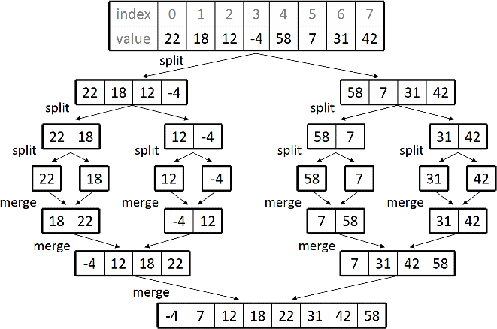
DATA STRUCTURES AND ALGORITHMS
MERGE SORT
Working Principle

Slide 21
MERGE SORT
DATA STRUCTURES AND ALGORITHMS
void merge(int arr[], int left, int middle, int right)
{
int nLeft = middle - left + 1;
int nRight = right - middle;
int *leftArray = new int[nLeft];
int *rightArray = new int[nRight];
for(int i = 0; i < nLeft; i++)
{
leftArray[i] = arr[left + i];
}
for(int i = 0; i<nRight; i++)
{
rightArray[i] = arr[middle+i+1];
}
int leftIndex = 0;
int rightIndex = 0;
int mergedIndex = left;
while(leftIndex < nLeft && rightIndex < nRight)
{
if(leftArray[leftIndex] < rightArray[rightIndex])
{
arr[mergedIndex] = leftArray[leftIndex];
leftIndex++;
}
else
{
arr[mergedIndex] = rightArray[rightIndex];
rightIndex++;
}
mergedIndex++;
}
while(leftIndex < nLeft)
{
arr[mergedIndex++] = leftArray[leftIndex++];
}
while(rightIndex < nRight)
{
arr[mergedIndex++] = rightArray[rightIndex++];
}
}
void mergeSort(int arr[], int left, int right)
{
if(left < right)
{
int middle = left + (right-left)/2;
mergeSort(arr, left, middle);
mergeSort(arr, middle + 1, right);
merge(arr, left, middle, right);
}
}

Slide 22
SEARCH ALGORITHMS: BINARY SEARCH
DATA STRUCTURES AND ALGORITHMS
DATA STRUCTURES AND ALGORITHMS
28

Slide 23

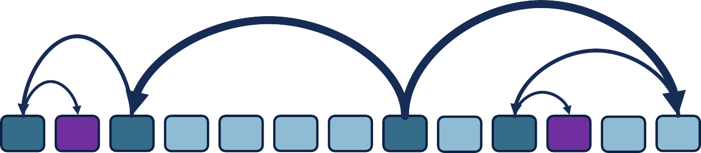
BINARY SEARCH
DATA STRUCTURES AND ALGORITHMS
int binary_search(int a[], int left, int right, int value){
while (left < right)
{
int middle = left + (right - left)/2; if(value < a[middle])
right = middle - 1;
else if(value > a[middle])
left = middle + 1; else
return middle;
}
return -1;
Search 87
Search 17
}
Search 17
Search 87
Search 17
Search 87
87 91
4
12 17 31 45 46 56 62 70
80
83
93 97
103
107
200

Slide 24
BINARY SEARCH: WITH RECURSION
DATA STRUCTURES AND ALGORITHMS
int binary_search_r(int a[], int left, int right, int value){
if(left > right) return -1;
int middle = left + (right- left)/2; if(value < middle)
binary_search_r(a,left, middle-1,value);
else if( value > middle)
binary_search_r(a, middle + 1, right, value);
else
return middle;
Search 87
Search 17
}
Search 17
Search 87
Search 17
Search 87
87 91
4
12 17 31 45 46 56 62 70
80
83
93 97
103
107
200

Slide 25
DATA STRUCTURES AND ALGORITHMS
APPENDIX: SORTING FUNCTIONS
DATA STRUCTURES AND ALGORITHMS

Slide 26
Sorting in C++ (#include<algorithm>)
DATA STRUCTURES AND ALGORITHMS
Sorting vectors
#include <iostream> #include <algorithm>
Sorting arrays
int main()
{
int intArray[SIZE] = { 5, 3, 32, -1, 1, 104, 53 };
//Now we call the sort function sort(intArray, intArray + SIZE);
cout << "Sorted Array looks like this." << endl; for (size_t i = 0; i != SIZE; ++i)
cout << intArray[i] << " ";
using namespace std; const int SIZE = 7;
int main(){
int intArray[SIZE] = { 5, 3, 32, -1, 1, 104, 53 };
sort(intArray, intArray + SIZE);
cout << "Sorted Array looks like this." << endl; for (size_t i = 0; i != SIZE; ++i)
cout << intArray[i] << " "; return 0;
}
return 0;
}
Example 1.
std::sort(myvector.begin(), myvector.end());
Example2.
std::sort(myvector.begin(), myvector.end(), myCompFunction);

Slide 27
Sorting in C++ (#include<algorithm>)
DATA STRUCTURES AND ALGORITHMS
#include <iostream> #include <algorithm> #include <vector>
bool wayToSort(int i, int j) { return i > j; }
using namespace std;
Another solution to the problem of getting it to sort descending is to use std::greater(), which would look like this.
// We need this function to define how to sort
// the vector. We will pass this function into the
// third parameter and it will tell it to sort descendingly. bool wayToSort(int i, int j) { return i > j; }
int main()
{
vector<int> intVec = { 56, 32, -43, 23, 12, 93, 132, -154 };
sort(intVec.begin(), intVec.end(), greater<int>());
// Do not include the () when you call wayToSort
// It must be passed as a function pointer or function object sort(intVec.begin(), intVec.end(), wayToSort);
for (int i : intVec) cout << i << " ";
return 0;
}

Slide 28
Sorting by parameters in structures
DATA STRUCTURES AND ALGORITHMS
int main()
{// Make a vector that holds 5 blank Person Objects vector<Person> people(numberOfPeople);
struct Person
{
string name;
int age;
string favoriteColor;
};
// This will ask for user input to populate the container
// with 5 different indivuals.
for (vector<Person>::size_type i = 0; i != numberOfPeople; ++i){
cout << "Person #" << i + 1 << " name: ";
cin >> people[i].name;
cout << "Person #" << i + 1 << " age: "; cin >> people[i].age;
cout << "Person #" << i + 1 << " favorite color: "; cin >> people[i].favoriteColor;
}
cout << "\n\n";
// Sort by name
sort(people.begin(), people.end(), sortByName); for (Person &n : people)
cout << n.name << " "; cout << endl;
// Sory by age
sort(people.begin(), people.end(), sortByAge); for (Person &n : people)
cout << n.age << " "; cout << endl;
// Sort Container by name function
bool sortByName(const Person &lhs, const Person &rhs)
{ return lhs.name < rhs.name; }
// Sort Container by age function
bool sortByAge(const Person &lhs, const Person &rhs)
{ return lhs.age < rhs.age; }
// Sort Container by favorite color
// We can just sort alphabetically and then it will group the
// color together.
bool sortByColor(const Person &lhs, const Person &rhs)
{ return lhs.favoriteColor < rhs.favoriteColor; }
// Sort by color
sort(people.begin(), people.end(), sortByColor); for (Person &n : people)
cout << n.favoriteColor << " ";
// A global const variable to hold how many people to ask for input for.
const unsigned numberOfPeople = 2;
return 0;
}

