Slide 1
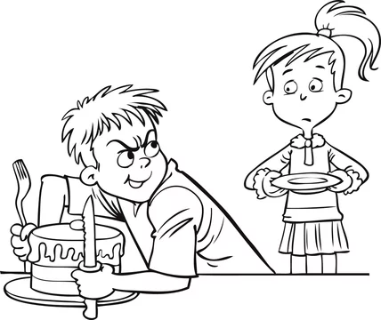
Greedy Methods

Slide 2
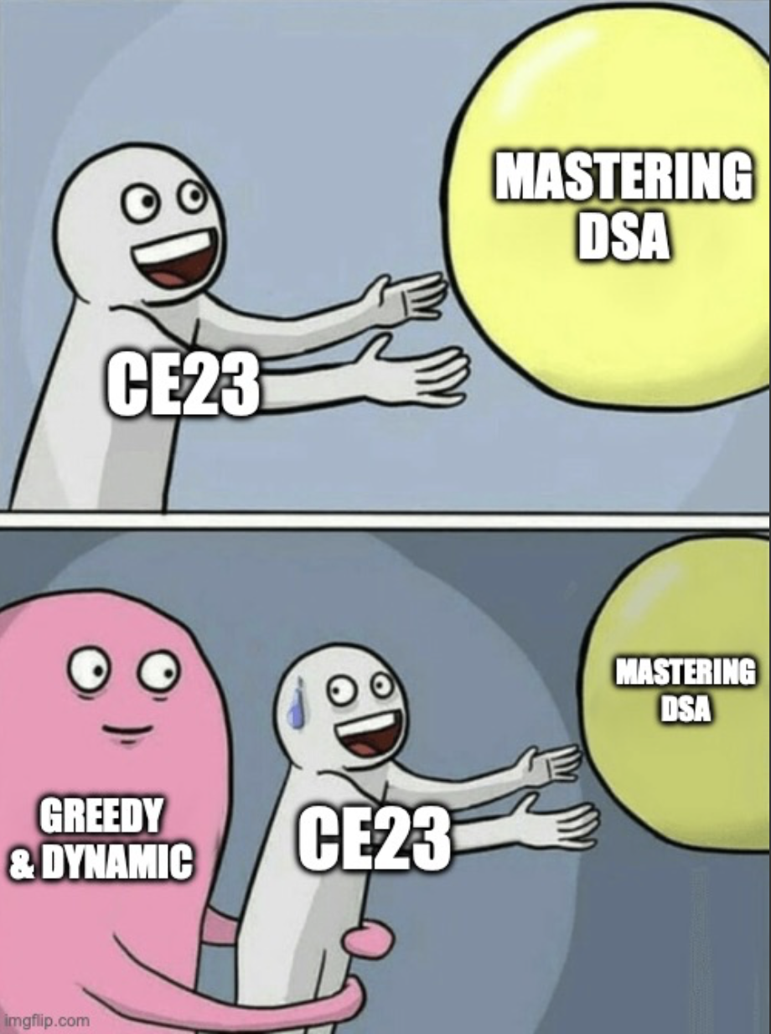
Meme Time

Slide 3
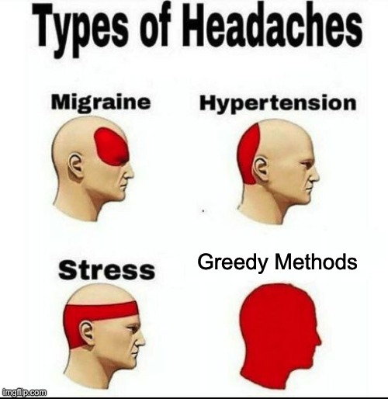
Meme Time

Slide 4

Meme Time

Slide 5
Greedy
Optimization problem is a problem with an objective function to either:
Maximize some profit
Minimize some cost
There are two techniques for solving optimization problems:
Greedy algorithms
Dynamic programming
The main concept of greedy algorithm is:
Divide the problem into multiple steps (sub-problems)
For each step take the best choice at the current moment
A greedy algorithm always makes the choice that looks best at the moment
We hope that locally optimal choice will lead to a globally optimal solution
If locally optimal choice DOES NOT lead to globally optimal solution, use dynamic programming

Slide 6
Greedy
E-OLYMP 6198. Minimum sum
Two arrays of positive integers are given a_{1..n} and b_{1..n}. Find the permutation i₁, i₂, ..., i_{n} of numbers 1, 2, ..., n, for which the sum
a₁ * b_{i1} + ... + a_{n} * b_{in}
is minimal. Each number must be included in permutation only once.
Input. The first line contains the number of elements n (n ≤ 100) in arrays. The second line contains the elements of the first array, and the third line contains the elements of the second array. The array elements do not exceed 10⁶.
Output. Print the minimal value of required sum.
Sample input
5
7 2 4 3 10
5 11 6 9 6
Sample output
165
The sum 168 is not minimal.
How to solve a problem?

Slide 7
Greedy
E-OLYMP 6198. Minimum sum
Consider the case of arrays with two elements. Let A = {p, q} (p < q), B = {x, y}. Consider the condition under which the sum p * x + q * y will be the smallest. Let's consider two variants of permutations.
The inequality p * x + q * y < p * y + q * x takes place if
x * (p – q) < y * (p – q)
Taking into account that p ≠ q, divide the inequality by (p – q) < 0. We get x > y.
So, p * x + q * y (for p < q) will be minimal if x > y.
Consider a pair of elements of the original arrays A and B. If a_{i} < a_{j}, b_{i} < b_{j}, then by swapping b_{i} and b_{j}, we’ll decrease the total sum.
How to solve a problem?

Slide 8
Greedy
E-OLYMP 6198. Minimum sum
Let’s take the pair for which a₁ < a₅ and b₁ < b₅. Swap b₁ and b₅. The sum will decrease.
For a given example, for any pair (i, j), the following holds: if a_{i} < a_{j}, then b_{i} > b_{j}. Therefore, the current permutation is optimal.
Sort array a in ascending order and array b in descending order. Then we get a sum with minimum value

Slide 9
E-OLYMP 7335. Saucepans and lids
Great disaster happened this morning in the cafe where you used to have your snack in university. Larysa Ivanivna, the cleaner, while sweeping the floor dropped one of cupboards and all kitchenware stored there has scattered over the floor. Luckily, this cupboard contained only saucepans with lids. However, some items bent or broke, so has been disposed.
Now the schoolmaster wants to calculate losses and understand how many new saucepans and lids should be bought. First, she needs to find out how many remaining saucepans can be covered with remaining lids.
Saucepans and lids are round shaped. A lid can cover a saucepan if and only if radius of the lid is not less than radius of the saucepan.
Input. The first line contains integers n, m (1 ≤ n, m ≤ 1000) – numbers of remaining saucepans and lids. The second line contains n integers a_{i} (1 ≤ a_{i} ≤ 1000) – radii of remaining saucepans. The third line contains m integers b_{i} (1 ≤ b_{i} ≤ 1000) – radii of remaining lids.
Output. Print one integer – the maximum number of saucepans that can be covered by available lids.
Sample input
5 5
4 8 1 2 5
7 2 4 6 5
Sample output
4
How to solve a problem?

Slide 10
E-OLYMP 7335. Saucepans and lids
Sort the radii of the lids and the radii of the saucepans in ascending order. For the smallest saucepan, find the smallest lid that can cover it. Next, for the second smallest pan, find the smallest suitable lid for it, and so on. The answer is the number of saucepans that can be covered.
Sample input
5 5
4 8 1 2 5
7 2 4 6 5
Sample output
4

Slide 11
E-OLYMP 2585. Profit
The cows have opened a new business, and Farmer John wants to see how well they are doing. The business has been running for n (1 ≤ n ≤ 100000) days, and every day i the cows recorded their net profit P_{i} (-1000 ≤ P_{i} ≤ 1000).
Farmer John wants to find the largest total profit that the cows have made during any consecutive time period. (Note that a consecutive time period can range in length from one day through n days.) Help him by writing a program to calculate the largest sum of consecutive profits.
Input. First line contains a single integer n. Each of the next n lines contains a single integer P_{i}.
Output. Print the value of the maximum sum of profits for any consecutive time period.
Sample input
7
-3
4
9
-2
-5
8
-3
Sample output
14
How to solve a problem?

Slide 12
E-OLYMP 2585. Profit
In the problem we need to find a subsequence of consecutive numbers that will have the maximum possible sum among all possible such subsequences. If the maximum sum is attained on subsequence x_{i}, x_{i+1}, ..., x_{j}, then for any k, 1 ≤ k < i and l, j < l ≤ n, the sum of elements x_{k}, ..., x_{i-1} and x_{j+1}, ..., x_{l} will be negative.
Kadane's algorithm. Move through the array from left to right and accumulate the current partial sum in the variable s. If at some moment s turns out to be negative, then we assign s = 0. The maximum of all values of the variable s during the passage through the array will be the answer to the problem.

Slide 13
E-OLYMP 138. Cash machine
The cash machine contains the sufficient number of banknotes with denominations 10, 20, 50, 100, 200 and 500 hryvnias. Find the minimum number of bills to give an amount of n hryvnias or print -1 if its impossible.
Input. One integer n (1 ≤ n ≤ 10⁶).
Output. Print the minimum number of banknotes to give n hryvnias or -1 if its impossible.
Sample input
770
Sample output
4
770 = 500 + 200 + 50 + 20
How to solve a problem?

Slide 14
E-OLYMP 138. Cash machine
The cash machine contains the sufficient number of banknotes with denominations 10, 20, 50, 100, 200 and 500 hryvnias. Find the minimum number of bills to give an amount of n hryvnias or print -1 if its impossible.
Input. One integer n (1 ≤ n ≤ 10⁶).
Output. Print the minimum number of banknotes to give n hryvnias or -1 if its impossible.
Sample input
770
Sample output
4
Take the note with maximum denomination c and use it to give the amount n as long as possible.
The maximum number of such notes that can be given is n / c.
The rest n % c hryvnia will be given with other denominations.

Slide 15
E-OLYMP 10893. Calculator
Ilya’s calculator performs two actions: multiplies the current number by three and adds one to it. The calculator now shows the number 1. Help Ilya to determine the smallest number of operations, after which he will get the number n.
Input. One integer n (10 ≤ n ≤ 10⁹).
Output. Print the minimum number of operations.
Sample input
1447
Sample output
16
How to solve a problem?

Slide 16
E-OLYMP 8538. Calculator
Ilya’s calculator performs two actions: multiplies the current number by three and adds one to it. The calculator now shows the number 1. Help Ilya to determine the smallest number of operations, after which he will get the number n.
Input. One integer n (10 ≤ n ≤ 10⁹).
Output. Print the minimum number of operations.
Sample input
1447
Sample output
16
Move from number n to 1 in greedy way:
if n is divisible by 3, divide it by 3;
otherwise subtract one from n;
Example
Let n = 21. You can get 1 for the minimum number of operations (for four) as follows:
21 → 7 → 6 → 2 → 1

Slide 17
E-OLYMP 9002. Chocolate lover
Aziz is very fond of eating chocolate. But since chocolate is very bad for teeth, his father won't let him eat a lot of chocolate. This time he managed to convince his father and get permission to eat one chocolate every day. Aziz loves two types of chocolate. One weighs a grams, the other b grams. Aziz's father allowed him to eat one chocolate every day for n days, but with condition that he should not eat the same chocolate for two days in a row. Now Aziz is worried about only one question. How to make sure that within n days he could eat the maximum amount (in grams) of chocolate.
Help him with this.
Input. One line contains three integers n, a and b (1 ≤ n, a, b ≤ 10⁹) .
Output. Print the maximum amount of chocolate (in grams) that Aziz can consume during n days.
Sample input 1
1 10 8
Sample input 2
3 1 2
Sample output
10
Sample output
5
How to solve a problem?

Slide 18
E-OLYMP 9002. Chocolate lover
If the number of days n is even, then Aziz can eat chocolate either in the order a b a b … a b,
or in the order b a b … a b a. However, in both cases, he will eat (a + b) * n / 2 grams of chocolate.
For odd n, Aziz can consume chocolate in one of the following orders: a b a b … a, or b a b … a b.
In the first case he will eat n / 2 * b + (n + 1) / 2 * a chocolate.
In the second case he will eat n / 2 * a + (n + 1) / 2 * b chocolate.
It remains to choose in which of these options the mass of chocolate is greater.

Slide 19
E-OLYMP 4211. Gas stations
Along the circumferential highway of length l there are n gas stations are located. If the driver wants to refuel at some point in the highway, he can drive up to any gas station, where he was happy to serve. Of course, if gasoline suddenly appears quite at the end, the driver, of course, go to the nearest gas station, even if he have to turn back.
However, occasionally there are unlucky drivers who suddenly right on the highway petrol ends. Determine the maximum possible distance to the nearest gas station, which require drivers to overcome this distance.
Input. The first line contains two integers: the length of the highway l (1 ≤ l ≤ 10⁵) and the number of gas stations n (1 ≤ n ≤ 10⁴). The second line contains n different integers l_{i} (0 ≤ l_{i} < l), the positions of gas stations.
Output. Print the maximum possible distance to the nearest gas station (with accuracy of 1 digit after the decimal point).
Sample input 1
5 4
4 0 3 1
Sample output
1.0
How to solve a problem?

Slide 20
E-OLYMP 4211. Gas stations
When the driver runs out of gas, he can move either forward or backward on the highway. If the distance between some neighboring gas stations is d, and the driver is on the highway somewhere between them, then in the worst case (if the gasoline runs out just in the middle) he will have to cover the distance d / 2.
It remains to find the greatest distance between all neighboring gas stations and divide it by 2.
Let l₁ and l_{n} be respectively, the positions of the first and last gas stations. Since the highway is circular and its length is l, the distance between the first and last gas stations is l – l_{n} + l₁.
Consider the sample from the problem statement. The greatest distance is reached between the gas stations in positions 1 and 3. It equals to d = 2. In the worst case, the driver have to walk the distance d / 2 = 1 to the nearest gas station.

Slide 21
E-OLYMP 609. Water
Recently Sergey went to the well for water but did not return. He took n cans with him, each of which he filled completely with water. Now Sergey wants to deliver them to his country house. This is where the problem lies. At one time Sergey can carry no more than 2 cans because he has only two hands. Moreover, he can carry no more than k liters of water.
Now Sergey stands at the well and thinks about the minimum number of times he can take all the water home, and whether he can do it at all. Help him solve this problem.
Input. The first line contains two integers n and k (1 ≤ n ≤ 10⁵). The second line contains n integers – the volumes of canisters in liters. All input numbers are positive and do not exceed 10⁹.
Output. If Sergey cannot take all the water home, print “Impossible”. Otherwise, print one number – the minimum required number of times to go.
Sample input 1
4 4
1 2 3 3
Sample output
3
How to solve a problem?

Slide 22
E-OLYMP 609. Water
If the volume of some canister is more than k, then it is impossible to take all the water home, print “Impossible”.
Sort the canisters in ascending order of volume. Let’s try to carry the largest canister together with the smallest one. If this is not possible, then the largest canister should be carried home alone. If possible, then remove the largest and the smallest canister from consideration and solve the problem for the remaining canisters in the same way.
Sample input 1
4 4
1 2 3 3
Sample output
3
Consider an example from the problem statement. Volumes of available cans are: 1, 2, 3, 3. Sergey can carry no more than k = 4 liters of water at a time. The sum of volumes of the smallest and the largest canisters is 1 + 3 = 4, which is no more than k. Therefore, for the first time Sergey will transfer these two cans.

Slide 23
E-OLYMP 609. Water
If the volume of some canister is more than k, then it is impossible to take all the water home, print “Impossible”.
Sort the canisters in ascending order of volume. Let’s try to carry the largest canister together with the smallest one. If this is not possible, then the largest canister should be carried home alone. If possible, then remove the largest and the smallest canister from consideration and solve the problem for the remaining canisters in the same way.
Sample input 1
4 4
1 2 3 3
Sample output
3
Canisters 2 and 3 remain. The sum of the volumes of the smallest and the largest canisters is 2 + 3 = 5, which is more than k. Therefore, at the second time, the largest canister should be carried home alone.
For the third time, Sergey will take home the last canister with volume of 2 liters.

Slide 24
E-OLYMP 6249. Planting trees
Farmer Jon has recently bought n tree seedlings that he wants to plant in his yard. It takes 1 day for Jon to plant a seedling, and for each tree Jon knows exactly in how many days after planting it grows to full maturity. Jon would also like to throw a party for his farmer friends, but in order to impress them he would like to organize the party only after all the trees have grown. More precisely, the party can be organized at earliest on the next day after the last tree has grown up.
Help Jon to find out when is the earliest day when the party can take place. Jon can choose the order of planting the trees as he likes, so he wants to plant the trees in such a way that the party will be as soon as possible.
Input. The first line contains a single integer n (1 ≤ n ≤ 10⁵) denoting the number of seedlings. Then a line with n integers t_{i} (1 ≤ t_{i} ≤ 10⁶) follows, where t_{i} denotes the number of days it takes for the i-th tree to grow.
Output. You program should output exactly one line containing one integer, denoting the earliest day when the party can be organized. The days are numbered 1, 2, 3, ... beginning from the current moment.
Sample input 1
4
2 3 4 3
Sample output
7
How to solve a problem?

Slide 25
E-OLYMP 6249. Planting trees
It is beneficial to plant the tree that grows the longest first. Sort the growth times of trees in descending order – in this order we’ll plant them.
Let John plant a tree on the i-th day that will grow for t_{i} days. This means that the tree will grow from the (i + 1)-th day to the (i + t_{i})-th. If the i-th tree is the last to grow, then the party can be held on the (i + t_{i} + 1)-th day. It remains to find the maximum among these values, which will be the answer:
Example
On the left we will consider the case if we’ll plant the trees in the order 2, 3, 3, 4.
On the right, consider the case when trees are planted in a decreasing (optimal) order of their growth time.
The day the tree was planted is marked in blue.

Slide 26
E-OLYMP 2103. Knapsack
Vasya is going to hike with fellow programmers and decided to take a responsible approach to the choice of what he will take with him. Vasya has n things that he could take with him in his knapsack. Every thing weighs 1 kilogram. Things have different “usefulness” for Vasya.
The hiking is going to be very long, so Vasya would like to carry a knapsack of weight no more than w kilo.
Help him to determine the total “usefulness” of things in his knapsack if the weight of backpack can be no more than w kilo.
Input. The first line contains integers w and n (1 ≤ w, n ≤ 20). The second line contains n integers c_{i} (1 ≤ c_{i} ≤ 1000) – the “usefulness” for each thing.
Output. Print the total “usefulness” of things that Vasya can take with him.
Sample input
2 3
1 5 3
Sample output
8
How to solve a problem?

Slide 27
E-OLYMP 2103. Knapsack
Let's use the greedy approach. Sort things in order of non-increasing usefulness. Since the weight of each item is 1 kilogram, Vasya should take min(w, n) of the most useful items.
Sample input
2 3
1 5 3
Sample output
8
Consider the sample from the problem statement.
Sort three given items in descending order.
And take the two with the greatest usefulness.

Slide 28
E-OLYMP 4831. Knapsack
Find the maximum weight of gold that can be carried out in a knapsack of capacity s, if there are n gold ingots with specified weights.
Input. The first line contains one number s (1 ≤ s ≤ 10⁴). Then given non-negative n (1 ≤ n ≤ 300) integers, not exceeding 10⁵ – the weights of ingots.
Output. Print the desired maximum weight.
Sample input
20
5 7 12 18
Sample output
19
For a given example, a maximum weight of 19
is reached for the subset {7, 12}
How to solve a problem?

Slide 29
E-OLYMP 4831. Knapsack
Create an array m, in which we set m[i] to 1, if we can obtain the weight i with the available ingots. Initially set m[0] = 1.
Let the array m have already been filled in the required way for some set of ingots. The next ingot of weight w arrives. Then one should set to 1 all such m[i] (w ≤ i ≤ s) for which m[i – w] = 1.
The answer is the largest weight, not bigger than s, that you can carry in your backpack.
Sample input
20
5 7 12 18
Sample output
19
Consider the filling of the cells of array m with the arrival of the next ingot.
The weights of the ingots are indicated on the left.

Slide 30
E-OLYMP 4831. Knapsack
memset(m,0,sizeof(m));
m[0] = 1;
while(scanf("%d", &w) == 1)
{
for(i = s; i >= w; i--)
if (m[i - w] == 1) m[i] = 1;
}
for(i = s;; i--)
if (m[i] > 0) break;
printf("%d\n", i);
Initialization of array m.
Process the next ingot of weight w. We go through the array m from right to left and set to 1 all such m[i] (w ≤ i ≤ s) for which m[i – w] = 1.
Look for the largest weight no more than s, that can be carried in the backpack, and print it.

